Slide 1
Session 2
The Command Line
Digital Health, Mastère Spécialisé · 2026
Paul Dubois

Slide 2
1. Why using a terminal?

Slide 3
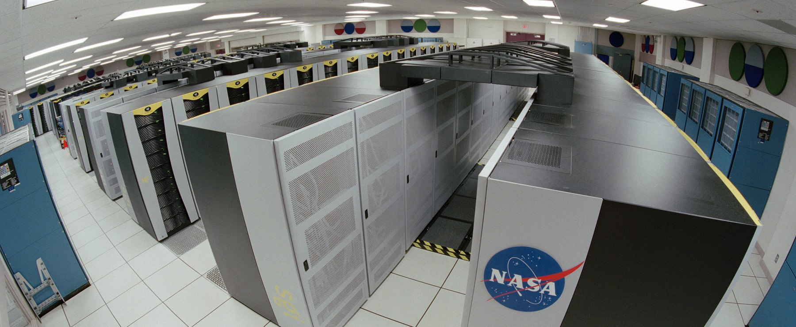
Most computers have no screen
Notes:
Rows of machines, and not one keyboard, mouse or monitor in the room. This is the NASA Columbia supercomputer, but it is also every hospital server room, every cloud instance, and every compute cluster you will send a job to. Nobody walks in and clicks. You reach these machines over the network (ssh), and what answers you is a text prompt. The graphical interface is the exception, available on your laptop and almost nowhere else. So the question is not whether the command line is pleasant. It is the only interface these machines have, and that is where the data and the computing power live. Ask the room: where do you think the imaging archive of a hospital actually sits?

Slide 4
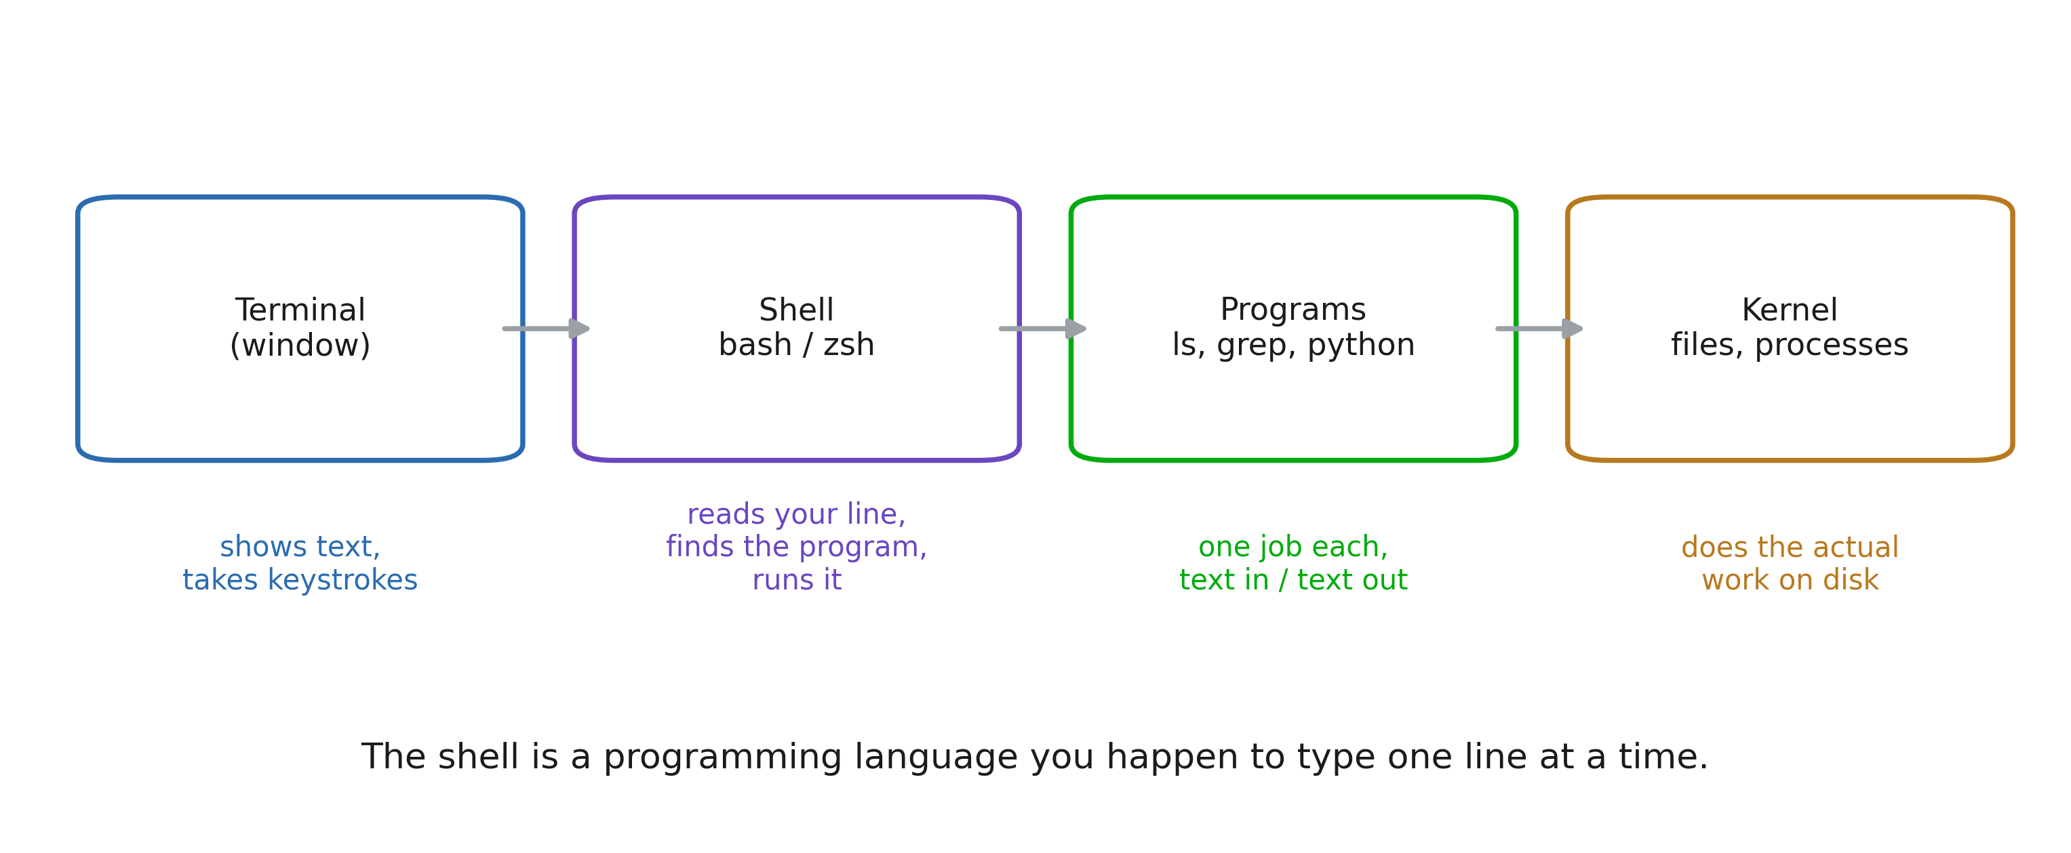
Terminal, shell, program, kernel
Notes:
Four words students use as synonyms for a fortnight. Fixing this early saves a lot of confusion later: “the terminal crashed” and “the shell is bash” and “ls is a program” are three different statements. Emphasise the closing line. Everything that follows (variables, loops, conditionals, functions) is available because the shell is a language. The prompt is a REPL.

Slide 5
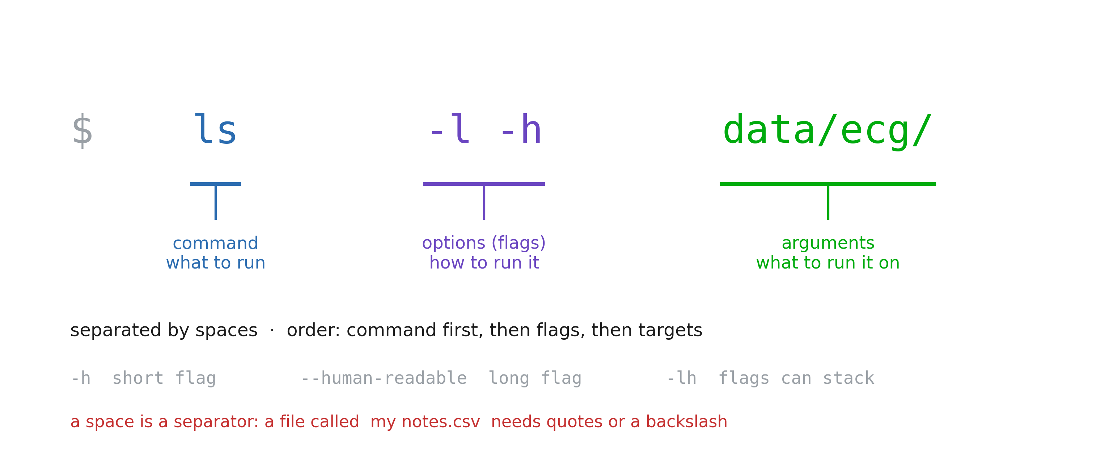
The anatomy of a command
Notes:
This is the grammar slide; every command in the notebook obeys it. Two traps to name now, because both will bite in the exercises: (1) a space separates arguments, so a filename with a space is two arguments unless it is quoted. Health data exports are full of Patient Records 2024.csv. (2) flags are case sensitive and not universal: -h is “help” in some tools and “human readable” in others. There is no committee.

Slide 6
2. Moving around, and moving data

Slide 7
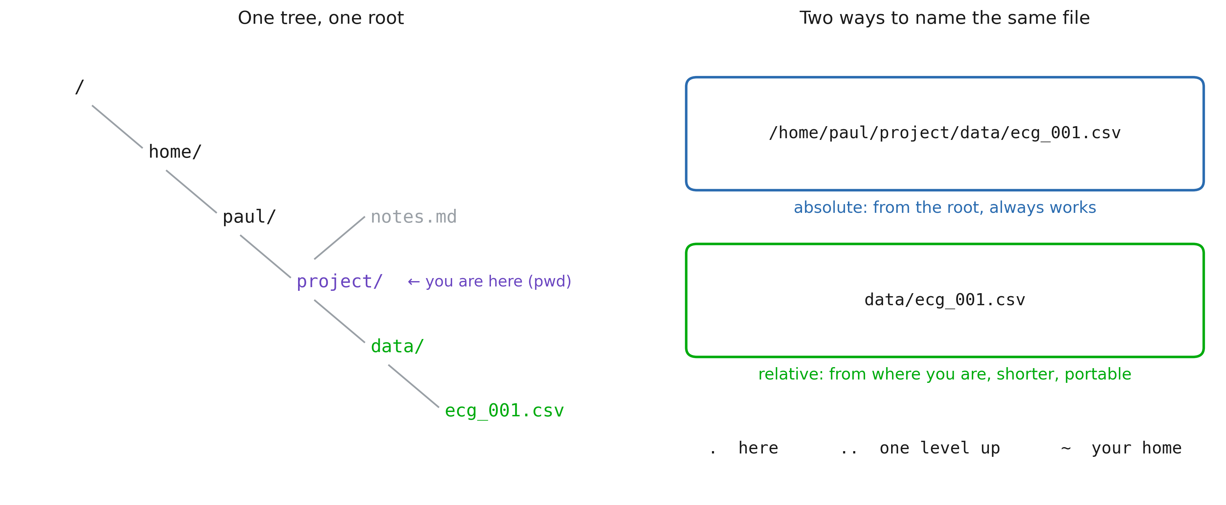
The filesystem is one tree
Notes:
Two ideas: there is a single root (no C: drive), and any file has two names (absolute and relative) that point to the same thing. Rule of thumb for their future scripts: absolute paths for data that lives somewhere fixed, relative paths for anything inside the project, so the project can be moved, shared, or run on the cluster untouched.

Slide 8
Five most usefull commands
pwd # where am I
cd data/ecg # go there (cd .. goes up, cd goes home)
ls -lh # what is here, with sizes
mkdir -p results/2026 # make a folder (and its parents)
cp a.csv backup/ # copy (mv = move / rename, rm = delete)
Notes:
Type these live, slowly, in a scratch folder. Let them see the prompt change with cd. Give the rm warning its own beat. Then give them the habit that actually protects them: run the dangerous thing as ls first (ls *.tmp), look at what matched, then swap ls for rm. Never trust a glob you have not printed.

Slide 9
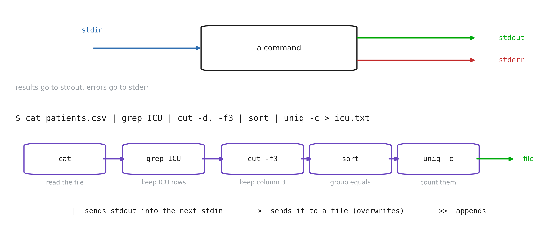
Text in, text out
Notes:
This is the intellectual core of the whole session, and the reason the tools are all small. Each program does one job and speaks the same currency: lines of text. The pipe is what makes them compose. Build the example one stage at a time on screen, showing the intermediate output after each |. Students remember the shape once they have watched it narrow. Mention that this is exactly pandas chaining, ten years older and on files it never has to load into memory.

Slide 10
More commands
Command | Does
cat / head / tail | print a file, its first, its last lines
wc -l | count lines (rows in a CSV)
grep 'ICU' | keep the lines that match
cut -d, -f2 | keep a column
sort / uniq -c | order, and count repeats
find . -name '*.csv' | list files matching a pattern, recursively
Notes:
Do not try to teach these exhaustively (the notebook does that). Here just establish that the toolbox is small, and that each one is a verb you can look up. sort | uniq -c is the shell’s value_counts(); say that out loud, it converts anyone who already knows pandas.

Slide 11
3. Version control

Slide 12
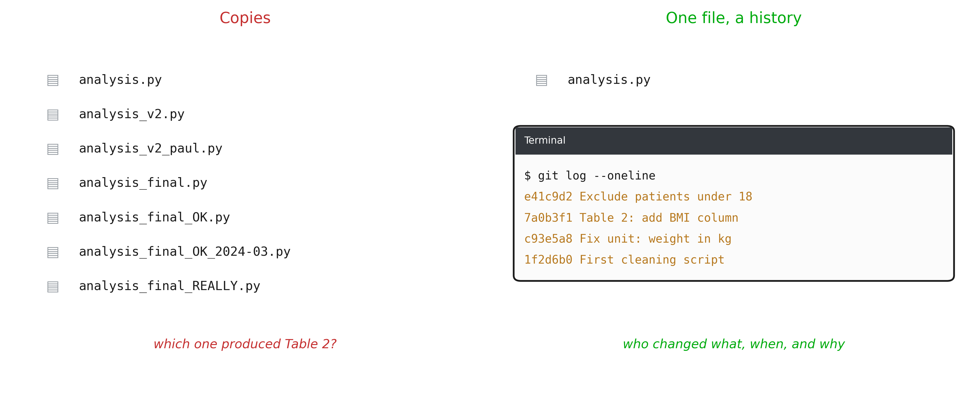
Which file is the final one?
Notes:
Everyone in the room has a folder like the one on the left. It fails exactly when it matters: a reviewer asks which version of the script produced Table 2, and nobody knows. git replaces copies with one file and a history. Each change is recorded with who made it, when, and a message that says why. In a regulated setting (a clinical study, a CE-marked device) this traceability is not a nice-to-have: it is what an audit asks for. git is a command-line program: everything from the first two sections applies.

Slide 13
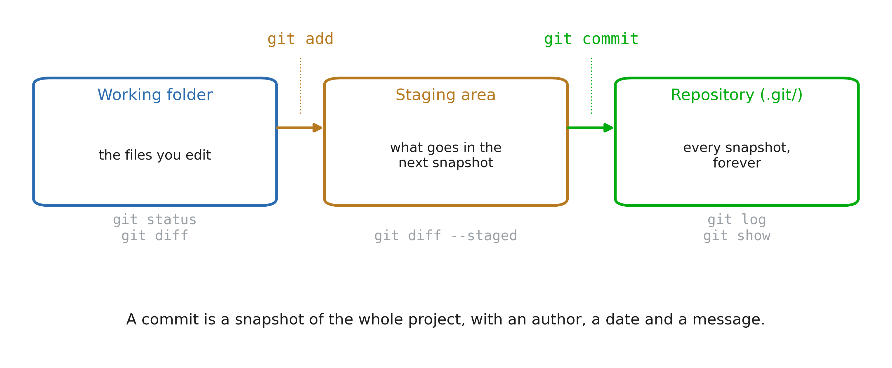
Creating a snapshot
Notes:
The one mental model to get right. You edit files in the working folder as usual. git add chooses which changes go into the next snapshot (the staging area). git commit records that snapshot in the repository, the hidden .git/ folder. Why the middle step: you changed three files but only two belong to the same fix. Stage those two, commit, then stage and commit the third with its own message. git status is the command to type when lost: it says what is in each area, and usually suggests the next command.

Slide 14
Daily loop
git init # once per project
git status # what changed?
git diff # show the changes
git add clean.py # stage a file
git commit -m "Drop rows without age"
git log --oneline # the history
Notes:
Live demo in a scratch folder: git init, create a file, status, add, status, commit, edit, diff, commit again, log. The first time, git asks who you are: git config --global user.name "..." and user.email. Every commit carries that name. A good message completes the sentence “this commit will…”: “Drop rows without age”, not “update” or “fix”. One logical change per commit.

Slide 15
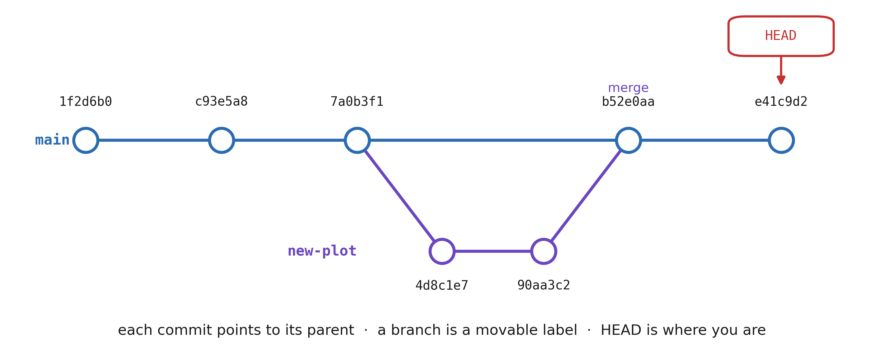
History and branches
Notes:
Each commit has an identifier (a hash, shortened to 7 characters) and points to the commit before it: the history is a chain. A branch is just a name on a commit, moving forward as you commit. git switch -c new-plot starts one: try an idea without touching main. If it works, git merge new-plot brings it back; if not, delete the branch and main never knew. git switch / git checkout <hash> moves HEAD, and the files in the folder change to match that snapshot. Nothing is lost: every commit is still there.

Slide 16
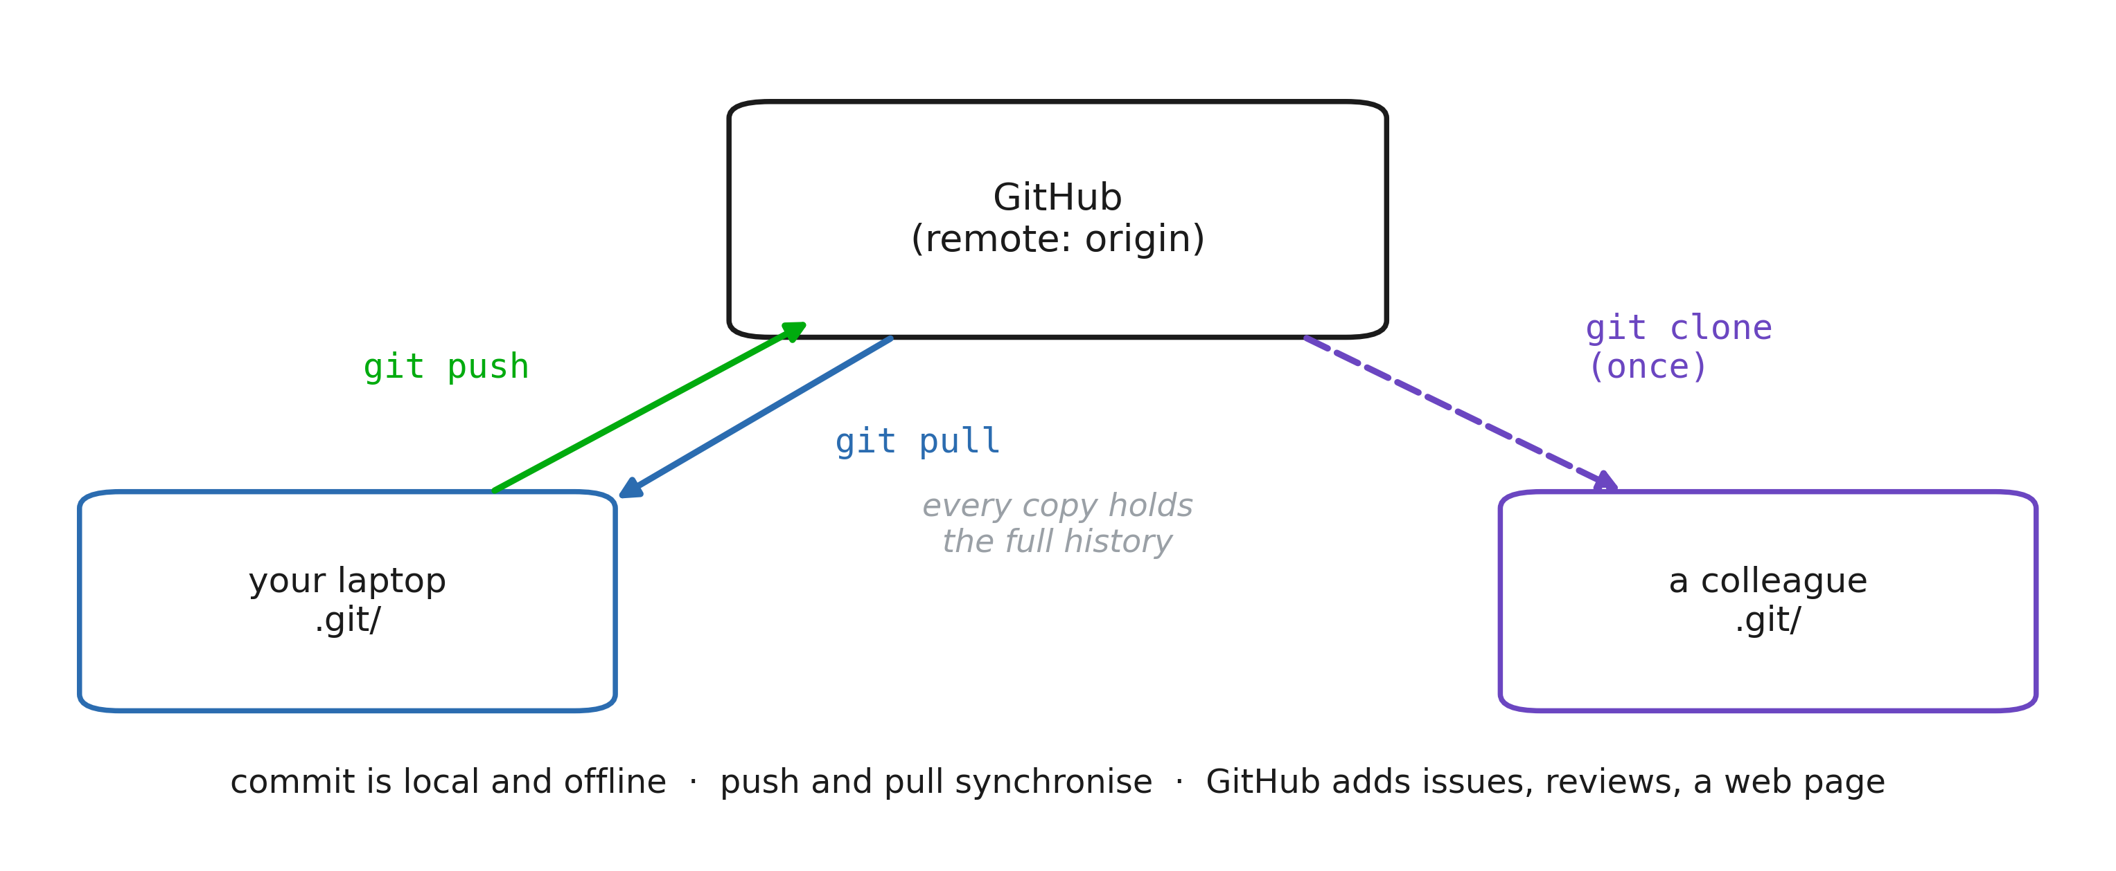
Local and remote
Notes:
git works entirely on your machine: commit on a train, without network. A remote is another copy of the repository, usually on GitHub (or GitLab, or the hospital’s own server). git clone makes your copy once; git push sends your new commits; git pull fetches the others’ commits and merges them into yours. GitHub adds what git does not have: a web page for the project, issues to track bugs, pull requests to review a change before it is merged. The course material lives there. Two people editing the same lines produce a conflict: git marks both versions in the file, you choose, then commit. It is a normal event, not an error.

Slide 17
Working with GitHub
git clone https://github.com/org/repo
cd repo
# ... edit, add, commit ...
git pull # get the others' work
git push # publish yours
Notes:
The everyday collaboration loop: pull before starting, push when done. Authentication: GitHub no longer accepts your password on the command line. Use an SSH key (ssh-keygen, then paste the public key in GitHub settings) or gh auth login. This is a good exercise in its own right, and it reuses ssh from the first section. For a new project: create the empty repository on GitHub, then git remote add origin <url> and git push -u origin main from your existing folder.

Slide 18
What to ignore
# .gitignore
data/ # patient data
*.csv
.env # passwords, API keys
.venv/ # re-created by uv sync
__pycache__/
Notes:
The health-data rule of this session. A commit is forever: deleting a file in a later commit leaves it in the history, readable by anyone who clones. A patient file pushed to a public GitHub repository is a data breach under GDPR, and must be reported. .gitignore lists the patterns git must never track: data, secrets, generated files. Write it first, before the first git add .. The repository holds the code that reads the data, and a README saying where the data lives and who may access it. The data itself stays on the secured server.

