Slide 1
Session 1
The Command Line: Talking to a Computer in Words
Digital Health, Mastère Spécialisé · 2026
Paul Dubois

Slide 2
1. Why using a terminal?

Slide 3
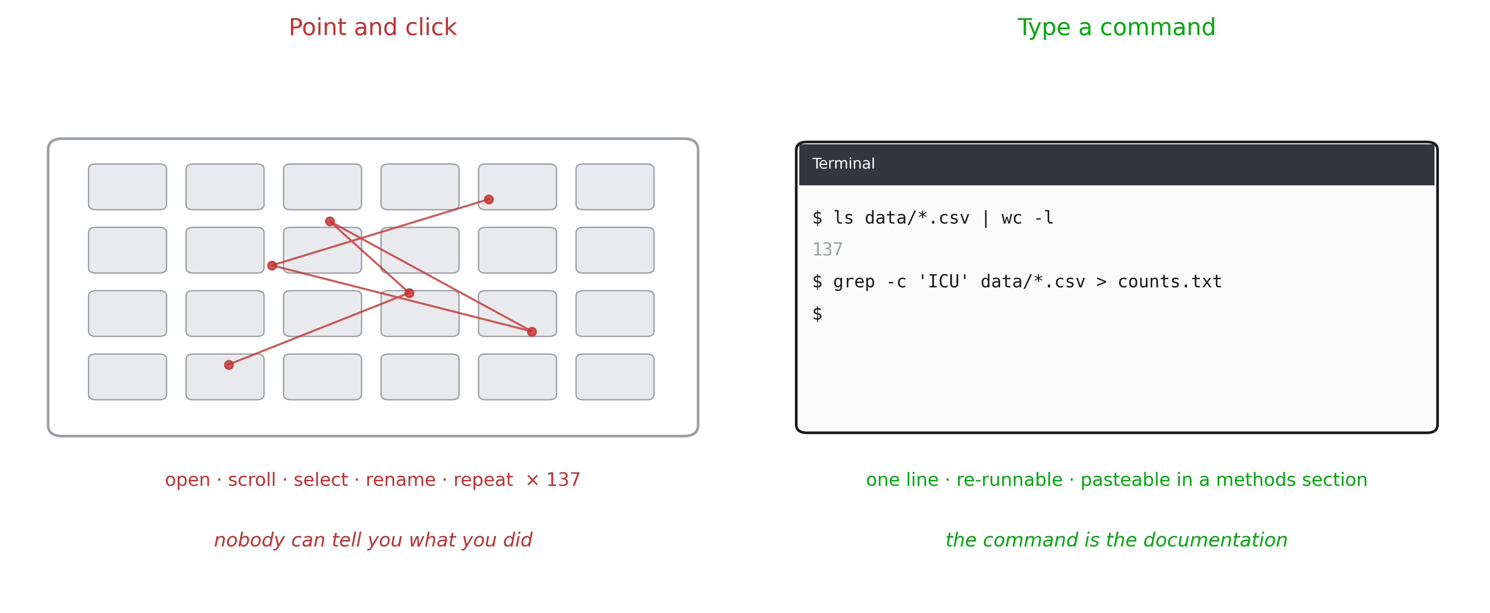
Some (most) tasks are faster
You are handed 137 exported ECG files. How many mention ICU?
Notes:
Open on the concrete task, not on the tool. Let the room answer the question first (someone will say “open them one by one”, someone else will say “Excel”). Then show the two panels. The point is not that typing is faster (though it is). The point is the last line: after the clicking, nobody (including you) can say what was done. After the command, the answer and the method are the same object. Do not defend the terminal on aesthetics. Defend it on evidence.

Slide 4
Where you will actually meet it
Servers. Hospital data does not leave the building; you connect to a machine with ssh and there is no desktop waiting for you
Pipelines. Imaging and omics tools (dcm2niix, fastqc, samtools) ship as commands, not as apps
Reproducibility. There is no clicking error possible
Scale. The step between 1 file and 4 000 files should cost you one line
Notes:
This is the slide that answers “why is a health data course starting with bash?”. Make it institutional, not ideological: this is simply the interface the field uses. The ssh point usually lands hardest, because for regulated data, remote text access is often the only access.

Slide 5
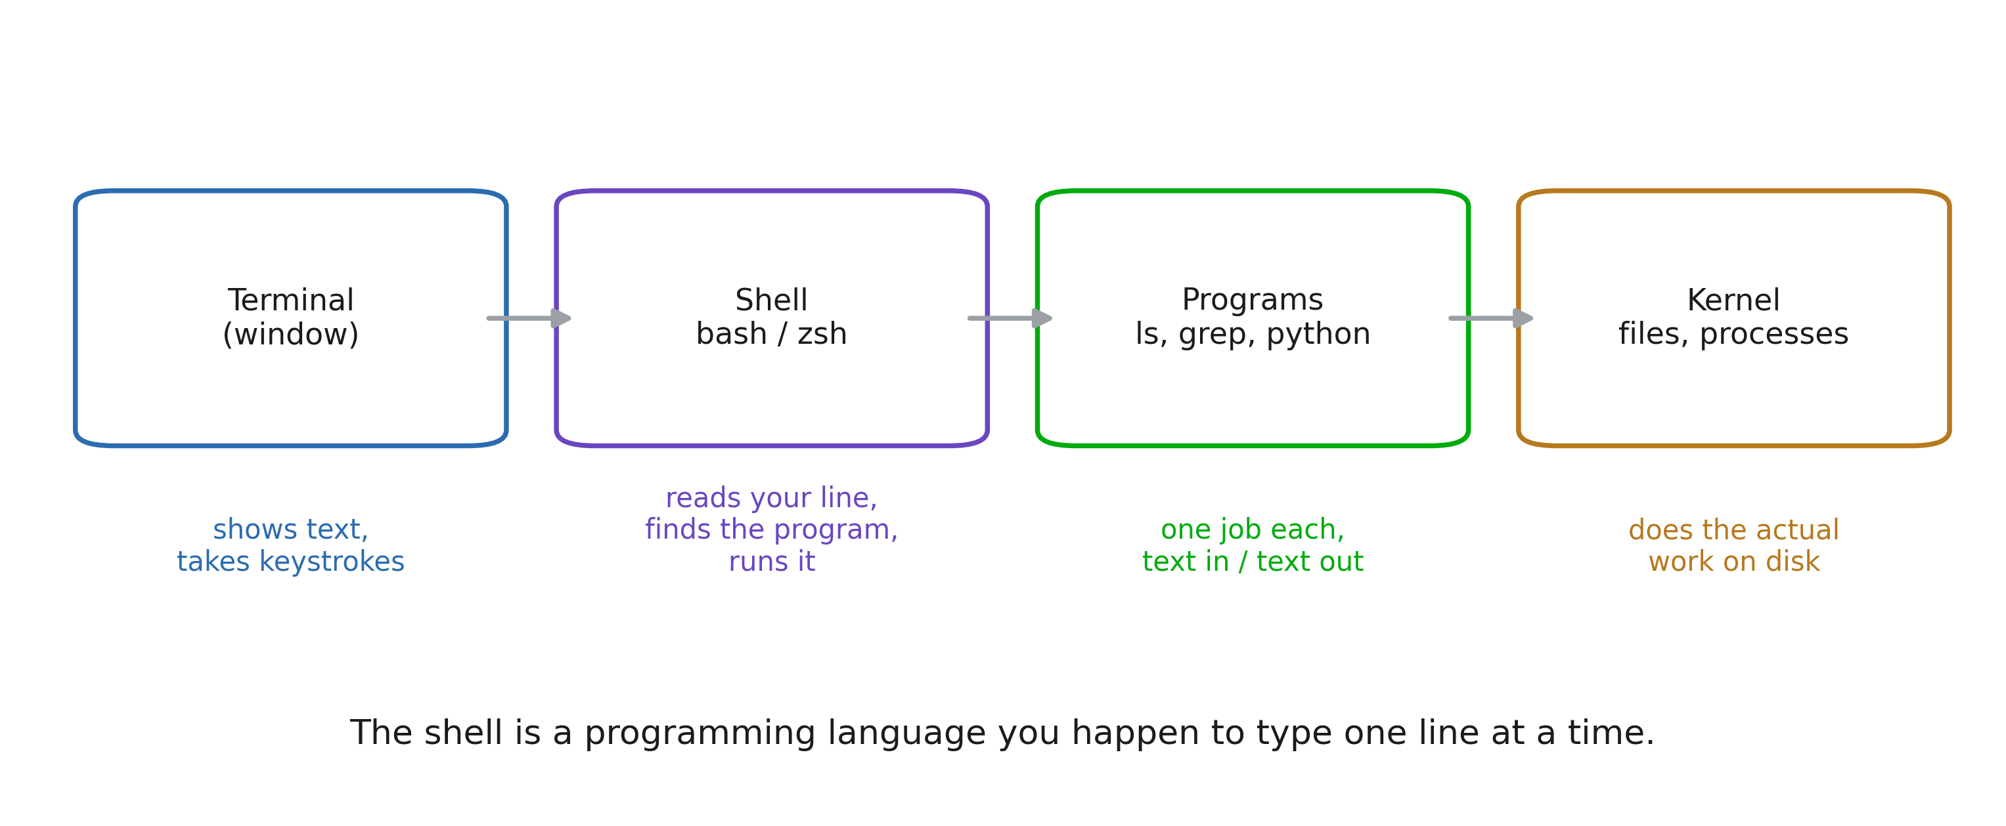
Terminal, shell, program, kernel
Notes:
Four words students use as synonyms for a fortnight. Fixing this early saves a lot of confusion later: “the terminal crashed” and “the shell is bash” and “ls is a program” are three different statements. Emphasise the closing line. Everything that follows (variables, loops, conditionals, functions) is available because the shell is a language. The prompt is a REPL.

Slide 6
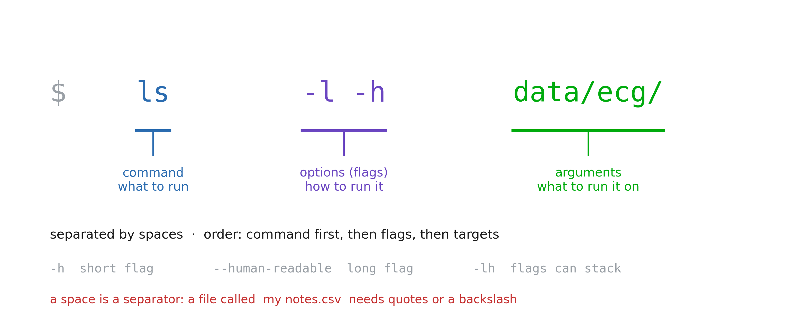
The anatomy of a command
Notes:
This is the grammar slide; every command in the notebook obeys it. Two traps to name now, because both will bite in the exercises: (1) a space separates arguments, so a filename with a space is two arguments unless it is quoted. Health data exports are full of Patient Records 2024.csv. (2) flags are case sensitive and not universal: -h is “help” in some tools and “human readable” in others. There is no committee.

Slide 7
2. Moving around, and moving data

Slide 8
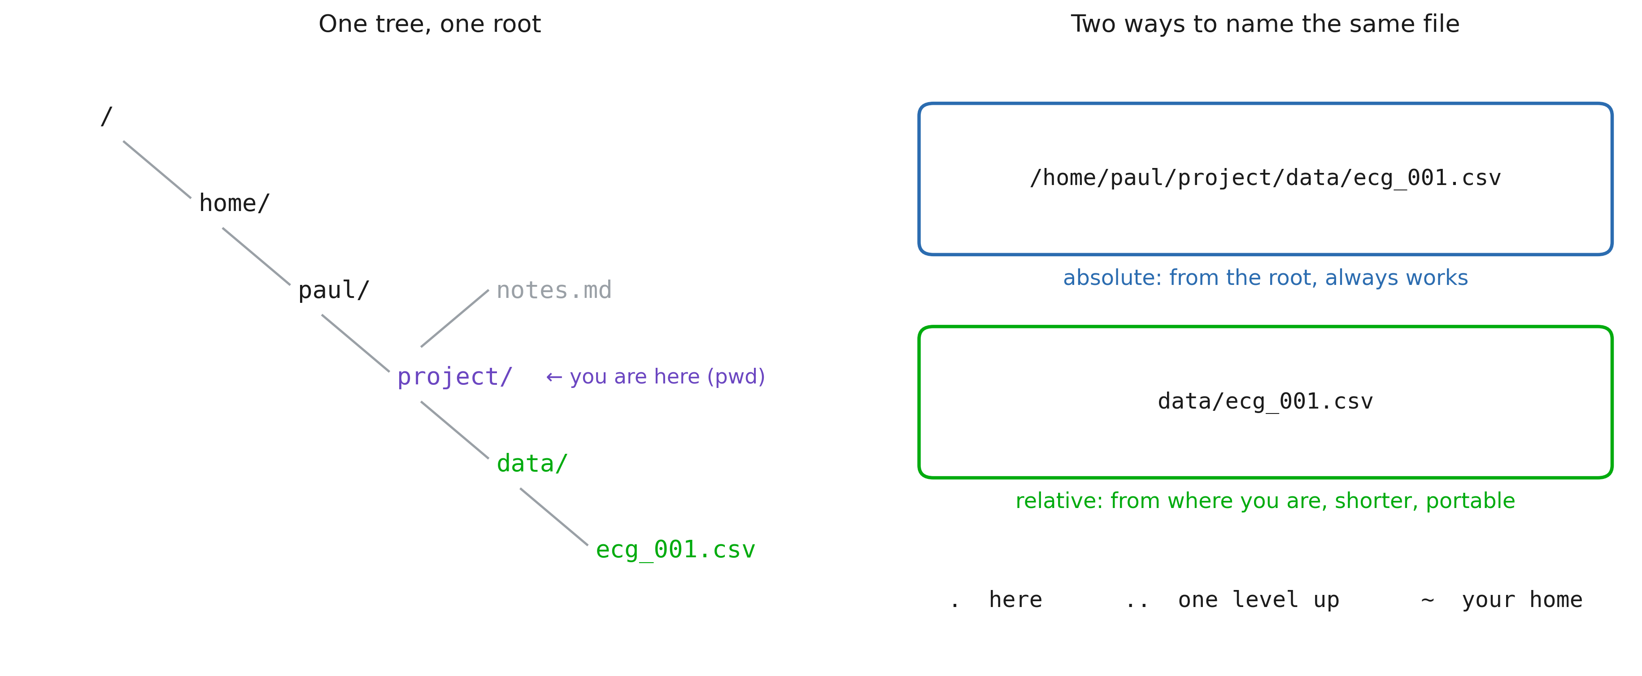
The filesystem is one tree
Notes:
Two ideas: there is a single root (no C: drive), and any file has two names (absolute and relative) that point to the same thing. Rule of thumb for their future scripts: absolute paths for data that lives somewhere fixed, relative paths for anything inside the project, so the project can be moved, shared, or run on the cluster untouched.

Slide 9
Five most usefull commands
pwd # where am I
cd data/ecg # go there (cd .. goes up, cd goes home)
ls -lh # what is here, with sizes
mkdir -p results/2026 # make a folder (and its parents)
cp a.csv backup/ # copy (mv = move / rename, rm = delete)
Notes:
Type these live, slowly, in a scratch folder. Let them see the prompt change with cd. Give the rm warning its own beat. Then give them the habit that actually protects them: run the dangerous thing as ls first (ls *.tmp), look at what matched, then swap ls for rm. Never trust a glob you have not printed.

Slide 10
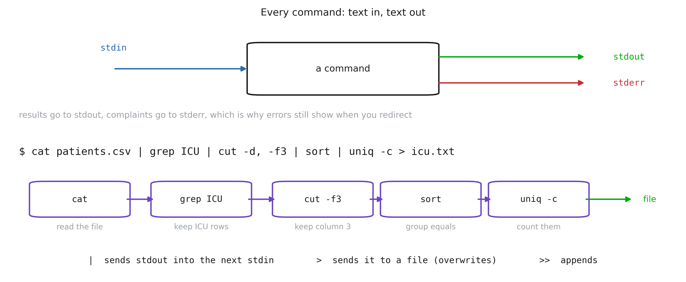
Text in, text out
Notes:
This is the intellectual core of the whole session, and the reason the tools are all small. Each program does one job and speaks the same currency: lines of text. The pipe is what makes them compose. Build the example one stage at a time on screen, showing the intermediate output after each |. Students remember the shape once they have watched it narrow. Mention that this is exactly pandas chaining, ten years older and on files it never has to load into memory.

Slide 11
More commands
Command | Does
cat / head / tail | print a file, its first, its last lines
wc -l | count lines (rows in a CSV)
grep 'ICU' | keep the lines that match
cut -d, -f2 | keep a column
sort / uniq -c | order, and count repeats
find . -name '*.csv' | list files matching a pattern, recursively
Notes:
Do not try to teach these exhaustively (the notebook does that). Here just establish that the toolbox is small, and that each one is a verb you can look up. sort | uniq -c is the shell’s value_counts(); say that out loud, it converts anyone who already knows pandas.

Slide 12
3. From the shell to Python

Slide 13
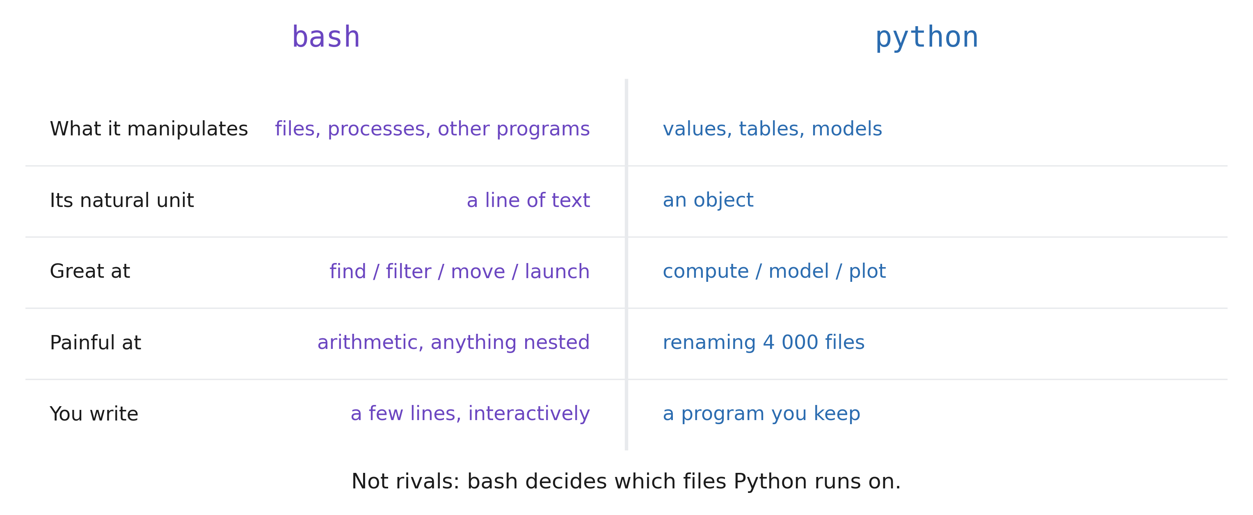
Two languages, one boundary
Notes:
Students arrive expecting a fight (“should I learn bash or Python?”), and the answer is that they do different jobs. bash manipulates files and programs; Python manipulates values. Adding two numbers in bash is awkward on purpose; renaming 4 000 files in Python is fifteen lines of os.walk that mv did in one. The working rule: if the sentence contains “for each file”, start in the shell. If it contains “for each patient”, you are already inside Python.

Slide 14
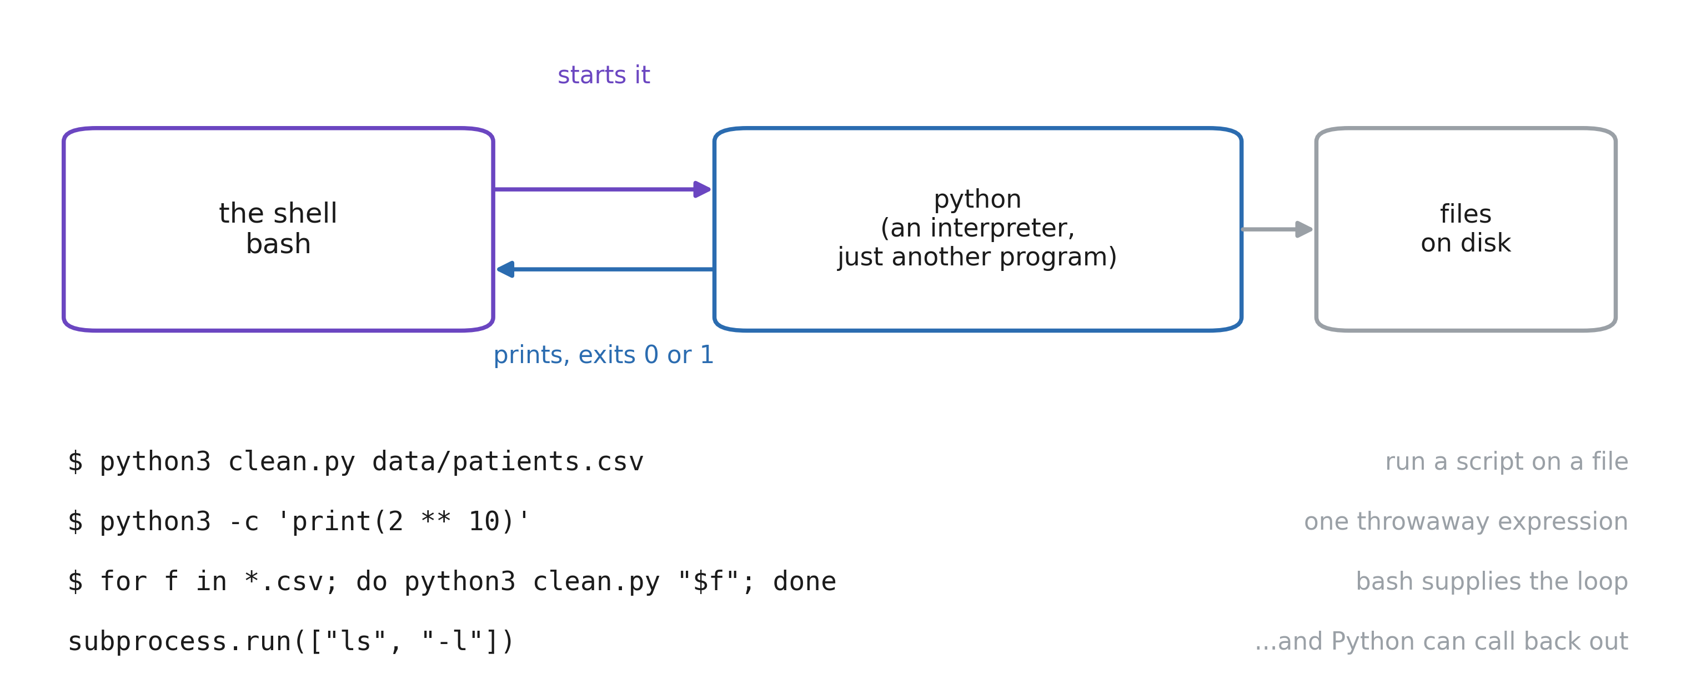
Python is just another program
Notes:
The demystifying slide. python3 is a file on disk that the shell finds and starts, exactly like ls, and which python3 proves it. It reads a .py file, or a -c string, or waits for you to type (the REPL). Two directions to point out. The shell supplies the loop and the file list; Python supplies the computation. And Python can call back out with subprocess, though if you find yourself doing that a lot, the job was probably a shell job. Mention the exit code: python3 script.py && echo ok only prints ok if the script did not crash. That is how steps get chained.

Slide 15
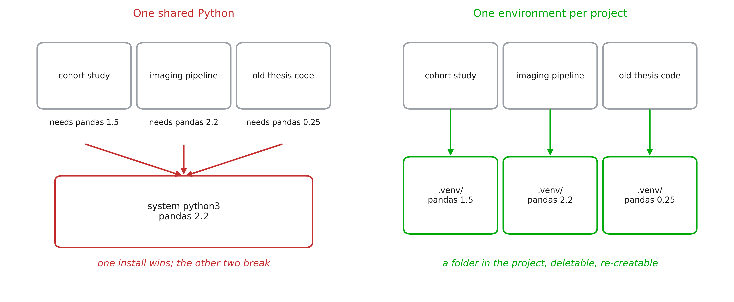
What is an environment?
Notes:
The single most common source of “it works on my machine” in this field. A virtual environment is not magic: it is a folder (.venv/) containing its own python and its own site-packages. “Activating” it just puts that folder first on PATH, which is why which python3 is the diagnostic command when something is wrong. Say plainly: never install into the system Python. On a managed hospital workstation you often cannot anyway, and the error will read externally-managed-environment.

Slide 16
Creating and using one
uv venv # create .venv/ here
source .venv/bin/activate # put it first on PATH (deactivate to leave)
which python3 # .../project/.venv/bin/python3 ← the check
uv pip install pandas # installs into .venv, not into the system
uv pip freeze > requirements.txt # exactly what you have, for someone else
One environment per project, inside the project, in .gitignore
Notes:
Type this live in an empty folder. Show which python3 before and after activating: that before/after is what makes the concept click. Insist that .venv/ is disposable and must never be committed, because it is derived, it is large, and it is specific to one machine. What you commit is the list of packages.

Slide 17
ruff
ruff is a linter (finds mistakes) and a formatter (fixes layout)
uv tool install ruff # or: uv pip install ruff / python3 -m pip install ruff
uvx ruff check . # run it once, installing nothing
ruff check . # unused imports, undefined names, dead code
ruff check --fix . # fix what can be fixed automatically
ruff format . # one house style, no more debates about spacing
Notes:
uvx ruff check . is the zero commitment demo (it downloads, runs, and leaves nothing behind). Run it on the notebook folder live. The interesting catch in a health project is usually a variable assigned and never used: nine times out of ten that line was meant to update the dataframe. ruff format replaces black; ruff check replaces flake8 and most of pylint. One tool, one config, in pyproject.toml.

