Slide 1
Do you understand where your models live?
HIGH DIMENSIONS
Paul Dubois - MICS Christmas day 2023

Slide 2
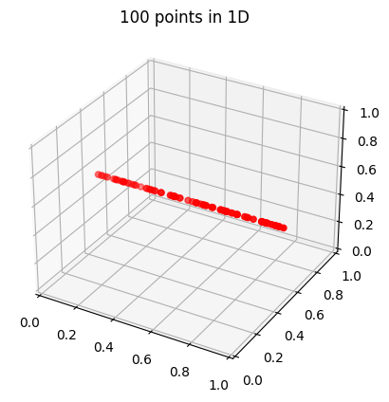
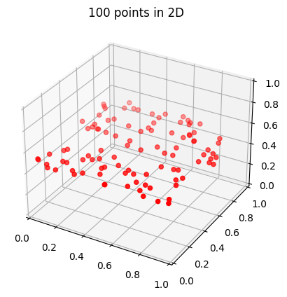
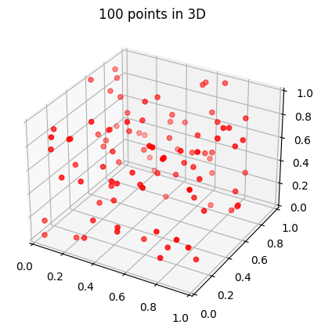
Curse of dimensionality

Slide 3
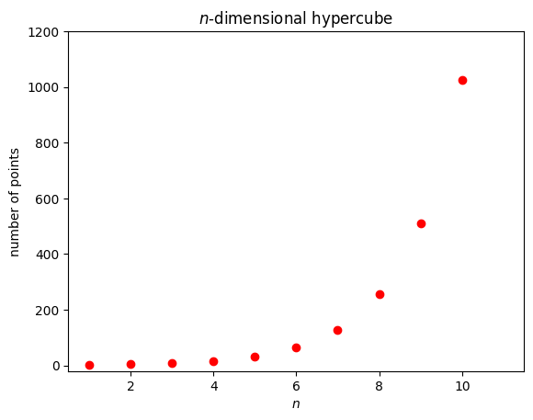
Curse of dimensionality

Slide 4
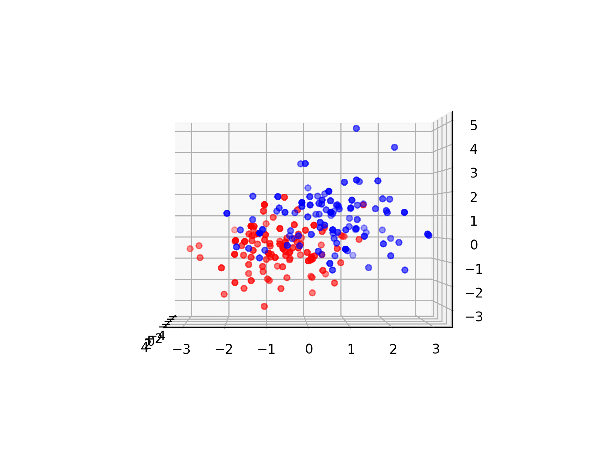
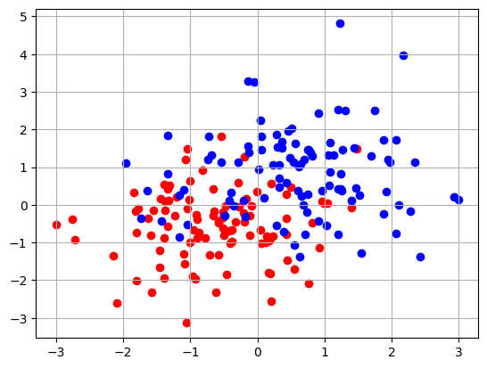
Blessing of dimensionality

Slide 5
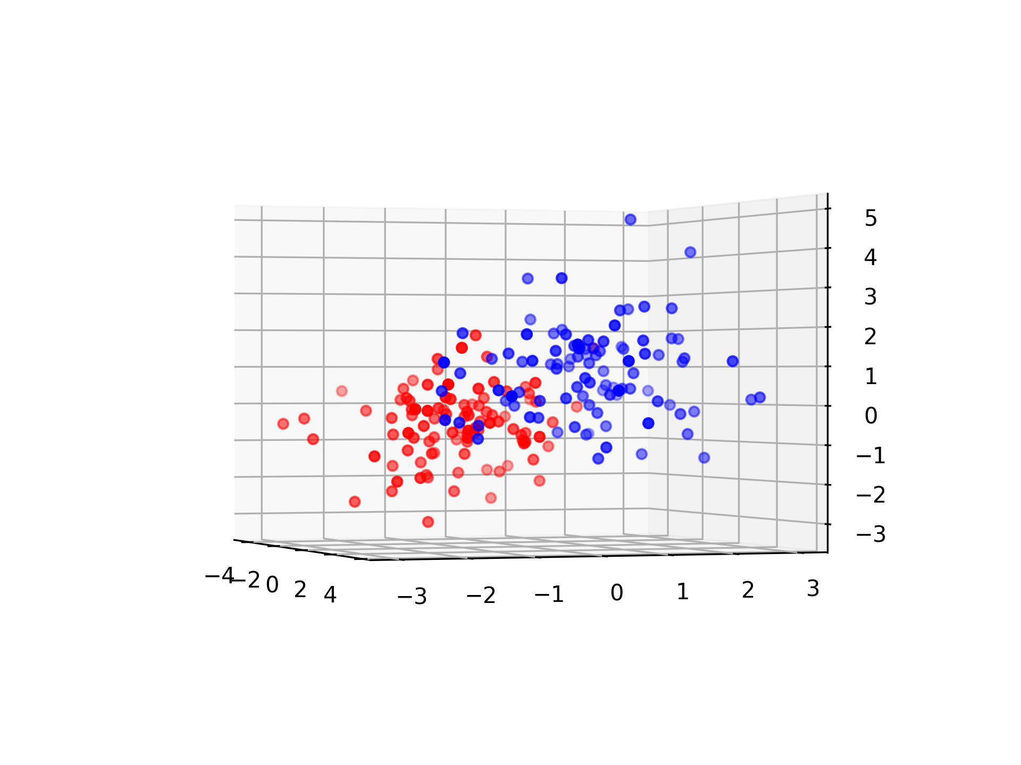
Blessing of dimensionality

Slide 6
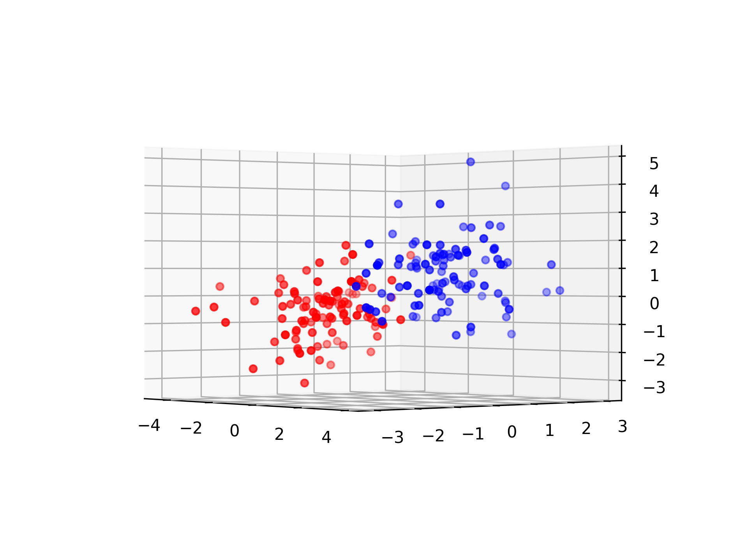
Blessing of dimensionality

Slide 7
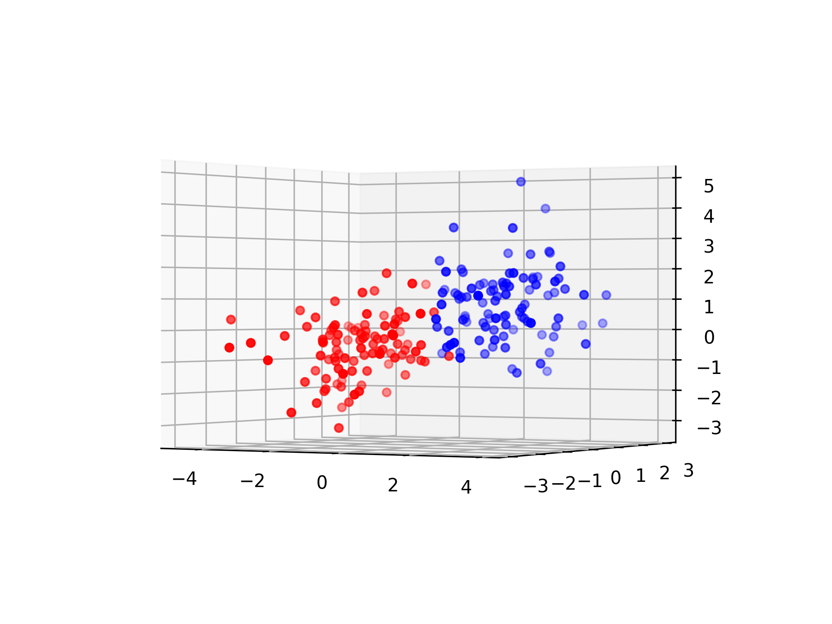
Blessing of dimensionality

Slide 8
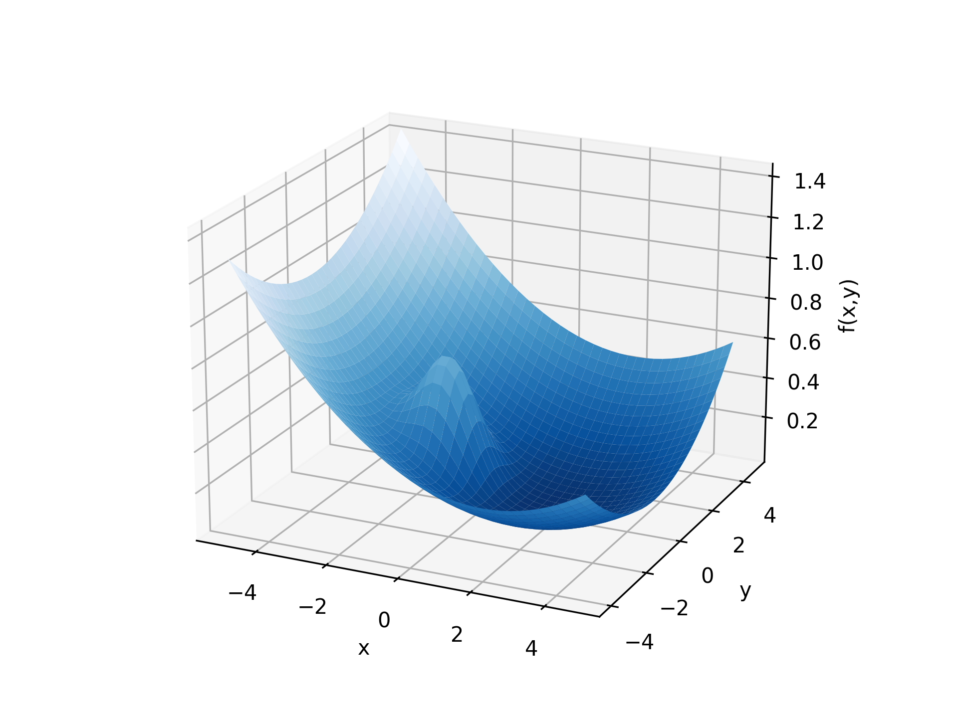
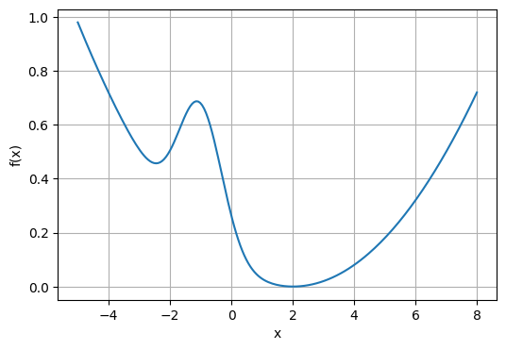
Blessing of dimensionality

Slide 9

Blessing of dimensionality

Slide 10
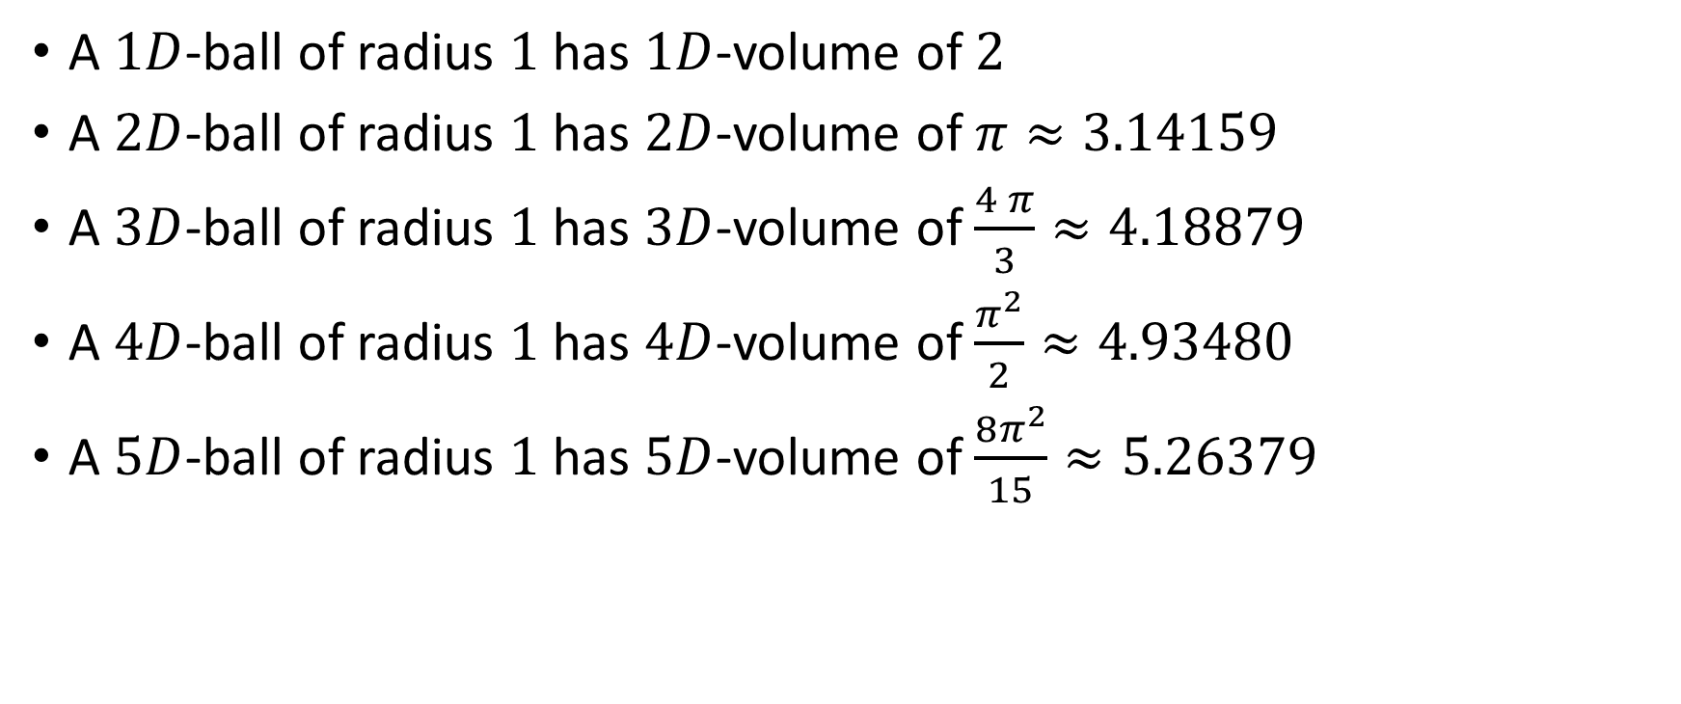

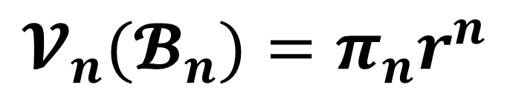
Higher dimensions of $π$
$$𝓥_{n}(𝓑_{n})=π_{n}r^{n}$$
(length)
(area)
A $1D$-ball of radius $1$ has $1D$-volume of $2$
A $2D$-ball of radius $1$ has $2D$-volume of $π≈3.14159$
A $3D$-ball of radius $1$ has $3D$-volume of $\frac{4 π}{3}≈4.18879$
A $4D$-ball of radius $1$ has $4D$-volume of $\frac{π^{2}}{2}≈4.93480$
A $5D$-ball of radius $1$ has $5D$-volume of $\frac{8π^{2}}{15}≈5.26379$

Slide 11
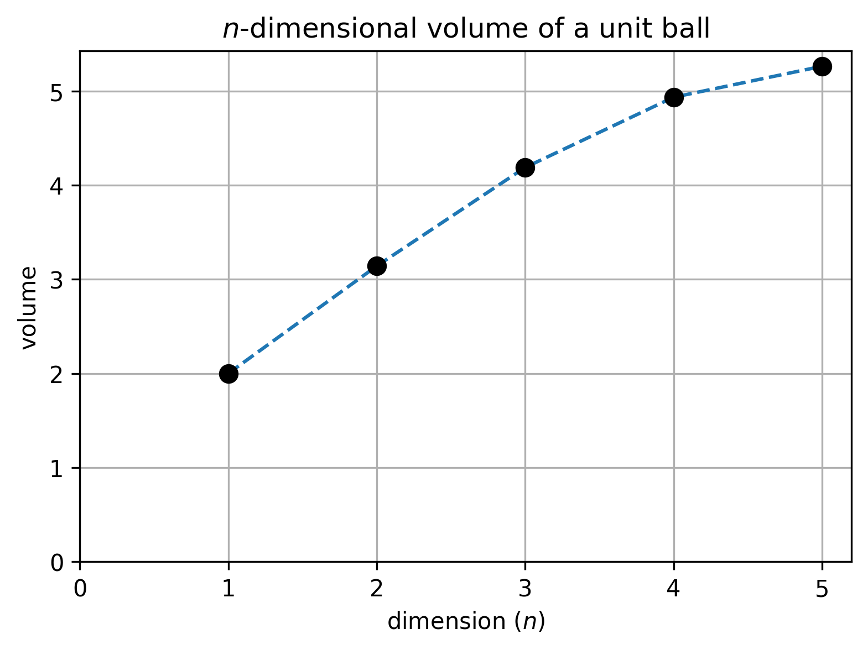
Higher dimensions of $π$

Slide 12
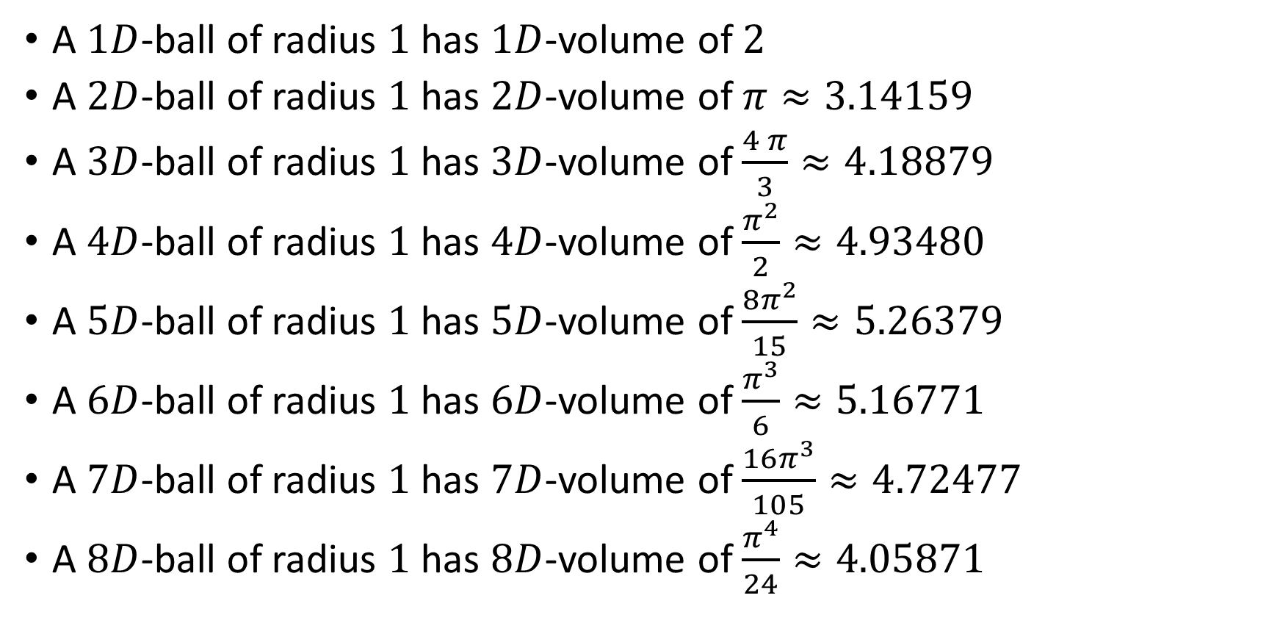

Higher dimensions of $π$
$$π_{n}=\frac{2π}{n}∙π_{n−2}$$
A $1D$-ball of radius $1$ has $1D$-volume of $2$
A $2D$-ball of radius $1$ has $2D$-volume of $π≈3.14159$
A $3D$-ball of radius $1$ has $3D$-volume of $\frac{4 π}{3}≈4.18879$
A $4D$-ball of radius $1$ has $4D$-volume of $\frac{π^{2}}{2}≈4.93480$
A $5D$-ball of radius $1$ has $5D$-volume of $\frac{8π^{2}}{15}≈5.26379$
A $6D$-ball of radius $1$ has $6D$-volume of $\frac{π^{3}}{6}≈5.16771$
A $7D$-ball of radius $1$ has $7D$-volume of $\frac{16π^{3}}{105}≈4.72477$
A $8D$-ball of radius $1$ has $8D$-volume of $\frac{π^{4}}{24}≈4.05871$

Slide 13
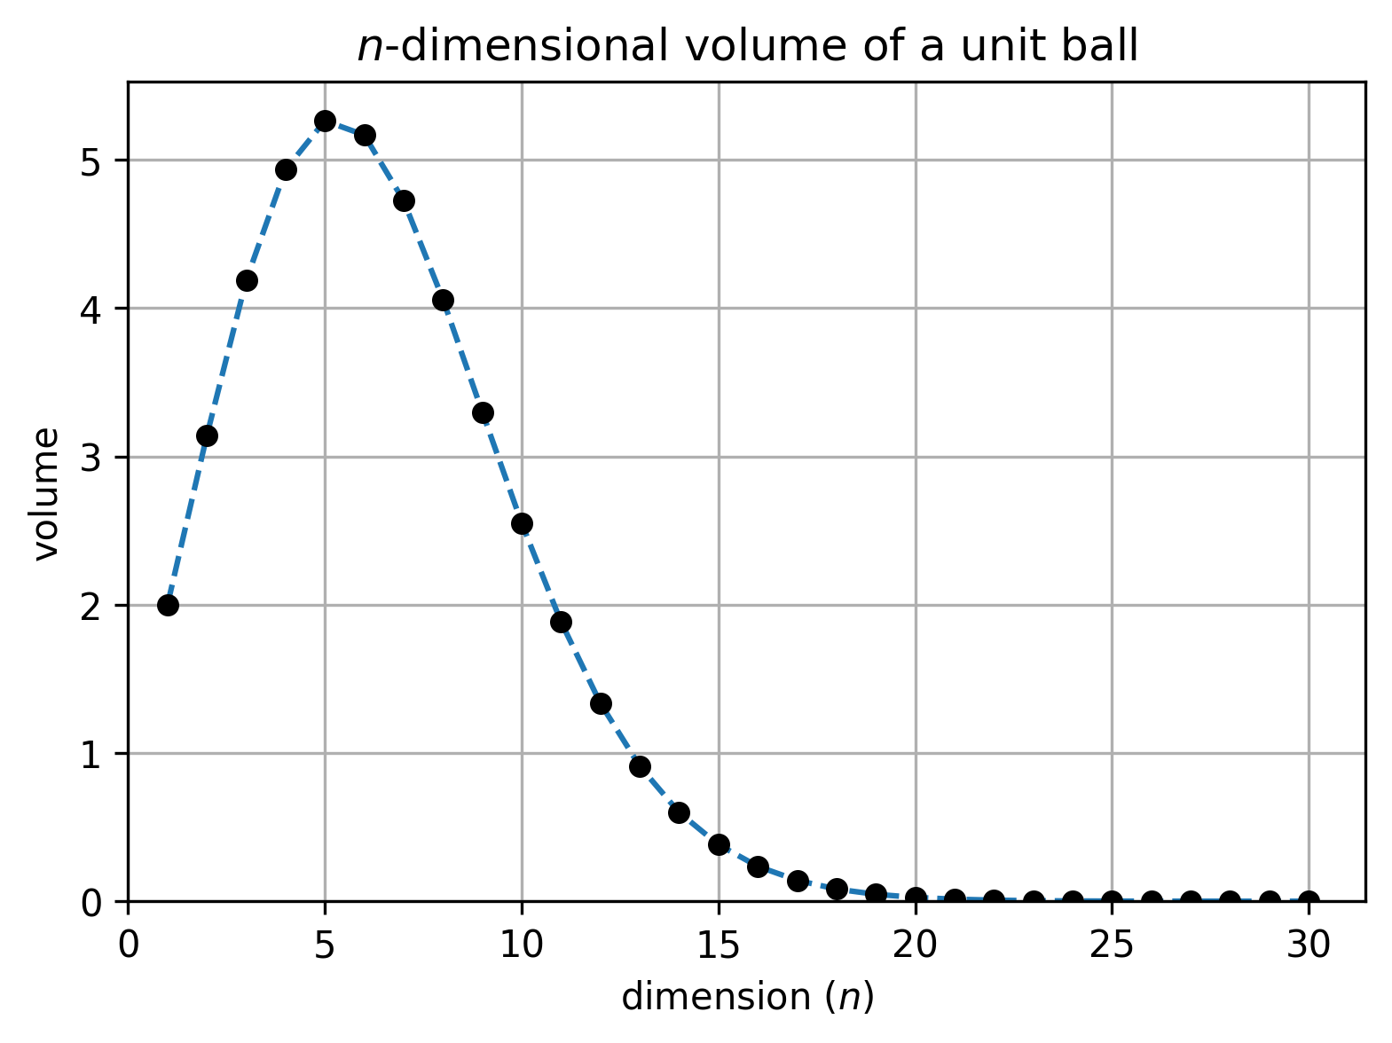
Higher dimensions of $π$

Slide 14
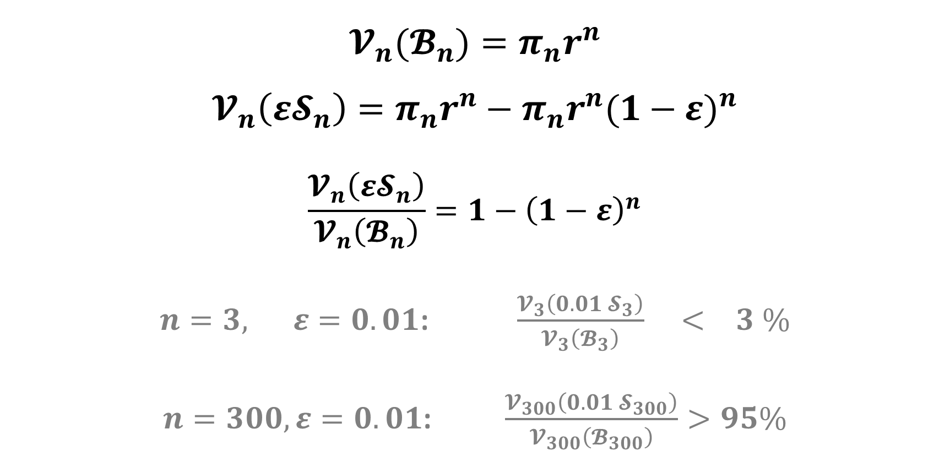
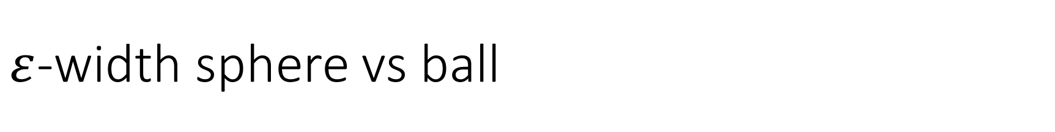

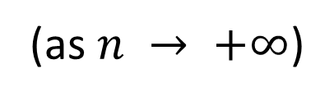
$ε$-width sphere vs ball
$$𝓥_{n}(𝓑_{n})=π_{n}r^{n}$$
$$𝓥_{n}\left({ε𝓢}_{n}\right)=π_{n}r^{n}−π_{n}r^{n}{(1−ε)}^{n}$$
$$\frac{𝓥_{n}\left({ε𝓢}_{n}\right)}{𝓥_{n}\left(𝓑_{n}\right)}=1−{\left(1−ε\right)}^{n}$$
$n=3, ε=0.01$: $\frac{𝓥_{3}\left(0.01 𝓢_{3}\right)}{𝓥_{3}\left(𝓑_{3}\right)} < 3 \%$
$n=300, ε=0.01$: $\frac{𝓥_{300}\left(0.01 𝓢_{300}\right)}{𝓥_{300}\left(𝓑_{300}\right)}>95\%$
$$→0$$
(as $n → +∞$)

Slide 15
4 circles paradox

Slide 16
4 circles paradox

Slide 17
4 circles paradox
(-2,2)
(2,2)
(-2,-2)
(2,-2)

Slide 18

4 circles paradox
(-2,2)
(2,2)
$1$
(-1,1)
(1,1)
(-1,-1)
(1,-1)
(-2,-2)
(2,-2)

Slide 19

4 circles paradox
(-2,2)
(2,2)
$1$
(-1,1)
(1,1)
$\sqrt{2}−1$
(-1,-1)
(1,-1)
(-2,-2)
(2,-2)

Slide 20
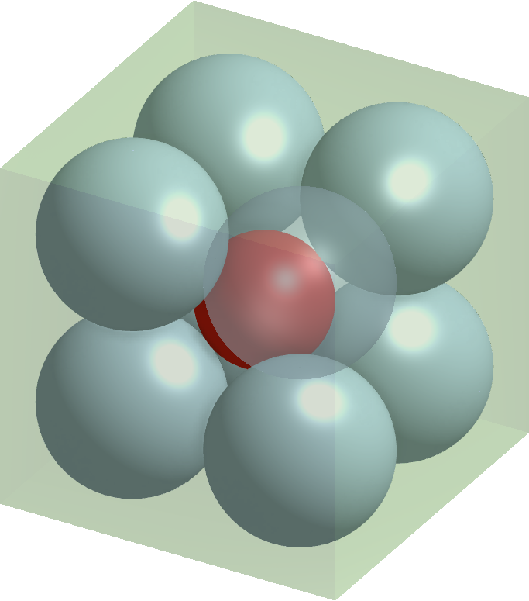
8 balls paradox

Slide 21
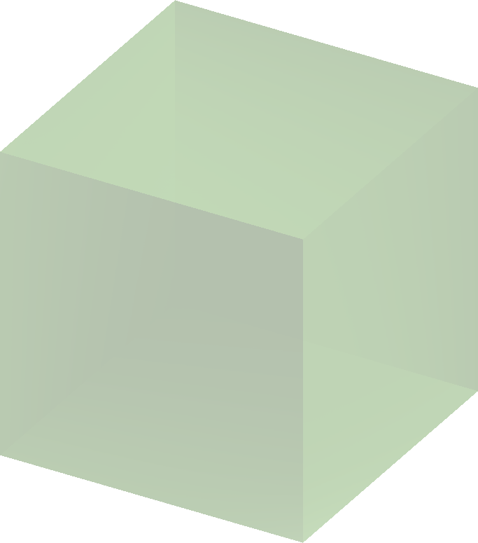
8 balls paradox
4x4x4 cube

Slide 22
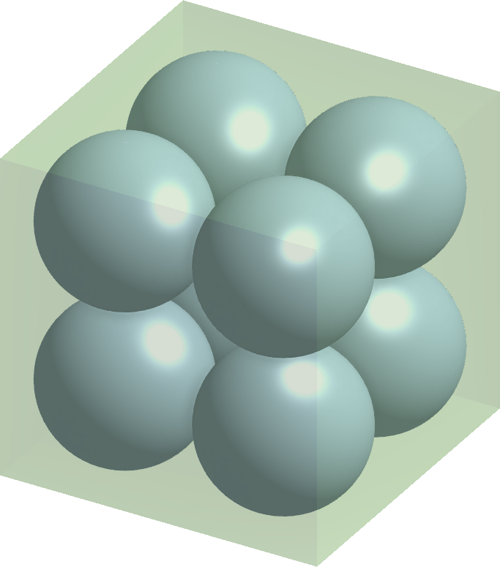
8 balls paradox
4x4x4 cube
radius 1

Slide 23
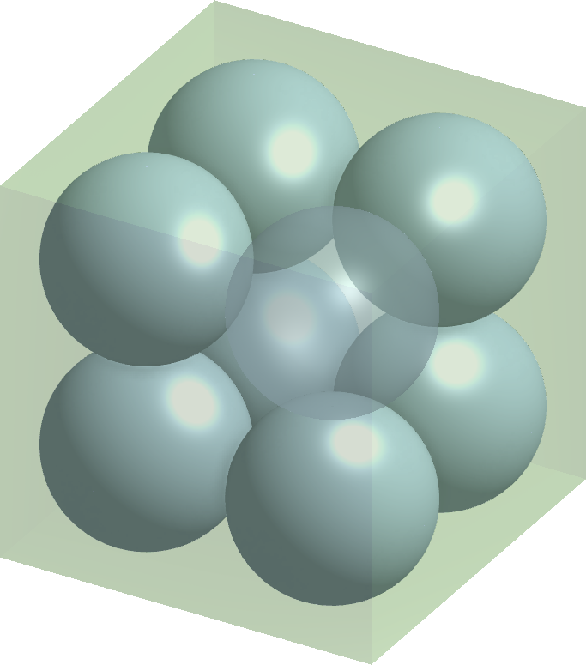
8 balls paradox
4x4x4 cube
radius 1

Slide 24
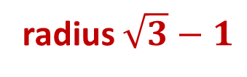
8 balls paradox
4x4x4 cube
radius 1
radius $\sqrt{3}−1$

Slide 25
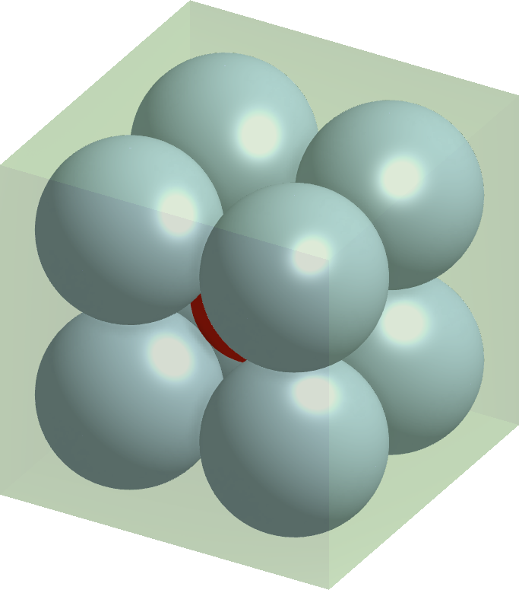
8 balls paradox
4x4x4 cube
radius 1
radius $\sqrt{3}−1$

Slide 26
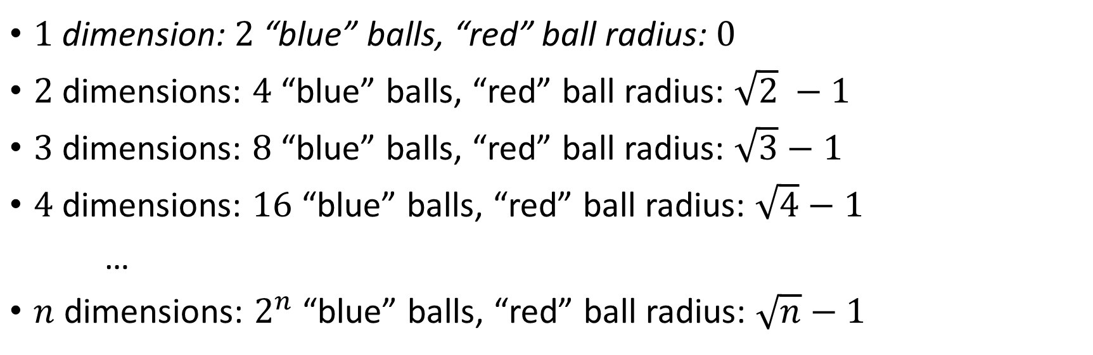
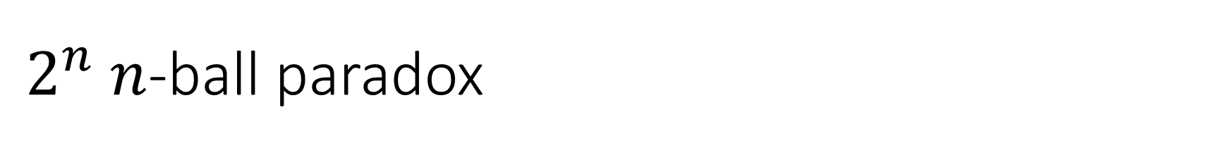


$2^{n}$ $n$-ball paradox
$$(=\sqrt{1} −1)$$
$1$ dimension: $2$ “blue” balls, “red” ball radius: $0$
$2$ dimensions: $4$ “blue” balls, “red” ball radius: $\sqrt{2} −1$
$3$ dimensions: $8$ “blue” balls, “red” ball radius: $\sqrt{3}−1$
$4$ dimensions: $16$ “blue” balls, “red” ball radius: $\sqrt{4}−1$
…
$n$ dimensions: $2^{n}$ “blue” balls, “red” ball radius: $\sqrt{n}−1$
$$(=1)$$
$10$ dimensions: $2^{10}=1024$ “blue” balls, “red” ball radius: $\sqrt{10}−1 ≈2.16>2$

Slide 27
4 circles paradox

Slide 28
4 circles paradox

Slide 29

8 balls paradox

Slide 30
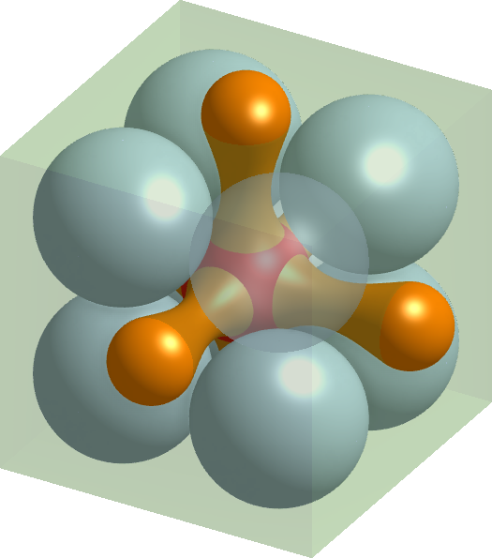
8 balls paradox
Not Convex

Slide 31
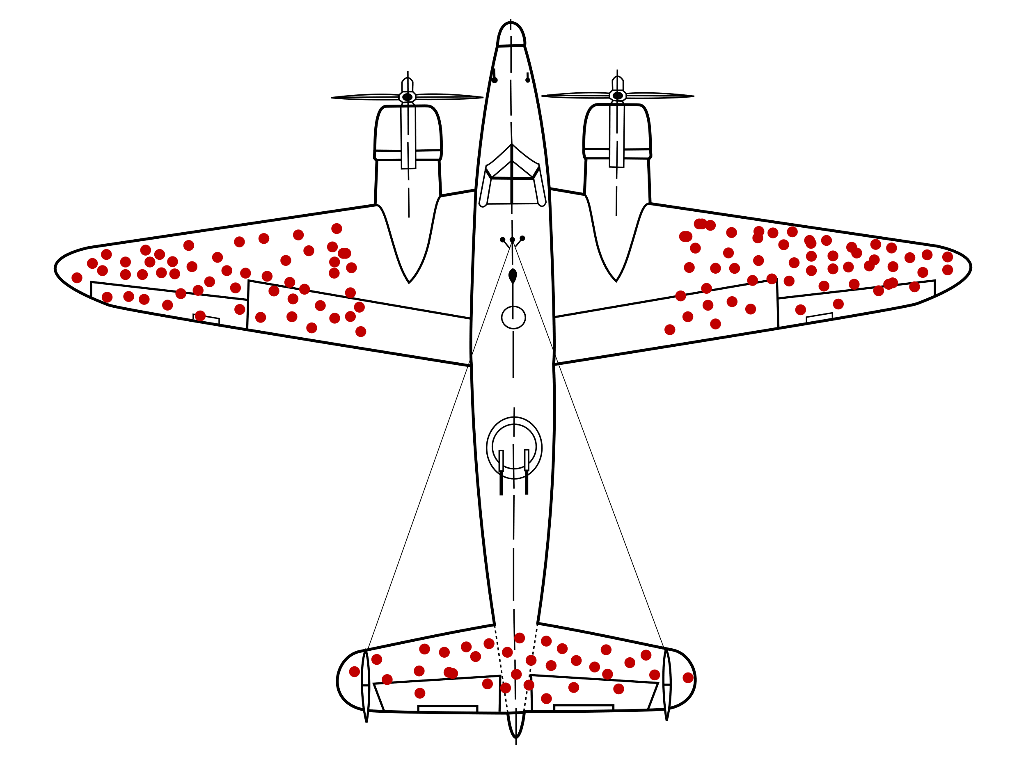
Statistics

