Slide 1
Do you understand where your models live?
HIGH DIMENSIONS
Paul Dubois - MICS Christmas day 2023

Slide 2
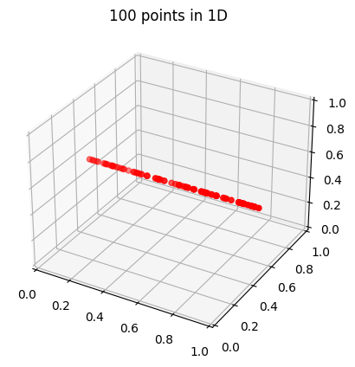
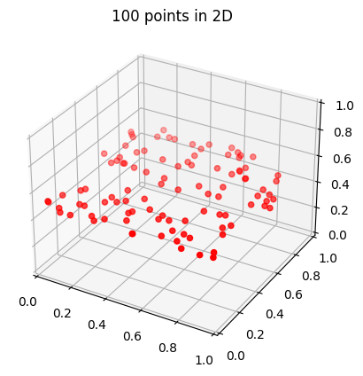
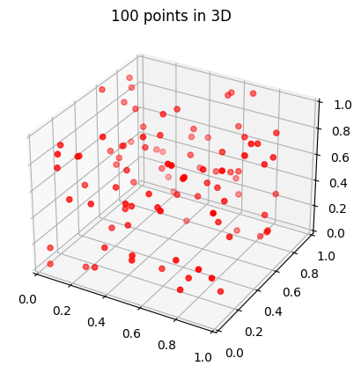
Curse of dimensionality

