Slide 1
EmergencyAlerter
Arlinda Butja
Florian Mayerhofer
Michael Stifter
IMS16

Slide 2
Content
Idea
Personas/User Stories
GUI Prototype
Results

Slide 3

Idea
Oh no, not again!
Capabilities of a Smartwatch

Slide 4
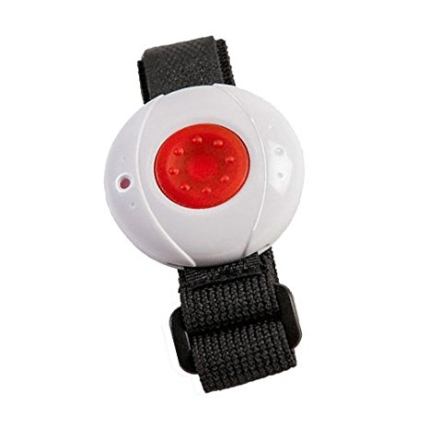
What makes us special?
Well known concept
Variety of use cases - Multipurpose
Unobtrusive and easy usage
Heartrate Monitor
Armbandsender Notruftelefon, Amazon
https://images-na.ssl-images-amazon.com/images/I/41eWJUdMIzL._SX466_.jpg

Slide 5
Personas/User Stories I
Susanne
Susanne is an exchange student, who studies Industrial Design. She comes from United States of America and is very enthusiastic about getting to know new people and being part of the 6-months exchange program. She also likes to party.
She had unpleasant experience coming home from a party, when she run into the beautiful city park. Such an app would help Susanne a lot in case of trouble.

Slide 6
Personas/User Stories II

Slide 7
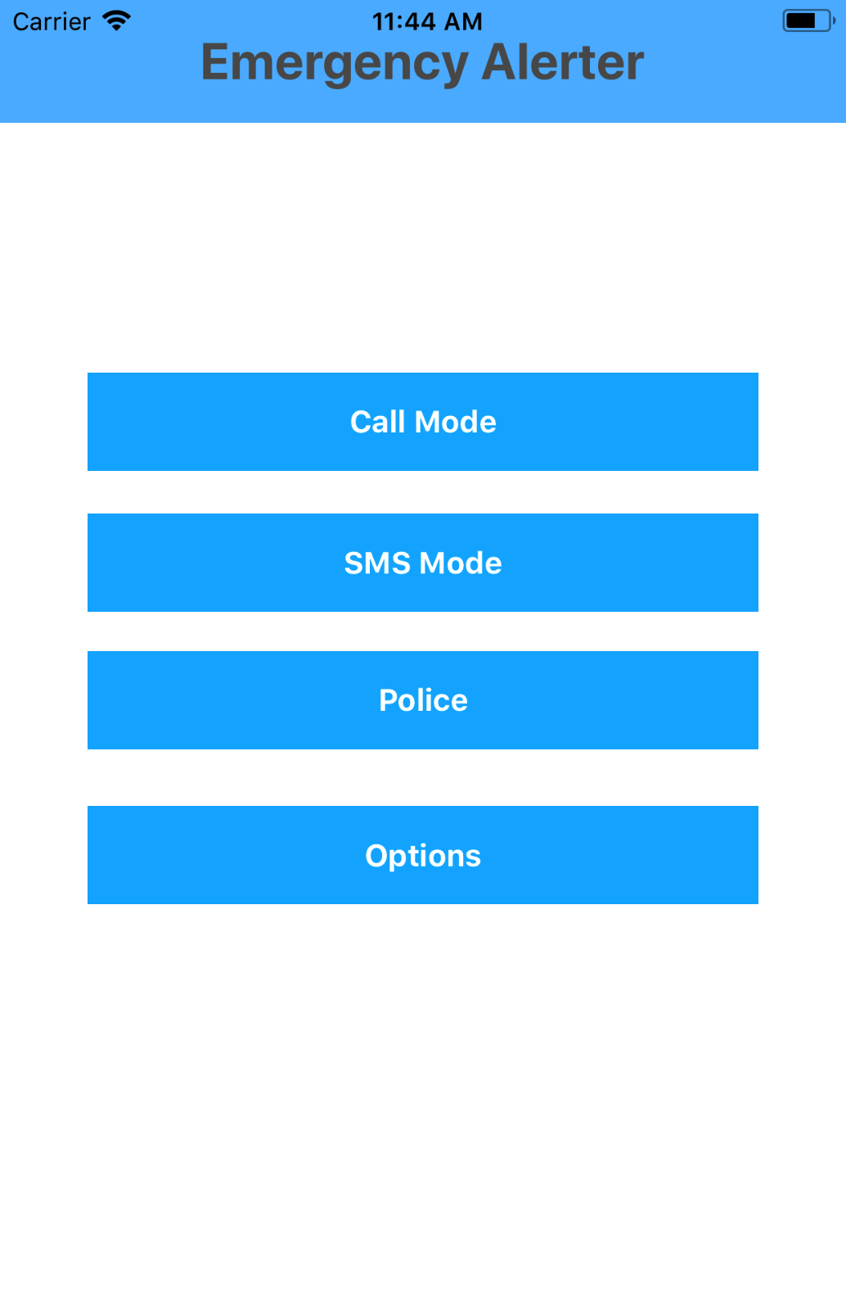
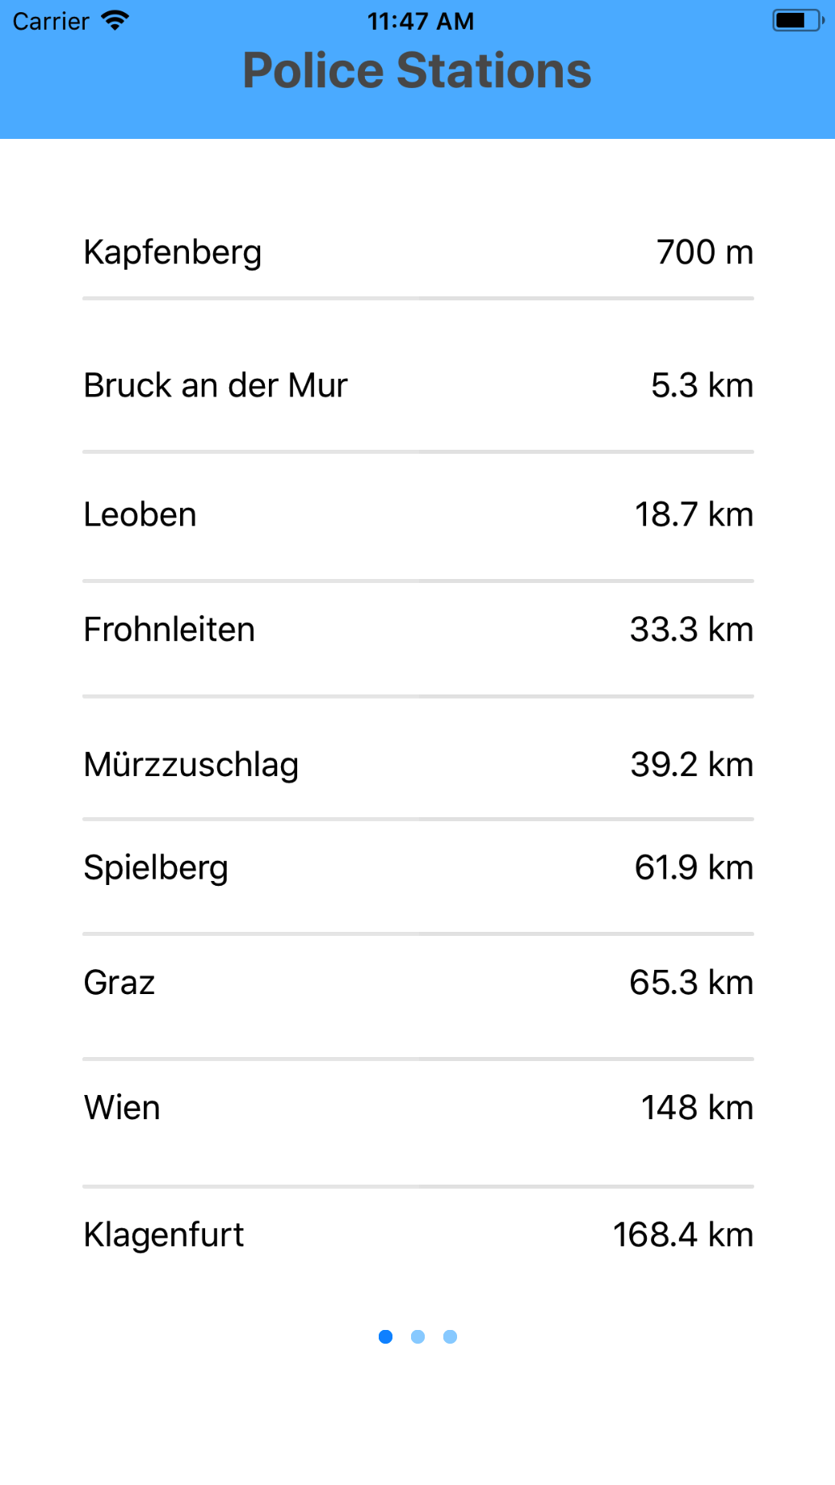

Slide 8
Results

Slide 9
Thank you for your attention

