Slide 1

PSI Ontology for
Protein Modifications
John S. Garavelli
Geneva, Switzerland
5 September 2005

Slide 2
Scope
Create a unique hierarchical, controlled vocabulary
(or ontology) for residue modifications, that satisfies
the needs of the PSI initiatives: PSI-MI, PSI-MS,
PSI-GPS

Slide 3
Requirements from PSI-MI
Ambiguous terms to describe modifications at different levels of resolution (phospho- Ser/Thr/Tyr/ residue, or tri/di/methylated lysine)
Consideration of residue modifications that are really protein cross-links such as ubiquitinated, neddylated, sumoylated.
Notes:
Mention that MI and GPS data results from lower resolution methods such as antibody detection compare to MS
I am cheating a bit, such requirement sounds realistic for GEL people but do nor really know them…

Slide 4
Requirements from PSI-MI
Clear distinction between the reaction leading to a modification and the modified status of an amino acid (terms like ‘phosphorylaTED residue’ and not ‘phosphorylaTION’)
Dynamic maintenance of the controlled vocabulary with addition of terms upon user request

Slide 5
Requirements from PSI-MS
Must include artifacts
Must include masses and mass differences
Consider sequential modifications on the same residue

Slide 6
Source Databases/Lists
RESID (http://www.ebi.ac.uk/RESID/index.html) database of 384 naturally occurring modifications with structures and 3D models, fully annotated and cross-referenced
UNIMOD (http://www.unimod.org/) database of 250 natural and artifactual modifications with basic annotation
Delta Mass (http://www.abrf.org/index.cfm/dm.home) list of 352 natural and artifactual modified residues and mass spectrometry decomposition products with basic annotation

Slide 7
Source Ontologies
GeneOntology (www.geneontology.org) 412 process terms cross-referencing RESID
PSI-MI (sourceforge.net/projects/psidev) 150 terms with short labels and synonyms cross-referencing RESID, including ambiguous terms and artifacts
ChEBI (www.ebi.ac.uk/chebi/) terms cross-references RESID (preliminary)

Slide 8
UniMod
250 modifications
RESID
134*
Gene Ontology process
384 fully annotated natural modifications
208*
DeltaMass
PSI-MI CV
352 modifications
Maintenance methods
PSI protein modification ontology
Notes:
1- we are doing the union of the modification databases (manually), merging information of naturally occurring PTM with artificially observed one and REFER to this databases as ref for the terms
2- we will REFER to some GO process for the special modification such as ubiquitination, neddylation, sumolation
3- from PSI-MI we will adopt the ambiguous terms and the dynamic maintenance with sourceforge. Mention PSI-MI ptm CV will disappear and not be maintained once the new ontology is in place
4- the intersection numbers (with asterisks) are estimates

Slide 9
Ontology structure and maintenance
Hierarchical structure to handle ambiguous terms
DAG (direct acyclic graph) to support simultaneous classification by modification process or chemical character
Flat file maintainable with open source editor (DAG-Edit)
Repository and user request management through SourceForge

Slide 10
Ontology term description
An identifier in the PSI-PTM name space, a unique and meaningful short label, a full name,
A structured definition with term relations
Synonyms with alias type (systematic chemical name, misnomer, etc...)
Additional information:
  indication whether the modification is natural or artifactual
  the amino acid modified
  indication whether the modification depends on, is subsequent to, or co-occurs with another modification
  mass and mass difference
  citation of source database or publication

Slide 11
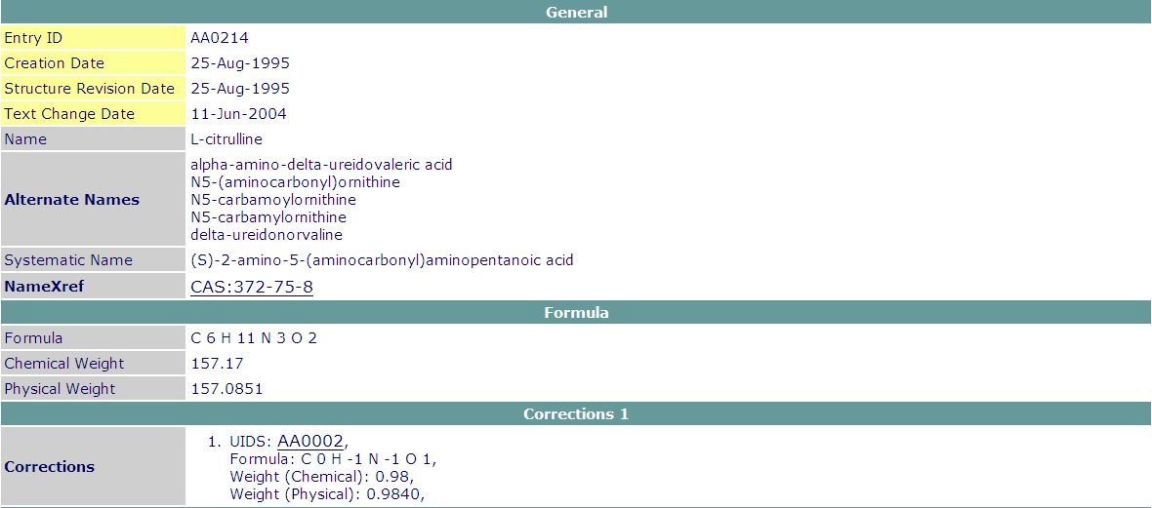
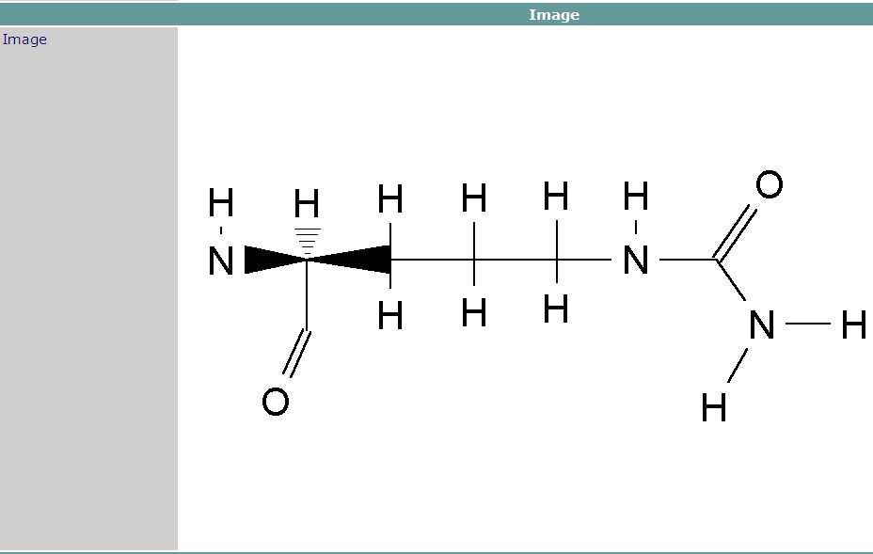
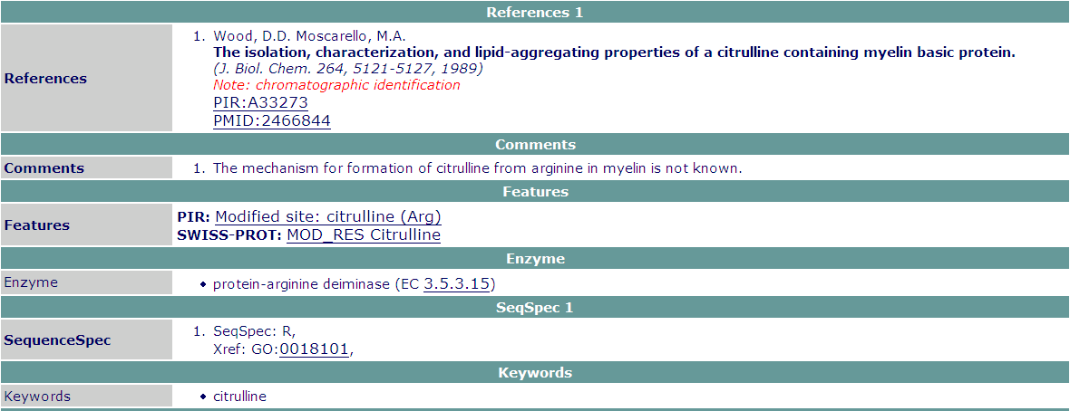
RESID Database Entry

Slide 12
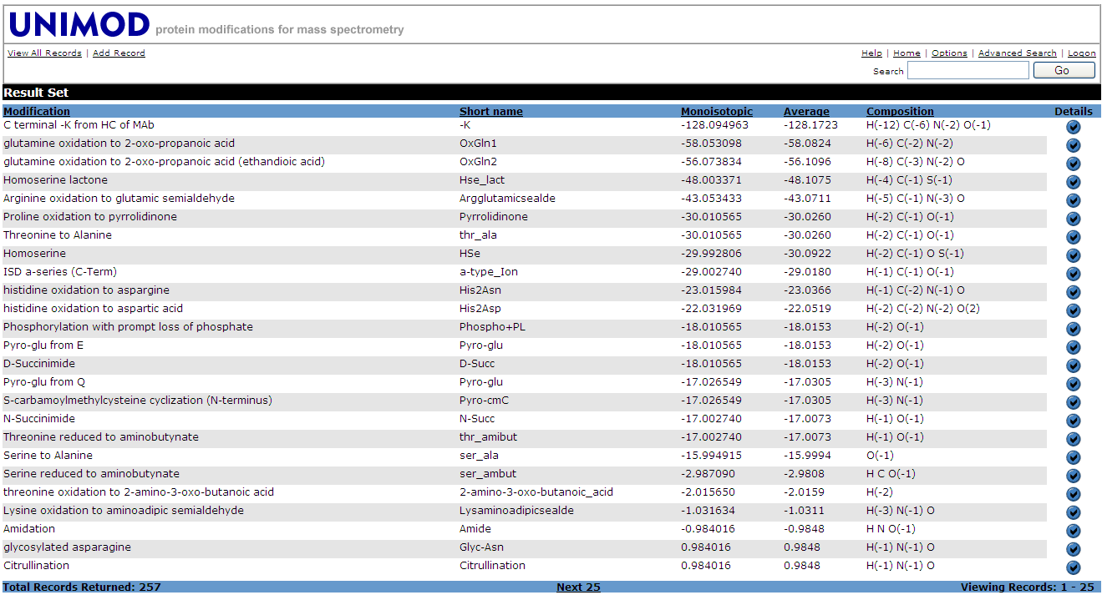
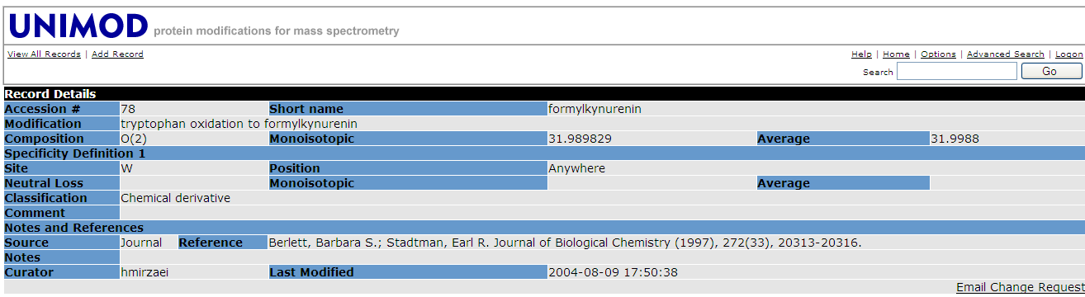
UNIMOD Database Table and Entry

Slide 13
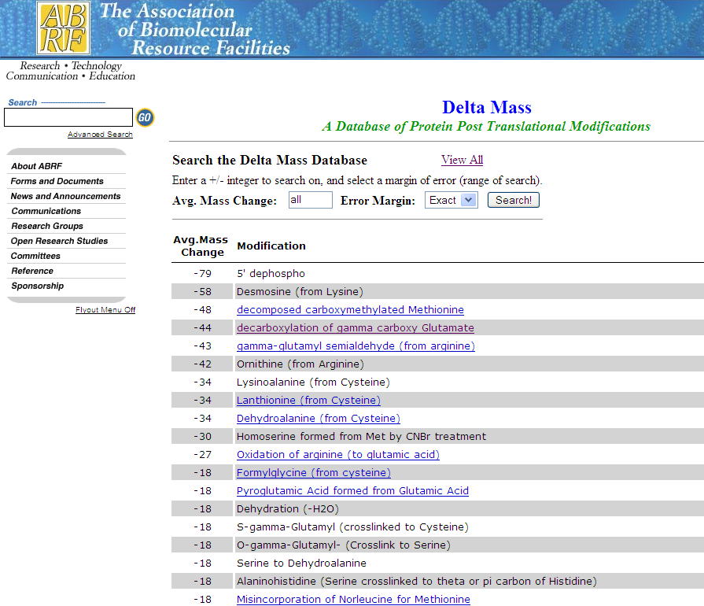
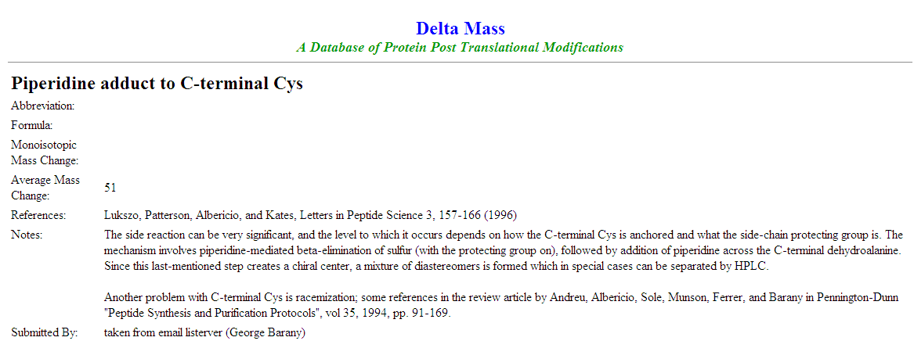
Delta Mass List and Entry

Slide 14
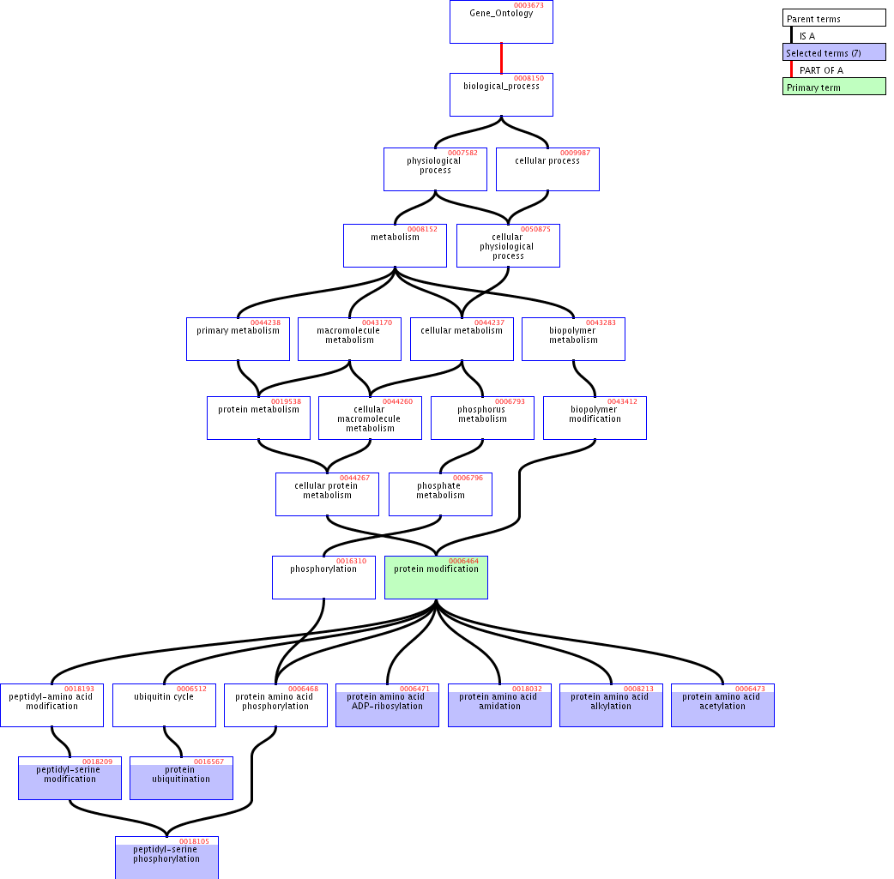
GO protein modification process

Slide 15
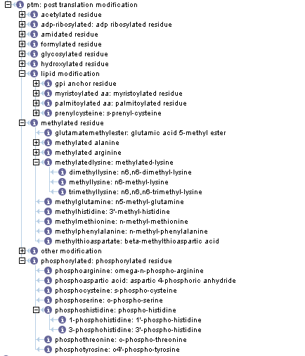
PSI-MI Controlled Vocabulary
Notes:
All PTM point to RESID database, and have corresponding reaction in the interaction type CV

Slide 16
PSI-PTM Root Definition
id: PTM:0001
name: PTM: protein modification
def: “covalent modification of, or a change resulting in an alteration of the measured molecular mass of, a peptide or protein amino acid residue”
is_a: PTM:0000

Slide 17
Example Definition: AcRes
id: PTM:0002
name: AcRes: acetylated residue
def: “a protein modification that effectively replaces a hydrogen atom with an acetyl group”
comment: “Amino hydrogens are replaced to produce amides; hydroxyl hydrogens are replaced to produce esters; and sulfanyl (thiol) hydrogens are replaced to produce thioesters.”
is_a: PTM:0001

Slide 18
Example Definition: NAcCys
id: PTM:0008
name: NAcCys: N-acetyl-L-cysteine
def: “a protein modification that converts an L-cysteine residue to either N-acetyl-L-cysteine” [RESID:AA0043]
synonym: “(R)-2-acetylamino-3-sulfanylpropanoic acid” []
synonym: “2-acetylamino-3-mercaptopropanoic acid” []
synonym: “N-acetylcysteine” []
synonym: “CAC” [BIND]
synonym: “\[C\:ac\]” [BIND]

Slide 19
Example Definition: NAcCys
xref_unknown: MassMono:145.0197
xref_unknown: MassAvg:145.18
xref_unknown: DiffMono:42.0106
xref_unknown: DiffAvg:42.04
xref_unknown: Origin:Cys
is_a: PTM:0007

Slide 20
Example Definition: AcSer
id: PTM:0022
name: AcSer: acetylated serine
def: “a protein modification that converts an L-serine residue to either N-acetyl-L-serine or O-acetyl-L-serine” [RESID:AA0051, RESID:AA0364]
synonym: “acetyl-L-serine” []
synonym: “acetylserine” []
synonym: “SAC” [BIND]
synonym: “\[S\:ac\]” [BIND]
is_a: PTM:0002

Slide 21
Example Definition: NAcSer
id: PTM:0023
name: NAcSer: N-acetyl-L-serine
def: “a protein modification that converts an L-serine residue to N-acetyl-L-serine” [RESID:AA0051]
synonym: “(S)-2-acetylamino-3-hydroxypropanoic acid” []
synonym: “N-acetylserine” []
synonym: “SAC” [BIND]
synonym: “\[S\:ac\]” [BIND]
is_a: PTM:0022

Slide 22
Example Definitions: OAcSer
id: PTM:0024
name: OAcSer: O-acetyl-L-serine
def: “a protein modification that converts an L-serine residue to O-acetyl-L-serine” [RESID:AA0364]
synonym: “(S)-2-amino-3-acetyloxypropanoic acid” []
synonym: “O-acetylserine” []
synonym: “serine acetate ester” []
synonym: “SAC” [BIND]
synonym: “\[S\:ac\]” [BIND]
is_a: PTM:0022

Slide 23
Example Definition: NOAc2Ser
id: PTM:0025
name: NOAc2Ser: N,O-diacetyl-L-serine
def: “a protein modification that converts an L-serine residue to O-acetyl-L-serine” [RESID:AA0364]
synonym: “(S)-2-acetylamino-3-acetyloxypropanoic acid” []
synonym: “N,O-diacetylserine” []
synonym: “N-acetylserine acetate ester” []
is_a: PTM:0022

Slide 24
Example Definition: AcRes
id: PTM:0033
name: ResNH2: amidated residue
def: “a protein modification that effectively replaces the alpha-carboxyl group of a residue with a carboxamido group”
is_a: PTM:0001

Slide 25
Example Definition: ResDa
id: PTM:0146
name: ResDa: deamidated residue
def: “a protein modification that effectively replaces a carboxamido group with a carboxyl group”
is_a: PTM:0001

Slide 26
Example Definition: AsnDa
id: PTM:0147
name: AsnDa: deamidated asparagine
def: “a protein modification that converts an L-asparagine residue to L-aspartic acid”
is_a: PTM:0146

Slide 27
Example Definition: Na
id: PTM:0565
name: Na: sodium ion adduct
def: “the replacement of a proton by a sodium counterion as determined by mass measurement” [PMID:11125103]
synonym: “sodium cation” []
synonym: “sodiated” []
synonym: “Na” []

Slide 28
Example Definition: Na
comment: “The mass is computed for the adduct, so only a mass difference is given.”
xref_unknown: DiffAvg:21.98
xref_unknown: DiffMono:21.9819
xref_unknown: Origin:NonAA
is_a: PTM:0563

Slide 29
Example: AC_ICAT_D8
id: PTM:0566
name: AB_ICAT_D8: Applied Biosystems original ICAT(TM) (2)H8 cysteine adduct
def: “the replacement of a sulfanyl hydrogen on cysteine by the original Applied Biosystems proprietary isotope coded affinity tag” [PMID:11125103]
synonym: “AB_old_ICATd8” [UNIMOD:12]

Slide 30
Example: AC_ICAT_D8
comment: “The mass is computed for the adduct, so only a mass difference is given.”
xref_unknown: DiffAvg:450.62
xref_unknown: DiffMono:450.2752
xref_unknown: Origin:Cys
is_a: PTM:0563

Slide 31
Example Definition: CMCvCEC
id: PTM:0567
name: CMCvCEC: cysteine acrylamide adduct instead of S-carboxymethylcysteine
def: “a protein modification that converts an L-cysteine to a cysteine acrylamide adduct, such as S-(1-carboxamidoethyl)cysteine, instead of S-carboxymethylcysteine”
synonym: “carboxymethyl-cysteine vs propionamido-cysteine" [DeltaMass]

Slide 32
Example Definition: CMCvCEC
comment: “The mass actually represents a mass difference computed for the adducts only.”
xref_unknown: MassAvg:29.04
xref_unknown: MassMono:29.0267
xref_unknown: DiffAvg:13.04
xref_unknown: DiffMono:13.03164
xref_unknown: Origin:Cys
is_a: PTM:0563

