Slide 1

FGE-OM: Functional Genomics Experiment Object Model
Andy Jones
Department of Computing Science
University of Glasgow

Slide 2

Overview
Motivation for shared standards
FGE-OM
Database implementation - RAPAD
Current biological projects
Ontologies

Slide 3
Motivation for Shared Standards
Aid comparison across different techniques
  mRNA : protein volume : localisation
Proteomics standardisation can learn from past efforts of MGED
Shared aspects of microarrays & proteomics:
  Overview of experiment
  Sample origin
  Experimental protocols (similarity between RNA extraction & protein solubilisation)
  RNA fluorescence signal, similar to protein volume on a 2-D gel
  Common interpretation across multiple samples

Slide 4
Functional Genomics Experiment - Object Model
Namespaces
Components common to all functional genomics experiments
BioOM
Top-level of the
Object Model
MAGE-OM
derived
Microarray specific components
FGE-OM
ArrayOM
PEDRo and Gla-PSI
derived
Classes modelling proteomics technologies
ProteomicsOM
Jones et al. Bioinformatics 2004 (in press)

Slide 5
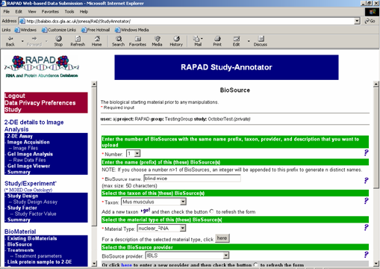
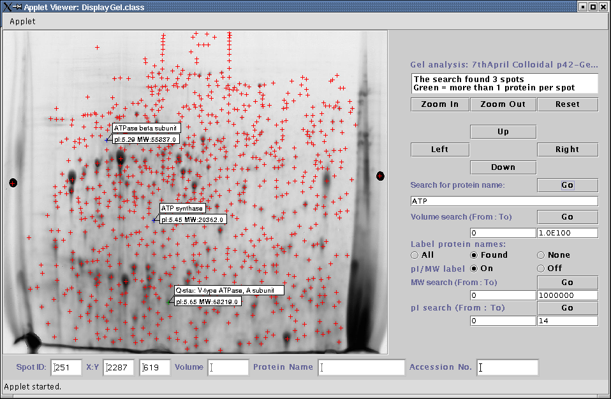
A database for microarrays and proteomics
Based on RAD microarray database at Penn
Additional tables to store proteomics
Interface based on the RAD Study-Annotator
Manduchi et al. Bioinformatics
2004, 20(4):452-9

Slide 6
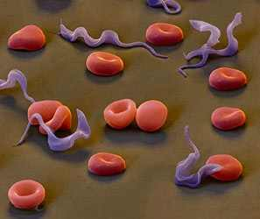

Proteome of Trypanosoma brucei
Trypanosomes cause sleeping sickness and other diseases in Africa and Latin America
Model organism for parasitology
Aims:
Genome sequencing, microarrays and proteomics to find all the expressed genes and proteins - GeneDB at Sanger
Proteomics component in Glasgow
2-DE, MS and LC-MS to find approx. 4000 proteins
Find potential drug targets and improve genome annotation

Slide 7
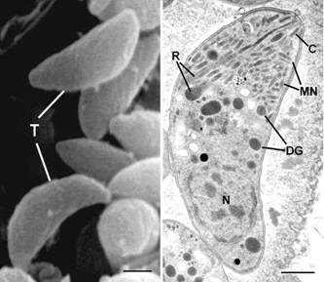
Integrating microarrays and proteomics
Example:
Human cell culture infected with Toxoplasma gondii: microarrays and proteomics
IDs returned from mass spec searches do not match cDNA clones, problematic for v. large investigations
Solution:
Use AllGenes: Database Of Transcribed Sequences (DoTS), contains predefined mappings across different IDs
Only human and mouse - integrating data for other species may require sequence similarity searching
http://www.allgenes.org/

Slide 8
Overview of BioOM packages
Packages
Classes
Experiment
Protocol
Bio-Material
Measure-ment
Extendable
Bio-Sequence
BQS
BioEvent
Description
Describable
BioAssay Data
Higher Level Analysis
AuditAnd Security
Identifiable
BioAssay
BioAssay and BioAssayData changed - classes relating to microarrays moved into ArrayOM
Other packages: unchanged from MAGE-OM
Classes at top level for adding IDs, links to external DBs and any other additional information

Slide 9
Experiment package
Experiment
Contact
Store overview
Links to parameter varied across samples
Link to data model and assays (BioAssay)
Experiment Design
BioAssay Data
type
category
Ontology Entry
BioAssay
Experiment Factor
unit
Factor Value
Measure-ment

Slide 10
Overview of ArrayOM packages
Array, ArrayDesign, DesignElement
  Describe layout of array
QuantitiationType - microarray specific classes e.g. Signal
ArrayBioAssay - hybridization of mRNA to array
ArrayBioAssayData - contains the data dimensions in microarrays
  Not directly applicable to proteomics or other experiments
ArrayDesign
DesignElement
Quantitation Type
Array
Array BioAssay
Array BioAssayData

Slide 11
ProteomicsOM namespace
Source of model:
PEDRo (MIAPE) most proteome specific classes remain unchanged
Our own proposal Gla-PSI, additional coverage of:
  Image analysis
  Multiple analysis of 2D gels
  DIGE (Difference gel electrophoresis)
  Comp Func Genom 4:492-501 (2003)

Slide 12
Overview of ProteomicsOM packages
Classes are linked to BioOM for adding generic descriptions and protocols
Different design principles from MAGE-OM
Attributes specify many of the datatypes to be captured
Designed to allow easy changes to the model as PSI proposals change
Proteome BioAssay
ProteinData
Protein Separation
ProteinRecord
MassSpec Protocol
MassSpec Data
- Inheritance: changes to subclasses without affecting core model in BioOM

Slide 13
ProteomicsOM:ProteinSeparation package
Separation techniques
Separation products
Gel2D
GelSpot
BioAssay Treatment
BioMaterial
Column
Fraction
Source biomaterial
BioMaterial
Measurement
Separation techniques: subclass of BioAssayTreatment
Separation products: subclass of BioMaterial
Product of one separation technique can lead into another using BioMaterialMeasurement
BioOM:Protocol can be attached to BioAssayTreatment

Slide 14
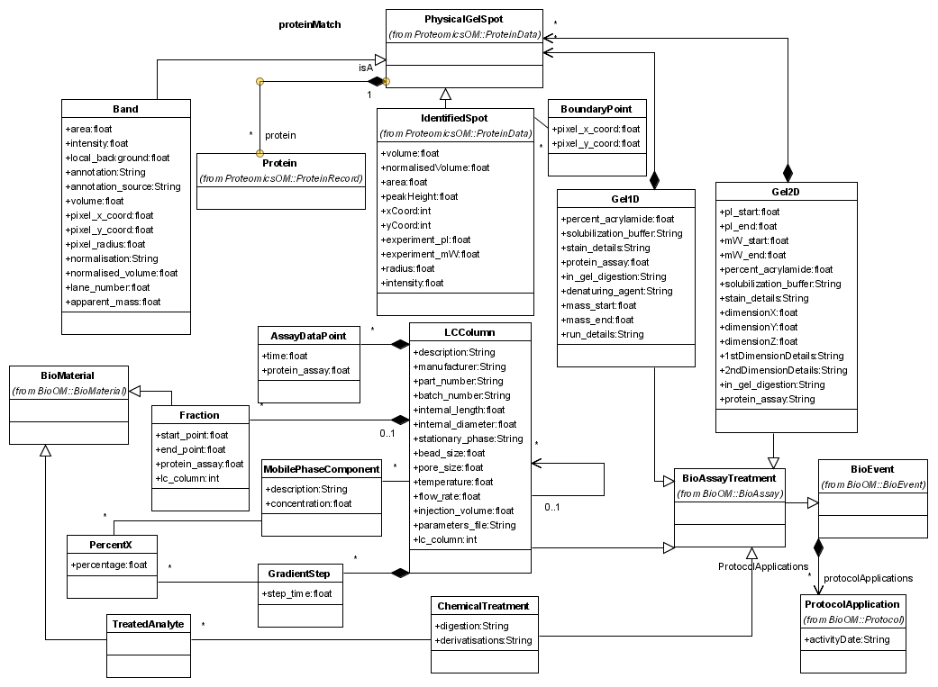
ProteinSeparation Package

Slide 15
ProteomicsOM:ProteomeBioAssay package
GelImageAnalysis - analysis of 2-DE by specialist software
Re-uses Image and ImageAcquisition
Linked by Physical-BioAssay
Legend
BioOM
ProteomicsOM
Channel
BioAssay
Physical BioAssay
Measured BioAssay
Image
treatment
target
Feature Extraction
Measured BioAssay
Data
BioAssay Treatment
Image Acquisition
BioMaterial Measurement
GelImage Analysis
BioAssay Data

Slide 16
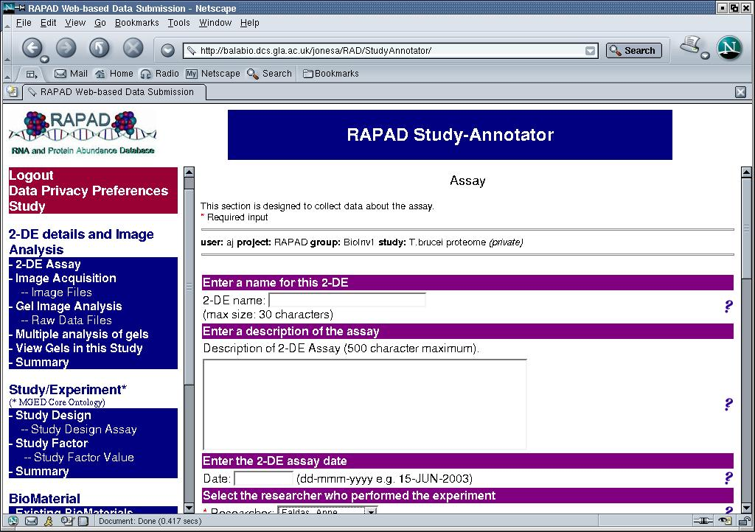
Gel2D
- 1st, 2nd dimension, stain protocols, operator, mw & pI range

Slide 17
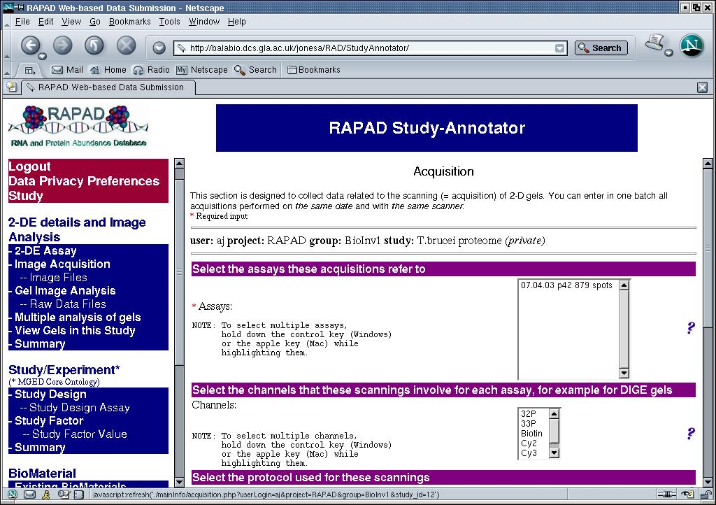
Image
Image Acquisition
Channel

Slide 18
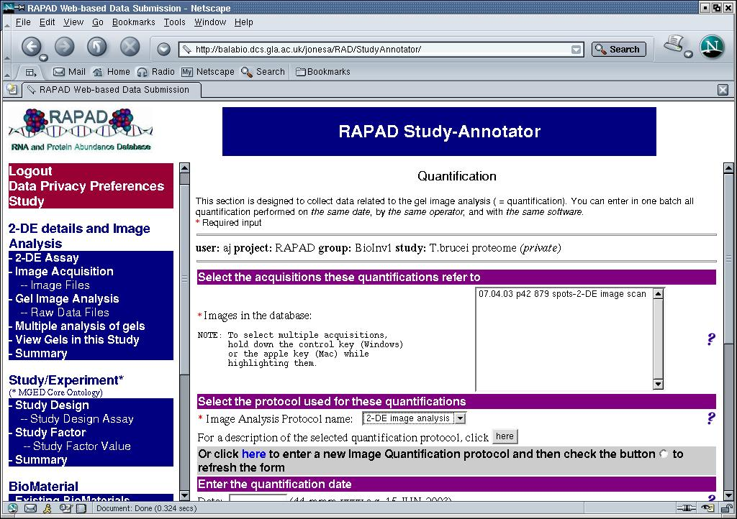
GelImage Analysis

Slide 19
ProteomicsOM:ProteinData package
BioAssay Data
IdentifiedSpot - stores gel spot data
Subclass of Physical-GelSpot and BioMaterial captures further treatments
BioAssayDimension captures spots matched across gels
DIGESingleSpot captures single channel
BioMaterial
BioAssay Dimension
BioData Values
Physical GelSpot
Physical BioAssay
BioData Tuples
Identified Spot
Feature Extraction
SpotRatio
DIGESingle Spot
GelImage Analysis
Multiple Analysis
Matched Spots

Slide 20
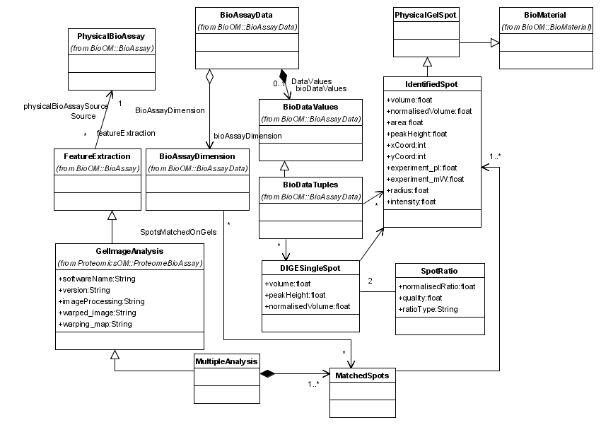
ProteinData Package

Slide 21
Clicking a spot launches a new web page
Identified Spot
Protein
Search capabilities over protein name, range of pI, mass or spot volume

Slide 22
MassSpecProtocol and MassSpecData
BioAssayTreatment - link to source of material and Protocol
Also links to specific classes for MS protocol
Data stored as a list of peaks
Classes for capturing database searches from PEDRo
MassSpecProtocol Package
MassSpecData Package
BioMaterial Measurement
BioAssay Treatment
Peak
MassSpec Experiment
PeakList
PEDRo derived classes modelling MS protocol
PEDRo derived classes modelling database searches
Separated into two packages allowing changes to format where necessary
Legend
BioOM
ProteomicsOM

Slide 23
ProteinRecord package
Proteins identified by MS and database searches
Class Protein stores a single protein record
Protein modifications stored using OntologyEntry
Link to external records stored in DatabaseEntry
ProteinHit
DBSearch
MassSpecData package
ProteinRecord package
Protein
Protein Modification
species
modificationType
Legend
Database
Entry
Ontology
Entry
BioOM
Location
ProteomicsOM

Slide 24
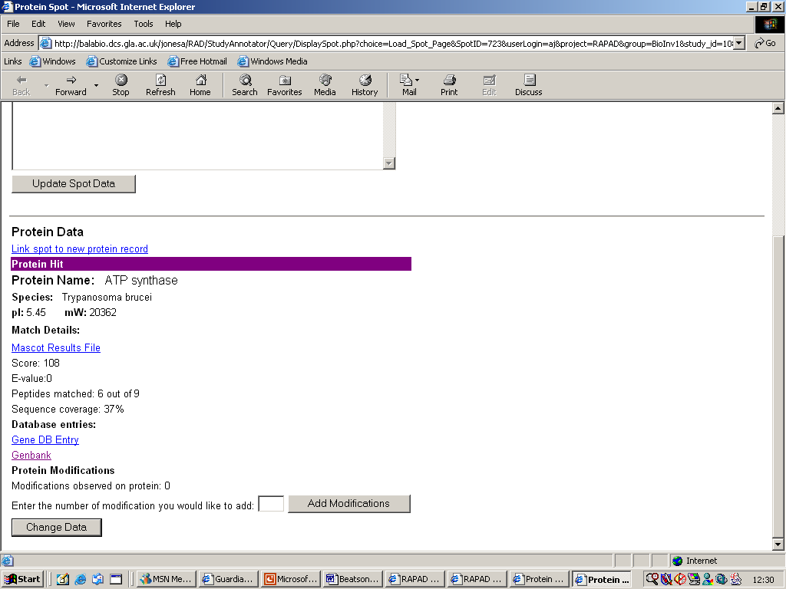
ProteinHit
Display protein name, species, pI and MW
Data about protein modifications observed
Protein

Slide 25
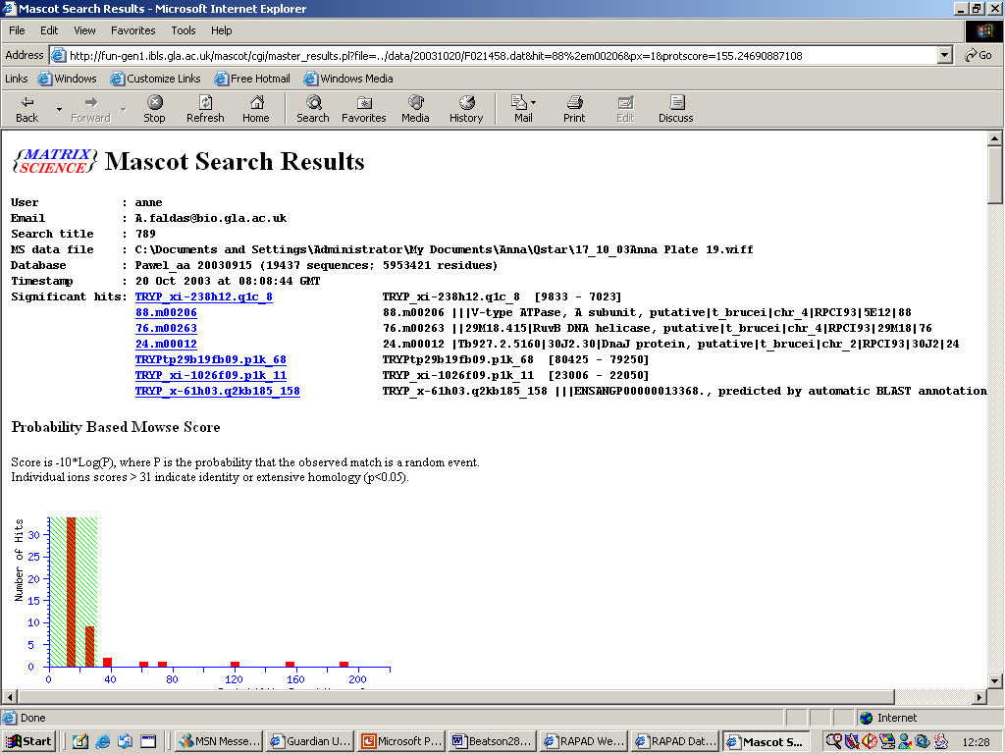
ProteinHit
DBSearch
Measures of quality of match by MS. Link to MASCOT results

Slide 26
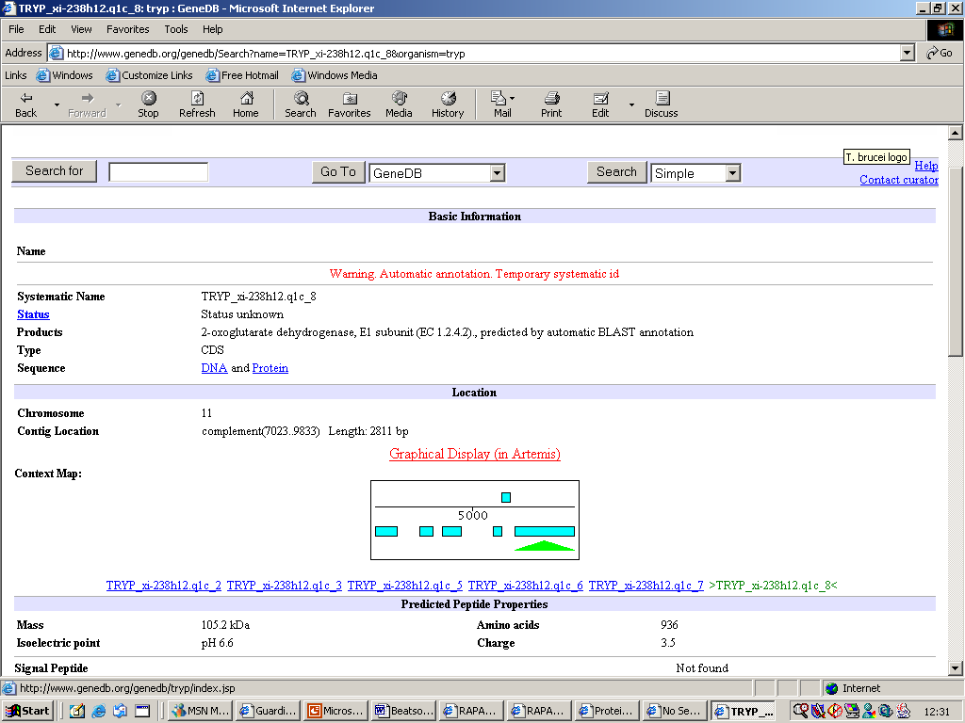
Protein
Database Entry
Link to GeneDB record - parasite genome database
- Accession and database URL are stored in the DatabaseEntry table

Slide 27
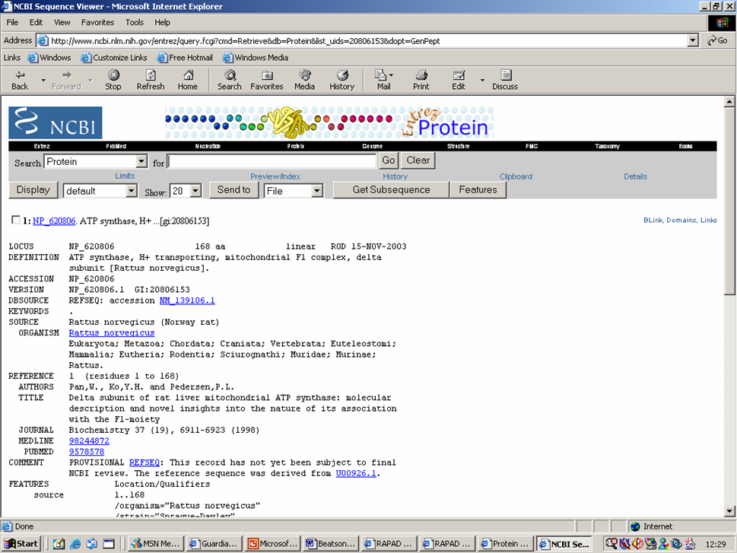
Protein
Database Entry
Link to Genbank record
(or other database)

Slide 28
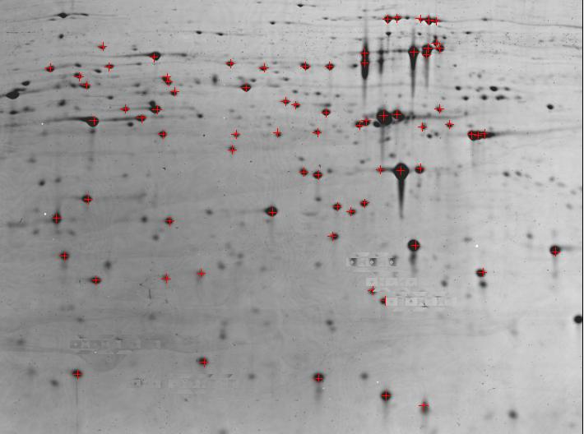
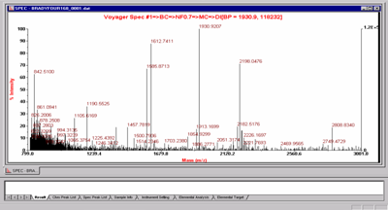
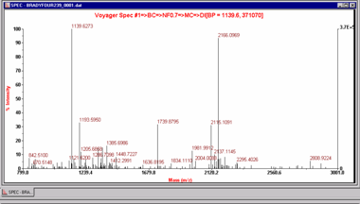
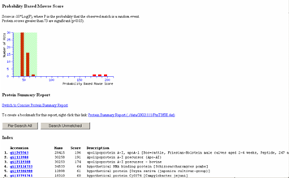
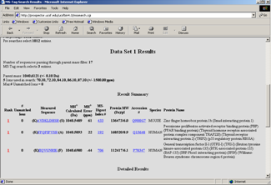
Proteomics Workflow
2D-PAGE
Sample Origin
Protein
Solubilisation
Mass Spectrometry
MALDI
MS/MS
Image Analysis
ID Vol X Y
1 454 23 24
2 222 28 87
3 12 20 12
4 662 262 101
5 49 222 90
6 113 485 10
7 119 98 987
ID Vol X Y
1 654 23 24
2 25 28 87
3 187 21 16
4 672 262 111
5 54 222 90
6 113 487 10
7 125 98 987
Database Search
Multiple Gel
Analysis
Protein identification
Statistical
Analysis

Slide 29
Experiment
1
Workflow in FGE-OM
BioMaterial
2
Treatment
Experiment description
Protein solubilisation
Protein separation
Scanning
Gel image analysis
Spot data model
Mass Spec link to match spots to proteins
3
BioMaterial
BioAssay
Treatment
Physical BioAssay
4
Image
Acquisition
Physical BioAssay
5
6
7
Feature
Extraction
Measured BioAssay Data
MassSpec Experiment
(also linked to BioAssayTreatment)

Slide 30
Ontologies
MAGE links to external ontologies e.g. MGEDOntology (MO)
Other ontologies also used e.g. NCBI Taxonomy for species
FGE-OM makes extensive use of ontologies for both microarrays and proteins
The first release of PEDRo avoided ontologies in many cases
  Some concepts e.g. biological sample description very difficult to capture without ontologies
MO - http://mged.sourceforge.net/ontologies/

Slide 31
PSI Ontology?
In RAPAD ontologies used to populate user interface
Store flat representation of MO
Additional terms used for proteins
  e.g. Protein Modification terms (glycosylation, phosphorylation ...)
Terms could contribute as additions to MO?
  OR
PSI should develop own ontology?

Slide 32
Summary and Future Work
FGE-OM is intended as a guide for possible design of MAGE v.2 and PSI-MGED interactions
Working model will require tools for generating FGE-ML and XMLSchema
RAPAD will be used to add proteomics 7to GUS database system at Penn
  add proteomics support to ToxoDB, PlasmoDB, GeneDB

Slide 33


Contact
Email: jonesa@dcs.gla.ac.uk
URL: www.gusdb.org/fge.html
Bioinformatics Research Centre - www.brc.dcs.gla.ac.uk
Acknowledgements
This work is in collaboration with the CBIL at Penn, in particular Chris Stoeckert and Angel Pizarro.
Data is from the labs of Mike Turner and Jonathan Wastling in Glasgow.
Project supervisors: Ela Hunt and Jonathan Wastling
The Functional Genomics Facility at Glasgow is supported by a Wellcome Trust grant. My research is supported by an MRC Bioinformatics PhD studentship.

Slide 34
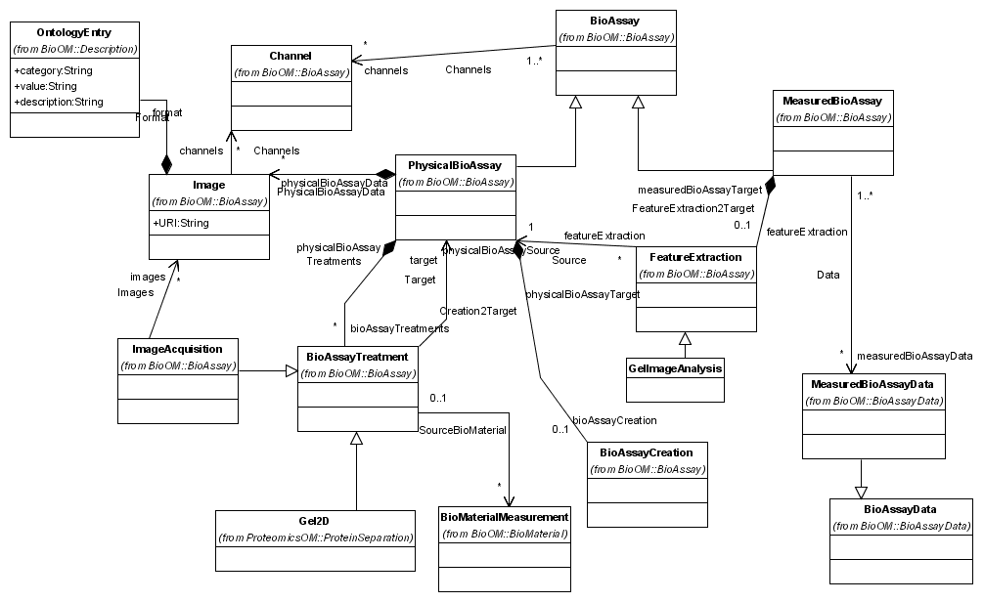
ProteomeBioAssay Package

Slide 35
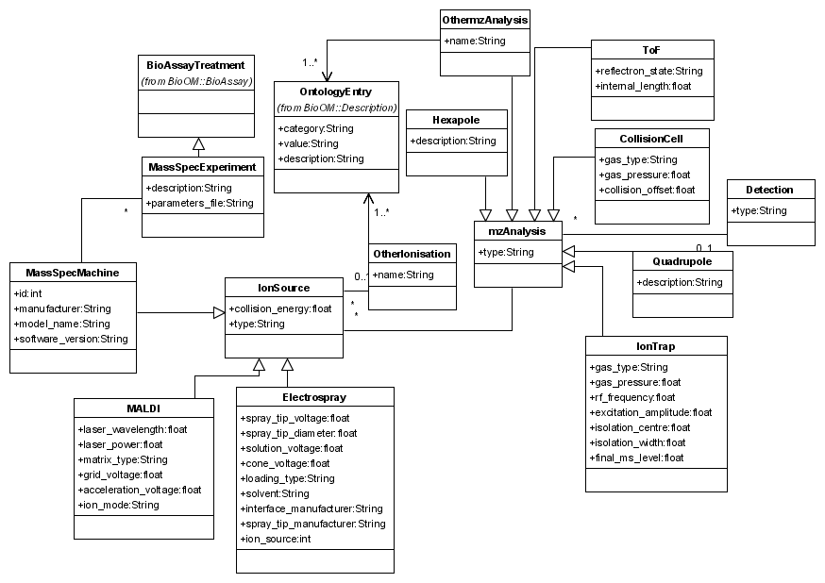
MassSpecProtocol Package

Slide 36
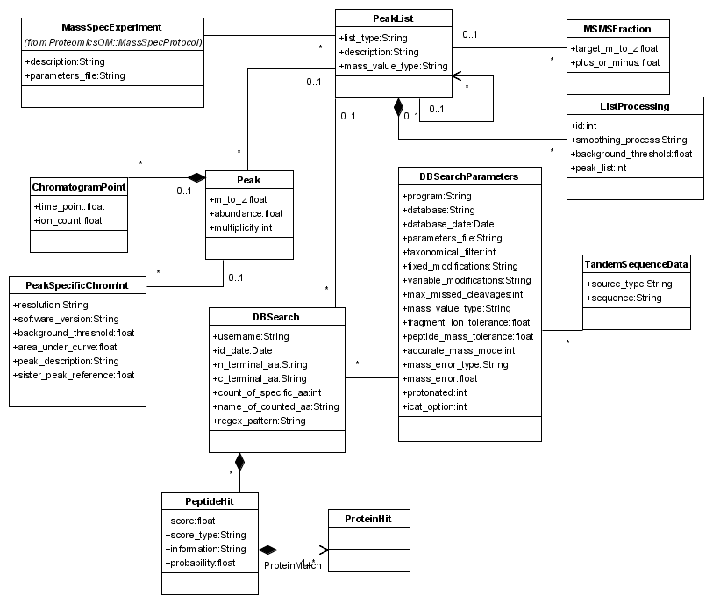
MassSpecData Package

Slide 37
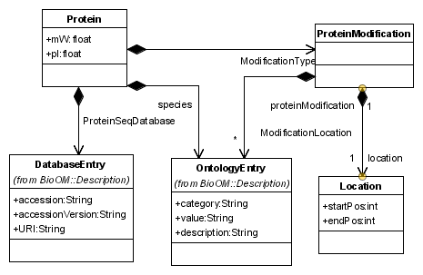
ProteinRecord Package

