Slide 1
www.proteios.org an open source proteomics project
Per Gärden, Samuel Andersson, Jari Häkkinen Lund Swegene Bioinformatics Facility, Sweden
Rikard Alm Biochemistry, Lund University, Sweden
Frank Potthast Functional Genomics Center, Zürich, Switzerland
Fredrik Levander Lund Proteomics Resource Facility, Sweden

Slide 2
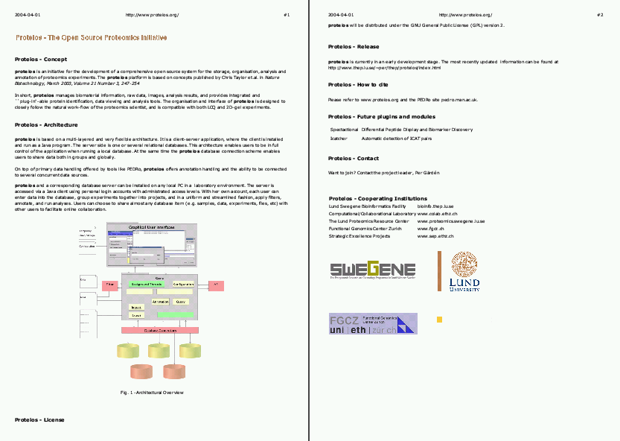
Background

Slide 3
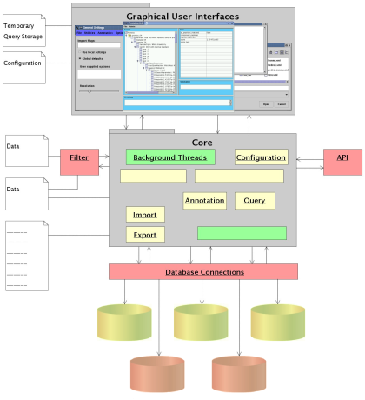
Architectural Overview

Slide 4
Features
User accounts - IP protection
Cross platform - cross database (Java/Hibernate)
Data access from any computer
Import/export of PEDRo/validation
URIs to raw data files, e.g. mzXML, gel images, …
Will be compliant to PSI standards

Slide 5
Analysis - Plug-ins
Analysis tools will be implemented
Plug-in framework
  Mascot
  ICATcher
  PeptideProphet, ProteinProphet
  PSI-MI: Cytoscape
  …

Slide 6
Status
Version 0.4 (current)
  Full, automatic PEDRo import/export
  No analysis tool yet, gel biased
Version 0.5 (end of May, 2004)
  Updated GUI
  Import of stepwise experimentation data
  Query functionality
Near future version
  Mascot plug-in

