Slide 1


CEBS OBJECT MODEL FOR SYSTEMS BIOLOGY DATA, SysBio-OM http://cebs.niehs.nih.gov
Sandhya Xirasagar
xirasagars@saic.com

Slide 2
CEBS- Objectives
Systems biology approach to identify comprehensive and highly
predictive sets of biological markers of environmental stressors and
understand the mechanisms of action of the stressors
Transcriptomics
  Microarrays
Proteomics
  Chromatography, 2D Gel Electrophoresis, Mass Spectrometry
  Protein Arrays, Yeast 2 Hybrid Screen
Metabolomics
  Chromatography, Nuclear Magnetic Resonance (NMR), Mass Spectrometry

Slide 3
CEBS-Strategy
Integrate data from multiple complex data streams (including
transcriptomics, proteomics, metabolomics, toxicology)
Unify data representation and facilitate cross platform queries
and reuse of software to analyze and display these data
Standardize data storage, annotation, and export to ensure
efficient and accurate data exchange between data sources

Slide 4
Open Source Object Models
MicroArray Gene Expression Experiments Object Model (MAGE-OM)
Representation of Microarray Gene Expression Experiments
(http://www.omg.org/docs/formal/03-02-03.pdf)
Proteomics Experiment Data Repository (PEDRo) Representation of Proteomics Experiments (http://pedro.man.ac.uk/home.shtml)
IntAct Data Repository
Representation of Protein-Protein Interaction Data (http://www.ebi.ac.uk/intact/index.html)

Slide 5
Protein Expression Workflow Scenario
Chromatographic Separation
2D Gel Electrophoresis
Image Analysis/Spot Quantitation
Digestion of Gel Spot
Mass Spectrometry
Protein Identification/Quantitation

Slide 6
Protocol
BioEvent
BioMaterial
BioSequence
BioAssay
Experiment
CommonBioAssayData
(BioAssayData)
SummaryData
SysBio-OM

Slide 7
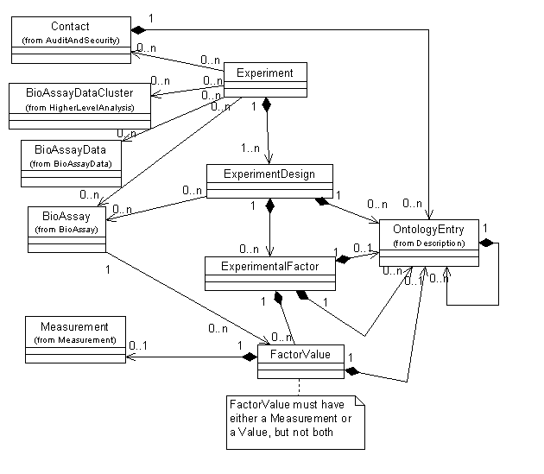
Experiment

Slide 8
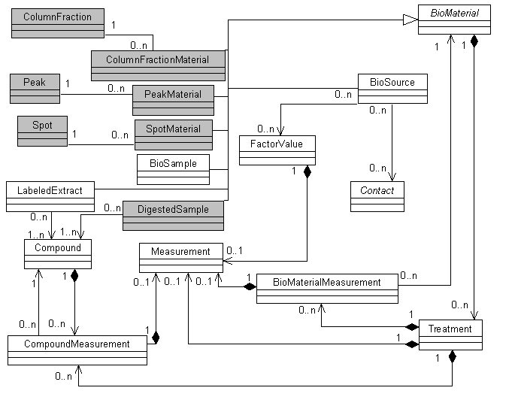
Biomaterial

Slide 9
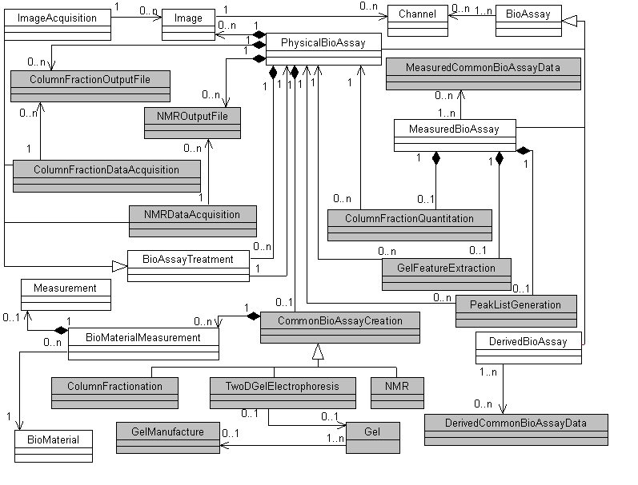
Bioassay

Slide 10
Biomaterial

Slide 11
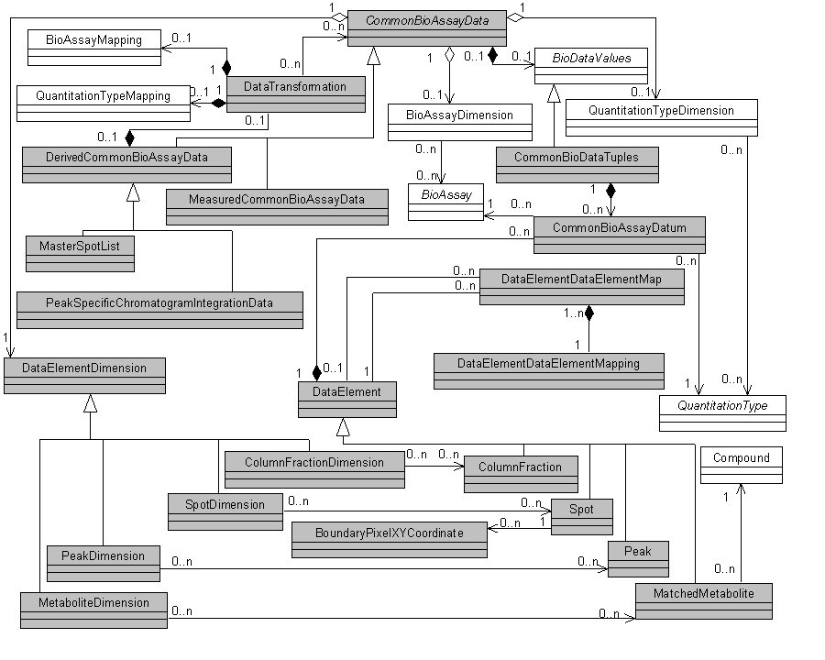
CommonBioAssayData

Slide 12
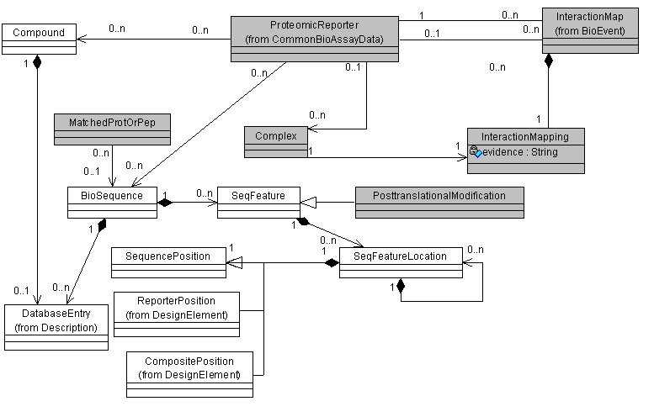
Biosequence

Slide 13
Issues Relating to Data Volume/Complexity
LC data
MS/MS Data
Use of appropriate identifiers
Should all the data reside in a relational format?
Can we use direct queries as short cuts to circumvent complex navigational object paths?
Controlled Vocabulary

Slide 14
Ontologies in MAGE

Slide 15
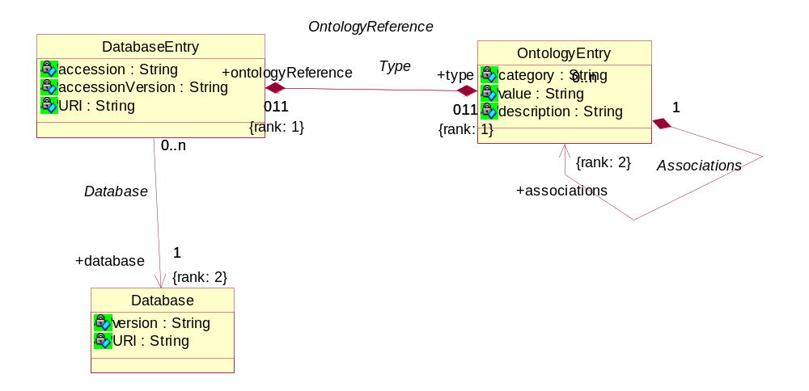
MAGE-ML – Much of the data necessary for querying is in OntologyEntry

Slide 16
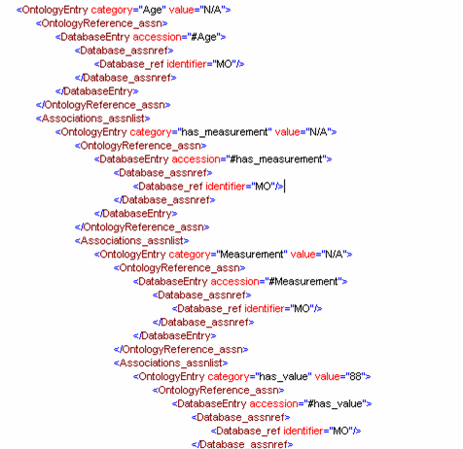
OntologyEntry in MAGEML

Slide 17
Issues
We need to have objects to present to form designers to capture important information
We need to accurately query un-controlled vocabulary ontologies from the application
Validate Ontology entry structure (in MAGEML) in a reusable fashion
Validate Ontology entries data transparently
Integrity of Ontological data at the database level

Slide 18
Java Ontology Binding
Use known strategies (Like Java XML Binding)
Unmarshall MAGE-ML ontologies into a useful structure
Reuse code that interacts with the generated classes
Create a pluggin that knows the structure of MAGE-ML Ontologies and can marshall and unmarshall them

Slide 19
Ontology Enabled MAGE-OM
MAGE Java Toolkit
MAGE Ontology
JAOB Code
Generation
Object Model Implementation including Ontologies
MAGE ML Plugin
ORM Mapping
RDBMS
MAGE ML Instance

Slide 20
Methodology
Treat the classes in the Ontology as Java classes
Generate java code from DAML+OIL
Generate UML diagrams for documentation
Provide plugins for marshalling and unmarshalling of MAGE-ML
DAML:DARPA Agent Markup Language
OIL: Ontology Inference Layer

Slide 21
Current Status (scott.f.gustafson@saic.com)
Ontology classes for critical attributes (BioMaterialCharacterstics) currently being hand coded for CEBS
Object Relational Mapping (OJB) in process
Updates to the MGED toolkit in process

Slide 22
Acknowledgements
National Center for Toxicogenomics
B. Alex Merrick
Kenneth B. Tomer
Stanley Stasiewicz
Michael D. Waters
Ray Tennant
Science Applications International Corp.
Scott Gustafson
Denny D. Chan
Kenneth J. Yost III
Nianquing Xiao
Paradigm Genetics Inc.
Susan Sumner
Scripps Research Institute
John R. Yates III
Funding: Contract No. N01-ES-25495 by NIEHS, NIH

Slide 23
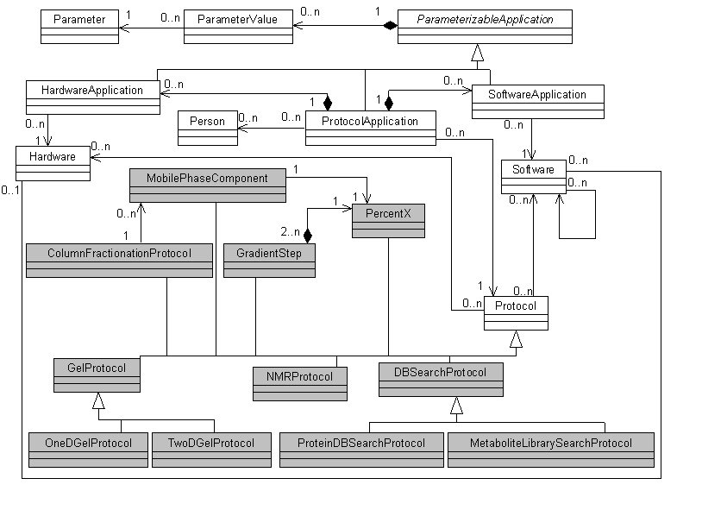
Protocol

Slide 24
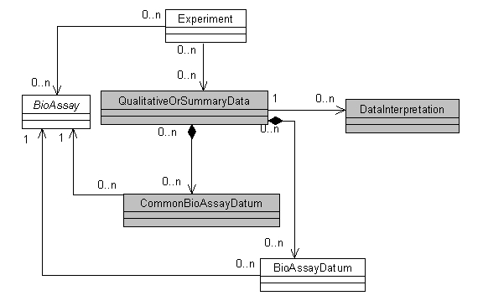
SummaryData

