Slide 1
PEDRo – Fitting data to the Model
Thomas McLaughlin
UMIST

Slide 2
What is PEDRo
Developed at Manchester in consultation with proteomics scientists worldwide towards developing a proteome repository
System to capture proteomics data from conception right through to results
        Sample Generation
        Processing
        Mass Spectrometry
        Results analysis

Slide 3
Proteomics experiment data
Sample generation:
  Origin of sample: hypothesis, organism, environment, preparation
Sample processing:
  Gels (1D/2D), columns, other methods
    images, gel details, spot coordinates
    stationary and mobile phases, flow rate, temperature, fraction details
Mass Spectrometry
  machine type, ion source, voltages
In Silico analysis
  peak lists, database, partial sequence, program, parameters, hits

Slide 4
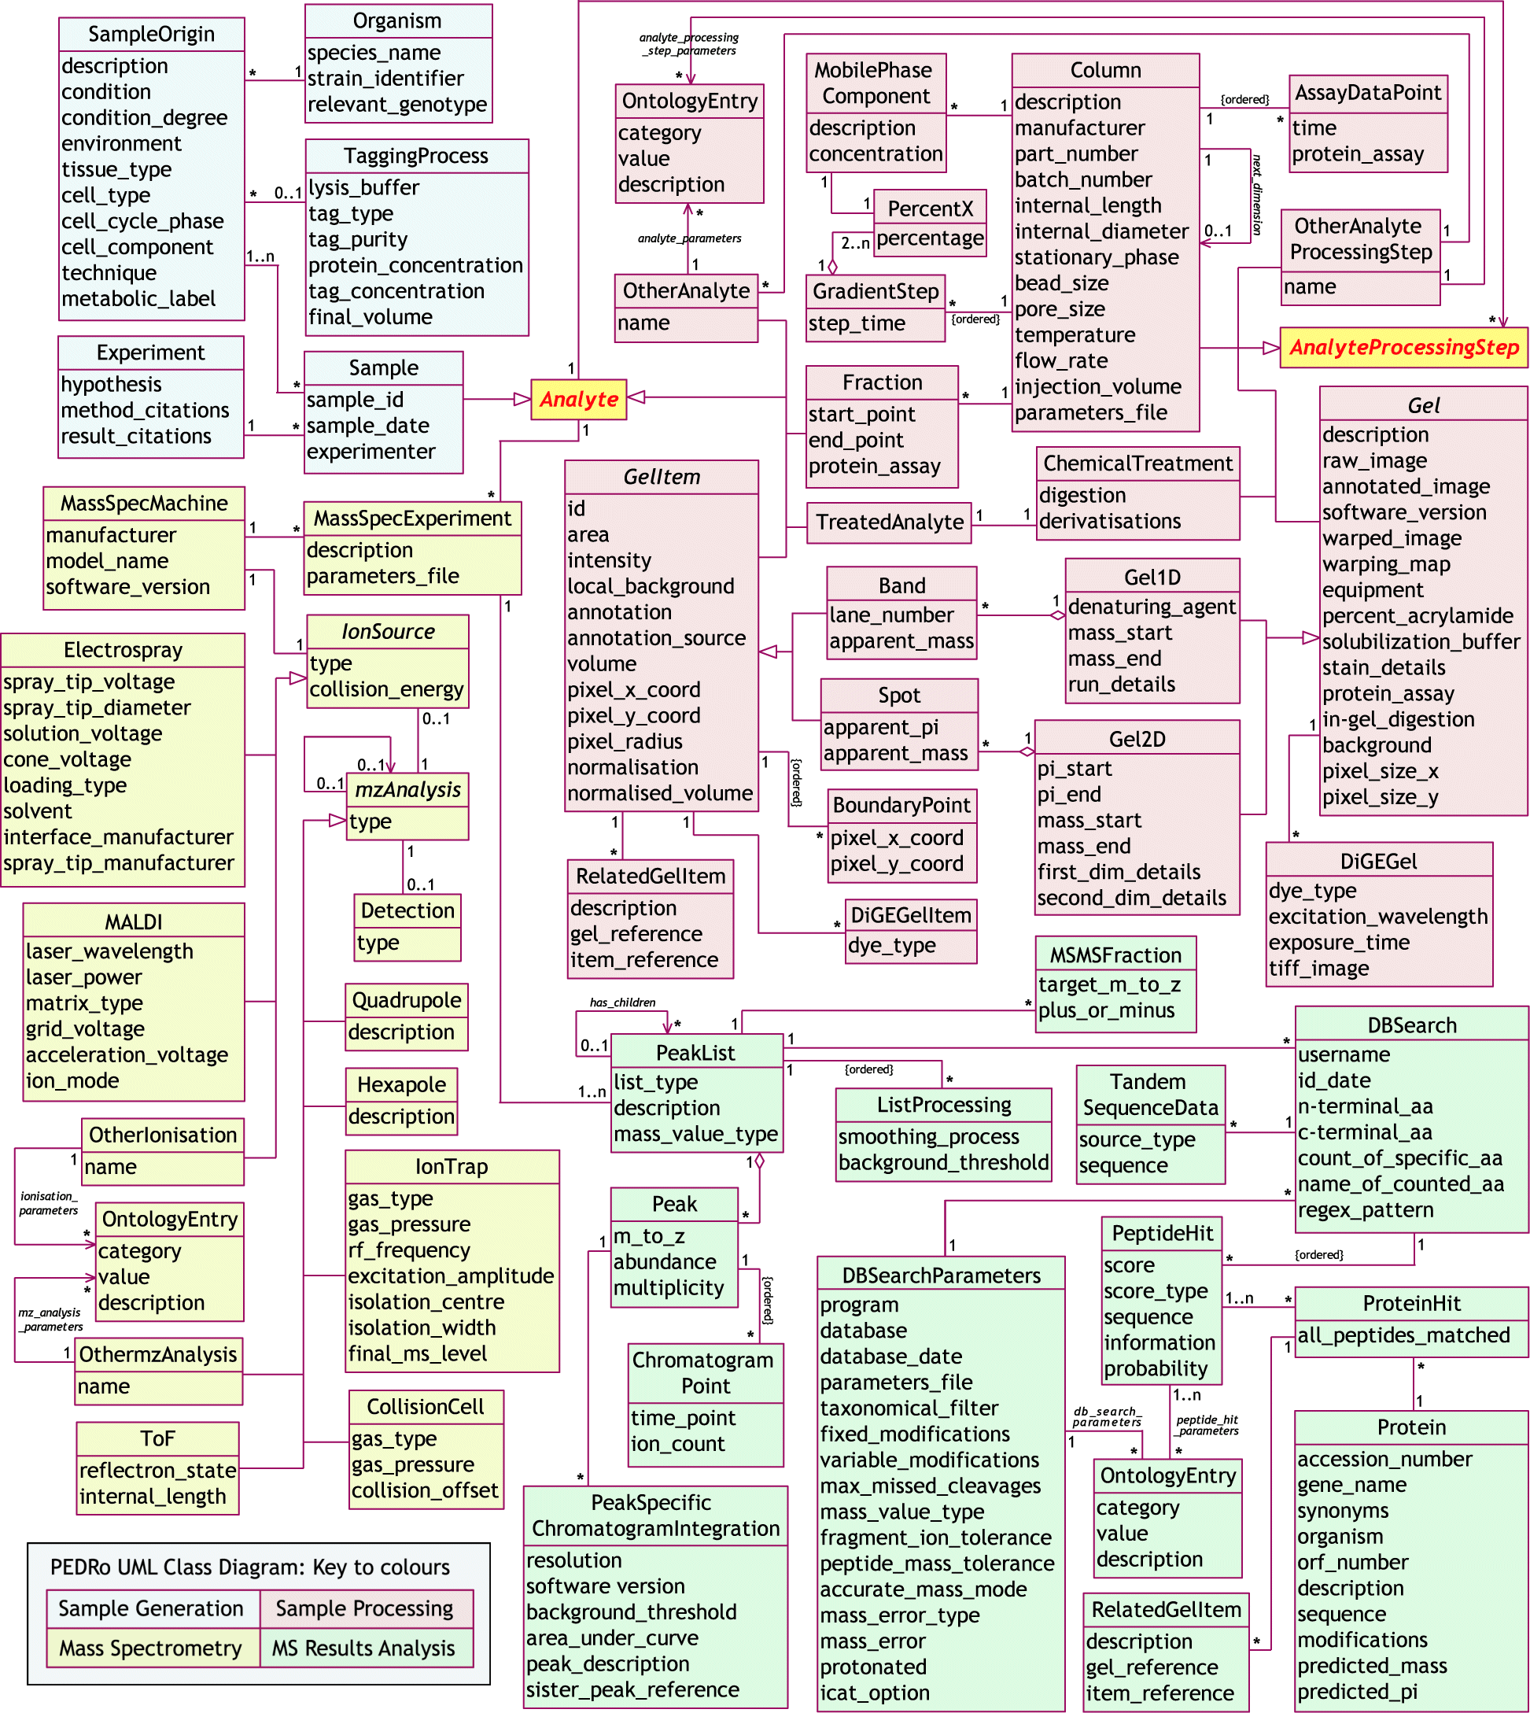

Slide 5
History
Developed under COGEME (Consortium for Genomics of Microbial Eukaryotes) funded by BBSRC.
Published in Nature Biotech after consultation with proteomics community.

Slide 6
PEDRo DB
Aims
    Disseminate data
    Validate model (does all data fit?)
    Capture enough data to
        Analyse and identify problems with data (ie. Which point a contamination occurs)
        Allow experiment to be accurately rerun with different instruments, software from a certain point.
        Validate results for publication.
        Emulate experiment and recreate results.

Slide 7
Our Aims
Populate model with diverse data from different groups.
Evaluate and identify kinks in model ie. where data does not fit correctly.
Export as XML to be added to XINDICE Database.
Identify areas where importers, parsers can be developed to facilitate easier interaction with users (interface).
Notes:
Impede operation as in a plan or system

Slide 8
Data currently in Database
Dataset | Sample | Separation | MS | Software | No.
LRF UMIST | Homo Sapiens | 2D Gel | MALDI-ToF | MASCOT PMF | 1
BMS UMIST | S. Cerevisiae | 2D Gel | MALDI-ToF | MASCOT PMF | 2
Chemistry UMIST | T. Brucie | 1D Gel | MALDI-ToF, LC MS/MS | MASCOT PMF MS/MS | 1
Cambridge | Arabidopsis | 2D Gel DIGE | LC MS/MS | MASCOT MS/MS | 1
Norwich | Streptomyces coelicolor | 2D Gel | MALDI-ToF | MASCOT PMF | 1
Aberdeen | Candida glabrata | 2D Gel | MALDI-ToF | MASCOT PMF | 2
Edinburgh | Mus | 2D Gel | MALDI-ToF | MASCOT PMF | 1

Slide 9
Model Issues
MS/MS Data is not modelled adequately
Required fields where data not always available
Import utilities need to be developed for large datasets such as MS/MS data as typing can be tedious and drawn out.
Different groups use different techniques therefore model does not always fit structure of data ie. Values for gels averaged from more than one.

Slide 10
Model Issues
Wrong type of data being captured ie. matched all peptides true or false, Taxonomy filter etc.
General interface issues
Units
Data required where none available
Annotation, need better defined/suited variables

Slide 11
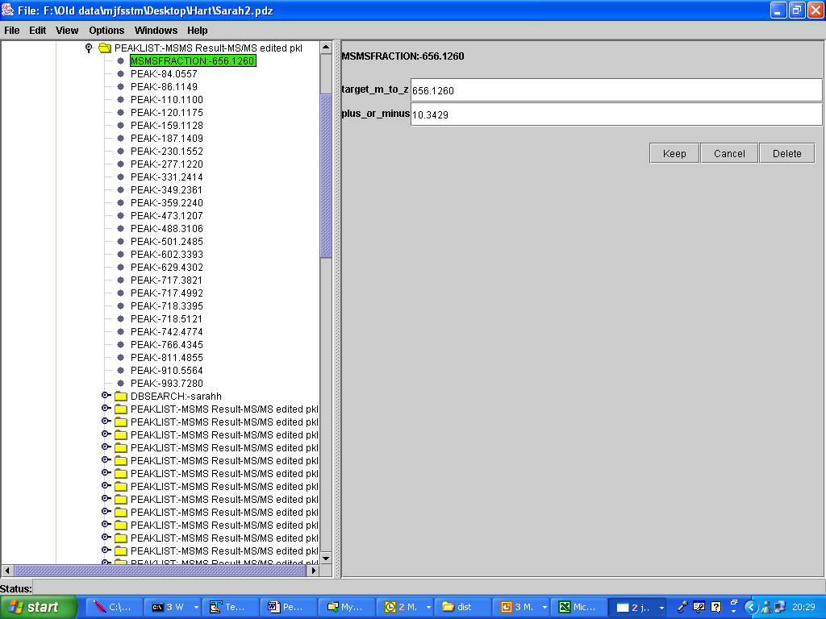
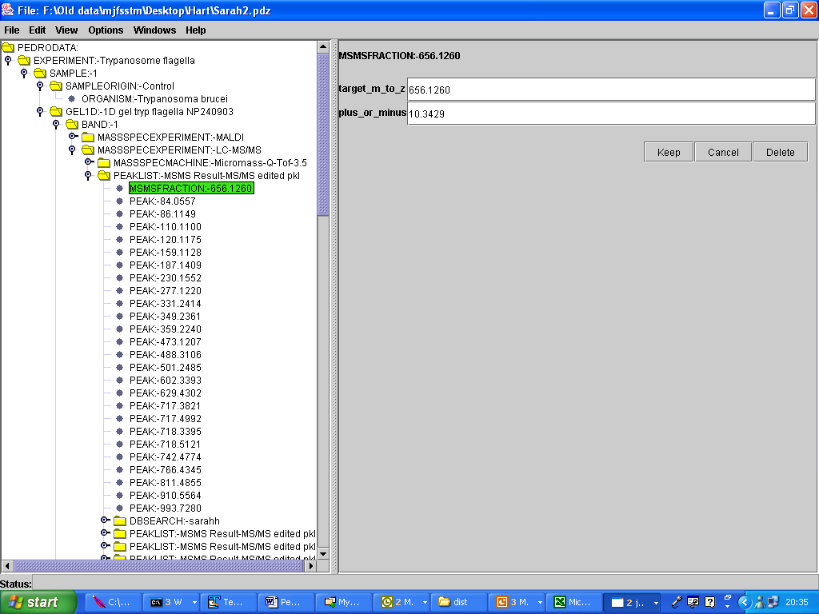
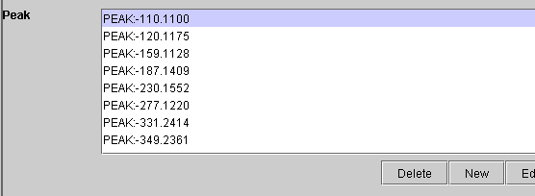
Notes:
Currently modelled as a single entity however each parent ion has numerous children how it should look

Slide 13
Lessons
Models cannot be created without input from all users
Diverse data from different groups facilitates evaluating the system
As in most cases problems are not found until each group applies their own data.
Systems have had to be created to electronically add data no-one wants to spend hours typing. Fortunately most instrument data types are easy to convert.

Slide 14
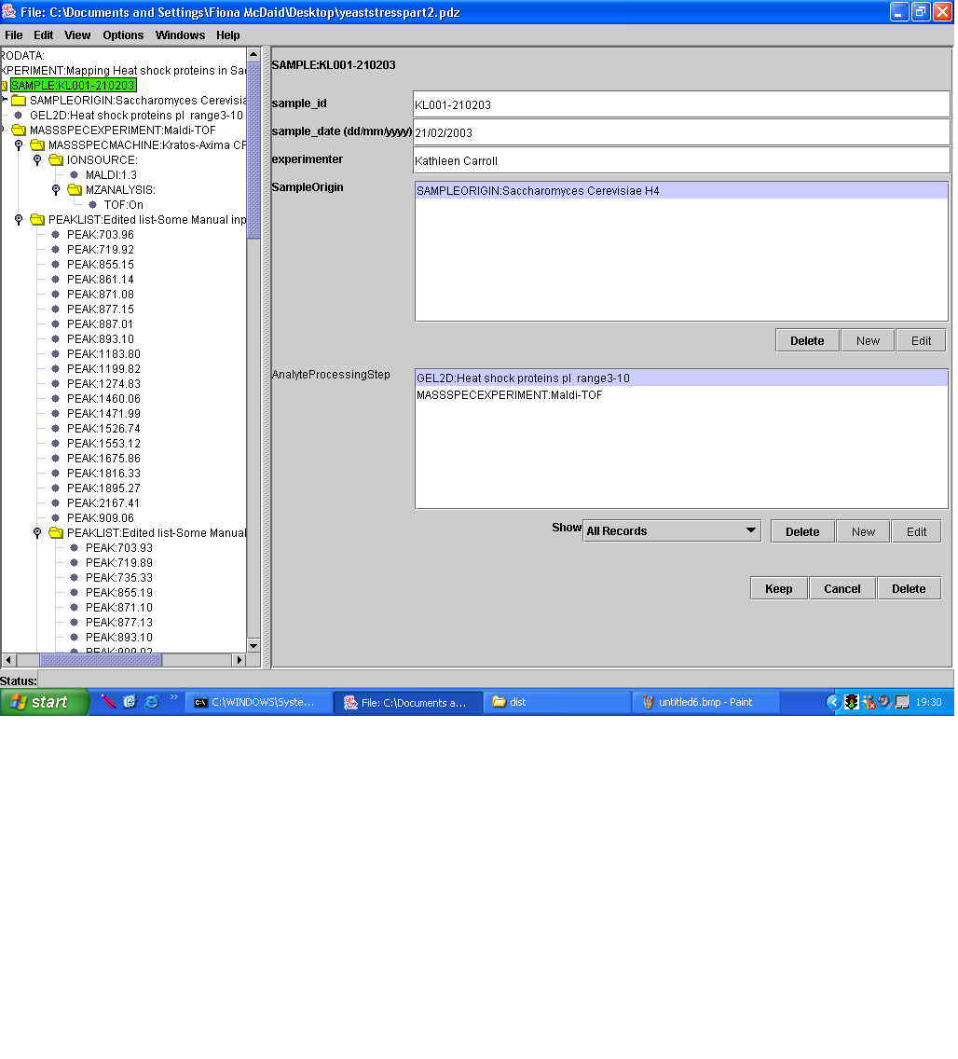
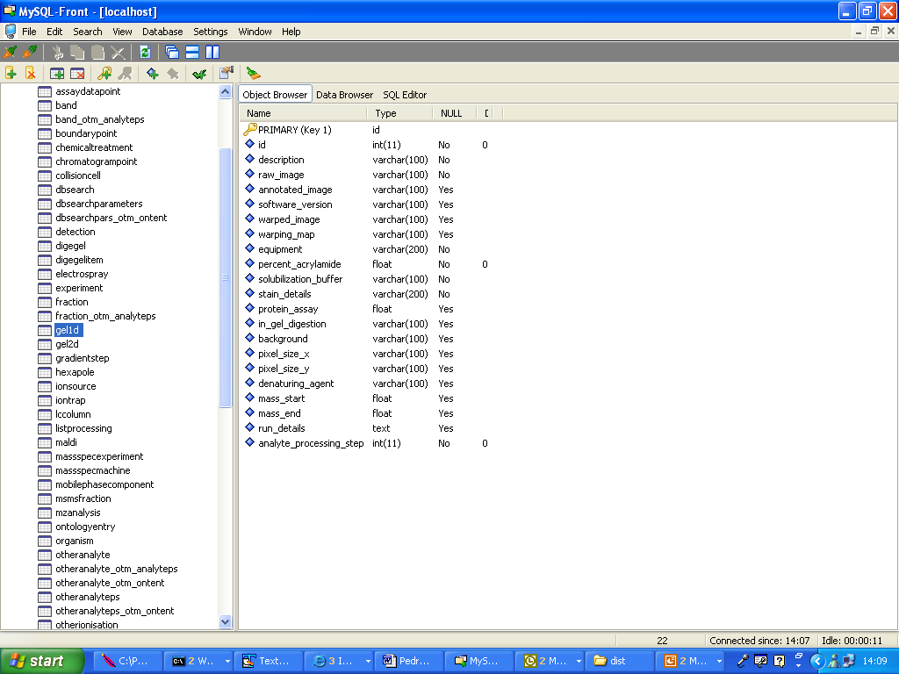

Where to Next
Pedro
Relational DB
<Sample>
<sample_id>D0117</sample_id>
<sample_date>2001-07-09</sample_date>
<experimenter>David Stead;Zhikang Yin</experimenter>
</Sample>
XML Data
XML Database
Notes:
Should generate interest from other researchers evaluating model

Slide 15
Where to next
MS companies ( software, machines) out-putting their data in XML format (less user data input)
XINDICE database and data-set goes live MAY 2004
Feedback from future groups to help evaluate and further develop model.
Software to export PEML to new model XML

Slide 16
Summary
Pedro has to be tweaked to model more difficult types of proteomics data
Some major changes need to be made to the model
Pedro models non-complex techniques quite well
A lot of the interface problems can be solved by changing the data-types stored in the database. A lot of user feedback related to problems with interface only accepting integers and not variables ie. Units of measurement in most cases this should not affect the DB.

Slide 17


Acknowledgements
Simon Hubbard
Norman Paton
Andy Brass
Chris Garwood
Kevin Garwood
Caroline Evans
Sarah Hart
Kathleen Carroll
Norman Morrison
Steve Oliver
Chris Taylor
Groups
Cambridge
Norwich
Aberdeen
Edinburgh

