Slide 1
MAGE: pitfalls & horrors
Ugis Sarkans
EBI

Slide 2
Outline
MAGE pitfalls
MAGE horrors

Slide 3
Outline
MAGE – very short introduction
Ambiguities
Complexity
Relevance for other domains
Object model & ontologies
Object model, XML etc
MAGE & OMG
MAGE & ArrayExpress
Some other considerations

Slide 4
How the information should be exchanged?
MAGE OM- MicroArray Gene Expression Object Model
  formal specification - UML (Unified Modeling Language) model
  described by a set of diagrams
  standardized through Object Management Group
    stability
  describes the domain of microarray data

Slide 5
UML Packages of MAGE
what was done
results
what was used
Experiment
HigherLevelAnalysis
BioMaterial
BioAssayData
BioAssay
Array
QuantitationType
ArrayDesign
miscellaneous
AuditAndSecurity
Measurement
DesignElement
Protocol
Description
BQS
BioSequence
BioEvent

Slide 6
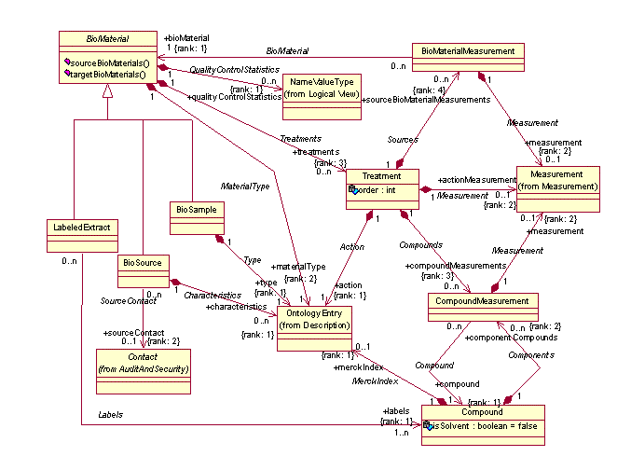
MAGE – an example diagram

Slide 7
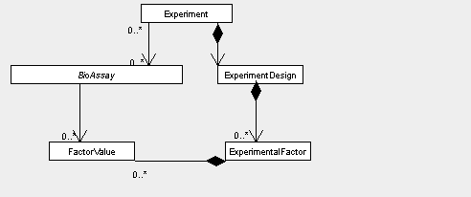
Experiment

Slide 8
BioAssayData
DesignElement
BioAssay
QuantitationType
Transformation

Slide 9
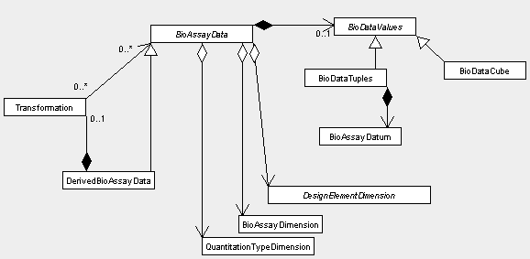
BioAssayData

Slide 10
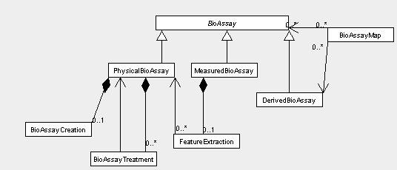
BioAssay

Slide 11
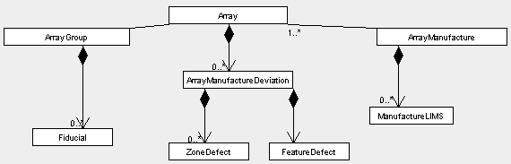
Array

Slide 12
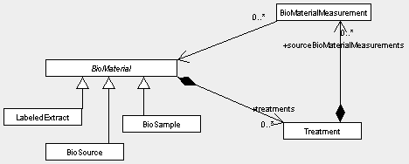
BioMaterial

Slide 13
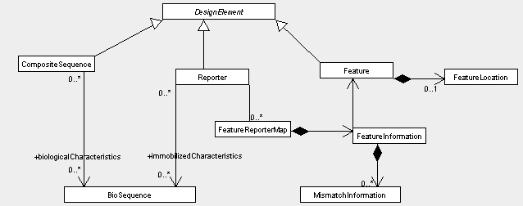
DesignElement

Slide 14
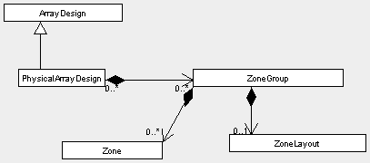
ArrayDesign

Slide 15
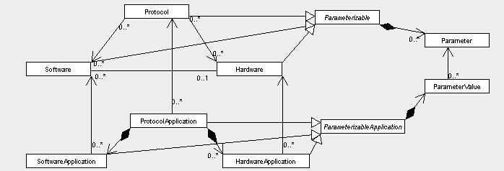
Protocol

Slide 16
MAGE-ML
MAGE-ML: MicroArray Gene Expression Markup Language
  automatically derived from MAGE-OM
<Experiment identifier="E-MANP-1">
<Descriptions_assnlist>
<Description text="HeLa cells grown to subconfluent density and CaCo-2 cells grown to high density were...."/>
</Descriptions_assnlist>
…..
<Providers_assnreflist>
<Person_ref identifier="PERS:m_muckenthaler"/>
…..
</Providers_assnreflist>
<BioAssays_assnreflist>
<PhysicalBioAssay_ref identifier="PBA:1"/>
……
<MeasuredBioAssay_ref identifier="MBA:1"/>
…...
</BioAssays_assnreflist>
<ExperimentDesign_assn>
<ExperimentDesign>
<Types_assnlist>
<OntologyEntry category="experimentdesign:type" value="treated vs. untreated"/>
</Types_assnlist>
<ExperimentalFactors_assnlist>
<ExperimentalFactor identifier="EF:compound" name="compound">
<FactorValues_assnlist>

Slide 17
XML tree example
MAGE-ML
AuditAndSecurity_pkg
Experiment_pkg
Contact_assnlist
Experiment_assnlist
Contact
Experiment
Provider_assnref
ExperimentDesign_assn
ExperimentDesign
Contact_ref

Slide 18
XML tree example
MAGE-ML
AuditAndSecurity_pkg
Experiment_pkg
Contact_assnlist
Experiment_assnlist
Contact
Experiment
Provider_assnref
ExperimentDesign_assn
ExperimentDesign
Contact_ref
identifier = URN:LSID:ebi.ac.uk:arrayexpress:….

Slide 19
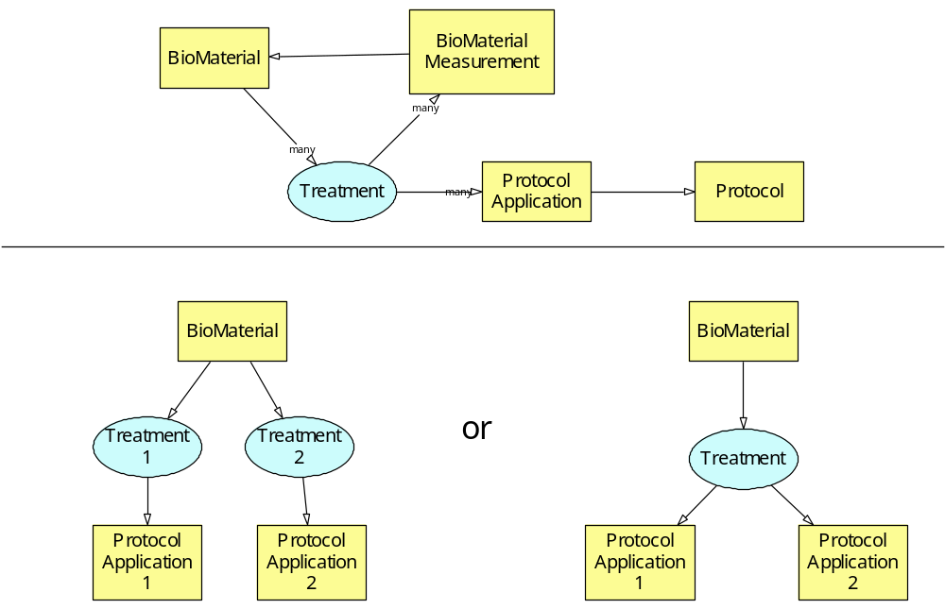
Ambiguities (1)

Slide 20
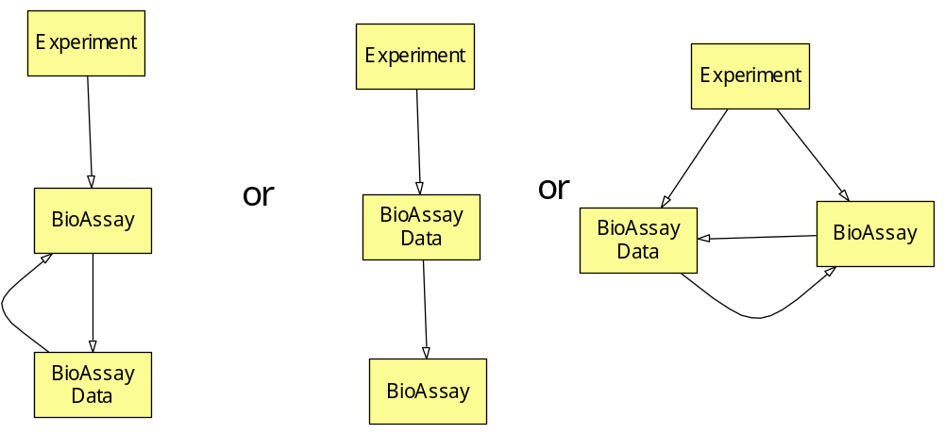
Ambiguities (2)

Slide 21
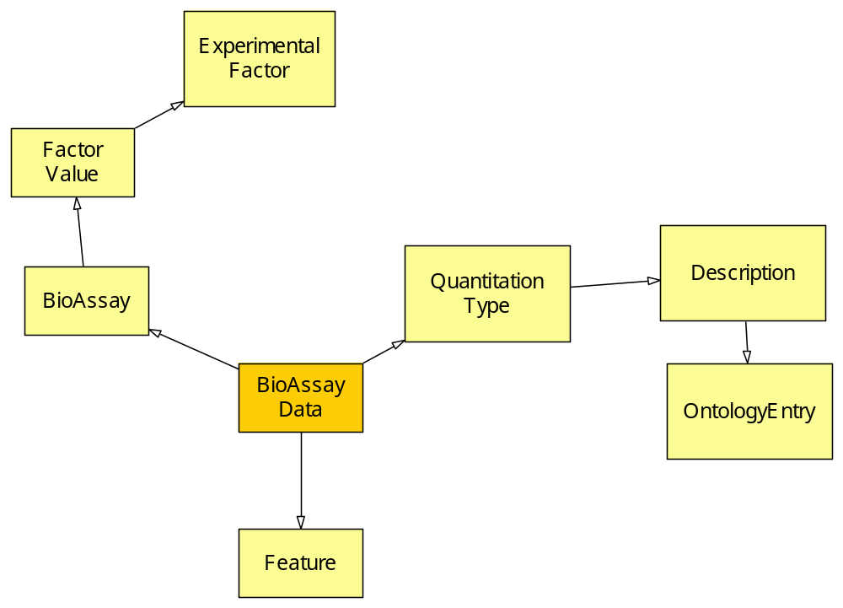
Complexity

Slide 22
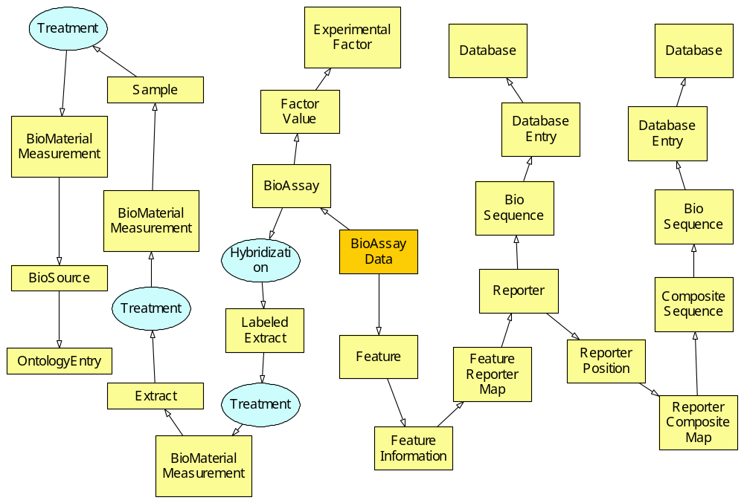
Complexity

Slide 23
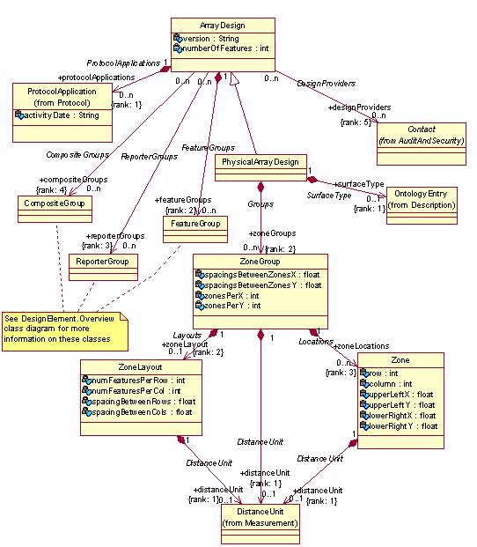
ArrayDesign Package

Slide 24
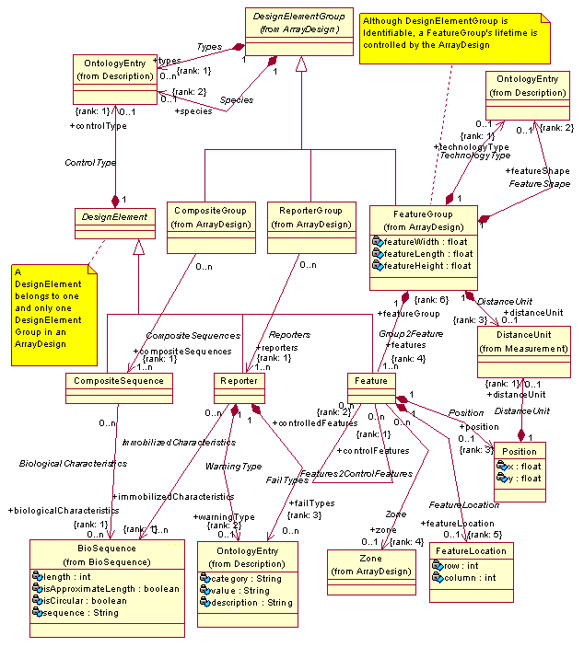
DesignElement Package

Slide 25
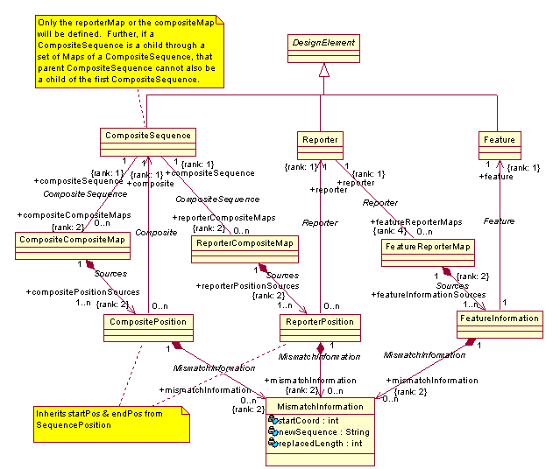
DesignElement (2)

Slide 26
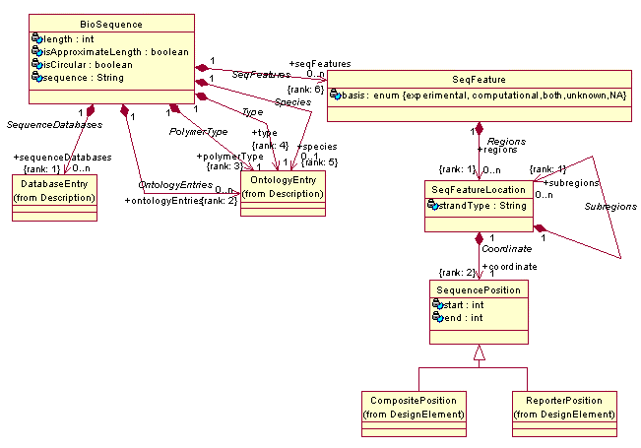
BioSequence Package

Slide 27
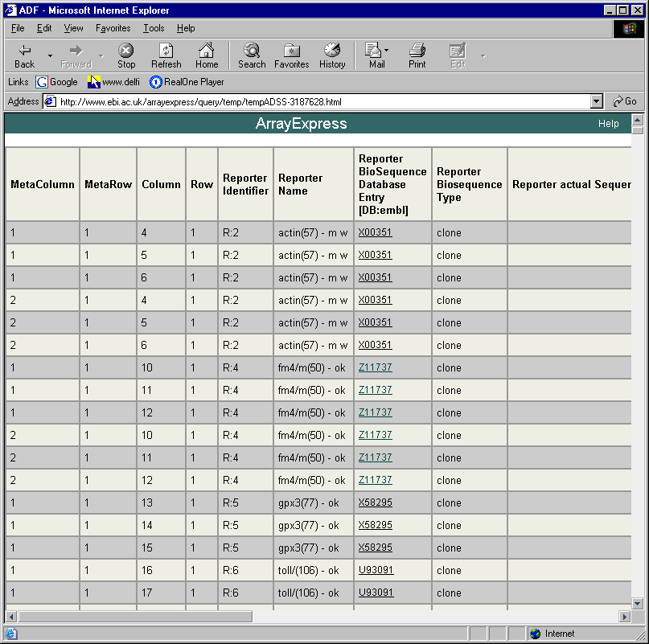
Array representation - ADF format

Slide 28
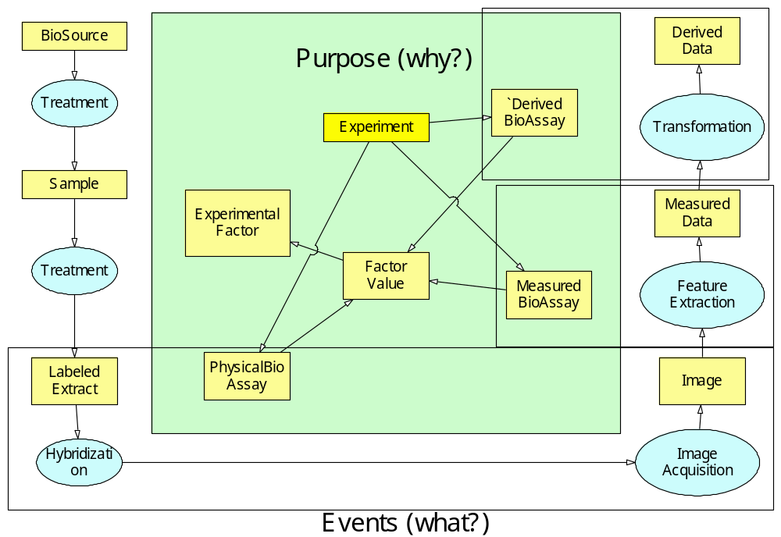

Slide 29
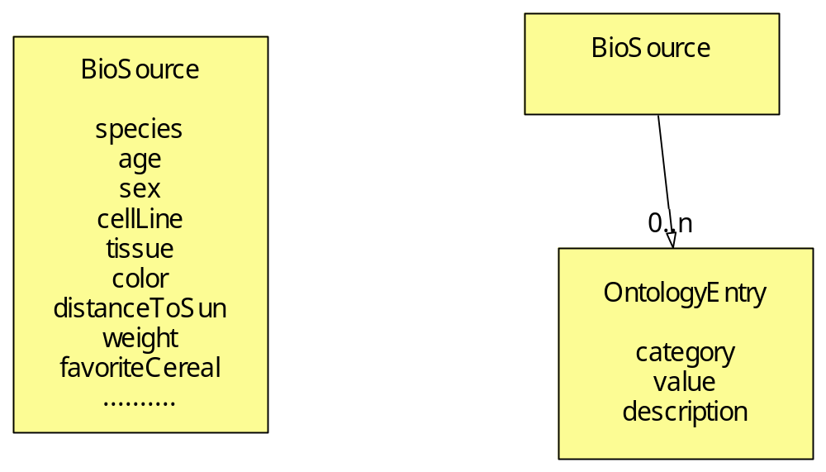
To ontologize or not to ontologize

Slide 30
Model vs. ontology
Model – stable; ontologies – flexible
Adding/modifying/deleting attributes – easy; adding/modifying/deleting associations – hard
Therefore: attributes and their types in ontologies, domain structure (classes + associations) in the model

Slide 31
Model and its derivatives
Model – conceptual or restricted
  how easy to serialize (XML)
  database size
    images
  query performance

Slide 32
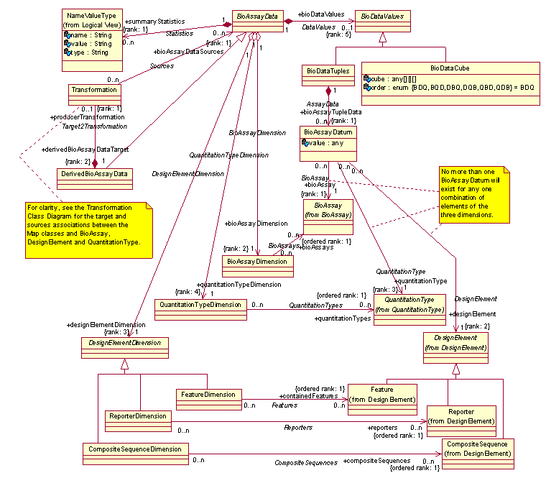
BioAssayData Package

Slide 33
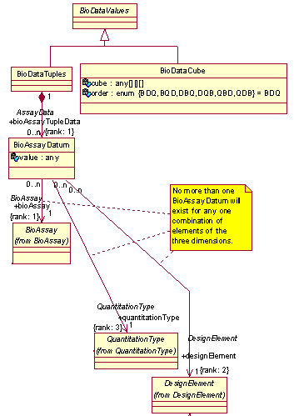
BioAssayData (4)

Slide 34
MAGE & OMG
Object Management Group
  sofware standards organization
provides framework for standards development
  (-) slows down development
  (+) sofware vendors are more likely to support a standard developed in a controlled manner
no “OMG gods” exist; standards created by the community
  Life Sciences domain task force

Slide 35
ArrayExpress Infrastructure
Submissions
EBI
Local MIAMExpress
Installations
www
MIAMExpress
(MySQL)
Array
Manufacturers
MAGE-ML
Queries
ArrayExpress
(Oracle)
Data
pipelines
www
MAGE-ML
LIMS
Data analysis
www
Data Analysis
software
Expression
Profiler
MAGE-ML import, export
Microarray
software
External
Bioinformatics
databases
Other
Microarray
databases

Slide 36
ArrayExpress architecture
Web page
template
Web page
template
MAGE-ML
(DTD)
Tomcat
MAGE-ML (doc)
Velocity
template
engine
MAGE-ML (doc)
MAGE-OM
MAGE-ML (doc)
Java servlets
MAGE
validator
MAGE
loader
MAGE
unloader
Castor
ArrayExpress
(Oracle)
object/
relational
mapping
error.log

Slide 37
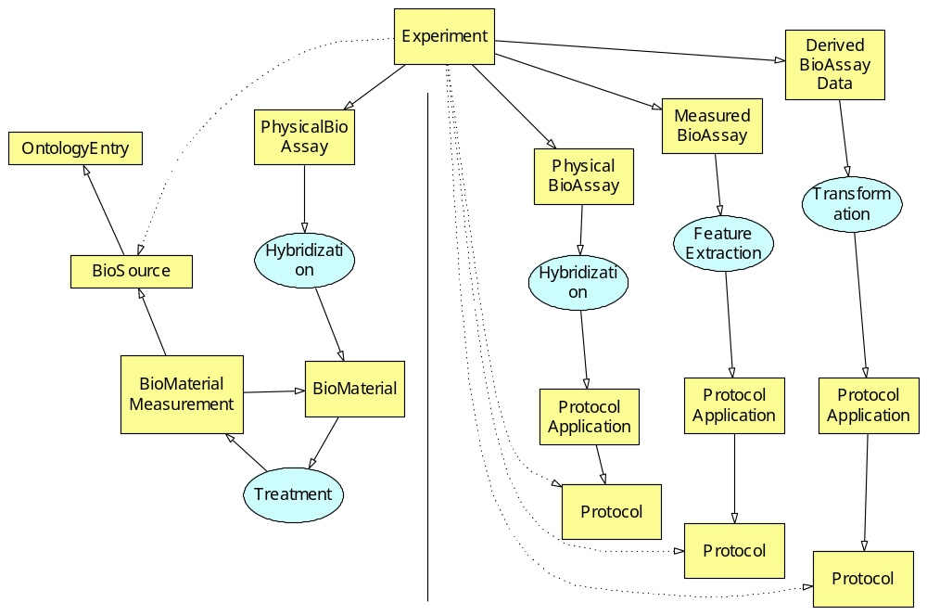
Model & database

Slide 38
Miscellaneous
Mandatory vs. optional constructs
  in MAGE almost everything is optional
  enables usage in various scenarious
  doesn’t guarantee MIAME compliance
Object models for didactic purposes

