Slide 1




MIAPE: The Minimum Information
About a Proteomics Experiment
Chris Taylor (EBI, UK); Kathryn Lilley (Uni. Cambridge, UK); Pierre-Alain Binz, Christine Hoogland (SIB, Switzerland)
http://psidev.sf.net/gps/

Slide 2
HUPO PSI — MIAPE
Proteomics experiments are now commonplace
  Proteomics techniques are practised ever more widely
  Often in high–throughput mode — vast quantities of data
But the amount of publicly available data is disappointing
  Sample extraction and processing usually undocumented
  Analytical methods employed in deriving conclusions absent
  No widely used databases of (for example) mass spectral data
The Proteomics Standards Initiative generates:
  Data format standards
  Standard definitions
    Controlled vocabularies / ontologies
    Minimum reporting requirements (MIAPE)

Slide 3
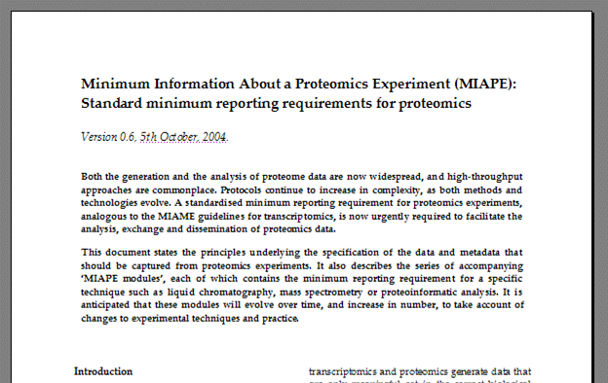
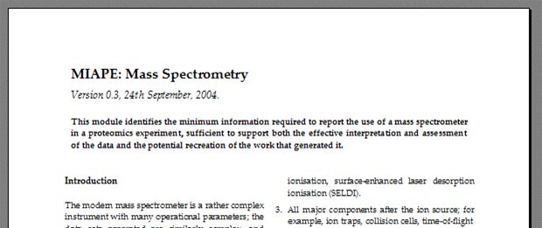
Minimum Reporting Requirement
MIAPE
  Minimum Information About a Proteomics Experiment
  Requirement to be enforced by journals, repositories, funders
  Technology-specific modules associated with a parent document
    Users should assemble the relevant modules into a bespoke reporting requirement for their particular workflow

Slide 4
Minimum Reporting Requirement
The MIAPE ‘parent document’— underlying principles:
1. Sufficiency
  Unambiguous description of the experimental context
  Allow understanding of the results and their interpretation
  Sufficient to permit a critical evaluation of same
  In principle allow recreation of the work
2. Practicability
  Achieving MIAPE compliance should not be so burdensome as to prohibit the widespread use of the guidelines
The MIAPE ‘modules’ — technology-specific guidelines
  One module per technology (e.g. mass spectrometry)
  Each module (to be) validated by an ad hoc expert committee
  Users assemble modules into a bespoke reporting requirement

Slide 5
Module Development Process
Stage One: Requirements gathering
  Extensive interactions with the community
  Consideration of several (informal) use cases
  Internal generation of first draft of guidelines
Stage Two: Committee review
  Build an invited panel of leaders in the particular technique
  Send draft for ‘review’ by experts on an individual basis
  Final round of discussion by panel on email list
Stage Three: Controlled release
  Make the module publicly available
  Recommend to organised groups and proactive individuals
    e.g. http://www.abrf.org/
  Provide mechanisms to gather feedback
Stage Four: Enforcement
  Offer the module to journals, repositories and funders for review, with a view to their enforcing it (either to get published, or to get money)

Slide 6
The MIAPE Modules (1)
1. Study design and sample generation
  Administrative details pertaining to the gestalt
    e.g. the list of modules used, date of file completion etc.
  Experimental motivation
  Factors of interest
  Numbers of replicates
  Relation to other studies
  Origin and ‘preprocessing’ of biological material
2. Prefractionation and sample treatment
  Use of various techniques to fractionate or deplete a sample
  Preparation of a sample for further separation or analysis
    for example, to analyse in a mass spectrometer
3. Liquid chromatography
  The use of columns, of all scales and flow rates

Slide 7
The MIAPE Modules (2)
4. Gel electrophoresis
  The use of gel-based electrophoretic separation techniques
    single- or multi-dimensional, native or denaturing
  Gel image acquisition
  Electroblotting
5. Proteoinformatics for gel electrophoresis
  The use of software tools to process and analyse images of gels
    for example, to identify spots, measure relative intensities, or warp images to align them
6. Mass spectrometry
  The use of a mass spectrometer
  The generation of peak lists from raw data
  Quantitation based on the use of an isotopic or chemical label
    the application of that label is a ‘sample treatment’ though, and is therefore captured elsewhere

Slide 8
The MIAPE Modules (3)
7. Proteoinformatics for mass spectrometry
  The use of processing engines to analyse MS data; includes
    The use of search engines that assign peptides, proteins or biological class membership to spectra
    The matching of those peptides or proteins, or de novo sequence, against protein sequences from a database
    The use of quality control measures (e.g. evaluation of the significance of the processed results)
There are some significant absences from the above list…
  Protein arrays (‘chips’), both protein—ligand and antibody-based
  Methods used to investigate naturally-occurring protein-protein and other protein-ligand (e.g. small molecule) interactions
    TAP tagging, yeast two-hybrid experiments, arrays (again)
    Note though that ‘far-Western’ (native) electroblotting is included in the ‘Gel electrophoresis’ module

Slide 9
Legacy Data…
MIAPE requires detailed annotation to be supplied in all cases
  The problem of legacy, or ‘pre-guidelines’ data is significant
  Poor annotation does not mean poor data (although of course the quality of the work will be more difficult to establish)
What to do with such legacy data (e.g. for database submission)?
  Reannotate the data set, with reference to the appropriate MIAPE modules, to the fullest extent possible
  Flag the data set as ‘legacy’ and attach a summary of where the reporting requirements have not been met
One major caveat:
  Data and metadata should never be ‘created’
    Even the simple interrelating of the parts of a data set can be hazardous (cf. the interrelationships of different MS scans)
  The only allowable additions are those that serve to indicate the absence of real data (e.g. the use of ‘null’ or ‘unavailable’).

Slide 10
MIAPE: Conclusions
The MIAPE minimum reporting requirement
  Establish provenance and relevance of a data set
  Sophisticated search and analysis becomes possible
    e.g. exclude data generated by a particular technique
  Extraction of maximum value from MIAPE-compliant data sets
  Specific modules for mass spec and search engines
  First tranche of modules completed by Spring ‘05
Progress in gaining acceptance
  Positive response from UK-based funders and government
    ‘Recommend’ for now, enforce in the future
  Interest expressed by the National Institutes of Health (USA)
  Strong support from the major journals in the field
    MIAPE will be factored into the process of developing common ‘quality’ guidelines

Slide 11



Acknowledgements (lots of them!)
Many people have contributed their expertise, at many meetings, notably at the various HUPO Proteomics Standards Initiative meetings (’02—’04).
Other notable contributions came from:
Weimin Zhu, Kai Runte, Henning Hermjakob, Rolf Apweiler (EBI, UK);
Randall Julian (Eli Lilly, ASTM, ASMS), Kathryn Lilley (Cambridge)
Pierre-Alain Binz, Christine Hoogland (SIB, Switzerland)
Andy Brass, Steve Oliver, Norman Paton, Simon Hubbard and group, Simon Gaskell and group (Manchester, UK); Kath Lilley’s group (Cambridge, UK); Ruedi Aebersold and group (ISB Seattle, USA); Al Brown and group (Aberdeen, UK); many other academic groups
Bruker Daltonic; Matrix Science; Kratos Analytical; GE Healthcare (Thermo, Amersham); Applied Biosystems; Nonlinear Dynamics; Agilent Technologies; Waters Corp.; MDS Sciex; IBM and many more
NERC, BBSRC, NIH; HUPO P/L/BPP; Journals such as Proteomics, Molecular and Cellular Proteomics, Journal of Proteome Research, Nature Biotech…

