Slide 1
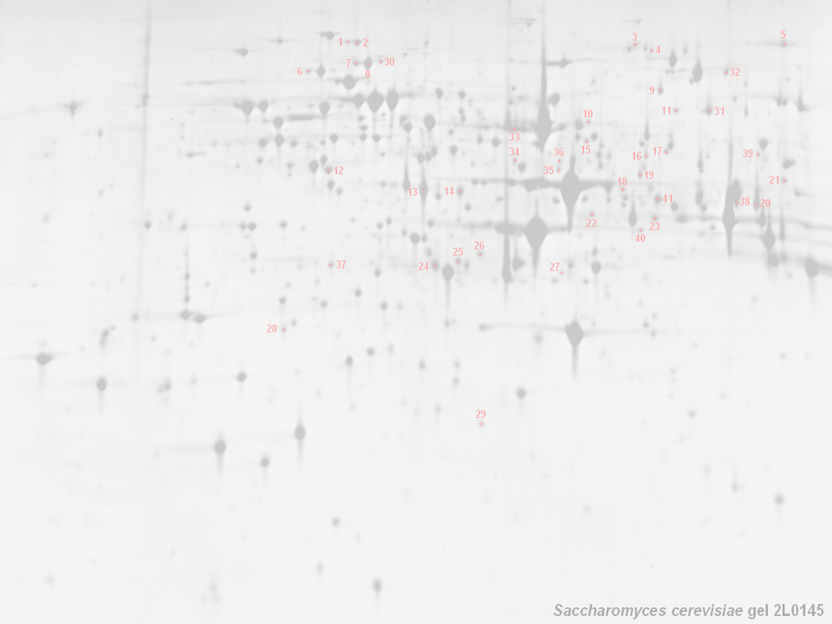



The HUPO PSI General Proteomics Standards Workgroup (PSI: GPS)
Chris Taylor, Weimin Zhu, Phillip Jones, Henning Hermjakob,
Rolf Apweler (EBI, UK); Kathryn Lilley (Uni. Cambridge, UK);
Randall K Julian (Eli Lilly Corp); Pierre-Alain Binz (SIB, Switzerland); Norman Paton (Uni. Manchester, UK); Kai Runte (Uni. Bielefeld, Ger)
http://psidev.sf.net/gps/

Slide 2
HUPO PSI: GPS — Background
HUPO PSI: GPS — General Proteomics Standards
The generation and analysis of proteome data are widespread
  High–throughput approaches are commonplace (if troublesome)
  Techniques continue to increase in complexity (DiGE, iTRAQ, SPR)
Publicly available proteomics data is rather limited
  Sample extraction and preparation usually undocumented
  Analytical methods employed in deriving conclusions absent
  No widely used databases of (for example) mass spectral data
A robust, standard representation of both methods and data from proteomics experiments is required
  Will facilitate handling, exchange and dissemination of data
    development of effective search/analysis tools
    derivation of maximum value from data sets

Slide 3
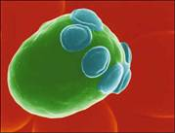
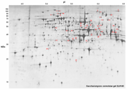

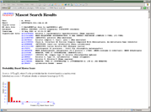
GPS — The Scope of our Remit
Sample generation
  Origin of sample
    hypothesis, organism, environment, preparation, paper citations
Sample processing, gel informatics
  Gels (1D/2D), columns, ‘chips’, other methods
    images, gel type and ranges, band/spot coordinates, quantitation
    stationary and mobile phases, flow rate, temperature, fraction details
Mass Spectrometry → ‘mzData’
    machine type, ion source, voltages
Mass Spectrometry Informatics
    peak lists, database name + version, partial sequence, search parameters, search hits, accession numbers, quantitation

Slide 4
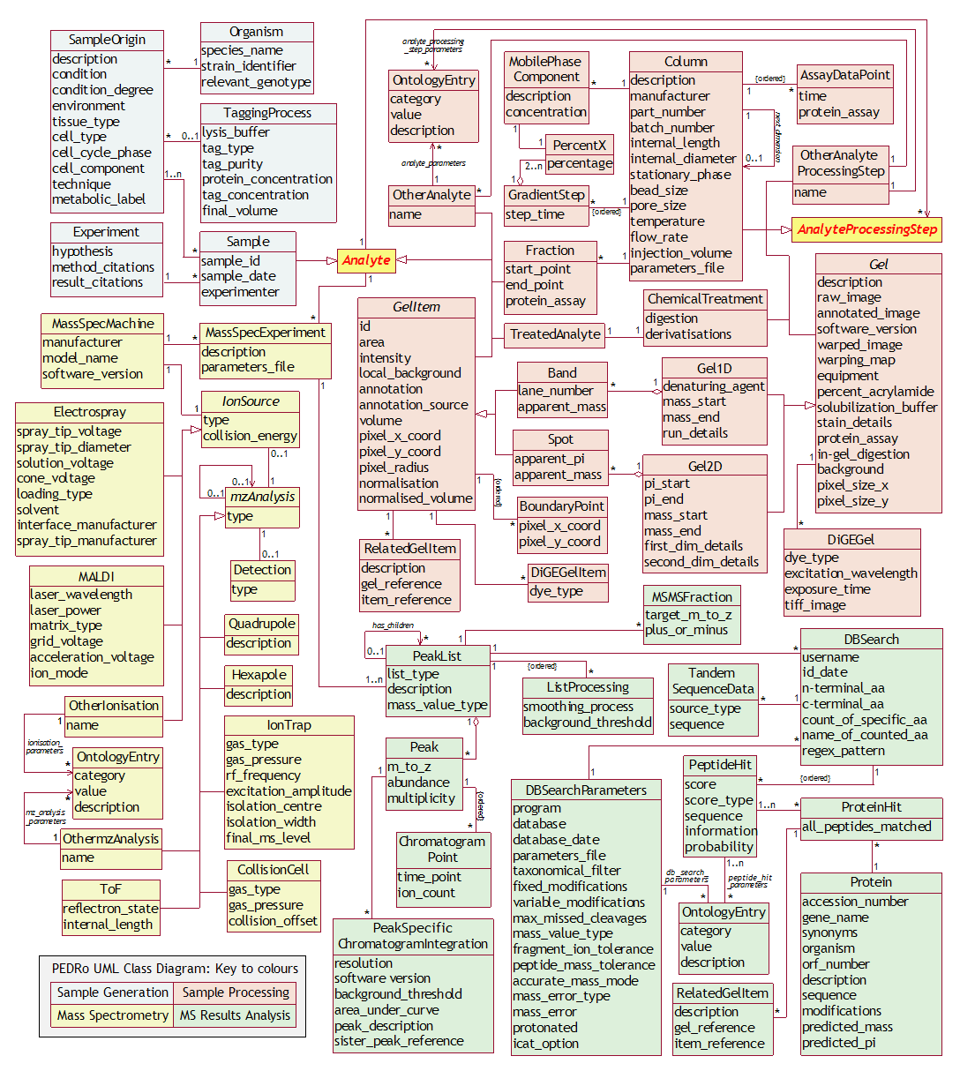
GPS — More Background
The PEDRo Model:
Developed at Manchester University, in collaboration with the PSI and the EBI
A ‘proof of concept’ model that covered most of the workflows currently found
in proteomics experiments
Intended as a ‘straw man’
to stimulate discussion of the scope and depth that would be required to adequately represent a proteomics experiment

Slide 5
PEDRo → HUPO PSI Standards
PEDRo
HUPO PSI (Oct ‘02, Jan ’03, July ’03, April ’04)
Manufacturers output formats + mzData model
Compatibility with search engines and tools
Consultation with domain experts and MGED
MIAPE
Public meetings to generate
maximum feedback
Publication in print and via
the web, to reach the widest
possible audience
PSI Ontology
PSI-OM
PSI-ML (+ PSI-DB),
mzData, mzIdent

Slide 6
GPS — Where Are We Going?
MIAPE
  Minimum Information About a Proteomics Experiment
  Requirement to be enforced by journals, repositories, funders
  Technology-specific modules associated with a parent document
XML formats for data exchange
  Markup language (PSI-ML) designed for data exchange, submission
  mzData in a mature state — mzIdent under development now
  All based on the GPS proteomics workflow model, PSI-OM
Ontology work (“depends on what your definition of ‘is’ is…”)
  Crucial for the construction of unambiguously worded data files
  GPS will ultimately contribute terms to the MGED ontology (extended)
Other activities
  Document examining the comparability of search engine metrics
  Study on what constitutes a ‘good’ peptide/protein identification
  Both of these (plus MIAPE) will underpin the journals’ nascent quality guidelines (ref. Molecular and Cellular Proteomics; Carr et al.)

Slide 7
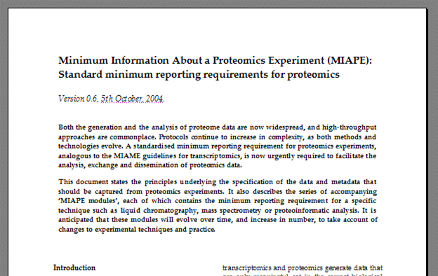
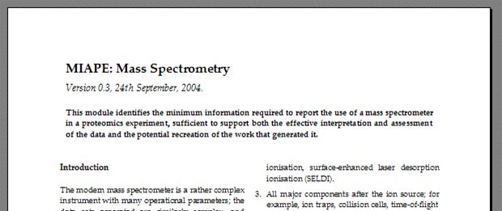
Minimum Reporting Requirement
MIAPE (covered in detail in the next talk…)
  Minimum Information About a Proteomics Experiment
  Requirement to be enforced by journals, repositories, funders
  Technology-specific modules associated with a parent document
    Users should assemble the relevant modules into a bespoke reporting requirement for their particular workflow

Slide 8
Fast Track: mzData, mzIdent
mzData (final release during this conference) —
  Covers use of a mass spectrometer and data generated
    Standard format
    Eliminate costs of incompatibilities
    Facilitate data exchange and analysis
    Strong vendor support — implementations by Bruker, Kratos (a Shimadzu subsidiary), Matrix Science (demos in parallel session)
mzIdent (mature by Spring ’05 PSI meeting) —
  Covers use of (peak list) search engines and the results
    A way to unify different search engine results
    Facilitate cross-comparisons (PSI and the major journals are working towards the production of common guidelines for comparing results)
Supporting controlled vocabulary (viable by January) —
  Crucial to support these two formats (and the rest of the PSI-ML)
    Development ongoing (in OWL); much to do…
    Rolling process of expansion

Slide 9
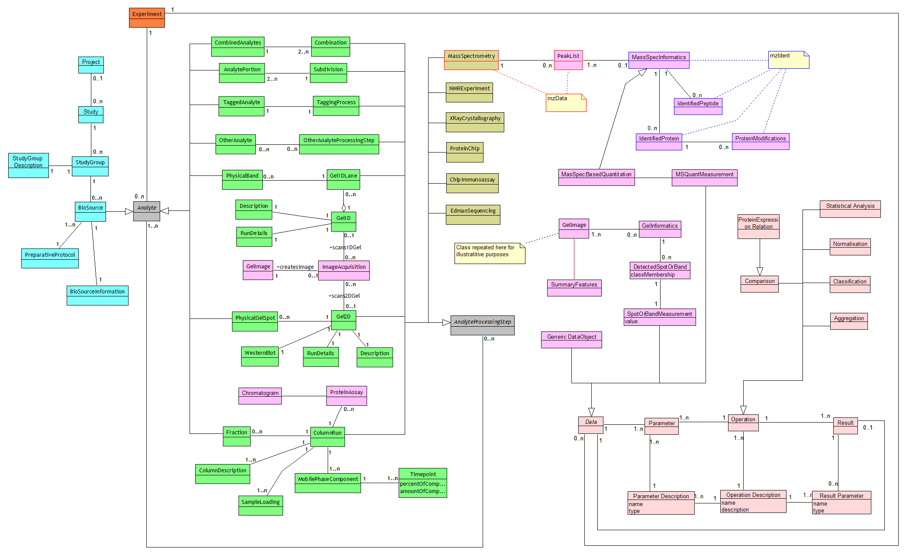
The PSI Object Model (1)
Abstract model of proteomics experimentation
  Implementation independent; neither hierarchical nor relational
  Standard XML implementation ongoing; reference-only RDB to follow
  Both OM and ML expected to be mature by the Spring ‘05 PSI meeting

Slide 10
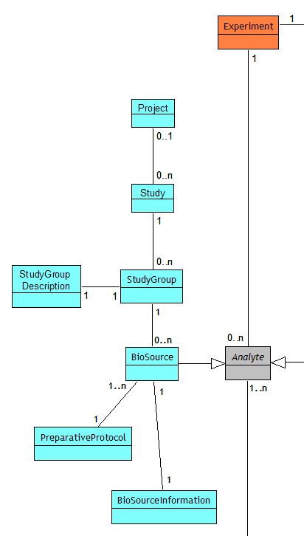
The PSI Object Model (2)
Project description and sample generation
  Experiment. The common 'handle' to which experimental work, analyses of data sets
  (see later slide), or both can be attached
  Project. Description of the overall framework of which this work is a part (e.g. liver, brain studies; may indicate work in other ‘omes)…
  Study. …the actual liver study itself
  StudyGroup. An homogenous grouping of subjects delineated by factors of interest, as described in Study Description
  Biosource. The material used in the study
  Biosource Information. Description of the individual biosource used (e.g. person ‘X’ is a non-smoking, 40 year old female)
  Preparative protocol. How the initial sample (Biosource = Analyte) was generated

Slide 11
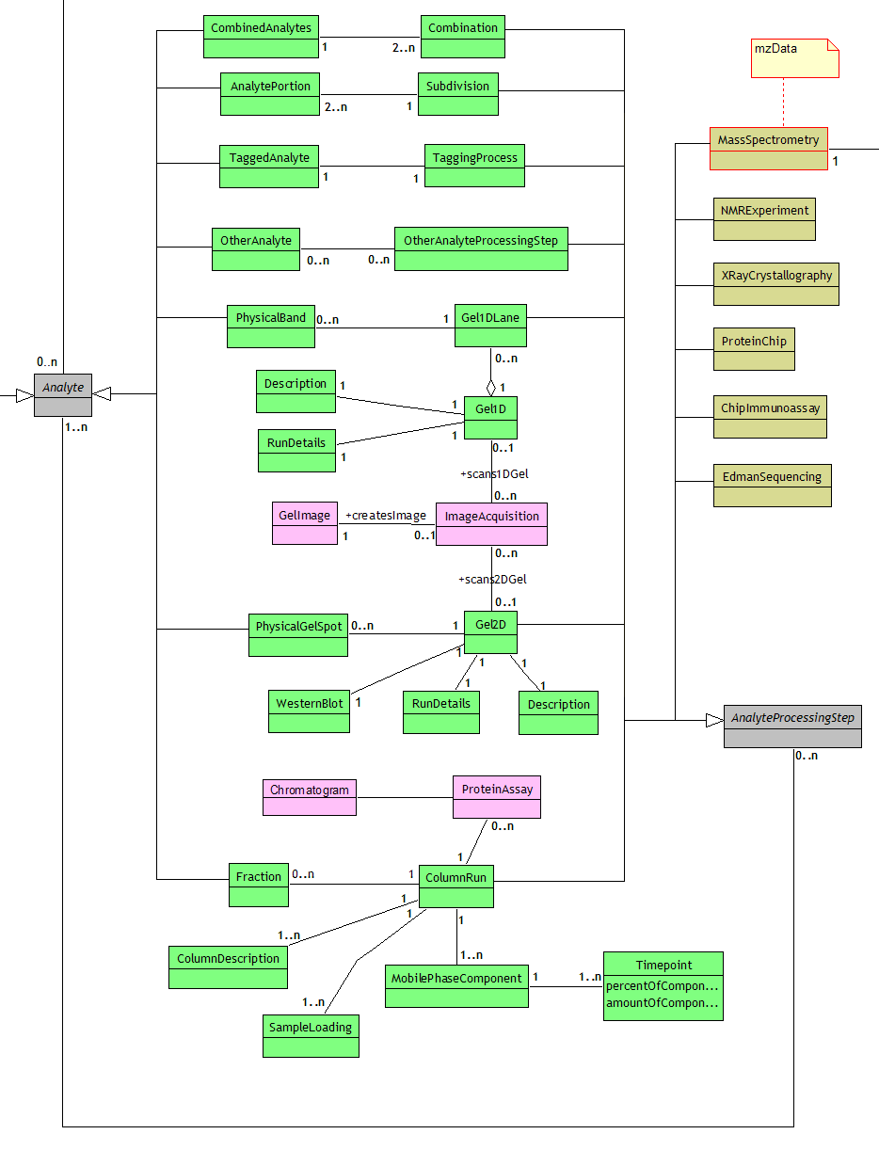
The PSI Object Model (3)
The analyte processing cycle:
  Can iterate from an Analyte (either the Biosource or the result of a previous ‘cycle’) through an AnalyteProcessing Step as many times as required
  Various analytical methods are represented (gels, columns etc.) plus sample manipulations (e.g. combination or ‘tagging’)
  Non-destructive techniques are in green, techniques destructive of the sample are in brown
  Purple represents the data generated by a technique
  mzData classes indicated by red outline — both mzData and mzIdent are fully integrated

Slide 12
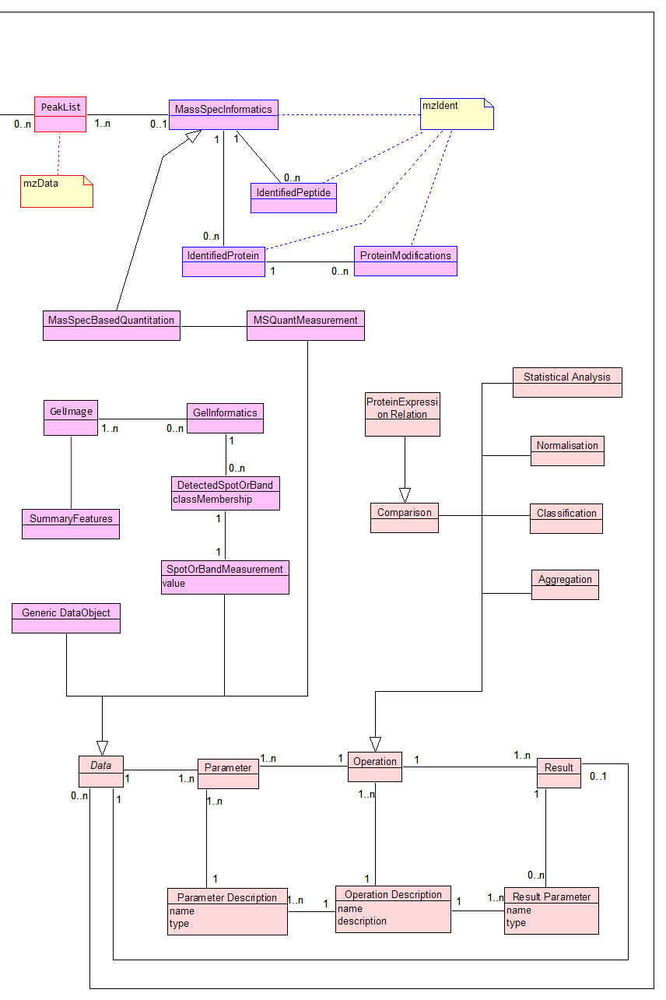
The PSI Object Model (4)
Data processing and further analysis
  Purple classes represent data from mass spectrometry (above) and gel image analysis (below); includes quantitation of proteins in both
  Pink classes represent generic statistical analyses of the data such as normalisation, comparison, generation of descriptive statistics and so on
  Bottom seven pink classes are completely generic and can capture any analysis process by defining parameters, operations on those parameters (including data) and the results from (each part of) the operation; this could be as simple as a summation, or as complex as a run of Mascot/SeQuest
  Data analyses kept separate to methods (Data is linked directly to Experiment), allowing reanalyses of existing data sets to be captured in PSI-ML

Slide 13
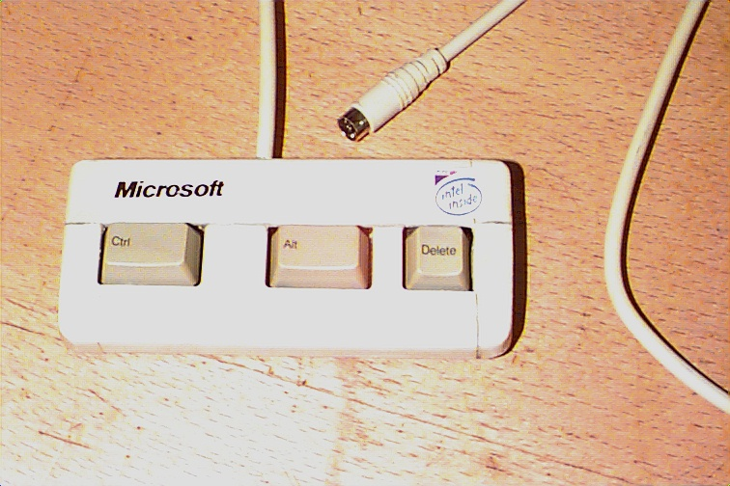


Ontologies, ontologies, ontologies…
1. Inaccessible
2. Multifarious
3. “Just right”
User-friendly ontology-aware data entry tools are extremely rare
  — The PSI will seek to encourage the development of such tools…

Slide 14
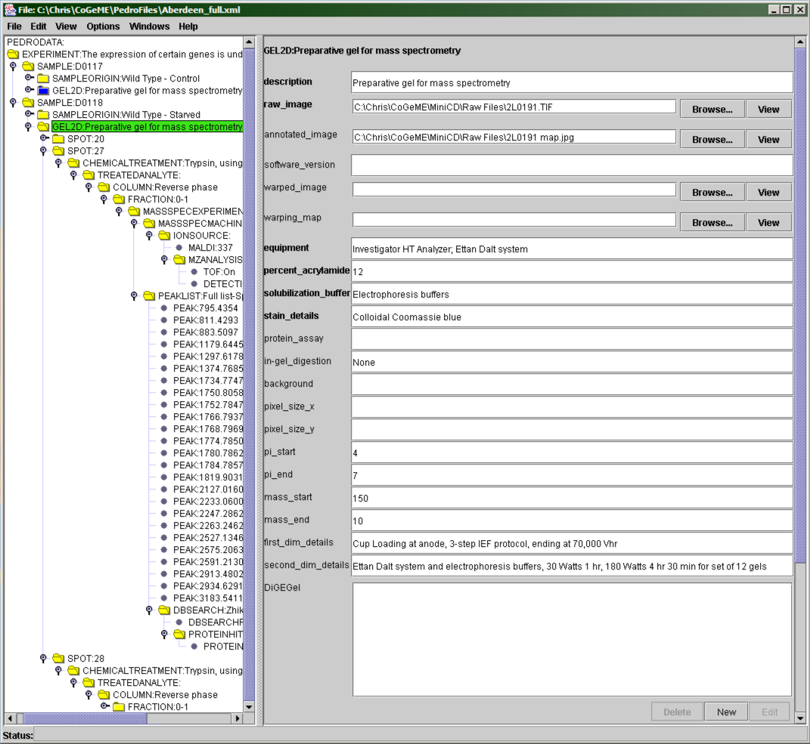
The Pedro Data Entry Tool
Generates forms for data entry directly from an XML Schema
Straightforward file validation (using rules from the schema)
The ontology support is strong in this one — Pedro can suggest terms from multiple ontologies with an ‘auto-complete’
as the user types
Many other features; and even more under development, or on the request list
http://pedrodownload.man.ac.uk

Slide 15
GPS — How Do We Get There?
Web site — http://psidev.sourceforge.net/gps/
    A web site will be maintained offering all versions of project files, plus documents and presentations
Email list
    Used to make announcements and discuss issues
    Details on how to join available on the website
Meetings
  Formal meetings
    PSI Spring meetings; full HUPO gatherings
  Informal meetings
    Ad hoc basis; details of all meetings (agendas before, minutes after) will be posted on the web.
  Expert committees
    Formed as required to advance or validate projects such as the individual MIAPE modules

Slide 16
The Functional Genomics Future
Functional genomics is the “One ′omics to rule them all”
  Affects ontology, file format, reporting requirements
Core biological description should be shared
  Study design and sample generation
  Requires extensive community liaison (see below)
  Heavy impact on the content of the relevant MIAPE module…
‘Add-on Modules’ (for data format and ontology terms)
  Proteomics (PSI); fairly well covered here…
  Transcriptomics; Microarray Gene Expression Data Society
    International organisation; academia, industry, government
    MIAME, MAGE, MGED Ontology; RSBI [tox/nut/env], NWG
  Metabol/nomics; Standard Metabolomics Reporting Structures
    Fairly new initiative; academia, industry, government
    Initially oriented around drugs (regulatory acceptance)

Slide 17
Conclusions
The MIAPE minimum reporting requirement
  Establish provenance and relevance of a data set
  Sophisticated search and analysis becomes possible
    e.g. exclude data generated by a particular technique
  Extraction of maximum value from MIAPE-compliant data sets
Standard data formats (PSI-ML, mzData, mzIdent)
  Standardised transport/exchange format for data and metadata
  Tool development and information exchange facilitated
Common ontology for functional genomics
  Underpins all of the above; requires significant effort (money)
All projects stand alone to maximise their utility
  Reporting standard; transport format; ‘dictionary of terms’
The wider context has not been ignored
  Established collaborations towards trans’omic resources

Slide 18
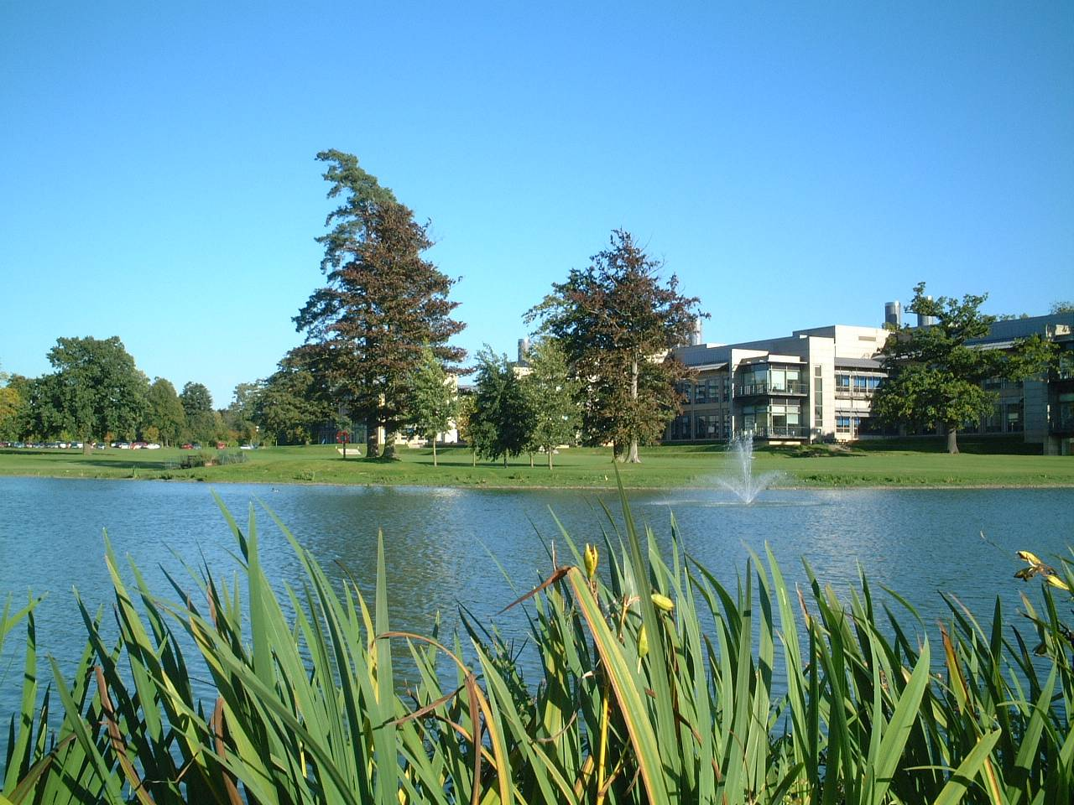


Acknowledgements (lots of them!)
Many people have contributed their expertise, at many meetings, notably at the various HUPO Proteomics Standards Initiative meetings (’02—’04).
Other notable contributions came from:
Weimin Zhu, Kai Runte, Henning Hermjakob, Rolf Apweiler (EBI, UK);
Randall Julian (Eli Lilly, ASTM, ASMS), Kathryn Lilley (Cambridge)
Andy Brass, Steve Oliver, Norman Paton, Simon Hubbard and group, Simon Gaskell and group (Manchester, UK); Pierre-Alain Binz (SIB, Switzerland);
Kath Lilley’s group (Cambridge, UK); Ruedi Aebersold and group (ISB Seattle, USA); Al Brown and group (Aberdeen, UK); many other academic groups
Bruker Daltonic; Matrix Science; Kratos Analytical; GE Healthcare (Thermo, Amersham); Applied Biosystems; Nonlinear Dynamics; Agilent Technologies; Waters Corp.; MDS Sciex; IBM and many more
NERC, BBSRC, NIH; HUPO P/L/BPP; Journals such as Proteomics, Molecular and Cellular Proteomics, Journal of Proteome Research, Nature Biotech…

