Slide 1



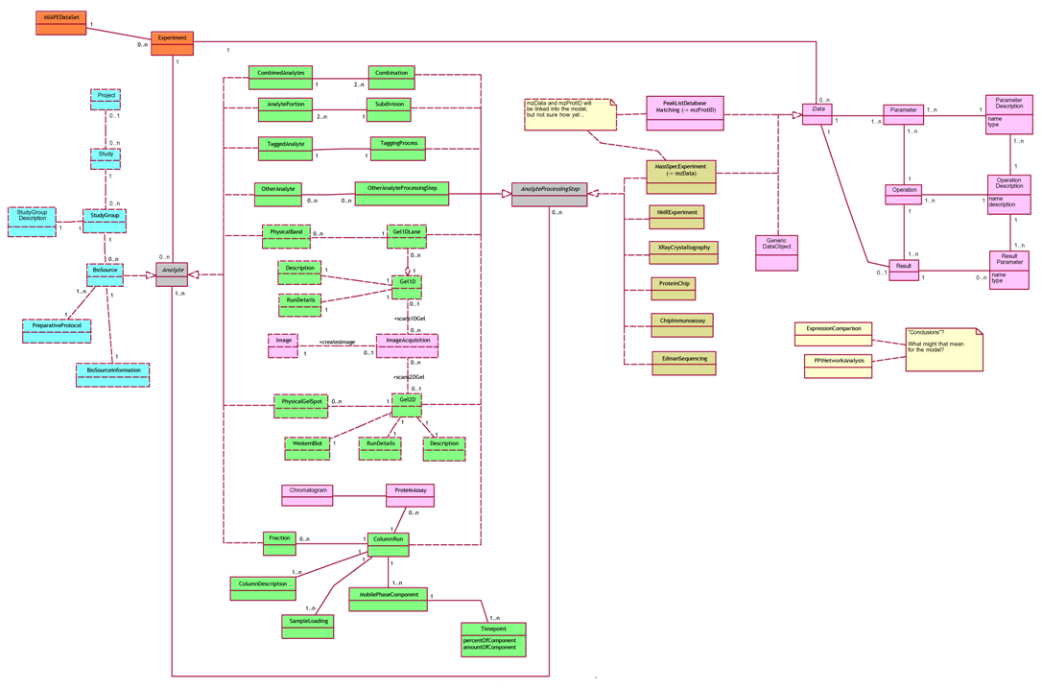
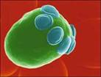


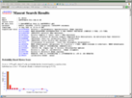
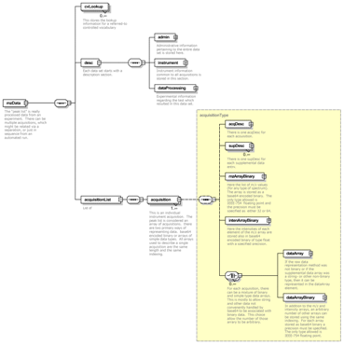

The MIAPE Standard, The PSI Object Model (PSI-OM) and What’s Next…
The HUPO Proteomics Standards Initiative – http://www.hupo.org/ – http://psidev.sf.net/
The HUPO PSI General Proteomics Standards workgroup (GPS) is tasked to provide standards with relevance to the whole of proteomics. In collaboration with partners both public and private, we are developing standard solutions in several areas:
Minimum reporting requirements — The Minimum Information About a Proteomics Experiment (MIAPE) document, with technology-specific modules, will provide guidelines on how to fully report a proteomics experiment. It is expected that the stipulations of this suite of documents will be enforced by journals, compliant repositories and funders (cf. MIAME).
XML format for data exchange — derived from the GPS proteomics workflow/data object model, PSI-OM, this markup language (known as PSI-ML) is designed to become the standard format for exchanging data between researchers, and for submission to repositories or journals. We will also provide a generic SQL implementation, but this should only be viewed as a reference implementation. The model and the exchange format will eventually form part of the emerging functional genomics model, which will be part developed by GPS in collaboration with the developers of the MAGE model for transcriptomics.
Ontologies — these lists of clearly defined terms are crucial for the construction of unambiguously worded data files. The GPS will contribute terms to the MGED ontology (extended), under the 'psi' namespace. We will also coordinate with the Mass Spec (and Search Engines) working group, whose ontology terms will likely be owned by the American Society for Mass Spectrometry (ASMS).
Other GPS activities — We are coordinating the generation of a document examining the comparability of search engine metrics (e.g. Mascot versus SeQuest). We may also produce a 'Design Principles' document, summarising the principles we utilise when evolving the design of both MIAPE and PSI-OM/ML.
This image of the PSI object model has been colour-coded mostly as a guide to the eye. Data elements are almost absent (including the DiGE stuff), these will be added to the next version within the next few weeks.
This is an abstract model of the entities of interest; therefore a link from, for example, a gel spot to the protein ID'd from it, has not been put in as this is an implementation-level optimisation (the 'demonstrator' XML will make this clearer). This is deliberately not a model of either an RDB or an XML Schema.
Entities are divided into [methods+data] and [analysis]: This is because it is not possible (broadly speaking...) to regenerate data without employing a method, which should be captured; whereas it is possible to re-run analyses over data sets ad infinitum. Whether it is better to have a tripartite division, and even whether to add 'Conclusions', is clearly a matter for debate.
The PSI-OM
Other work by the HUPO Proteomics Standards Initiative:
mzData This XML format (right) captures both the use of a mass spectrometer and the resulting peak lists (but not the ‘raw’ data). It will also serve as a module of the PSI-OM.
mzIdent Also part of PSI-OM, this model describes the search engine and database used to analyse peak lists, the data and parameters, and the results of the processing.
Molecular Interactions Format (MIF) This working standard defines a minimal data model that allows scientists and repositories to submit and exchange protein interaction data.
Tools etc. Coordinating development of converters, viewers and a repository.
Functional Genomics Object Model We are collaborating with the MGED consortium and a number of other organisations to develop both a model and an ontology with which to capture proteomics, transcriptomics and metabolomics data.
mzData
Moderated email discussion list details available from the PSI website
Comments and questions to: Chris Taylor — christ@ebi.ac.uk

Slide 2
