Slide 1
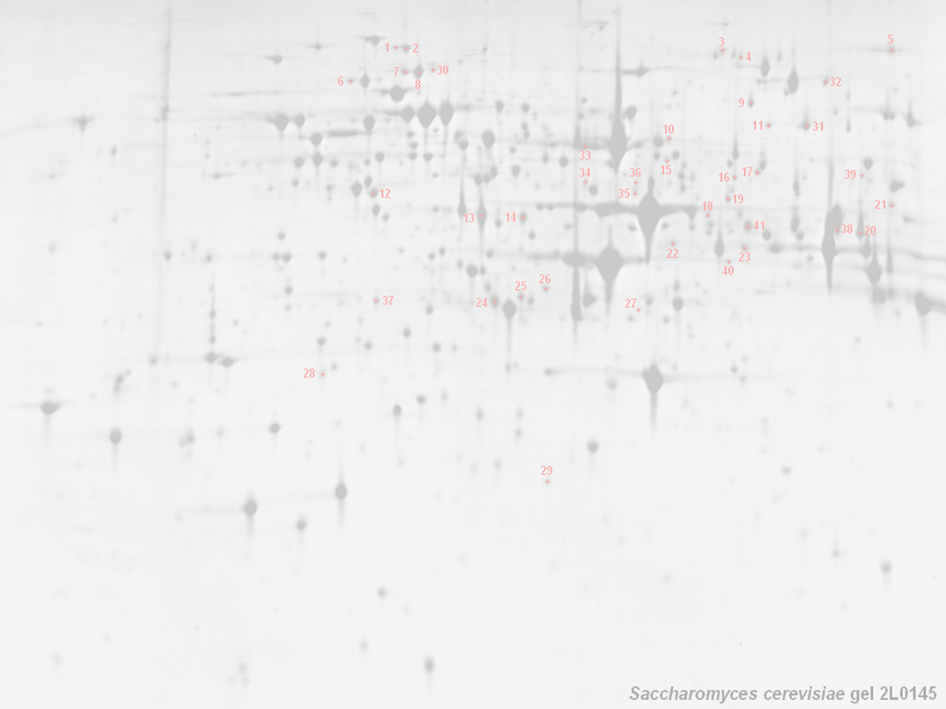



The HUPO Proteomics Standards Initiative
HUPO PSI, Chris Taylor, Henning Hermjakob,
Randall Julian, Weimin Zhu, Rolf Apweiler,
European Bioinformatics Institute;
Eli Lilly Corp. (RKJ); The World (PSI)
http://www.hupo.org/ — http://psidev.sf.net/

Slide 2

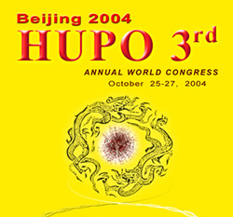
HUPO — Background
Founded in 2001 with several objectives:
  Consolidate national and regional proteome organisations
  Assist in the coordination of public proteome initiatives
  Engage in scientific and educational activities
Tissue proteome projects and other initiatives:
  Plasma, Liver, Brain, Glyco; PSI and Antibody initiative
Congresses (in addition to many smaller meetings):
  Paris, Nov. 2002; Montreal, Oct. 2003; Beijing, October 2004

Slide 3
HUPO PSI — Background
The Proteomics Standards Initiative (not methods..!)
  Data format standards (cf. NetCDF, AnIML, MAGE, CML etc.)
  Data representation and annotation standards
    controlled vocabularies / ontologies (e.g. GO, MO, ASTM)
    standard reference sets for genes, proteins, (methods?)
  Incorporates ‘bench scientists’, tech vendors, funders, publishers
Biggest win to date — Molecular Interaction Format (MIF)
  Several PPI databases exist; BIND, DIP, MINT, Hybrigenics, MIPS
    data provided in many different formats, not synchronised
    tedious work of repeatedly combining data sets
  The standard (MIF) defines a minimal data model
    allows scientists to provide core data, with back references
    simplifies synchronisation (cf. EMBL + GenBank + DDBJ)

Slide 4
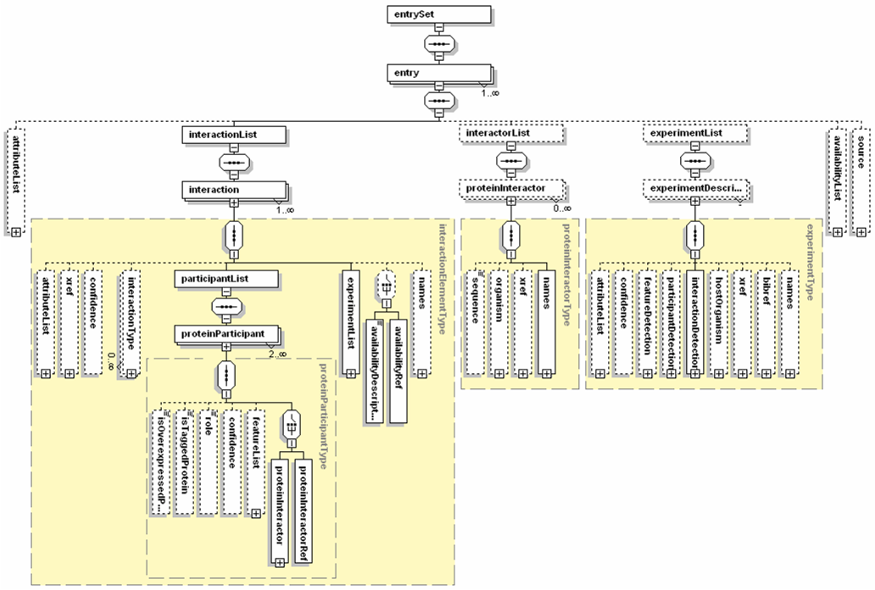
The MIF XML Schema

Slide 5
HUPO PSI: GPS — Background
HUPO PSI: GPS — General Proteomics Standards
The generation and analysis of proteome data are widespread
  High–throughput approaches are commonplace (if troublesome)
  Techniques continue to increase in complexity (DiGE, ICAT, SPR-MS)
Publicly available proteomics data is rather limited
  Sample extraction and preparation usually undocumented
  Analytical methods employed in deriving conclusions absent
  No widely used databases of (for example) mass spectral data
A robust, future proofed, standard representation of both methods and data from proteomics experiments is required
  Analogous to the MIAME+MAGE system for transcriptomics
  Will facilitate handling, exchange and dissemination of data
    e.g. the development of effective search/analysis tools

Slide 6
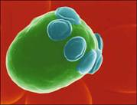
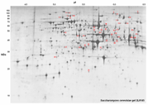

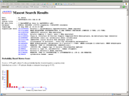
GPS — The Scope of our Remit
Sample generation
  Origin of sample
    hypothesis, organism, environment, preparation, paper citations
Sample processing +++
  Gels (1D/2D), columns, other methods
    images, gel type and ranges, band/spot coordinates
    stationary and mobile phases, flow rate, temperature, fraction details
[Mass Spectrometry] → ‘mzData’
    [machine type, ion source, voltages]
In Silico analysis → ‘mzAnalysis’?
    peak lists, database name + version, partial sequence, search parameters, search hits, accession numbers

Slide 7
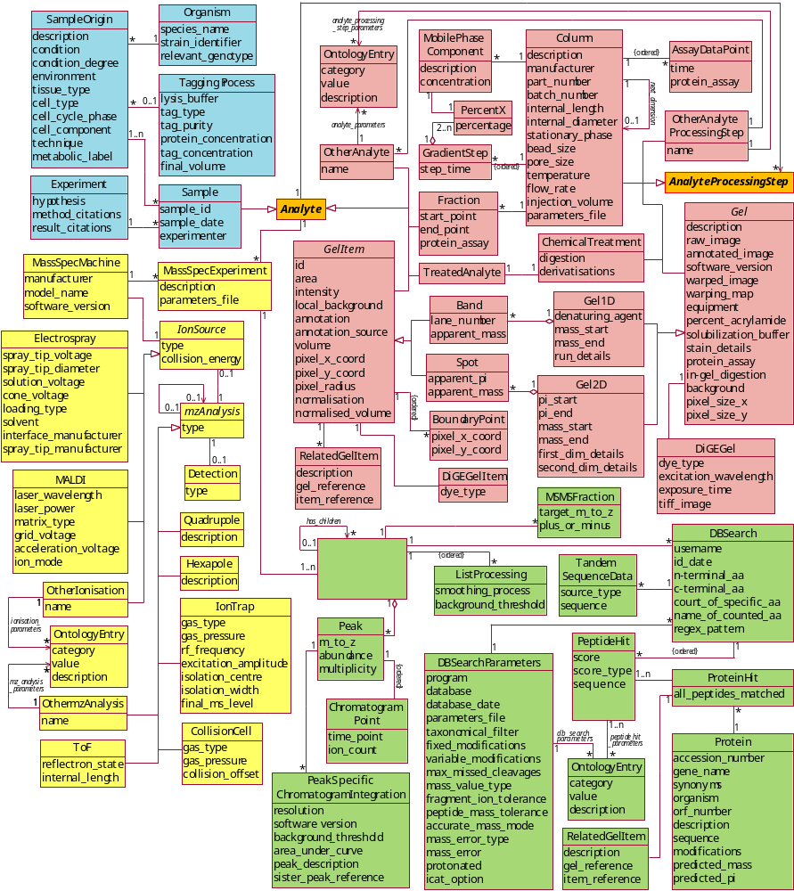

GPS — More Background
The PEDRo Model:
Developed at Manchester University in collaboration with the PSI and the EBI
A ‘proof of concept’ model that covers most of the workflows currently found
in proteomics experiments
Intended as a ‘straw man’
to stimulate discussion of the scope and depth that would be required to adequately represent a proteomics experiment

Slide 8
PEDRo → HUPO PSI Standards
PEDRo
HUPO PSI (Oct ‘02, Jan ’03, July ’03, April ’04)
Manufacturers output formats + mzData model
Input formats for search engines and tools
Consultation with domain experts and MGED
MIAPE
Public meetings to generate
maximum feedback
Publication in print and via
the web, to reach the widest
possible audience
PSI-Ont (MO)
PSI-OM
PSI-ML (+ PSI-DB)

Slide 9
So why take up our time at ASMS?
mzData stand-alone / ‘sub model’ now in a mature state
  Widespread vendor approval at PSI Nice (April ’04)
    The next big win for PSI and ASMS CAIG (RKJ)
    ASCII converters (.dta, .mgf, etc.)
    Prototype ‘raw’ converter (Thermo XCalibur API)
Many issues outstanding
  What to do about triple-play and next gen instruments
    mzData uses base64 encoding of spectral data but…
  Redevelopment of ASTM glossary, to be owned by ASMS
    Vendor parameter lists urgently required (Agilent, SciEx)
    How many terms should be controlled (how ‘labile’)?
  Use by PSI-OM (HUPO), AnIML (ASTM), mzXML (ISB)?
  Use AnIML for ‘full raw data’ (available ’05–’06)
Preliminary repository by October HUPO meeting

Slide 10
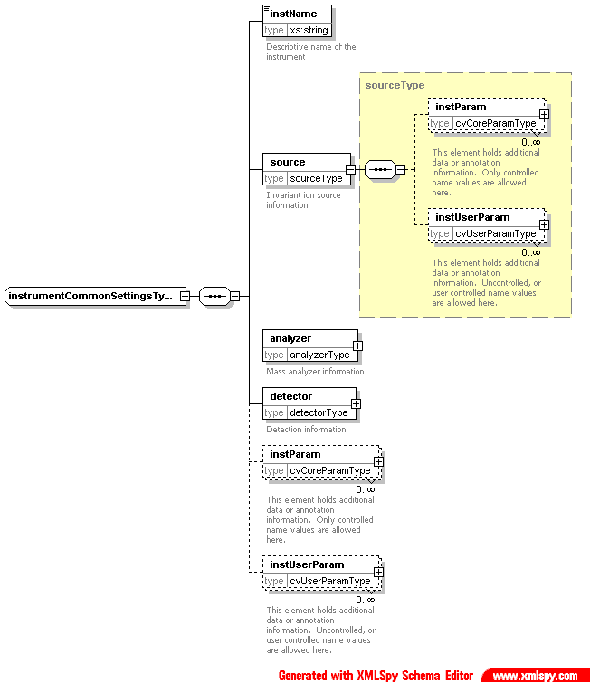
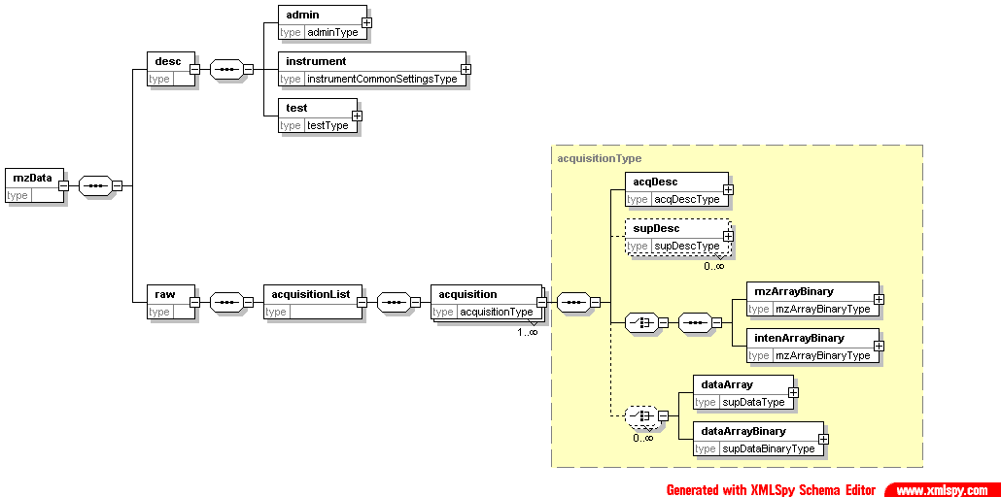
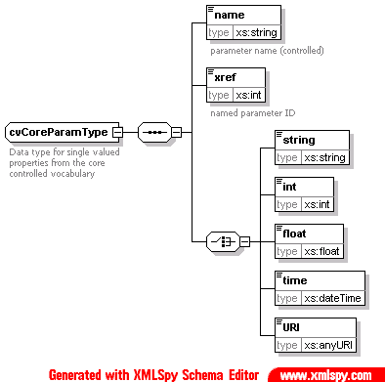
So why take up our time at ASMS?
<instParam>
<name>scan segment</name>
<xref>10000001</xref>
<int>2</int>
</instParam>
<instUserParam>
<name>base intensity</name>
<float>302038.000000</float>
</instUserParam>
<instUserParam>
<name>base mass</name>
<float>292.525513</float>
</instUserParam>

Slide 11
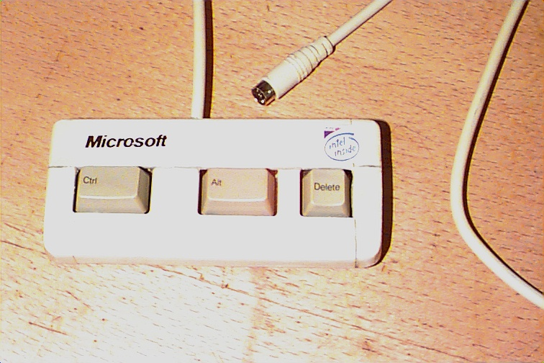


Ontologies, ontologies, ontologies…
1. Inaccessible
2. Multifarious
3. “Just right”
Pre-existing word sources that could be subsumed:
    ASTM LSOO, MGED, GO (for example), IBM, MIT, etc.

Slide 12
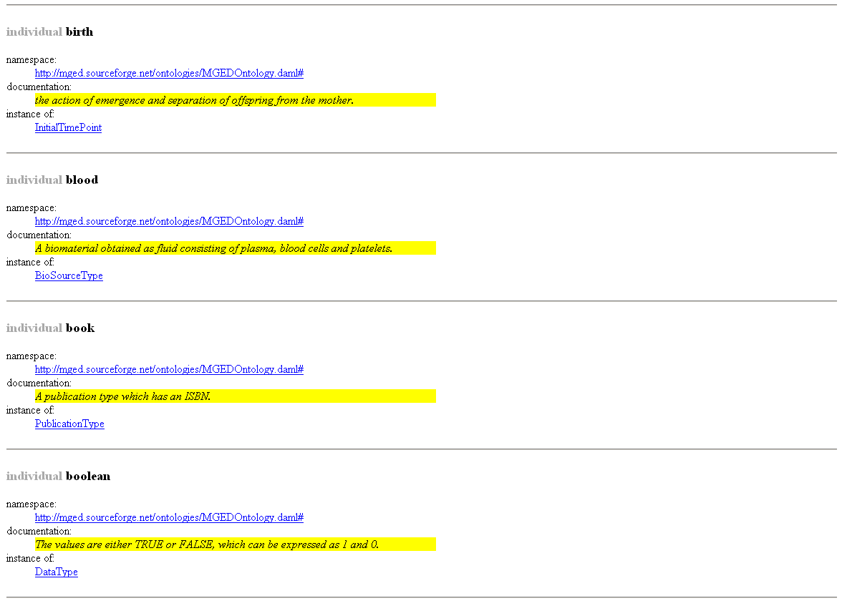
The MGED Ontology

Slide 13
The ASTM Glossary
FAB type
string
none
FAB matrix
string
none
source temperature
float
C
filament current
float
A
emission current
float
A
accelerating potential
float
V
detector type
string
none
detector potential
float
V
detector entrance potential
float
V

Slide 14
GPS — Where Are We Going?
Minimum Information About a Proteomics Experiment (MIAPE)
  Will contain guidelines on reporting a proteomics experiment
  Requirement to be enforced by journals, repositories, funders (cf. MIAME).
Data Models, and XML formats for Data Exchange
  mzData now in a mature state — implementations and the ontology next
  All based on the GPS proteomics workflow/data object model, PSI-OM
  Markup language (PSI-ML) designed for data exchange, and submission
  Will eventually form part of a multi-’ome functional genomics model,
  FGE-OM developed by GPS in collaboration with MGED
Ontologies (“depends on what your definition of ‘is’ is…”)
  Lists of clearly defined terms (degree of sophistication varies)
  Crucial for the construction of unambiguously worded data files
  GPS will contribute terms to the MGED ontology (extended)
  The Mass Spec (and Search Engines) working group’s ontology terms will likely be owned by the American Society for Mass Spectrometry (ASMS).
Other activities
  GPS ‘Design Principles’ document (for MIAPE and PSI-OM/ML)
  Document examining the comparability of search engine metrics

Slide 15
GPS — How Do We Get There?
Web site
    A web site will be maintained contains a record of versions, documents and presentations from meetings
Email list
    Used to make announcements and discuss issues
    Details at http://psidev.sourceforge.net/ (soon)
Telcons
    Average frequency of once every two weeks, to discuss issues and activities relating to the development of the standard
    Details posted on the email list
Meetings
  Formal meetings
    Will be associated with full HUPO gatherings
    Will have the authority to approve documents
  Informal meetings
    Will take place between formal meetings, with a view to progressing the documents. Details of future meetings, agendas and minutes will be posted on the email list.

Slide 16
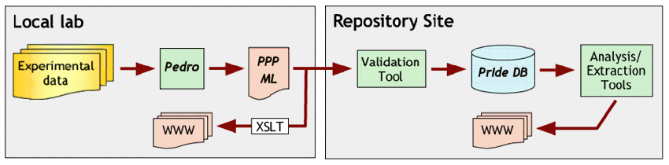
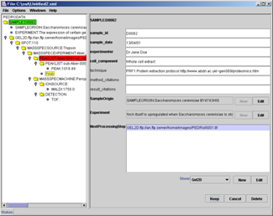
The Pedro Data Entry Tool
A tree-style browser simplifies manipulation of PEML files
Successive steps added as children
thereby enforcing an audit trail
  e.g. gel details cannot be entered
  without describing the sample
Generated from an XML Schema
Straightforward file validation
Use of ‘templates’, copy + paste
Ontology support + context help + security model (in beta)

Slide 17
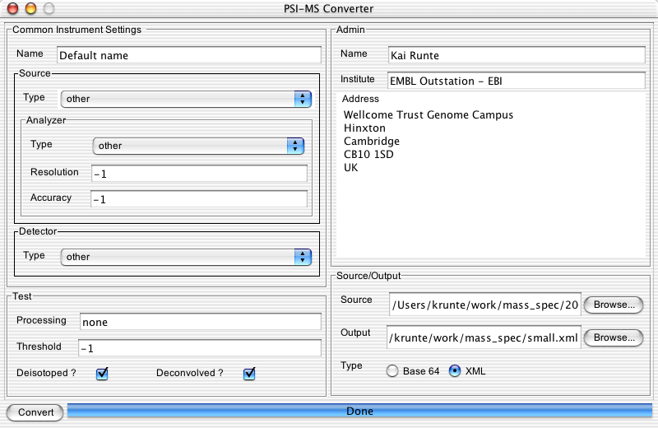
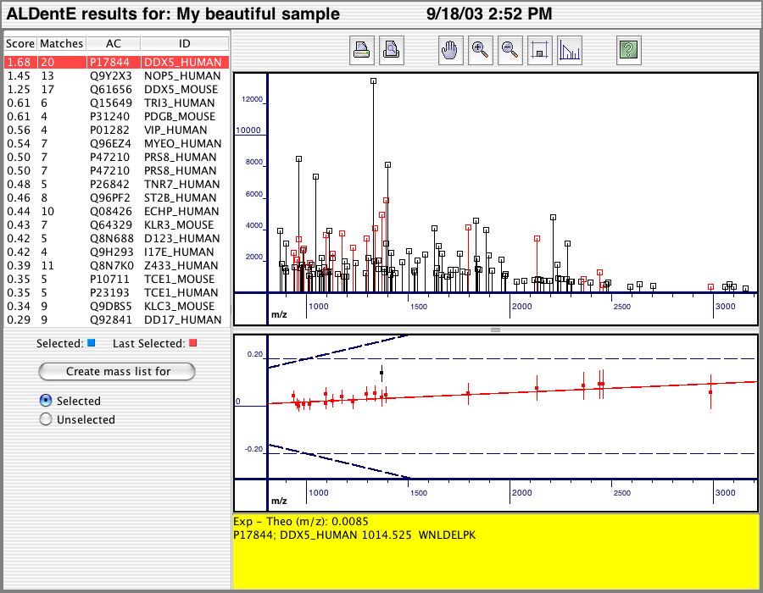
File Conversion and Import
Converter tool development (Kai Runte, EBI)
  Planned input formats (for the immediate future); Bruker-Daltonics, Inc.; Ciphergen; Biosystems, Inc.; Micromass-Waters; Protagen, Inc.; Thermo LabSystems; Institute for Systems Biology
.dta/.zta
pairs
other
formats
Search engine

Slide 18
Provision of repository and tools
Repository solution (Lennart Martens, U. Gent, Belgium; Henning Hermjakob, EBI)
  Initially developed for a database of protein identifications
  Re-useable technology; will be deployed for HUPO tissue projects, and ultimately to capture MIAPE-compliant data sets
PRIDE web
log4j
WWW
XSLT
Struts
PRIDE core
log4j
PRIDE
console
PRIDE DB
persistence
PRIDE XML
persistence
OJB
XPP
$pride:
RDBMS
XML
Log
files

Slide 19
The Functional Genomics Future
Functional genomics is the “One ′omics to rule them all”
    but don’t forget the little person…
Several strands of opinion seem to favour a recasting
  Core biological description (sample origination++)
  Add-on modules — transcriptomics, proteomics, metabolomics
How to learn from the bad, while keeping the good?
  Major benefits to a flexible model closely allied to ontologies
  Different benefits to a tightly defined model
  Both have their downsides…
Possible solution — Get your retaliation in first ☺
  Generic model, as above, linked to ‘official’ ontologies
  Domain (and even community) specific ‘Implementation’ models
    derived from the generic model plus ontology terms (data)
    officially guaranteed to map back (future-proof)

Slide 20
GPS — Conclusions
PSI-OM will be a modular, expansible data model
  The model is flexible, but should avoid ‘dialectisation’
  The markup (PSI-ML) will draw on the ontology
MIAPE will require a substantial amount of data
  Much of this information will be available in the lab of origin
  Use of templates and copy + paste in Pedro (for example)
But there are several advantages to such a system
  Ability to establish the provenance and relevance of a dataset
  Integration will facilitate sophisticated search and analysis
    Non–standard searches become possible, e.g. by technique
  Tool development and information exchange will be facilitated
The next steps towards maturation (by Autumn ‘04)
    Consultation, revision, validation, dissemination

Slide 21
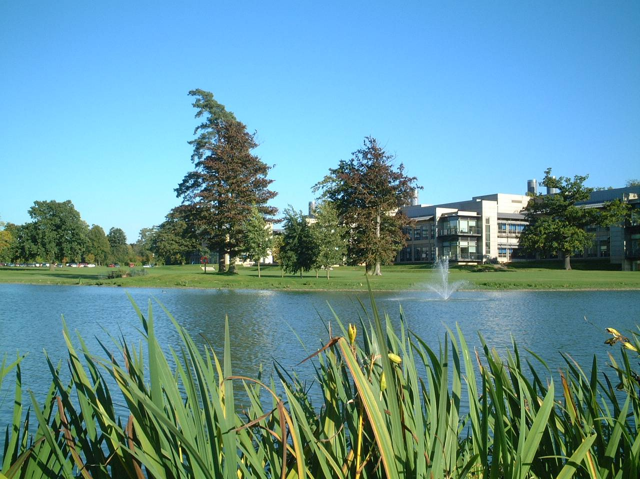


Acknowledgements (lots of them!)
Many people have contributed their advice and expertise to MIAPE, at various meetings formal and otherwise, notably attendees at the various HUPO Proteomics Standards Initiative meetings (’02—’04).
Other notable contributions came from:
Weimin Zhu, Kai Runte, Henning Hermjakob, Rolf Apweiler (EBI, UK)
Andy Brass, Steve Oliver, Norman Paton (Manchester, UK)
Randall Julian (ASTM/ASMS)
Simon Hubbard and group, Simon Gaskell and group (UMIST, UK)
Kathryn Lilley and group (Cambridge, UK)
Ruedi Aebersold and group, esp. Eric Deutsch (ISB Seattle, USA)
Al Brown and group (Aberdeen, UK)
Pedro was originally the project of Kevin Garwood (Manchester, UK)

