Slide 1
MGED Standards Efforts
A roadmap for your journey
Angel Pizarro
Programmer Analyst
CBIL, UPENN

Slide 2
Outline
A little history of Microarray Standards
Details on:
  What happened?
  How did it happen?
  What was learned?
Payoff: Foresight in what’s to come
Visions for the future

Slide 3
Microarray Standards Timeline
A time of BS
  BS = Before Standards
3 Publications of well annotated microarray studies
  2 Cell cycle
  Molecular classification of cancer
  2100 combined citations
Microarray and Gene Expression Data Society (MGED) created (1999)
  MIAME (2001)
  MAGE (2002)
  MGED Ontology(2003)

Slide 4
MGED Standardization Efforts
MIAME
  The formulation of the minimum information about a microarray experiment required to interpret and verify the results.
MAGE-OM
  The establishment of a data exchange format and object model for microarray experiments.
Ontology Working Group
  The development of ontologies for microarray experiment description and biological material (biomaterial) annotation in particular.
Transformations
  The development of recommendations regarding microarray data transformations and normalization methods.

Slide 5
MIAME
Informal specification of what should be a logical set of reporting requirements
Format is a check list
Intended audience are investigators that plan to publish microarray data

Slide 6
MAGE-OM
Formalization of the concepts in MIAME
Format is an object model (API)
Intended audience are technical folk
  Software designers
  Bioinformatitians, etc.

Slide 7
MAGE Specific Design Goals
Modularize MIAME concepts into a package structure
Create a platform independent model
  UML that is later translated into different platforms
Publish a platform dependent specification for validation of the data produced
  MAGE-ML DTD

Slide 8
MGED Ontology (MO)
Ontology concepts derived from the MIAME guidelines
Overall structure was derived MAGE-OM
Format is a DAML+OIL file
  OILed, Protégé read DAML+OIL files
  Web page of the terms
Purpose
  Provide standard terms for the annotation of microarray experiments
Benefits
  Unambiguous description of how the experiment was performed
  Structured queries can be generated

Slide 9
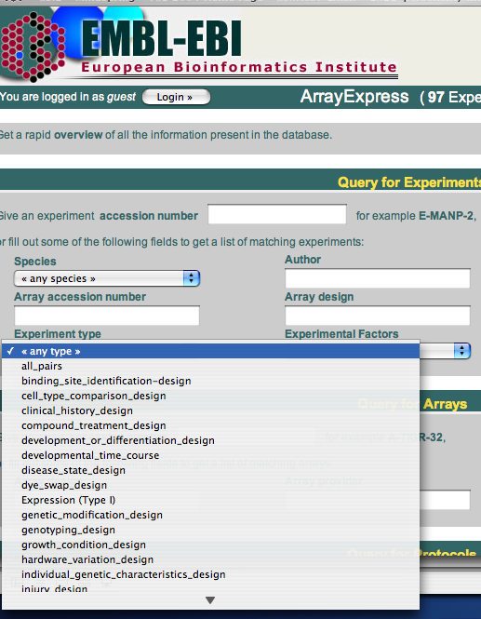
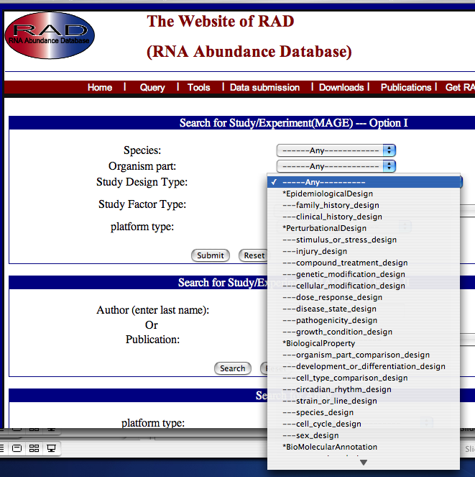
MO and Structured Queries

Slide 10
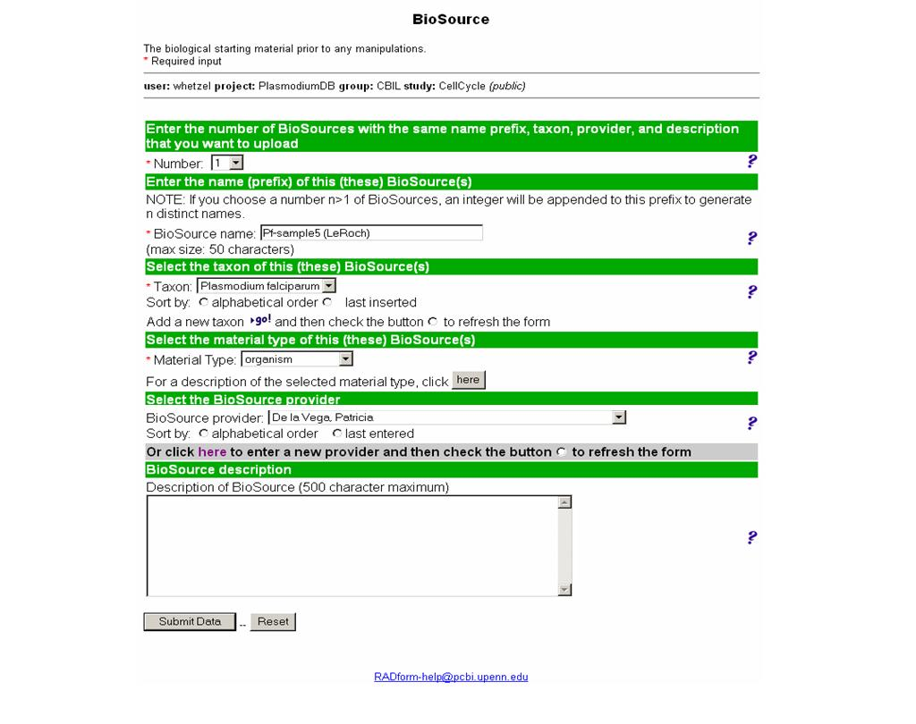
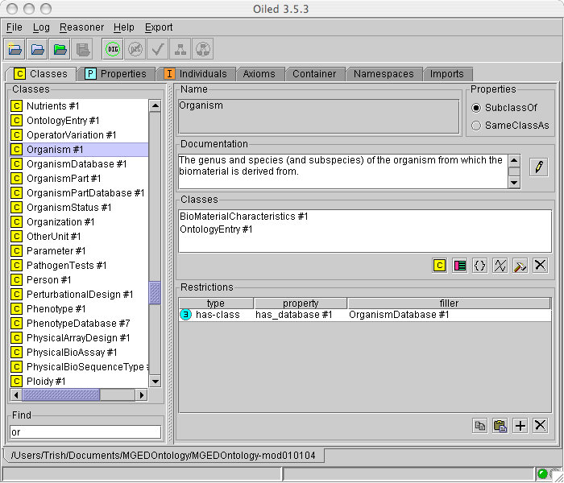
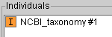
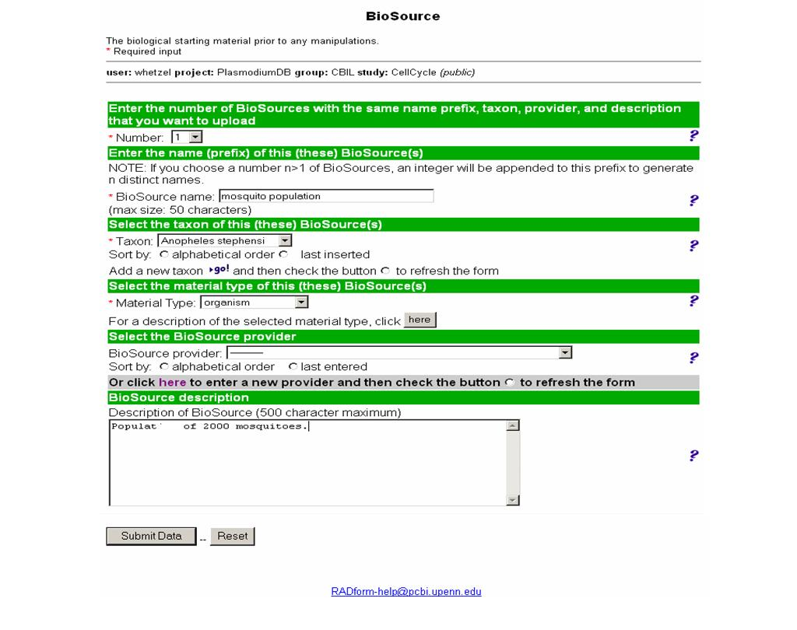
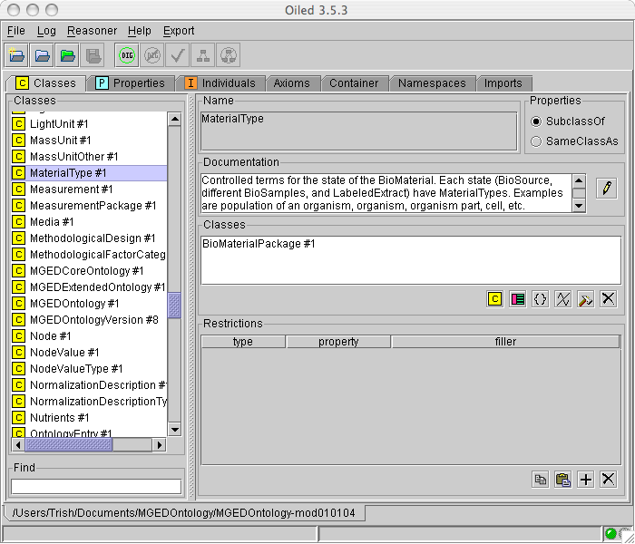
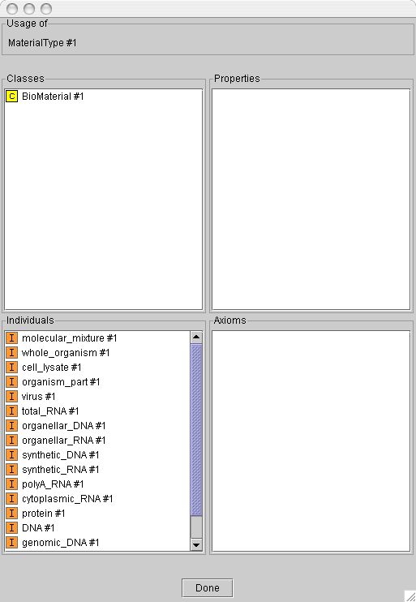
RAD Study Annotator:
BioSource Form

Slide 11
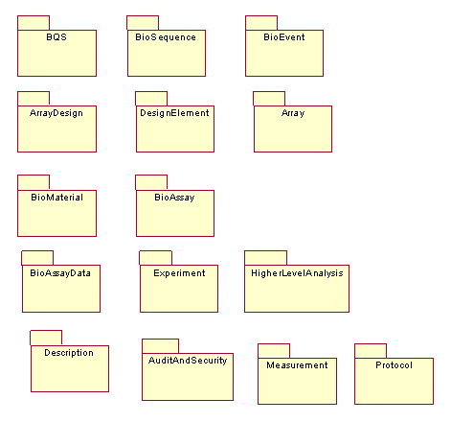
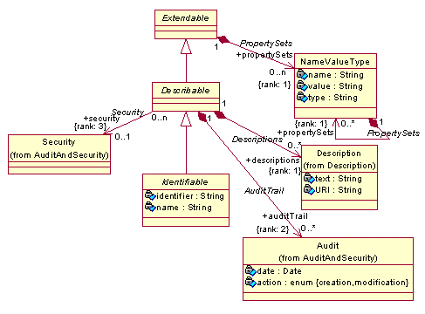
MAGE v.1

Slide 12
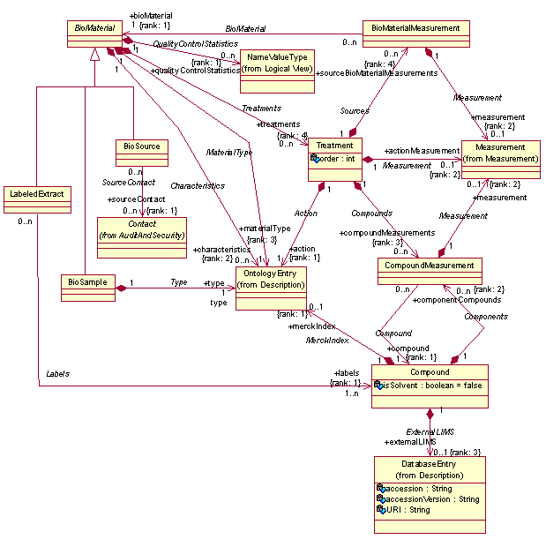
The Good

Slide 13
Why is this good?
Spectrum of modeling strategies
Ontology
optimal
Graph models
MAGE-OM
BioMaterial Use Case
Notes:
Object design spectrum: ontologies ←-----→ base type objects

Slide 14
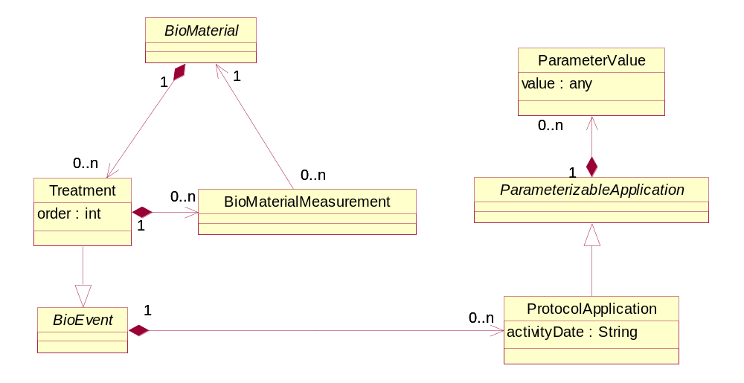
BioMaterial
Notes:
New BioMaterial

Slide 15
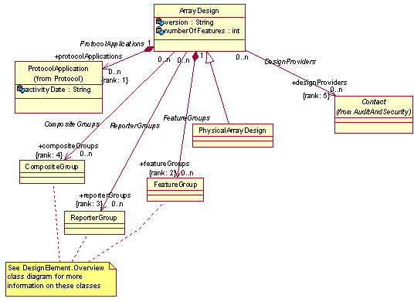
The Bad

Slide 16
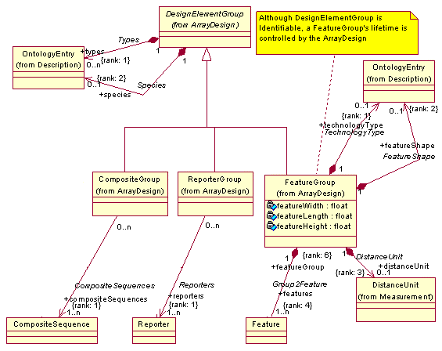
DesignElement

Slide 17
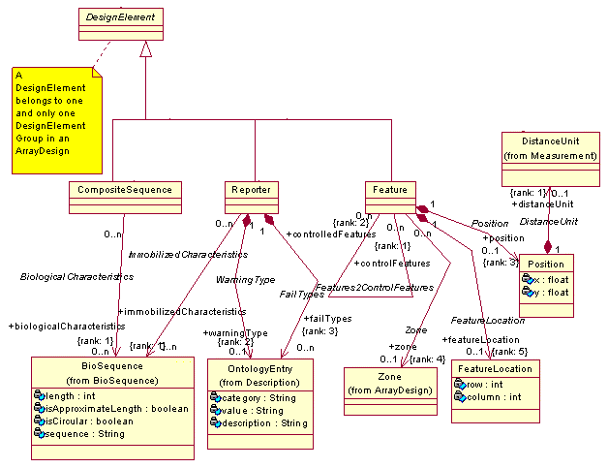
DesignElement (2)

Slide 18
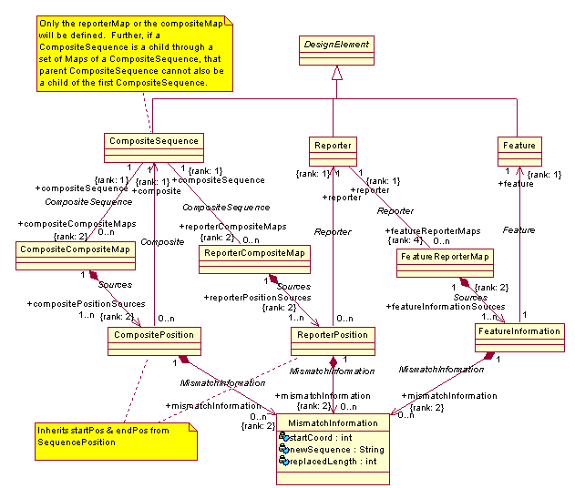
DesignElement (3)

Slide 19
Why is this bad?
Over engineered
  Pre-MAGE ArrayDesigns were tab-delimited files
Even simple concepts are represented in complex ways
Certain real world requirements were sacrificed for “possible” scenarios that are much less frequent

Slide 20
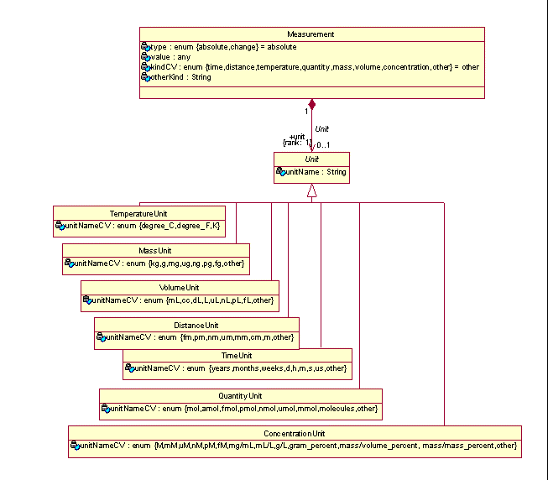
The Ugly
Enumerated types should be avoided
Easy to swallow but hard ot digest
Massive amount of logic that has to be adopted by other systems

Slide 21
Relationship of
MO to MAGE-OM
MO class hierarchy follows that of MAGE-OM
  MAGE classes with associations to OntologyEntry have an equivalent representative in MO
MO provides terms for these associations by:
  Defining the instances to use
  Referencing instances from external ontologies
    Take advantage of existing ontologies

Slide 22
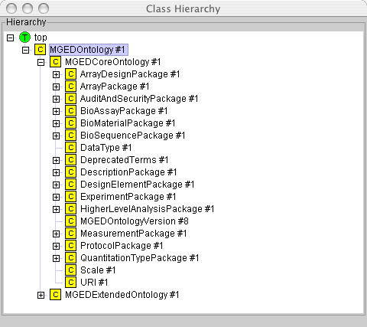
MGED Ontology
Class Hierarchy
MGED CoreOntology
  Coordinated development with MAGE-OM
  Ease of locating appropriate class to select terms from
MGED ExtendedOntology
  Classes for additional terms as the usage of genomics technologies expand

Slide 23
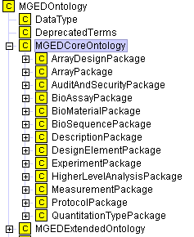
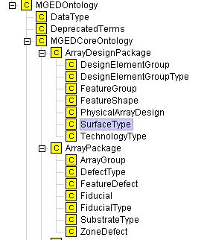
MAGE and MO

Slide 24
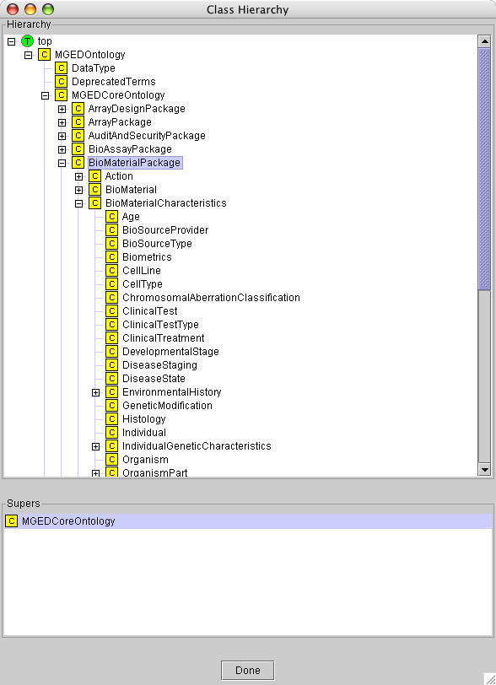
Main focus of MGED Ontology
Structured and rich description of BioMaterials
BioMaterial
+characteristics
OntologyEntry
+associations

Slide 25
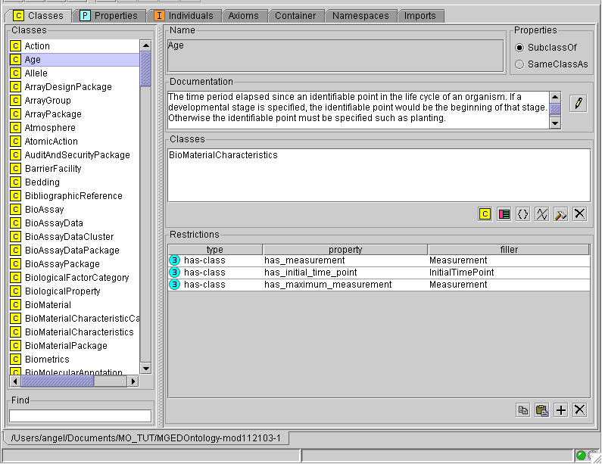
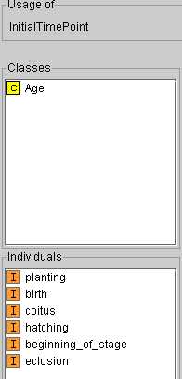

Slide 26
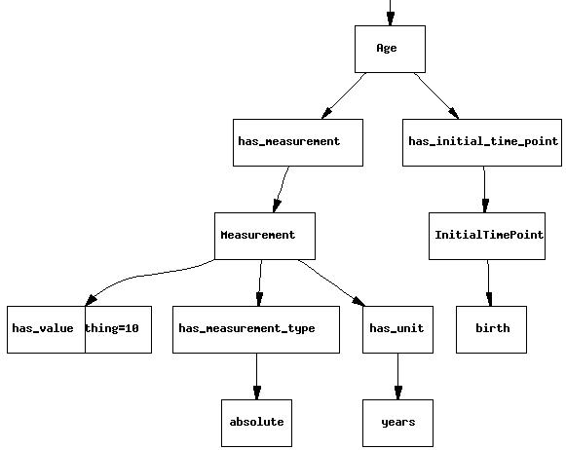
Graph representation of “Age”

Slide 27
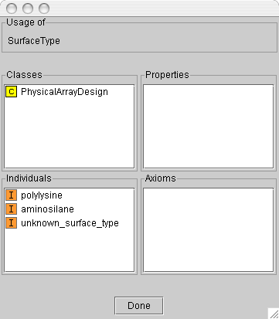
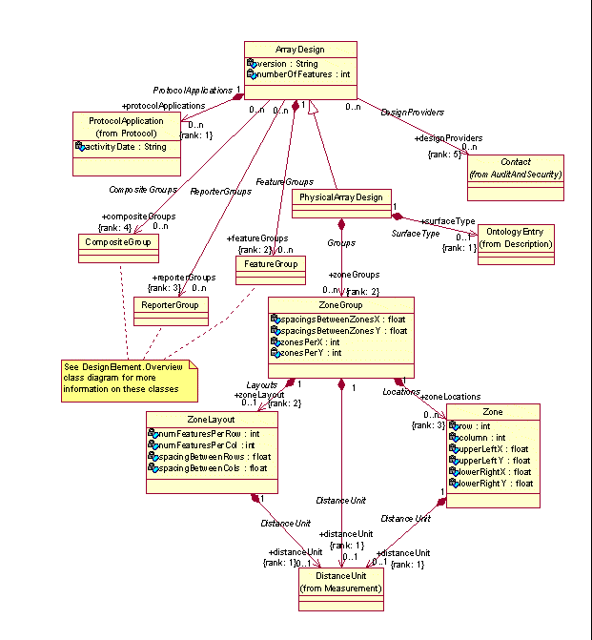
MAGE and MO

Slide 28
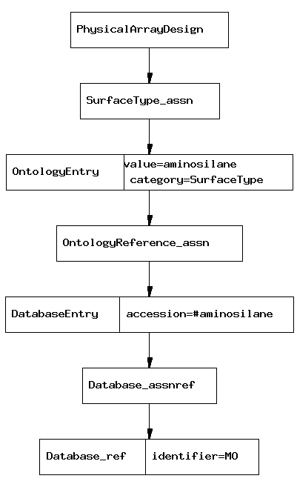

Slide 29
Informal specification
Formal specification
Strong type system
Immutable type system
Microarray
Standards
MIAME
MAGE-OM
MGED Ontology
Proteomics
Standards
PEDRo
PEDRo
FGE-OM
Functional
Genomics
Standards
?
?
?

Slide 30
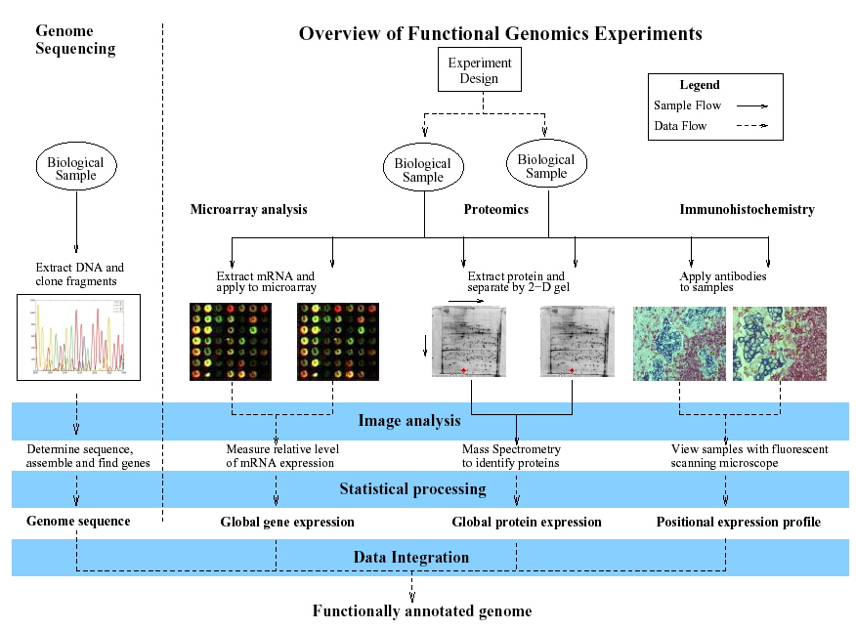
A Functional Genomics View
A. Jones et al. submitted

Slide 31
Use V-model process engineering
Domain
Use Cases
System test
Architecture
UML
Integration test
QA
Algortihms
Data structures
Platform API’s
Unit test

Slide 32
Informal specification
Formal specification
Strong type system
Immutable type system
Microarray
Standards
MIAME
MAGE-OM
MGED Ontology
Proteomics
Standards
PEDRo
MIAPE
PEDRo
MIAPE-OM
Functional
Genomics
Standards
MIAME
MIAME-Tox
MIAPE
UML Use Cases
Use Cases
FGE-OM
MGED Ontology

Slide 33
M AGE v.2 Mission
Address MAGE v. 1 criticisms
Allow for modular independent domain models
Structure components in the model to:
  Allow common use cases to be represented by simple constructs
  Allow more complex concepts to still be modeled, although would have to use more involved mechanisms
Provide the use cases that drove the development as formal documentation
  Help the community to adopt the standard

Slide 34
MAGE v.2 Mission
Microarrays no longer the only focus
  Not going to model other domains, that’s your job
Part of a new and more inclusive functional genomics model
  Name to be announced
Encode data specifications within the model itself
  MAGE
  MIAME enforcing MAGE
Look at the “mged-mage2” mailing list for specifics
  http://www.sourceforge.net/projects/mged/lists

Slide 35
What this means for PSI
A common set of support modules
  org.mged.fge.Common
    Protocol, BioMaterial, BioAssay, Audit, etc.
Further domain specific module development can be tied to stable releases
Provide a roadmap for development
And now for something completely different…

Slide 36
Ontology vs. object model development
PEDRo tried to kill several birds with one stone
  Develop an object model for software
  Develop a set of requirements for data reporting
  Provide guidelines of what to report
MIAPE is following this model
  IMHO not good, and here’s why

Slide 37
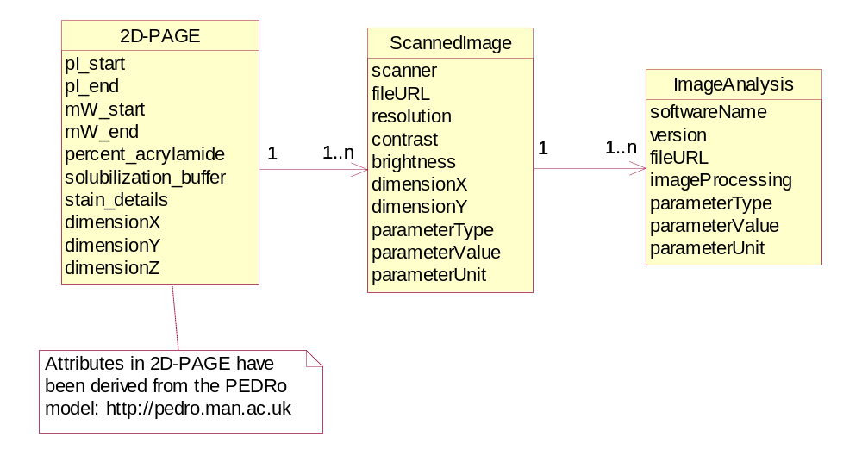
Current situation
Ontologies
Biologist
Generic Objects
OO Software Designers
Proteomics domain saw MAGE-OM and wants to adopt bits of it
  Sample preparation
BioMaterial

Slide 38
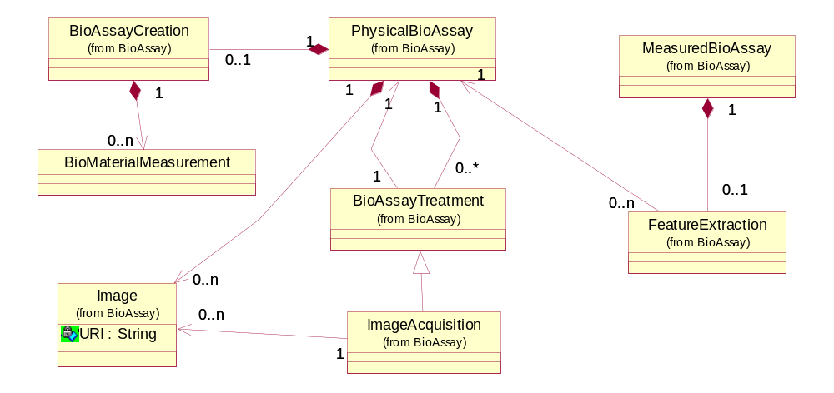
Merge with MAGE’s BioAssay

Slide 39
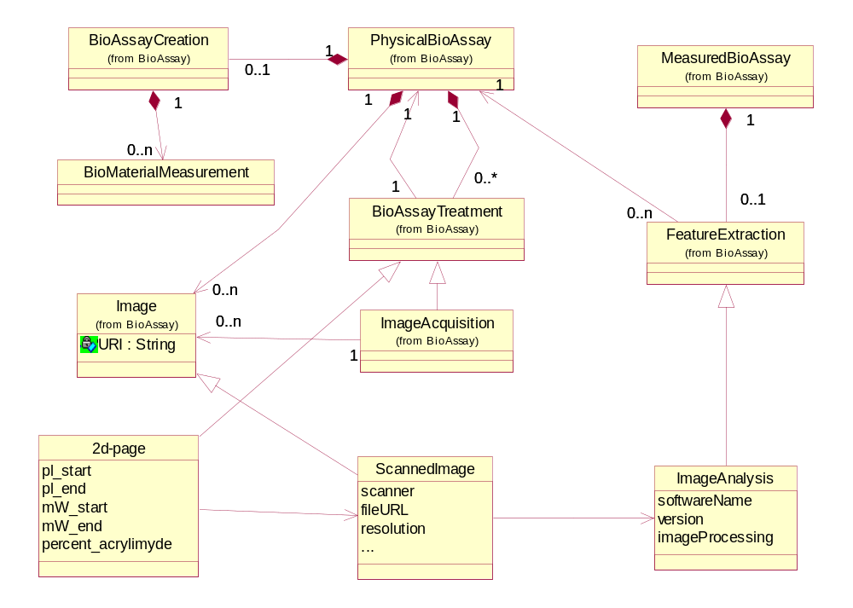
Proteomics-OM
Problem: Attribute sets are inflexible

Slide 40
Competing Goals
Generic structures for flexible
  Stable and long release cycles
  Adaptable to new situations
Attribute sets:
  Define the scope very clearly
  Allow rapid development and adoption of the API

Slide 41
“Templates” make generic structures palatable
What is a “template”?
  I don’t really know but, I didn’t have a better word to describe what I wanted to communicate at the time
  Akin to Active or Dynamic Object Models
Why not just use AOM then?
  AOM are not widely known/supported
  Other types of systems do not fit the bill
On to the hand waving…

Slide 42
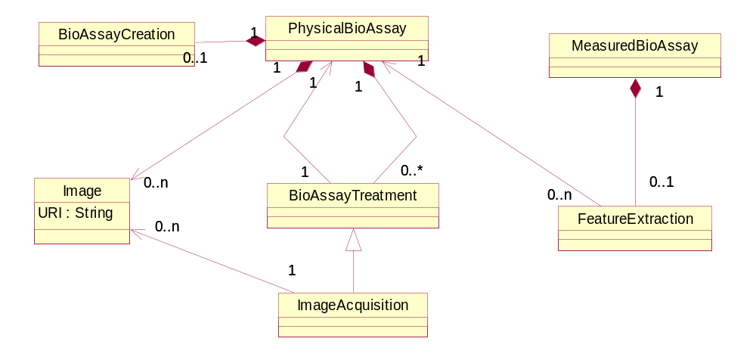
Template in action
2D-Page
  IS-A BioAssayTreatment
  HAS-A Protocol
    HAS Parameters
      pl_start
      pl_end
      mW_start
      mW_start
      …

Slide 43
Implementation and Usage
Use OWL to create templates
  Templates == Ontology
  Allows knowledge-experts to have a very rich say in what is specified as a “Standard”
TOTOM - Templates for Ontologies To Object Models
Possible uses:
  Runtime: use templates for dynamic object creation
  Compile: use in a build system for faster release cycles
  User Interfaces: Adaptable forms (ex. Pedro)
Different levels of constraint enforcement
  MAGE
  MIAME
  Toxico-MIAME

Slide 44
Acknowledgements
Chris Stoeckert
MGED Working groups
Chris Taylor

