Slide 1

pepXML File Format for Database Search Results and Subsequent Analysis
Andrew Keller
Institute for Systems Biology

Slide 2
Use of XML to Promote Standardized Analysis of MS/MS Data
A standardized analysis regimen must be applicable to a variety of:
Mass spectrometer types used to generate MS/MS data
Search engines used to assign peptides to MS/MS spectra
Common XML file formats facilitate uniform analysis, extensibility, and data sharing

Slide 3
XML Based Analysis Pipeline
Mass Spectrometer
Database
Search
*
Validation
Quantitation
Protein Inference
LCQ
SEQUEST
PeptideProphet
XPRESS
ProteinProphet
Qtof
Mascot
ASAPRatio
Qstar
Raw Data:
mzXML
COMET
Peptide ID:
pepXML
Peptide ID:
pepXML
Peptide ID:
pepXML
Protein ID:
protXML
4700
??
??
Raw Data
Level
Peptide Level
Analysis
Protein Level
Analysis

Slide 4
Data Viewing and Exchange
Mass Spectrometer
Database
Search
*
Validation
Quantitation
Protein Inference
LCQ
SEQUEST
PeptideProphet
XPRESS
ProteinProphet
Qtof
Mascot
ASAPRatio
Qstar
Raw Data:
mzXML
COMET
Peptide ID:
pepXML
Peptide ID:
pepXML
Peptide ID:
pepXML
Protein ID:
protXML
4700
??
Pep
View
Prot
View
??
Pep3D
Raw Data
Level
Peptide Level
Analysis
Protein Level
Analysis

Slide 5
pepXML File Format
Open source format for storing:
Database search settings and results
Subsequent peptide-level analysis
  Validation
  Quantitation
  Identification of corresponding
  database proteins

Slide 6
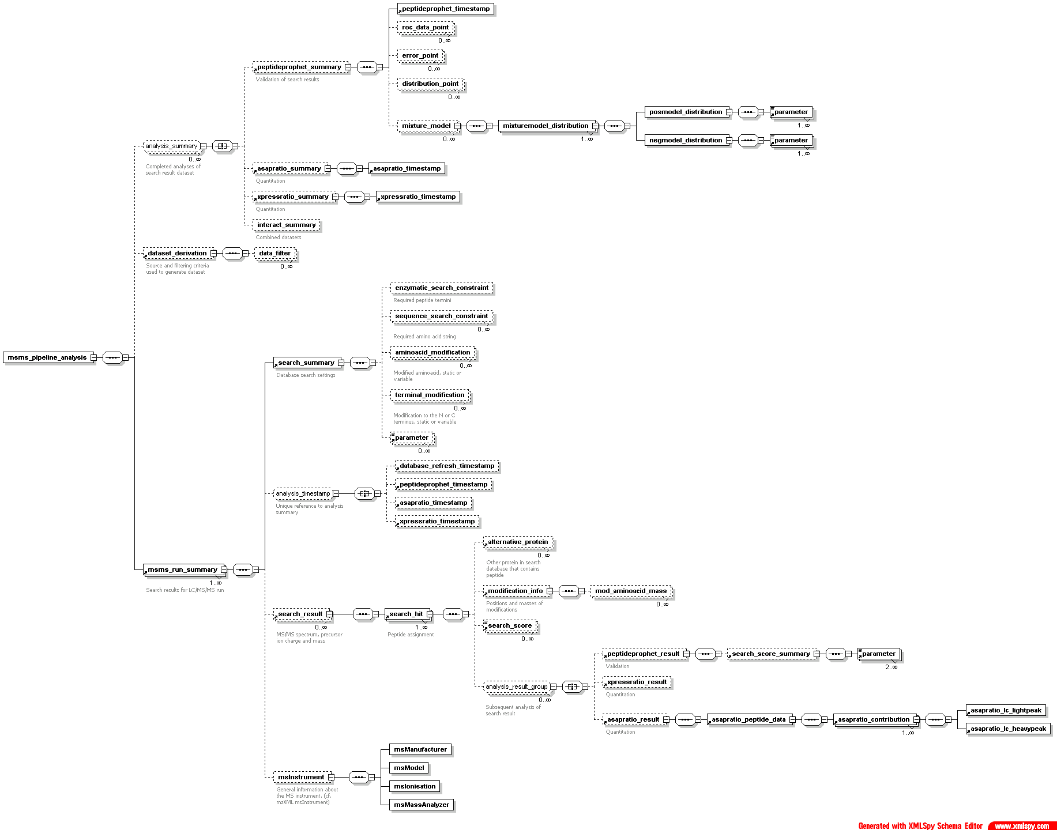
pepXML Schema
1
analysis keys
analysis summaries
2
3
dataset history
root
search settings
analysis refs
2
1
3
run summaries
search results
analysis results
instrument info

Slide 7
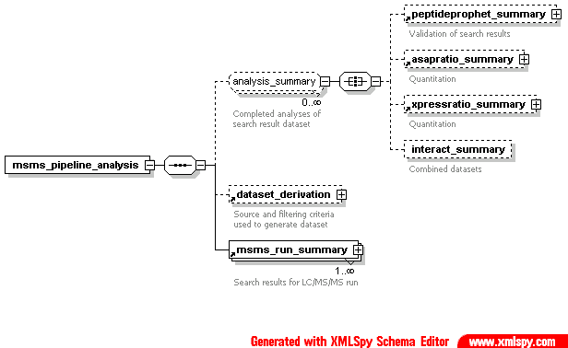
pepXML Top-level Organization

Slide 8
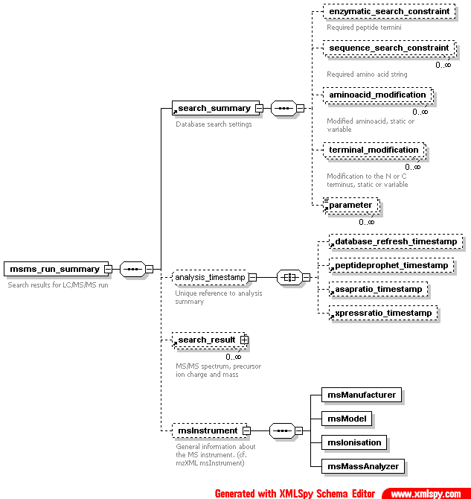
pepXML Search Run Summary

Slide 9
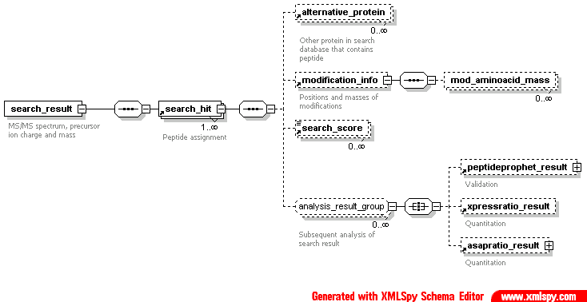
pepXML Search Result

Slide 10
Search Result Example
<search_result spectrum=“halo.1379.1379.3” start_scan=“1379” end_scan= “1379” precursor_neutral_mass=“3706.2” assumed_charge=“3” index=“49”>
<search_hit hit_rank=“1” peptide=“CYHGLEMIQKEQLVEMDVASENAQRALK”
peptide_prev_aa=“R” peptide_next_aa=“E” protein=“SW:DNB2_ADE40”
num_tot_prots=“2” num_matched_ions=“21” tot_num_ions=“108”
calc_neutral_pep_mass=“3708.9” massdiff=“+1.3” num_tol_term=“2” num_missed_cleavages=“2” is_rejected=“0” protein_descr=“P11806 human adenovirus type 40. early e2a dna-binding protein.”>
<alternative_protein protein=“SW:DNB2_ADE40a” protein_descr= “early e2a dna-binding protein short form” num_tol_term=“2”/>
<modification_info mod_cterm_mass=“16.0187” modified_peptide=
“C[545]YHGLEM[147]IQKEQLVEMDVASENAQRALK”>
<mod_aminoacid_mass position=“1” mass=“545.338806”/>
<mod_aminoacid_mass position=“7” mass=“147.192596”/>
</modification_info>
<search_score name=“xcorr” value=“3.472”/>
<search_score name=“deltacn” value=“0.072”/>
……..
<peptide_prophet_result probability=“0.4579”/>
</search_hit>
</search_result>
10

Slide 11
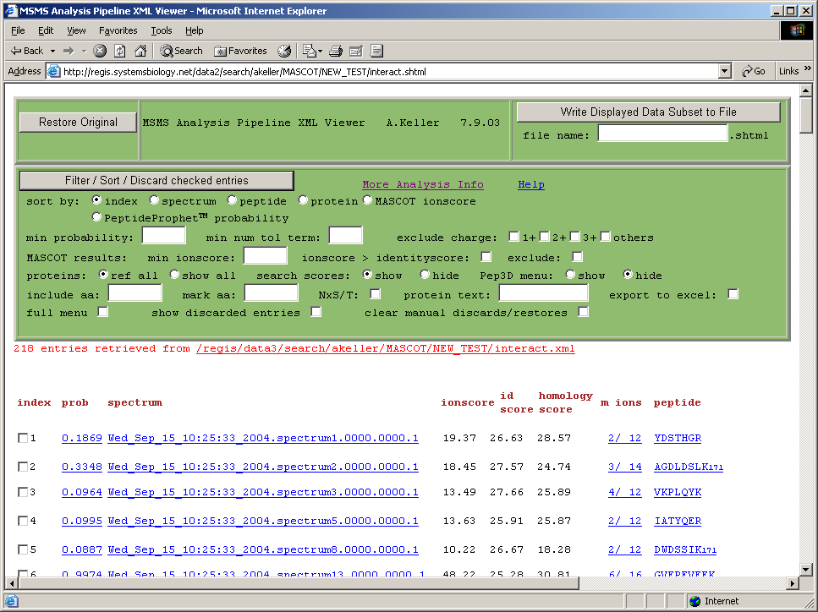
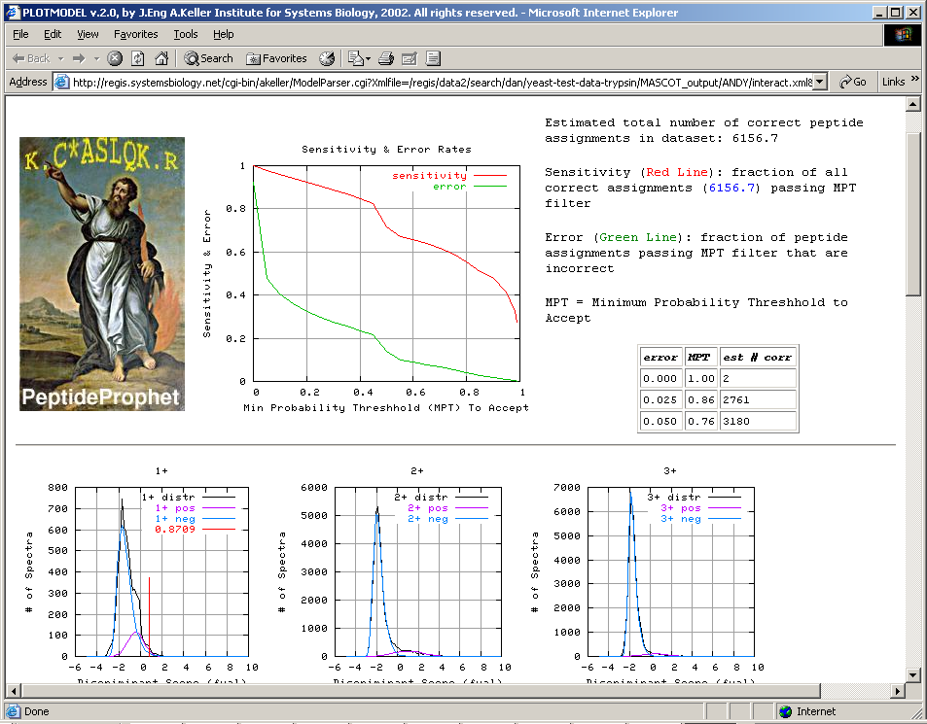
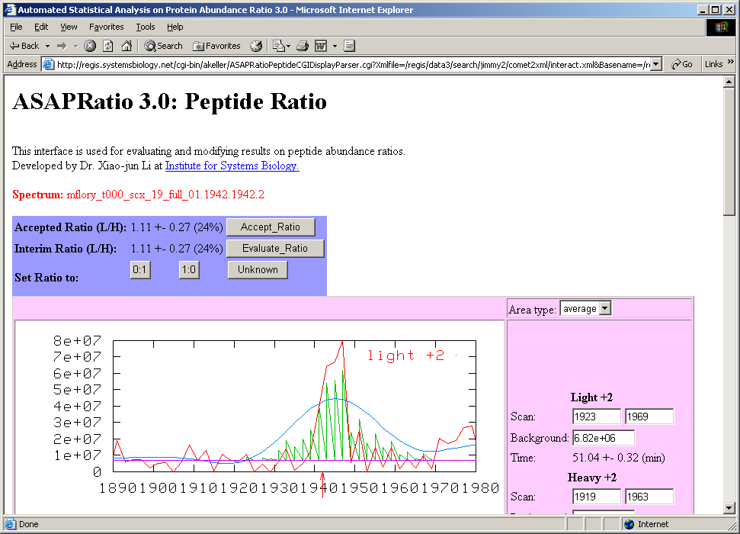
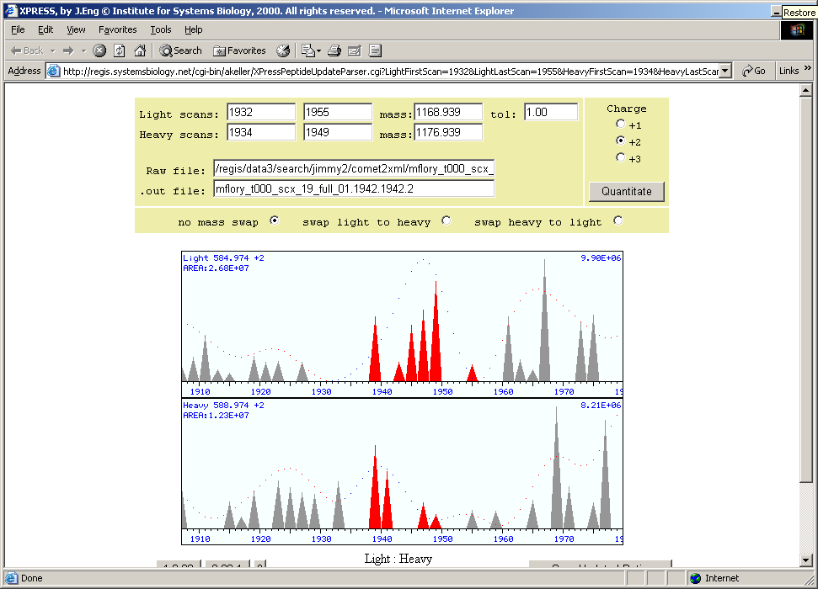
Viewing Data in pepXML Format
CGI program writes stylesheet and applies to pepXML

Slide 12
Summary
Converters available for SEQUEST, Mascot, and COMET
Input and/or Output format used by XPRESS, ASAPRatio, ProteinProphet, Pep3D programs
Converter planned for X!Tandem
More Information available at: http://www.proteomecenter.org

