Slide 1
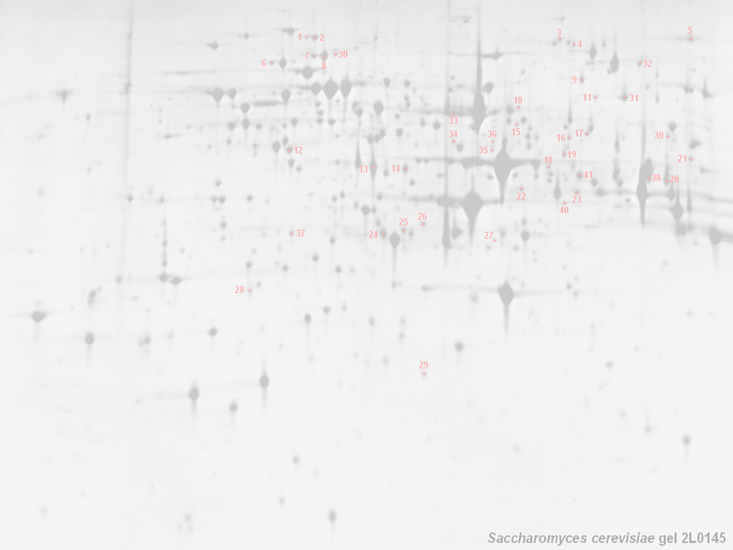



HUPO PSI: General Proteomics Standards
Pierre-Alain Binz, Christine Hoogland (SIB, Switzerland); Chris Taylor, Weimin Zhu, Phillip Jones (EBI, UK); Kathryn Lilley (Uni. Cambridge, UK); Randall K Julian (Eli Lilly Corp); Norman Paton (Uni.
Manchester, UK); Kai Runte (Uni. Bielefeld, Ger)
http://psidev.sf.net/gps/

Slide 2

HUPO — Background
Founded in 2001 with several objectives:
  Consolidate national and regional proteome organisations
  Assist in the coordination of public proteome initiatives
  Engage in scientific and educational activities
Tissue proteome projects and other initiatives:
  Plasma, Liver, Brain, Glyco; PSI and Antibody initiative
Congresses (in addition to many smaller meetings):
  Paris, Nov. 2002; Montreal, Oct. 2003; Beijing, October 2004

Slide 3
HUPO PSI — Background
The Proteomics Standards Initiative (not methods..!)
  Data format standards (cf. MS Word, WordPerfect, PDF, LaTeX)
  Standard term definitions, requirement for annotation
    controlled vocabularies / ontologies (≡ dictionary)
  Minimum reporting requirements (MIAPE)
  Incorporates ‘bench scientists’, tech vendors, funders, publishers
Biggest win to date — Molecular Interaction Format (MIF)
  Several PPI databases exist; BIND, DIP, MINT, Hybrigenics, IntAct
    data provided in many different formats, not synchronised
    tedious work of repeatedly combining data sets
  The standard (MIF) defines a minimal data model
    allows scientists to provide core data, with back references
    simplifies synchronisation (cf. EMBL + GenBank + DDBJ)

Slide 4
HUPO PSI: GPS — Background
HUPO PSI: GPS — General Proteomics Standards
The generation and analysis of proteome data are widespread
  High–throughput approaches are commonplace (if troublesome)
  Techniques continue to increase in complexity (DIGE, iTRAQ, SPR)
Publicly available proteomics data is rather limited
  Sample extraction and preparation usually undocumented
  Analytical methods employed in deriving conclusions absent
  No widely used databases of (for example) mass spectral data
A robust, standard representation of both methods and data from proteomics experiments is required
  Will facilitate handling, exchange and dissemination of data
    development of effective search/analysis tools
    derivation of maximum value from data sets

Slide 5
GPS — Where Are We Going?
MIAPE
  Minimum Information About a Proteomics Experiment
  Requirements to be enforced by journals, repositories, funders
  Technology-specific modules associated with a parent document
XML formats for data exchange
  All based on the GPS proteomics workflow model, PSI-OM
  Markup language (PSI-ML) designed for data exchange, submission
  mzData and mzIdent subsidiary formats for mass spectrometry only
Ontology development
  Crucial for the construction of unambiguously worded data files
Other activities
  Document examining the comparability of search engine metrics
  Study on what constitutes a ‘good’ peptide/protein identification
  Contributions to the journals’ debate on submission guidelines

Slide 6
Development Schedule
PSI-OM and derived markup language (PSI-ML) are maturing
  Draft versions of these (and everything else) on the website
    http://psidev.sourceforge.net/gps/
  Public meeting in Spring ’05 to finalise the first full release
MIAPE: MS module is in the ‘committee stage’
  First brace of modules finalised by Spring ’05
Controlled vocabulary development ongoing
  Working draft available via web pages
  In a useable state by the end of this year
mzData now in a mature state (one final release to go)
  Vendor implementations now underway
  Converters also under development (.dta, .mgf, ‘raw’)
mzIdent is ‘on the workbench’ (mature by Spring ’05)
  Working draft available via web pages
  In a useful state by Spring ‘05

Slide 7
The rest of this session…
The proteomics Standards Initiative Object Model (PSI-OM):
  Derived formats; mzData, mzIdent, PSI-ML
  Ontology development, collaborations and ‘functional genomics’
    Philip Jones (EBI, UK)
MIAPE: Background, current status, timeline
    Pierre-Alain Binz (SIB, Switzerland)
PRIDE: Background, current status, future plans
  Includes description of relationship to the HUPO tissue projects
    Philip Jones (EBI, UK)
The future for the PSI: GPS workgroup
  Will include open discussion of matters arising, if there is time
    Pierre-Alain Binz (SIB, Switzerland)

