Slide 1
PSI-MS
October 23rd, Beijing, 3rd HUPO Conference
Weimin Zhu, Randall Julian

Slide 2
Workshop Agenda
General overview and updates of PSI-MS activities
mzData and its implementations
mzData release 1.04 and CV
Instrument export support
Search engine import support
MIAPE-MS document
Break
mzIdent draft
Tool development
Discussion:
mzIdent, CVs, tools.

Slide 3
Overview - Why Standard?
The generation and analysis of proteome data are widespread, but no common exchange & comparison formats
Instruments and search engines output formats are mostly proprietary
Lack of guidelines of minimum requirements for publication and data repository
A robust, standard representation of both methods and data from proteomics experiments is required

Slide 4
Overview - What to standardize?
Data formats:
mzData & mzIdent
Controlled Vocabularies
Guidelines:
MIAPE-MS,
MIAPE-proteininformatics

Slide 5
PSI-MS Broader Scope and
UPDATES
Search
engines
Vendor-specific
binary format
Peaklist
formats
Outputs
formats
Converters
mzData
mzIdent
Upstream Data
Std. input format
Std. Output format
API/Toolkit
External Data
Repository
MIAPE
Retrieval system
& Visualisation
Data comparison
& Analysis
Data Mining

Slide 6
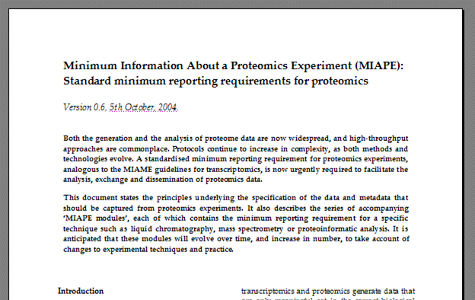
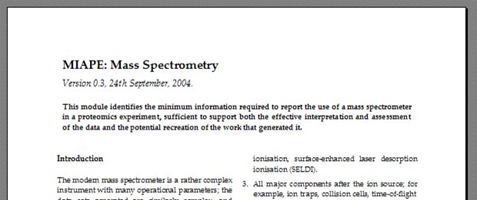
MIAPE Documents 1
MIAPE
Minimum Information About a Proteomics Experiment
Requirement to be enforced by journals, repositories, funders
Technology-specific modules associated with a parent document

Slide 7
MIAPE Documents 2
MIAPE ‘parent document’ — underlying principles
  Unambiguously describe the experimental context
    Standardised reporting requirement
    Sufficient to permit an assessment of data quality
    In principle allow recreation of the work
MIAPE ‘modules’ — technology-specific components
  Each module validated by an ad hoc expert committee
    ⊗ Mass spectrometry (can capture in mzData…)
    ⊗ Proteoinformatics for MS (can capture in mzIdent…)
    Other modules: Study design and sample generation, prefractionation techniques, gel electrophoresis, proteoinformatics for gel electrophoresis, liquid chromatography

Slide 8
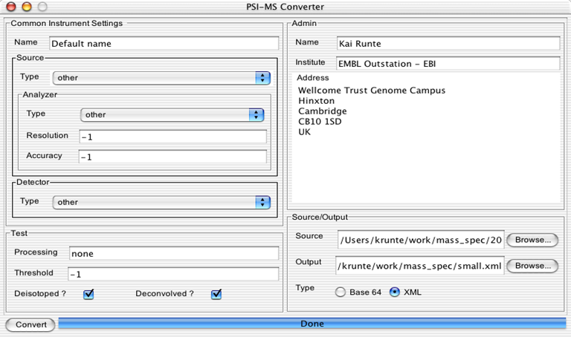
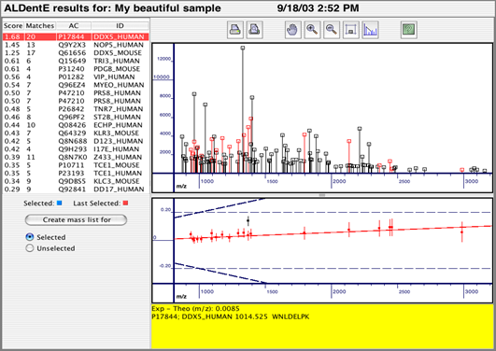
mzData Converters
Converter tool development (Kai Runte, Uni. Bielefeld, Germany)
  Implemented for an earlier version of mzData
.dta/.zta
pairs
other
formats
Search engine

Slide 9
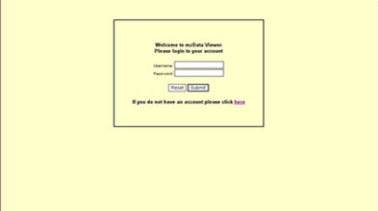
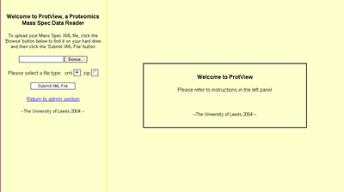
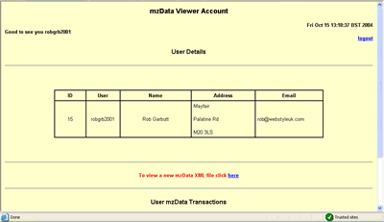
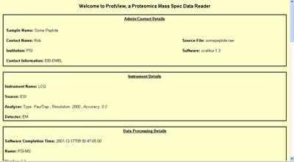
mzDataViewer
Rob Garbutt and David Westhead,
University of Leeds, UK
What is mzDataViewer?
  A web application that enables the presentation of MALDI mass spectrometry data from the standardised mzData XML format
How does mzDataViewer display data?
  The data is presented in a web browser using HTML
  All that is required to run the software is a web browser and an internet connection
http://java.webstyle-uk.com/XmlReader/db/login.jsp

Slide 10
Instrument Export: Bruker
Martin Bluggle, Protagen

Slide 11
Instrument Export: Shimatzu/Kratos
Has completed their implementation of v1.04
The tool will be included in the next release of Kompact
Next release of Launchpad software (v2.7.0) will be includes
Kompact, at the end of year 2004
Free software updates to existing customers
Software searching capacity will be mzData format-aware
When Mascot has completed their implementation.

Slide 12
Search Engine Import: Phenyx
Has completed their implementation of v1.04
Pierre-Alan, Switzland Institute of Bioinformatics, Geneva

Slide 13
Search Engine Import: Mascot
Has completed their implementation of v1.04
Will be officially released late 2004 or early 2005

Slide 14
Search Engine Import: Tamdem X!
Randall Julian, Eli Lilly

Slide 15
MIAPE-MS Module
Specify a significant degree of details should be captured, which includes spectral data and its subsequent processing.
Provide a guideline for mass spectrometry experiments in proteomics.
Effectively interprete and assess mass spectral data, and potentially recreate the work.

Slide 16
MIAPE-MS Module
General Features
- Global descriptions: people, machines, resolution, mass
accuracy etc.
- Control and analysis software information
Ion Source
- ESI
- MALDI
- SALDI
Post-source Componentries
Ion optics, TOF, Ion trap, Collision cell, FT-ICR, Detectors
Peaklist Generation and Annotation
- Creation of stick spectrum
- Quantitation for selected ions

Slide 17
Future Plan
Further Develop mzIdent
Further Develop CV
Develop MIAPI-Proteininformatics module
Further Develop tools
Faciliate collaboration with GPS and HUPO tissue groups,
and PRIDE database.
A workshop and a work session next year.

Slide 18
Collaborations
Three–tiered infrastructure for collecting data from the HUPO tissue proteome projects
Projects’ schemata to
include mzData/mzIdent
Labs generate data
(bottom tier)
Data collection centres
(DCCs) perform quality
control, file validation
Final reposition of the
validated data at EBI
in the PRIDE database
Eventually, all data to
be publicly accessible
GUI & Programmatic Interfaces
Data Distribution: Files, DB Dumps, Mirroring etc.
Repository @ EBI
(PRIDE)
Liver Project Central DCC
Plasma Project Central DCC
Brain Project Central DCC
Data producers (labs participating in one or more tissue projects)
Data submission
Data exchange

