Slide 1

PRIDE
PRoteomics IDEntifications database
A Data Repository and Data Transfer Format for Protein Identifications and Supporting Evidence
Phil Jones, EBI, UK.

Slide 2
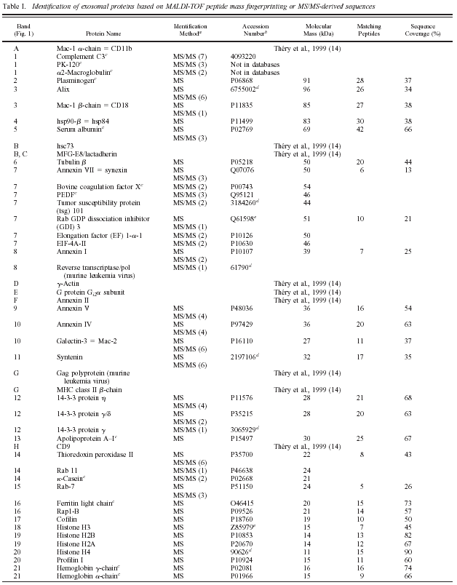
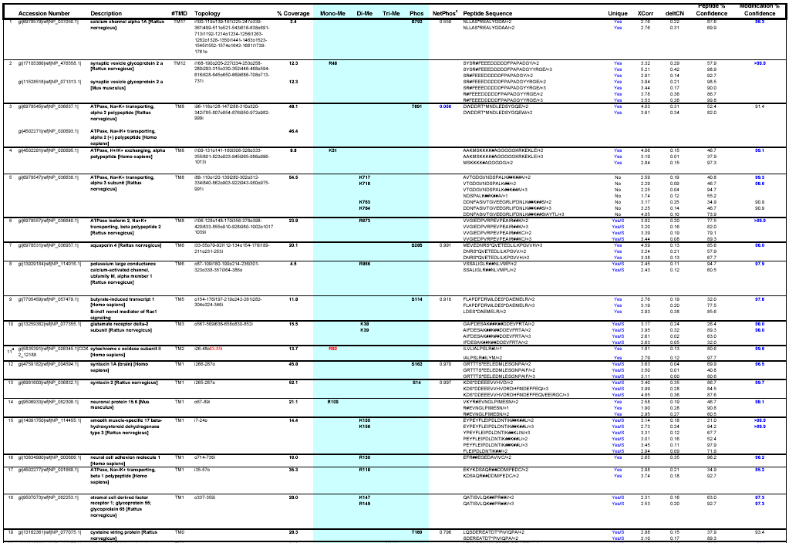
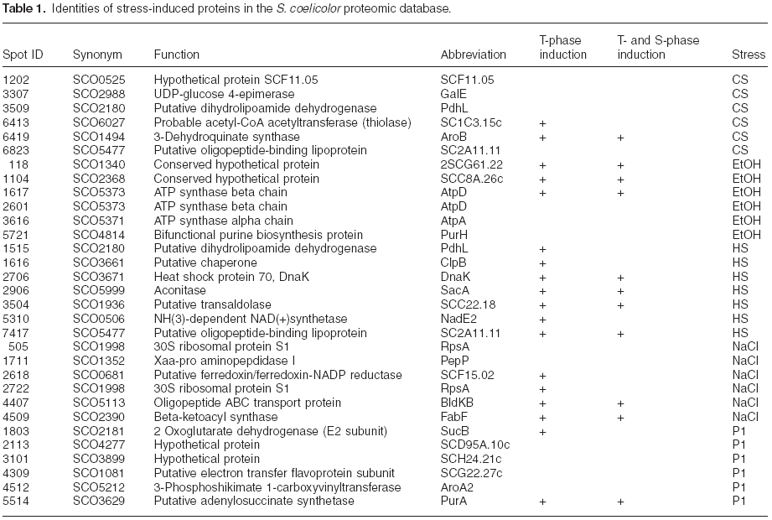
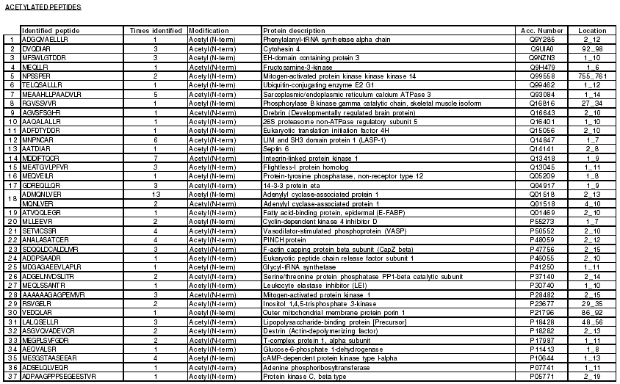
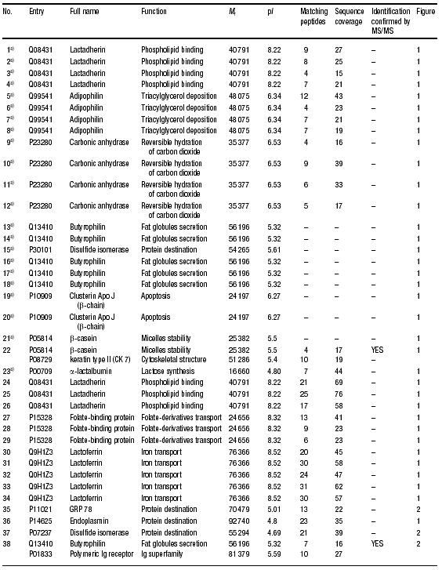
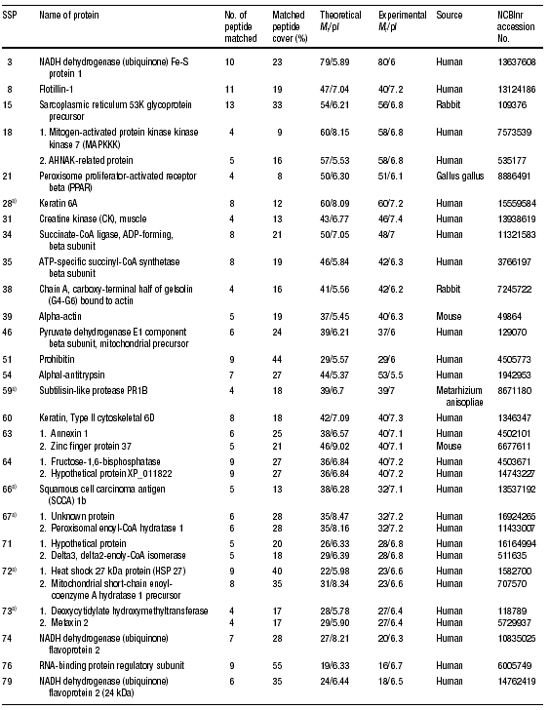
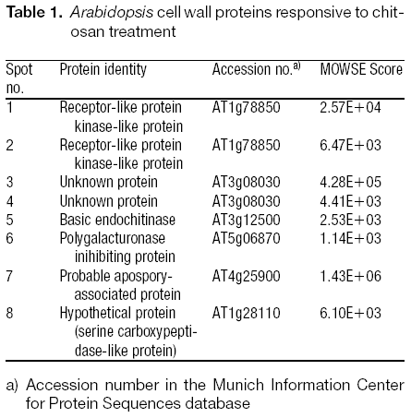
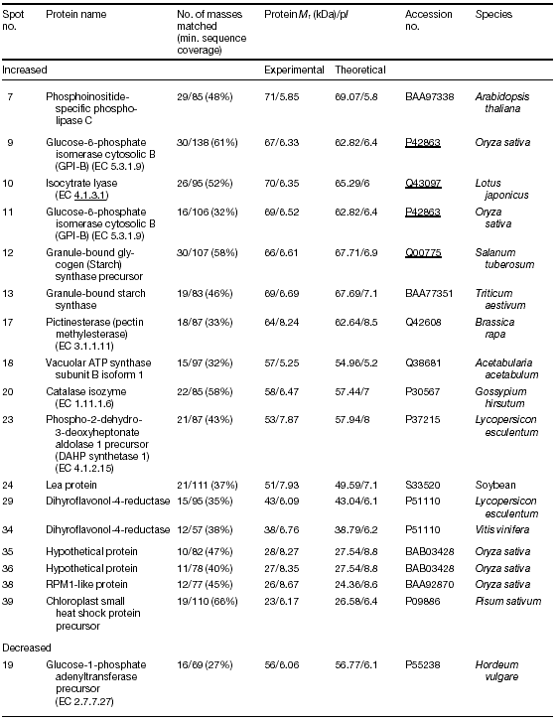
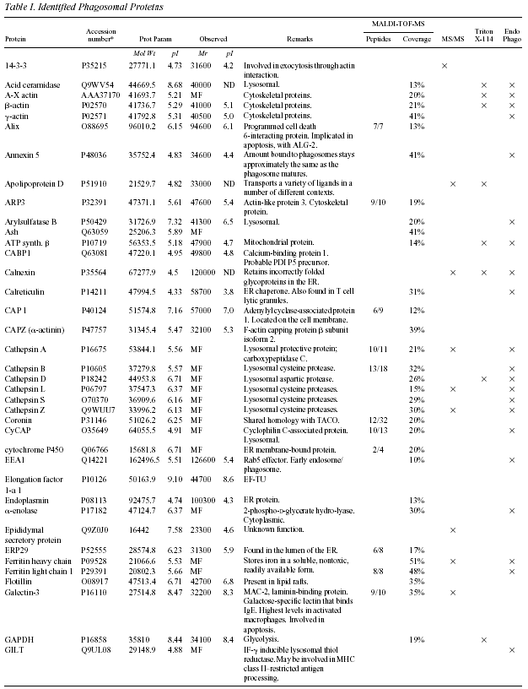
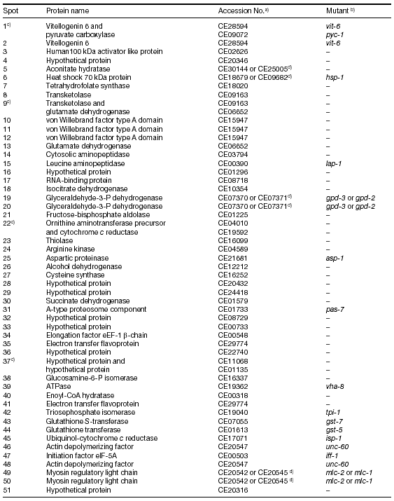
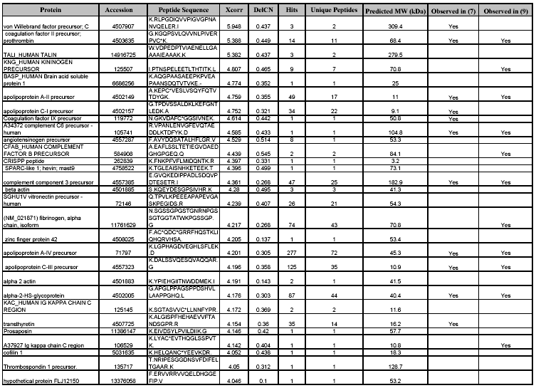
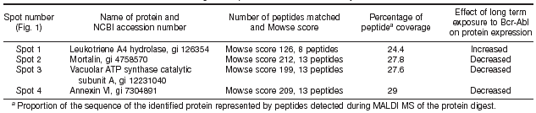
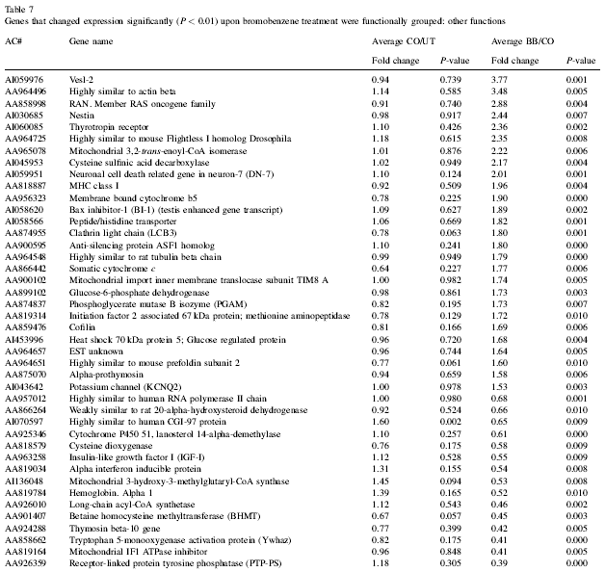
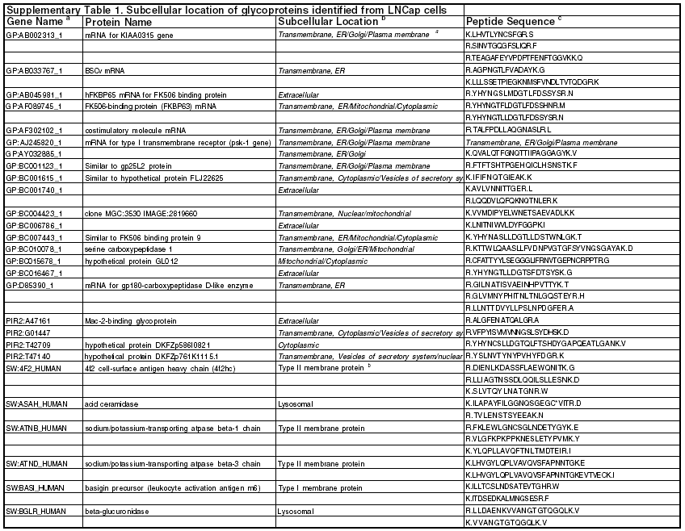
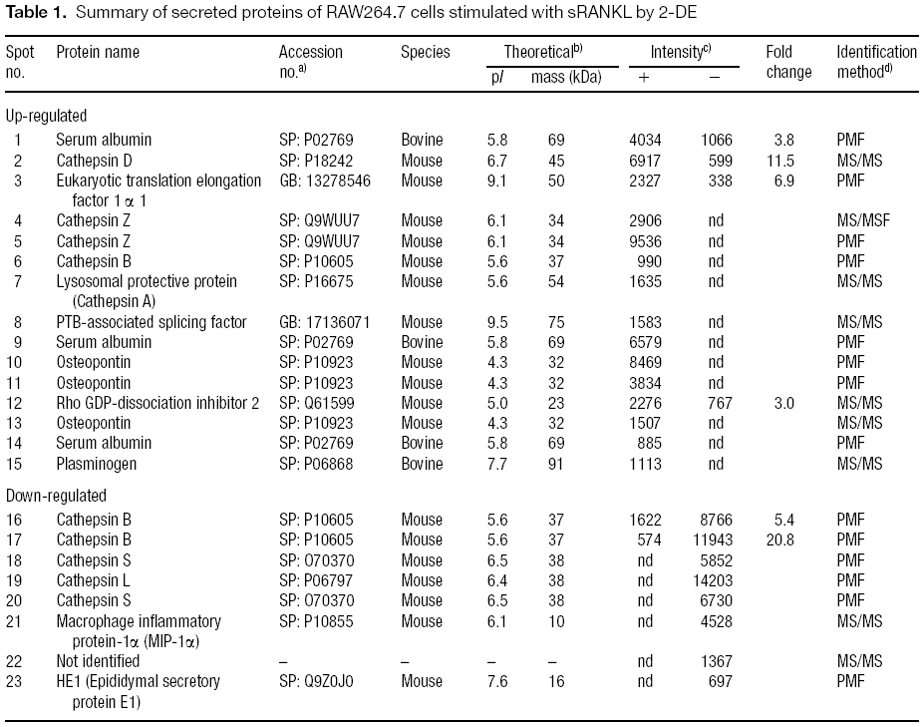
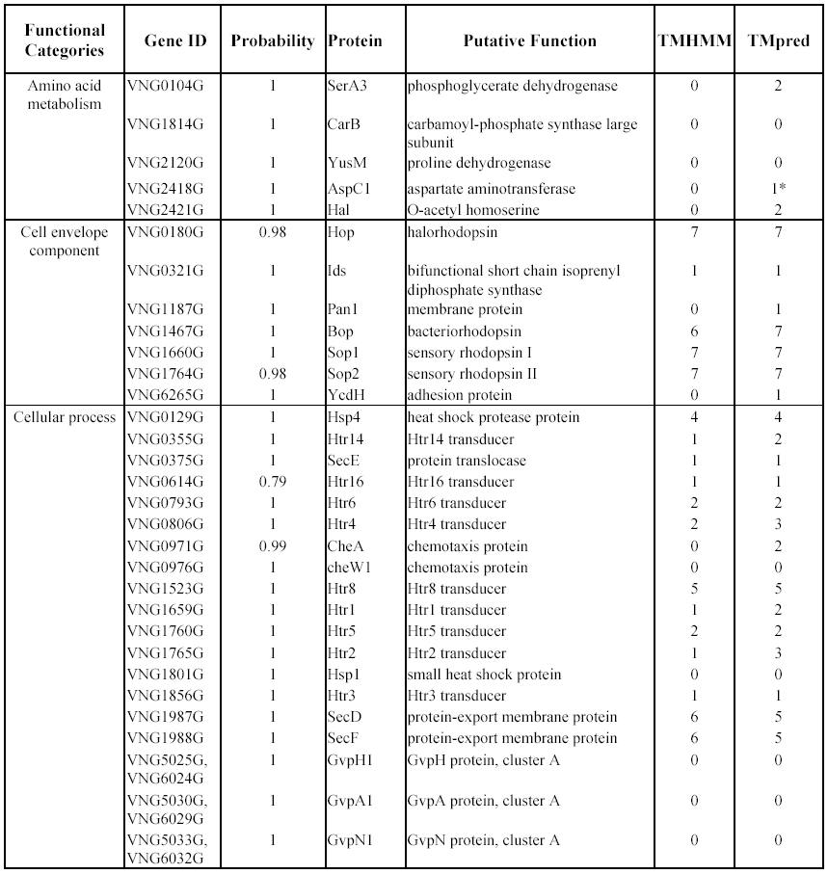
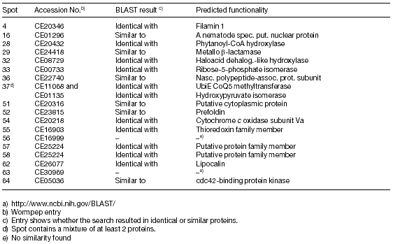
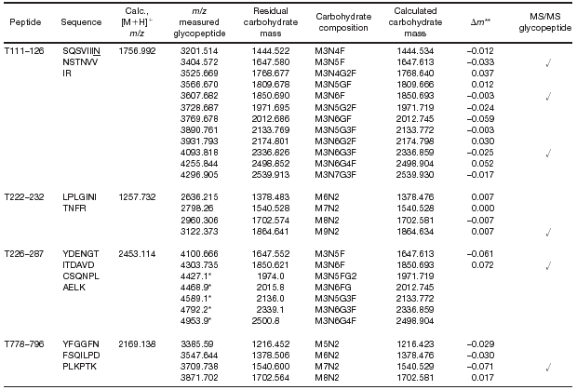
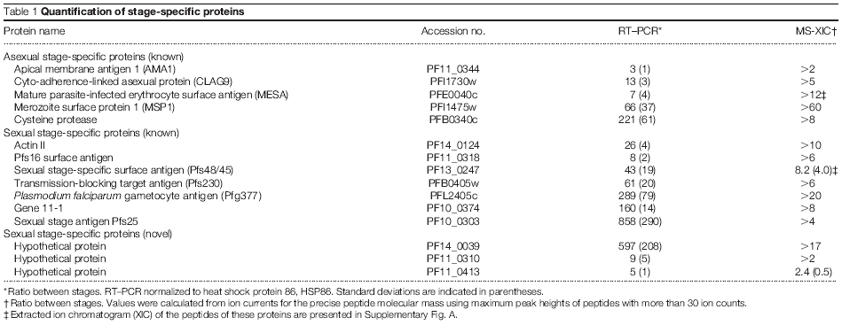
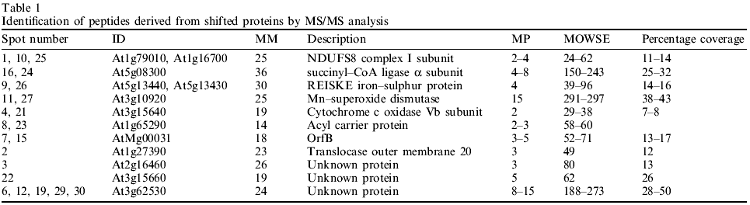
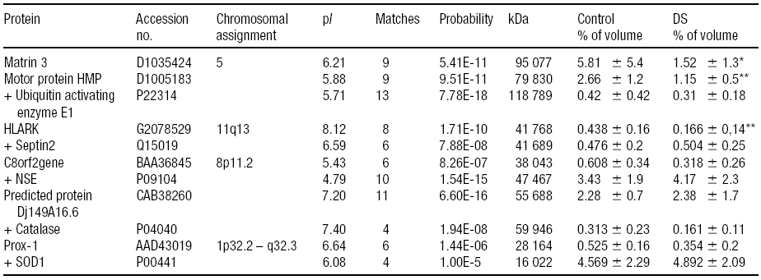
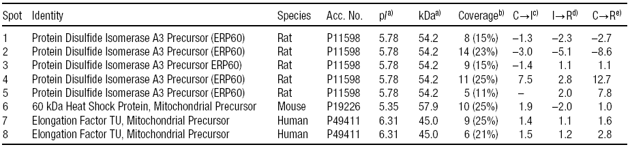
A lack of reporting standardisation…?

Slide 3
PRIDE – Requirements and Implementation
Requirements
The aim of the PRIDE project is to collect data from large scale proteomics experiments (such as the Human Proteome (HuPo) projects, amongst others) and to collect them in a database structure suitable as an addition to the established Swiss-Prot database.
Data of this kind is currently not stored as such and the project is therefore required to start by constructing a formalized description of the data to store, implementing a database suitable for both storing this data as well as allowing Swiss-Prot interaction, and finally a set of submission and interaction tools to feed data into the system and analyze the contents of the database.
The aim of the PRIDE project is to collect data from large scale proteomics experiments (such as the Human Proteome (HuPo) projects, amongst others) and to collect them in a database structure suitable as an addition to the established Swiss-Prot database.
Data of this kind is currently not stored as such and the project is therefore required to start by constructing a formalized description of the data to store, implementing a database suitable for both storing this data as well as allowing Swiss-Prot interaction, and finally a set of submission and interaction tools to feed data into the system and analyze the contents of the database.
Implementation

Slide 4
So what is PRIDE ?
PRIDE is a multi-faceted project offering:
An XML schema for transfer of proteomics protein identification data.
A relational database implementation for the data repository using OJB, allowing the use of most currently available RDBMSs. A central data repository is being set up at the EBI.
Secure upload of proteomics data in the PRIDE XML schema format. (Future developments: upload using the mzData XML schema and potentially a subset of the PSI XML schema.)
The ability to search the repository and download results in PRIDE XML or HTML format. (Future developments: download in alternative XML formats.)
Following release, will become open source and freely available.

Slide 5
The PRIDE Core
http://genesis.UGent.be/pride
PRIDE core
log4j
PRIDE
console
PRIDE DB
persistence
PRIDE XML
persistence
OJB
XPP
$pride:
RDBMS
XML
Log
files

Slide 6
The PRIDE Web Application
http://www.ebi.ac.uk/pride
PRIDE web
log4j
WWW
XSLT
Struts
PRIDE core
log4j
PRIDE
console
PRIDE DB
persistence
PRIDE XML
persistence
OJB
XPP
$pride:
RDBMS
XML
Log
files

Slide 7






PRIDE is very much Open Source…
XML
logging
W W W
RDBMS
Tomcat

Slide 8
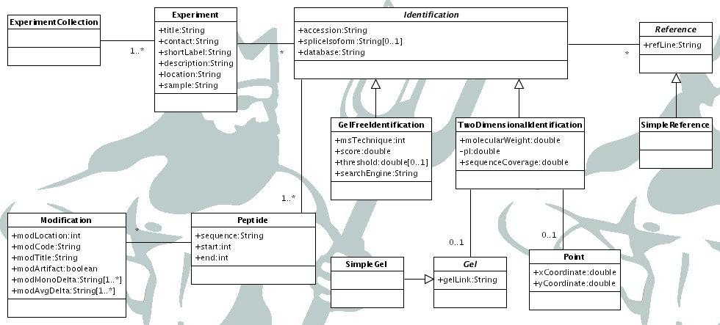
The PRIDE Data Model
This data model (excluding security and registration) will be used in the initial release of PRIDE (as currently released). Extensions will follow in 2005, including mass spec. peak lists.

Slide 9
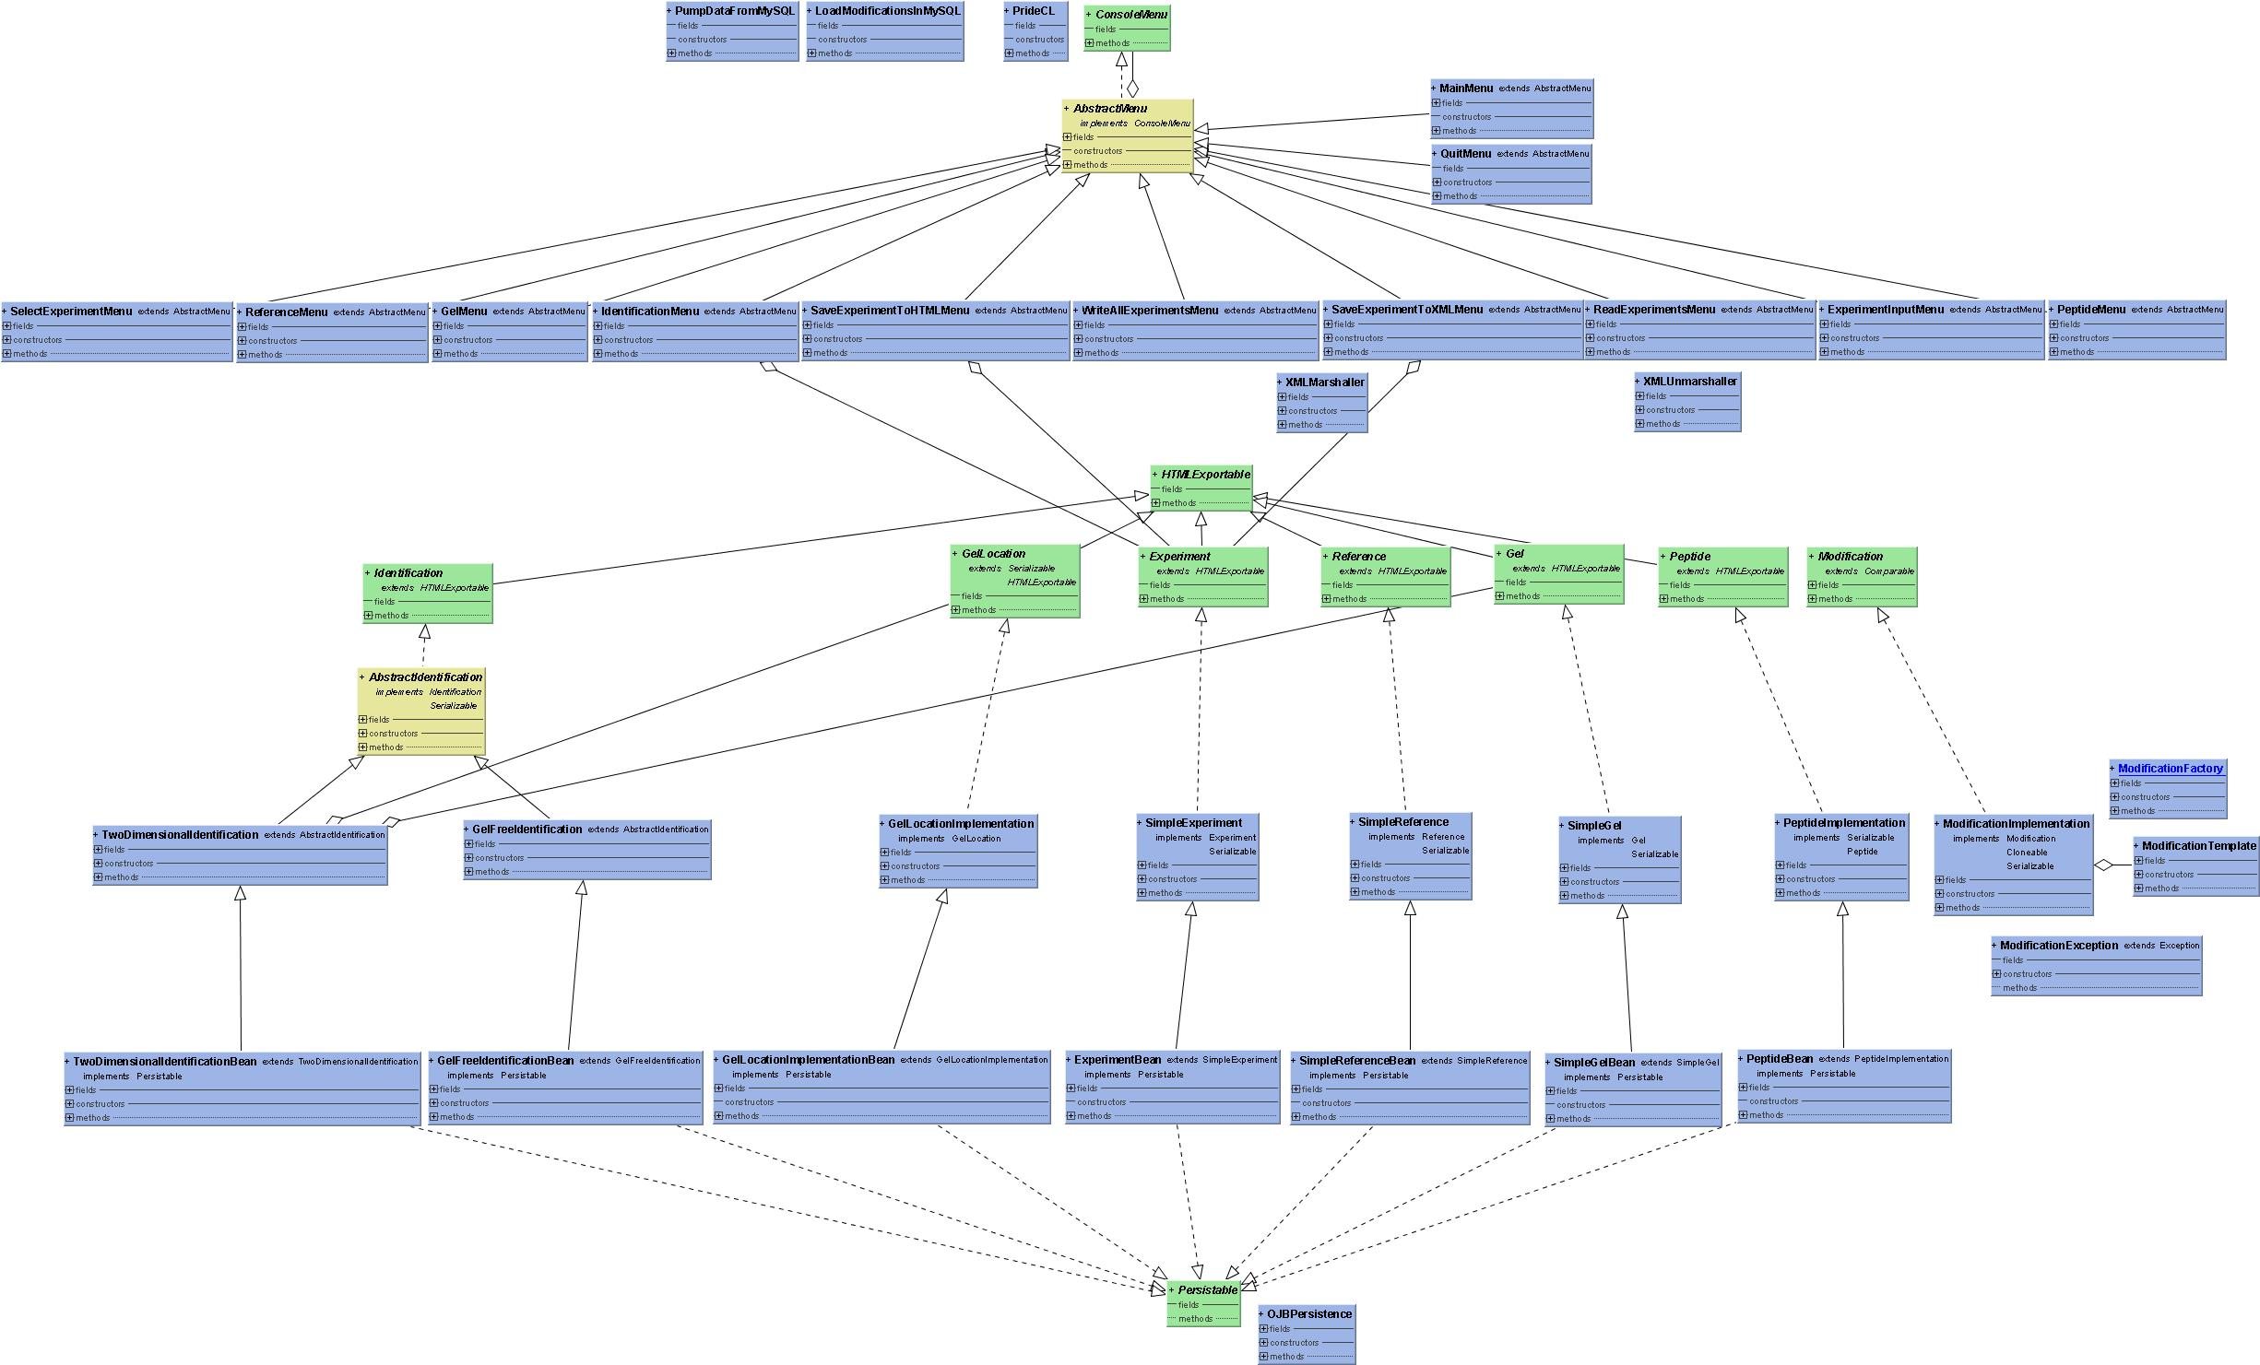
The PRIDE Object Model…
Console
XML
Core
Database

Slide 10
PRIDE – Security and Data Availability
Security measures for data privacy, traceability and group access
Before data can be uploaded, the user needs to register. All personal data is encrypted on the database.
All experimental data is linked to the person who has uploaded it.
Data can be marked as private. The person uploading the data can give a date upon which the data becomes public.
Group access to private data can be granted by creating a 'collaboration' on the system. Other users can then apply to join the collaboration. This is validated by the person who created it. This will allow geographically separated laboratories to share data via PRIDE before it is publicly available.

Slide 11
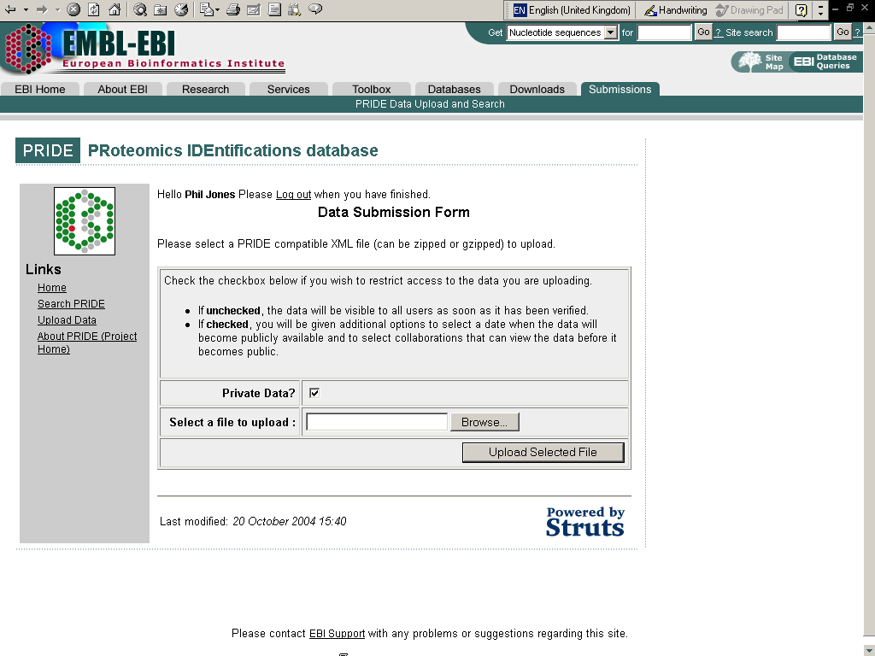
PRIDE Web Application – Data Upload

Slide 12
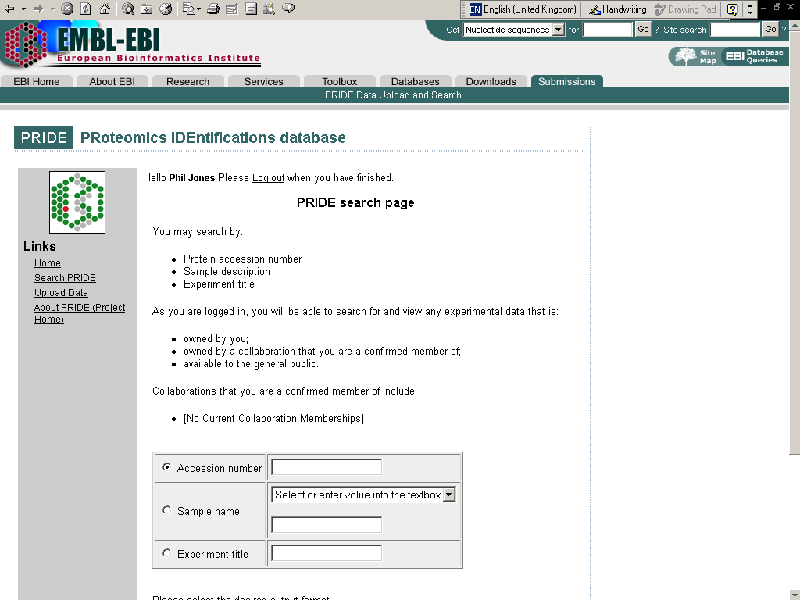
PRIDE Web Application – Data Search

Slide 13
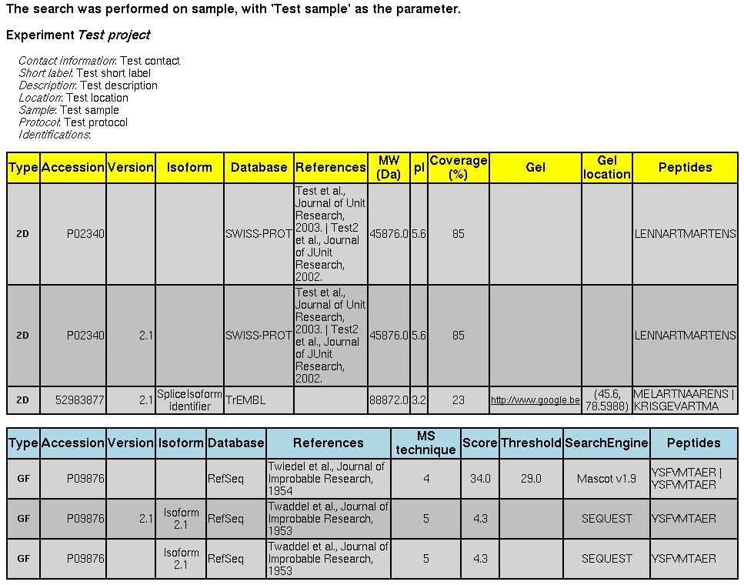
PRIDE Web Application – Search Results (HTML)

Slide 14
PRIDE – Acknowledgements
Lennart Martens (PRIDE's original designer & developer)
Samuel Kerrien
Mark Rijnbeek
Kai Runte
Chris Taylor
Henning Hermjakob
Rolf Apweiler

