Slide 1
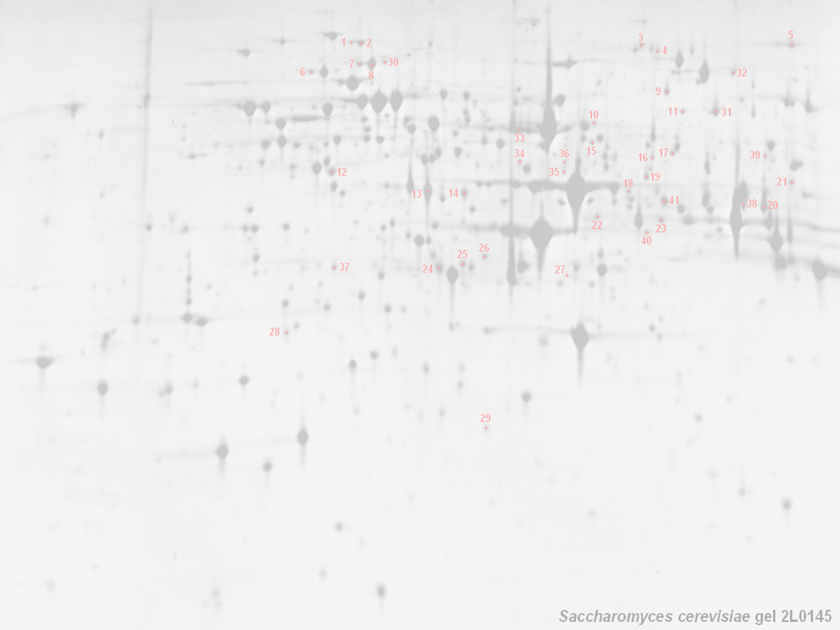


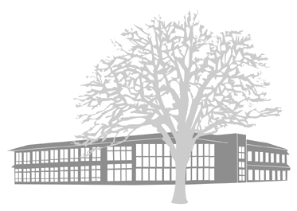
HUPO PSI: Mass Spectrometry
Weimin Zhu, Chris Taylor (EBI, UK); Randall K Julian (Eli Lilly Corp); Kai Runte, Andreas Wilke (Uni. Bielefeld, Ger (EBI, UK)
http://psidev.sf.net/ms/

Slide 2

HUPO — Background
Founded in 2001 with several objectives:
  Consolidate national and regional proteome organisations
  Assist in the coordination of public proteome initiatives
  Engage in scientific and educational activities
Tissue proteome projects and other initiatives:
  Plasma, Liver, Brain, Glyco; PSI and Antibody initiative
Congresses (in addition to many smaller meetings):
  Paris, Nov. 2002; Montreal, Oct. 2003; Beijing, October 2004

Slide 3
HUPO PSI — Background
The Proteomics Standards Initiative (not methods..!)
  Data format standards (cf. MS Word, WordPerfect, PDF, LaTeX)
  Standard term definitions, requirement for annotation
    controlled vocabularies / ontologies (≡ dictionary)
    minimum reporting requirements (MIAPE)
  Incorporates ‘bench scientists’, tech vendors, funders, publishers
Biggest win to date — Molecular Interaction Format (MIF)
  Several PPI databases exist; BIND, DIP, MINT, Hybrigenics, IntAct
    data provided in many different formats, not synchronised
    tedious work of repeatedly combining data sets
  The standard (MIF) defines a minimal data model
    allows scientists to provide core data, with back references
    simplifies synchronisation (cf. EMBL + GenBank + DDBJ)

Slide 4
HUPO PSI: MS & GPS — Background
The generation and analysis of proteome data are widespread
  High–throughput approaches are commonplace (if troublesome)
  Techniques continue to increase in complexity (DiGE, iTRAQ, etc.)
Publicly available proteomics data is rather limited
  Sample extraction and preparation usually undocumented
  Analytical methods employed in deriving conclusions absent
  No widely used databases of (for example) mass spectral data
A robust, standard representation of both methods and data from proteomics experiments is required
  Will facilitate handling, exchange and dissemination of data
    development of effective search/analysis tools
    derivation of maximum value from data sets
HUPO PSI: MS — Mass Spectrometry (formats, standards, ontology)
  MS Workgroup also contributes to PSI: GPS (General Proteomics Standards)

Slide 5
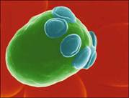
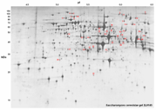

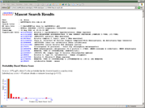
Scope for the MS Workgroup
Sample generation
  Origin of sample
    hypothesis, organism, environment, preparation, paper citations
Sample processing & gel informatics
  Gels (1D/2D), columns, ‘chips’, other methods
    images, gel type and ranges, band/spot coordinates, quantitation
    stationary and mobile phases, flow rate, temperature, fraction details
Mass spectrometry → ‘mzData’
    machine type, ion source, voltages
In silico analysis for MS → ‘mzIdent’
    peak lists, database name + version, partial sequence, search parameters, search hits, accession numbers, quantitation

Slide 6
XML Formats and Supporting CV
mzData —
  Covers use of a mass spectrometer and data generated
    Standard format
    Eliminate costs of incompatibilities
    Facilitate data exchange and analysis
    Facilitate data exchange and analysis
mzIdent —
  Covers use of (peak list) search engines and the results
    A way to unify different search engine results
    Facilitate cross-comparisons (PSI and the major journals are working towards the production of common guidelines for comparing results
Supporting controlled vocabulary —
  Crucial to support these two formats (and the rest of the PSI-ML)
    Development ongoing (in OWL); much to do…

Slide 7
PEDRo → HUPO PSI Standards
PEDRo
HUPO PSI (Oct ‘02, Jan ’03, July ’03, April ’04)
Mass spec vendors’ existing output formats
Compatibility with search engines and tools
Consultation with domain experts
MIAPE
Public meetings to generate
maximum feedback
Publication in print and via
the web, to reach the widest
possible audience
MS Ontology
PSI-OM
mzData, mzIdent,
→ PSI-ML

Slide 8
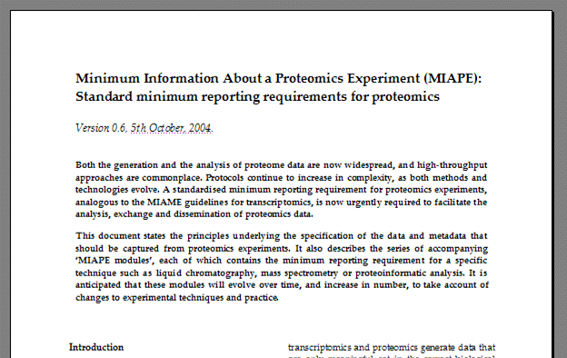
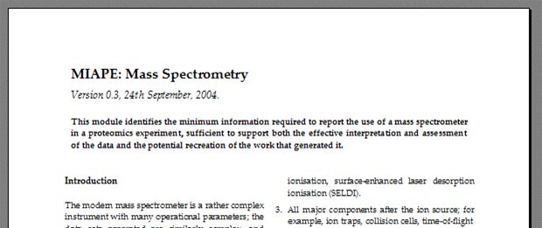
Minimum Reporting Requirement
MIAPE
  Minimum Information About a Proteomics Experiment
  Requirement to be enforced by journals, repositories, funders
  Technology-specific modules associated with a parent document
    Users assemble the relevant modules into a bespoke reporting requirement for a particular workflow

Slide 9
Minimum Reporting Requirement
MIAPE ‘parent document’ — underlying principles
  Unambiguously describe the experimental context
    Standardised reporting requirement
    Sufficient to permit an assessment of data quality
    In principle allow recreation of the work
MIAPE ‘modules’ — technology-specific components
  Each module validated by an ad hoc expert committee
    ⊗ Mass spectrometry (can capture in mzData…)
    ⊗ Proteoinformatics for MS (can capture in mzIdent…)
    Other modules: Study design and sample generation, prefractionation techniques, gel electrophoresis, proteoinformatics for gel electrophoresis, liquid chromatography

Slide 10
Supporting the proteome projects
Three–tiered infrastructure for collecting data from the HUPO tissue proteome projects, in their main experimental phase
Projects’ schemata to
include mzData/mzIdent
Labs generate data
(bottom tier)
Data collection centres
(DCCs) perform quality
control, file validation
Final reposition of the
validated data at EBI
in the PRIDE database
Eventually, all data to
be publicly accessible
GUI & Programmatic Interfaces
Data Distribution: Files, DB Dumps, Mirroring etc.
Repository @ EBI
(PRIDE)
Liver Project Central DCC
Plasma Project Central DCC
Brain Project Central DCC
Data producers (labs participating in one or more tissue projects)
Data submission
Data exchange

Slide 11
Provision of repository and tools
Repository solution developed by Lennart Martens (Uni. Gent, Belgium); Phil Jones, Henning Hermjakob (EBI)
  Initially developed to host a database of protein identifications scraped from the biological literature
  Re-useable technology; will be deployed for the HUPO tissue projects and ultimately to capture MIAPE-compliant data sets
PRIDE web
log4j
WWW
XSLT
Struts
PRIDE core
log4j
PRIDE
console
PRIDE DB
persistence
PRIDE XML
persistence
OJB
XPP
$pride:
RDBMS
XML
Log
files

Slide 12
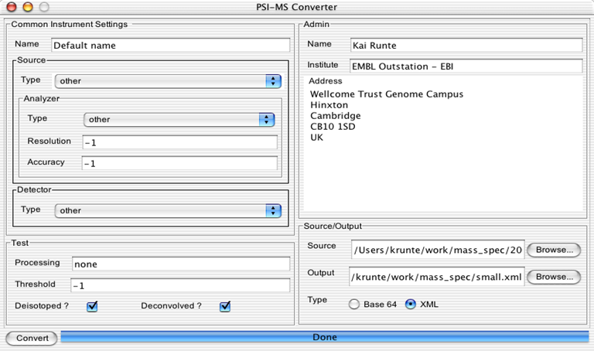
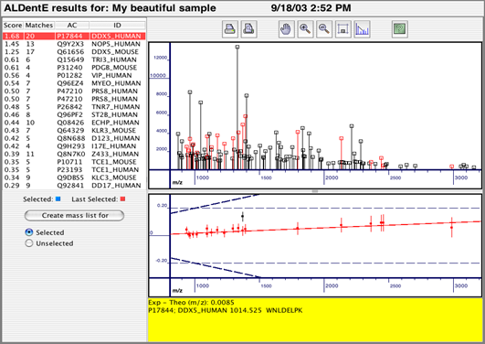
File Conversion and Import
Converter tool development (Kai Runte, Uni. Bielefeld, Ger)
  Implemented for an earlier version of mzData
    requires some updating after recent schema evolution
  Starting with .pkl, .mgf, .dta formats → mzData
.dta/.zta
pairs
other
formats
Search engine

Slide 13
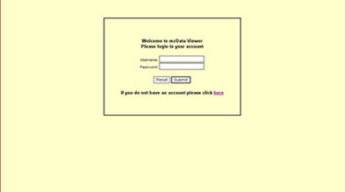
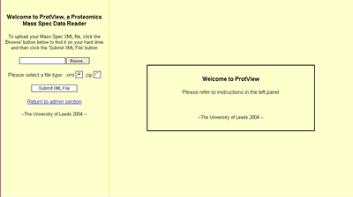
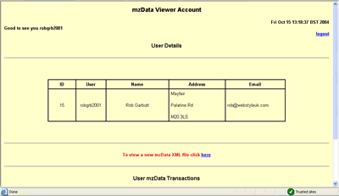
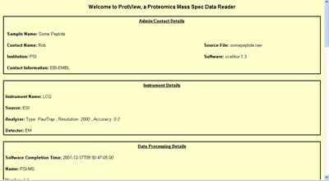
mzDataViewer
Rob Garbutt and David Westhead, University of Leeds, UK
What is mzDataViewer?
  A web application that enables the presentation of MALDI mass spectrometry data from the standardised mzData XML format
How does mzDataViewer display data?
  The data is presented in a web browser using HTML
  All that is required to run the software is a web browser and an internet connection
The core technology
  mzDataViewer is written in Java and utilises Java servlet technology along with the JDOM XML parser
  It is platform-independent and runs on a servlet container such as Tomcat
Software features
  Secure authentication into a unique account
  Data storage facility enabling tracking and comparison of previous mass spec data
  Facility to email outputted HTML file to the user
  Option of uploading XML or compressed ZIP files
http://java.webstyle-uk.com/XmlReader/db/login.jsp

Slide 14
GPS — How Do We Get There?
Web site
    http://psidev.sourceforge.net/ms/
    Project files, plus documents and presentations
Email lists
    Used to make announcements and discuss issues
    Details at http://psidev.sourceforge.net/
Meetings
  Formal meetings
    PSI Spring meetings; full HUPO gatherings
  Informal meetings
    Ad hoc basis; details of all meetings (agendas before, minutes after) will be posted on the web.
  Committees
    Formed as required to advance or validate projects
    Example: Committee being formed for MIAPE: MS module

Slide 15
Development Schedule
mzData now in a mature state (one final release to go)
  Vendor implementations now underway
  ASCII converters under development (.dta, .mgf, etc.)
  Prototype ‘raw’ converter (Thermo XCalibur API)
mzIdent is ‘on the workbench’
  Working draft available via web pages
  In a useful state by Spring ‘05
Controlled vocabulary development ongoing
  Working draft available via web pages
  In a useful state by the end of this year
Implementations to date
  Demo implementations: Bruker Daltonic; Kratos (Shimadzu);
  Matrix Science; Eli Lilly; University of Leeds (UK)

Slide 16
Conclusions
Standard data formats (mzData, mzIdent, PSI-ML)
  Standardised transport/exchange formats for data and metadata
  Tool development and information exchange will be facilitated
  mzData, mzIdent to be used (complete) in PSI-ML (when ready)
The MIAPE minimum reporting requirement
  Establish provenance and relevance of a data set
  Sophisticated search and analysis becomes possible
    e.g. exclude data generated by a particular technique
  Extraction of maximum value from MIAPE-compliant data sets
  Specific modules for mass spec and search engines
Common ontology for functional genomics
  Underpins all of the above; start from mass spec ontology and work outwards to cover whole scope of GPS as it matures

Slide 17
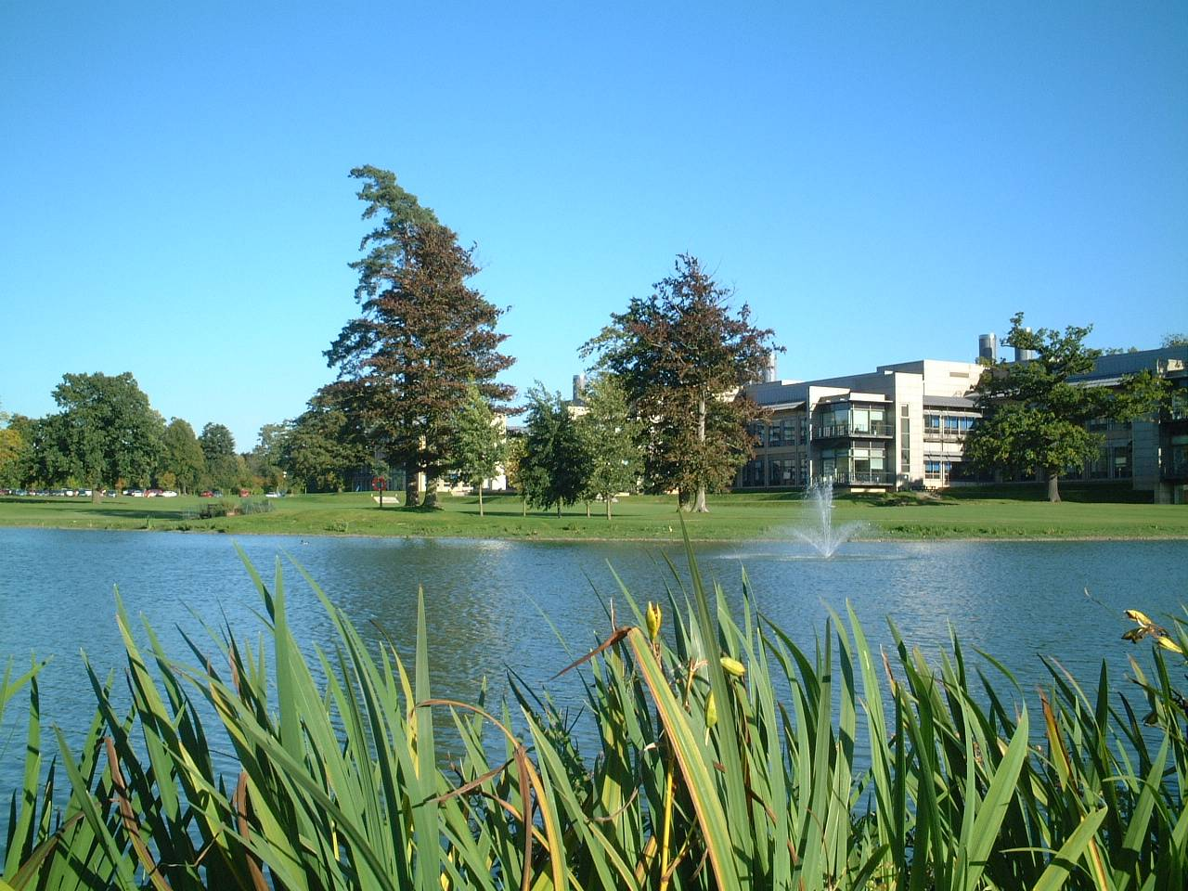


Acknowledgements (lots of them!)
Many people have contributed their expertise, at many meetings, notably at the various HUPO Proteomics Standards Initiative meetings (’02—’04).
Other notable contributions came from:
Weimin Zhu, Kai Runte, Henning Hermjakob, Rolf Apweiler (EBI, UK);
Randall Julian (Eli Lilly, ASTM, ASMS), Kathryn Lilley (Cambridge)
Andy Brass, Steve Oliver, Norman Paton, Simon Hubbard and group, Simon Gaskell and group (Manchester, UK); Pierre-Alain Binz (SIB, Switzerland);
Kath Lilley’s group (Cambridge, UK); Ruedi Aebersold and group (ISB Seattle, USA); Al Brown and group (Aberdeen, UK); many other academic groups
Bruker Daltonic; Matrix Science; Kratos Analytical; GE Healthcare (Thermo, Amersham); Applied Biosystems; Nonlinear Dynamics; Agilent Technologies; Waters Corp.; MDS Sciex; IBM and many more
NERC, BBSRC, NIH; HUPO P/L/BPP; Journals such as Proteomics, Molecular and Cellular Proteomics, Journal of Proteome Research, Nature Biotech…

