Slide 1



Biomolecular Interaction Network Database
John J. Salama
PSI Meeting
Nice, France
April 2004
A program of the Samuel Lunenfeld
Research Institute
A University of Toronto affiliated
research institute

Slide 2
BIND Specification
Describes interactions, complexes and pathways
Describes proteins, DNA, RNA, genes, small molecules
Over 2000 data fields
Built on top of the NCBI specification
Available in ASN.1 and XML Schema
Published in NAR (2003)
Currently at version 3.1
Moving to version 4.0 (will support lossless PSI record imports)

Slide 3
BIND Data
Data freely available for commercial and academic use
>79 000 records available at http://bind.ca
  Genetic interactions
  Interactions containing DNA, RNA and small molecules
  19, 000 biopolymer structure interactions (PDB)
Data available at ftp://ftp.blueprint.org/pub/BIND
  ASN.1
  XML
  Flat file (BIND Index)
  FASTA
  Cytoscape
  PSI (future)

Slide 4
Three Ways BIND Records Are Created
  High Throughput Imports
  CHIP-IP, TAP Tag, yeast two hybrid
  We hold submitted data until published - “HUP” policy
  External Submissions
  Submitters have the right to edit/alter their records over time
  We hold submitted data until published - “HUP” policy
  Internal Hand-Curation
  Added by BIND curators after reading interaction papers
Notes:
HTP staff import a high volume of interactions – lately genetic interactions from one of leading researchers in TO Charlie BOOne
Hiher and higher no. of external submisssions

Slide 5
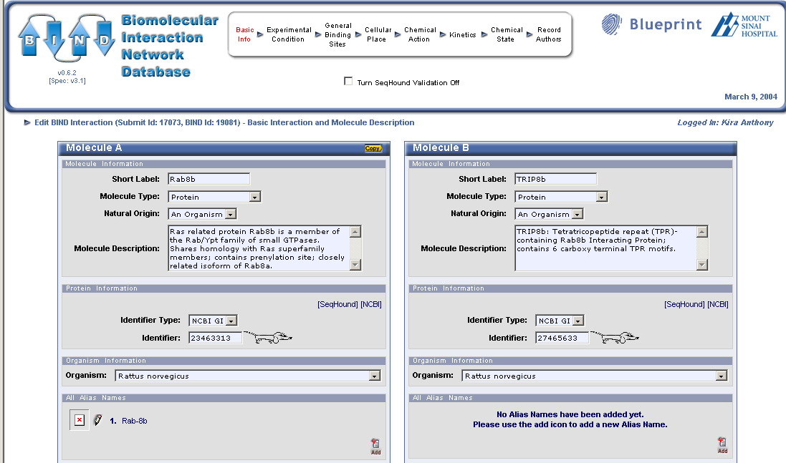
Interaction Submission – 4 of 5 Minimal Pieces

Slide 6
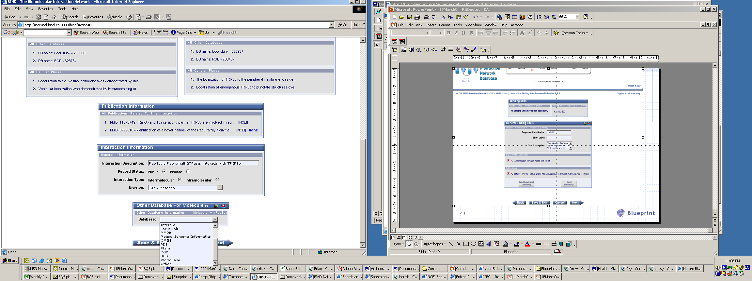
Interaction Submission – 5th Piece: Publication
Additional information:
Other Database Identifiers
Interaction Description

Slide 7
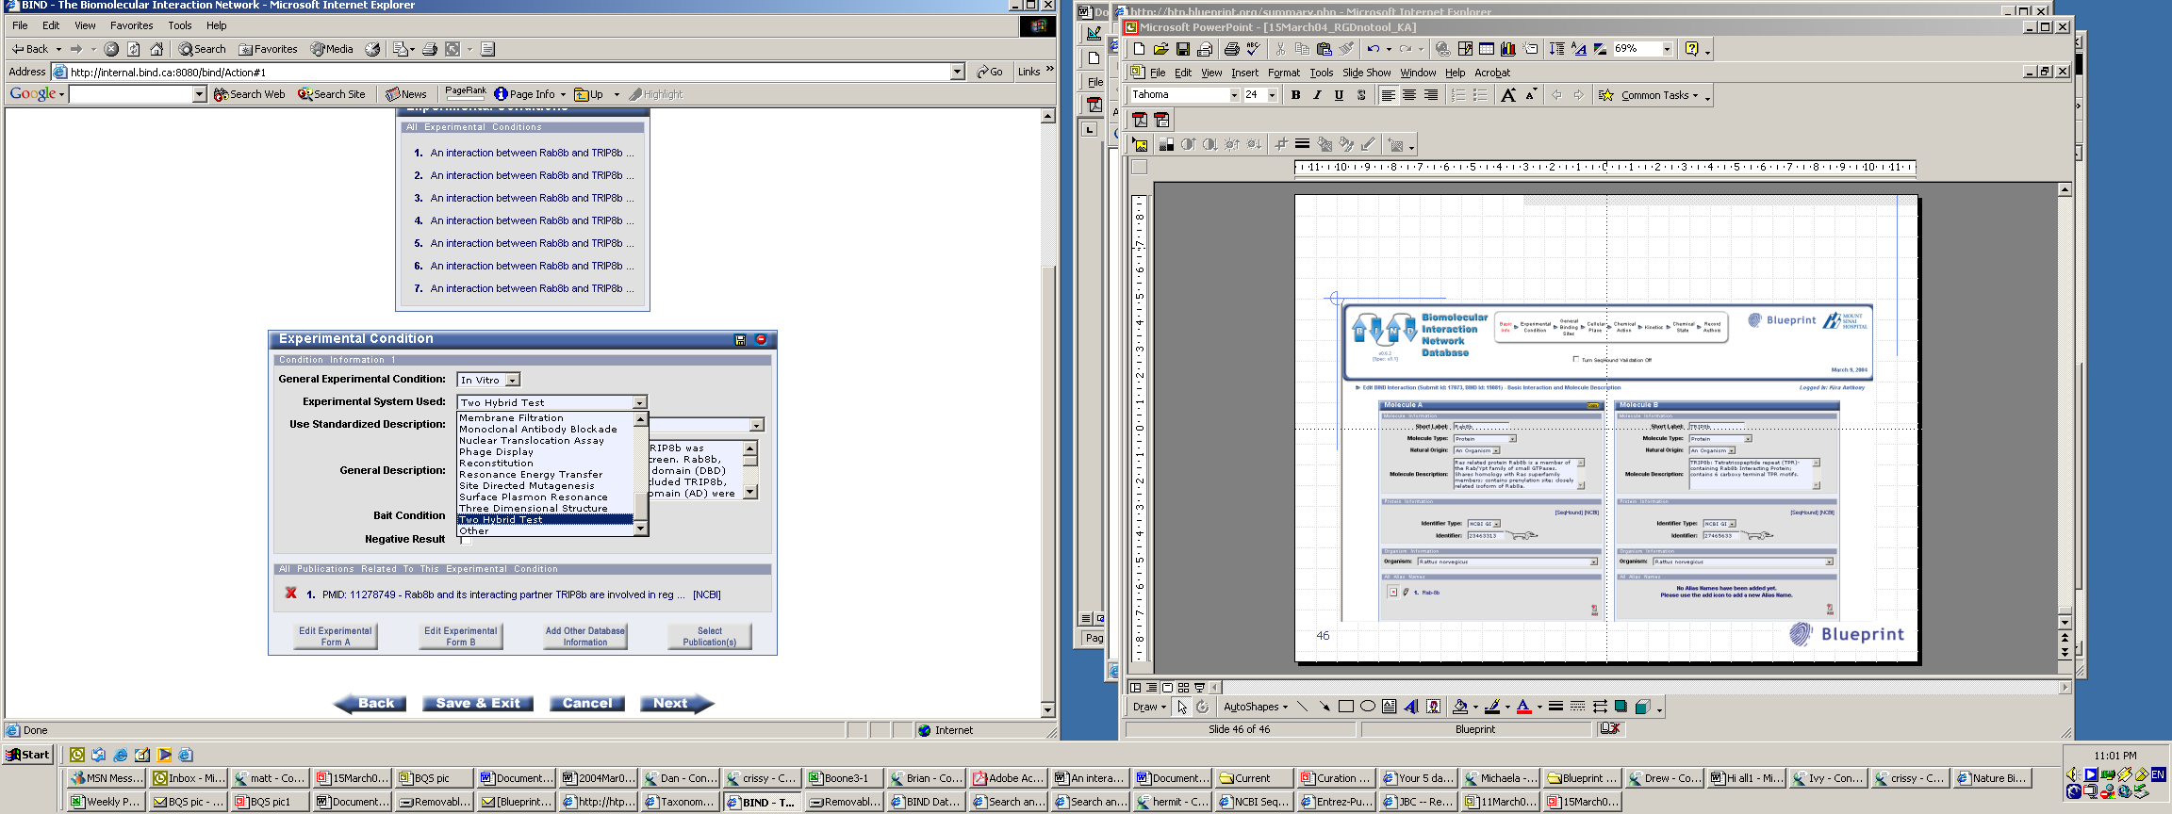
Interaction Submission: Experimental Conditions
Choose Experimental System
Use standard text description

Slide 8
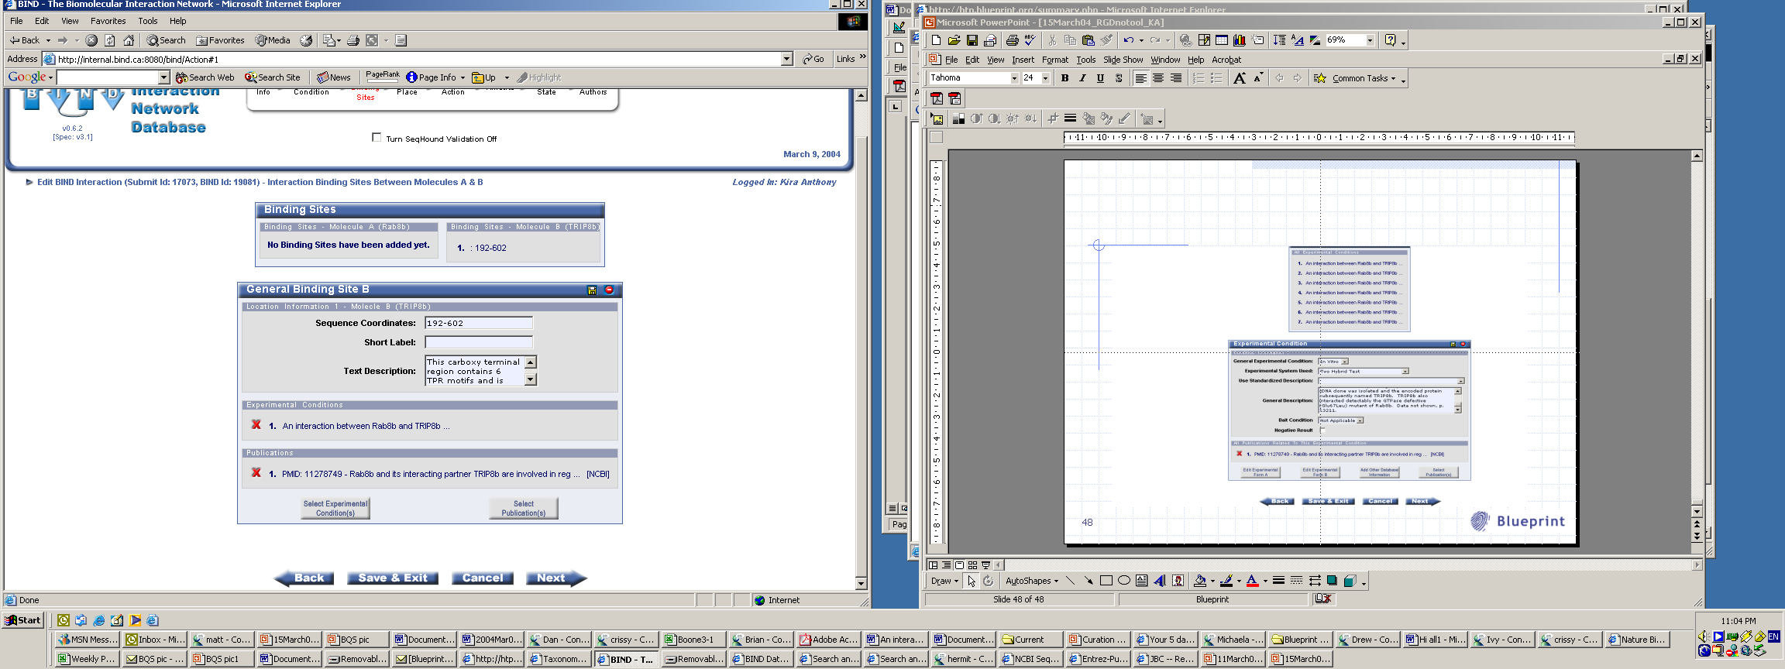
Interaction Submission: Binding Sites

Slide 9
Blueprint – A Global Curation Effort
Blueprint North America
  Currently 28 curators
  Expanding to 40 curators by Sept. ‘04
  Currently ~150 hand curated records/week
Blueprint Asia
  Currently 7 curators
  Expanding to 30 curators by ’06
  Currently in training
Blueprint Europe
  Will be announced at ISMB 2004
  Expected to be 20 curators

Slide 10
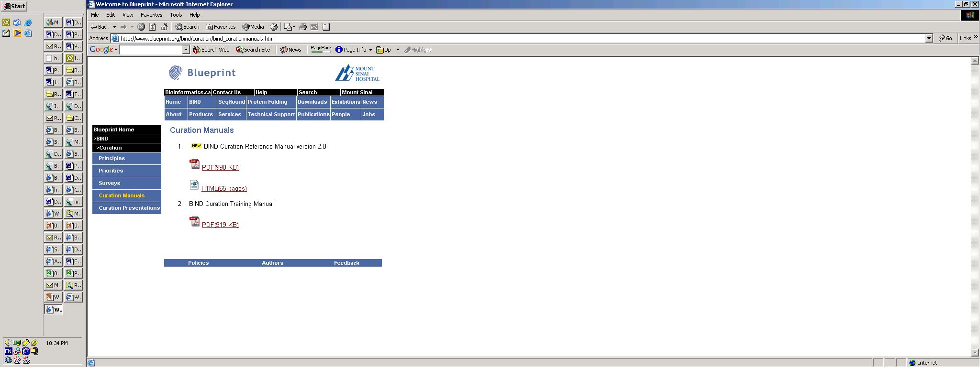

BIND Curation Manuals
Freely available online
Notes:
Details a step-wise progression of how generate a BIND record

Slide 11
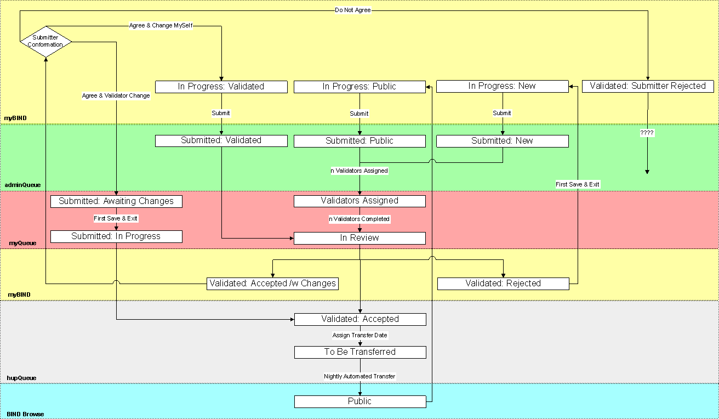
BIND Record Curation Process

Slide 12
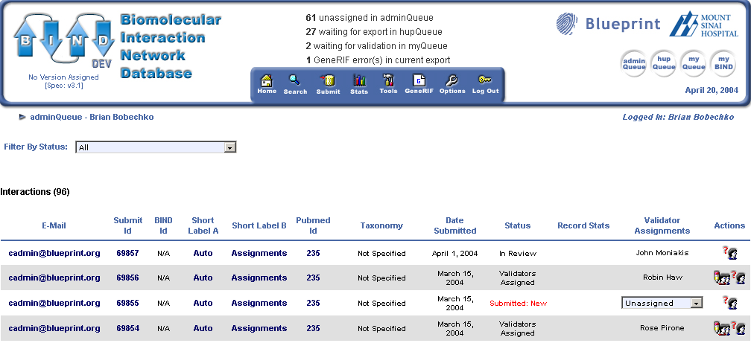

Supporting Distributed Curation
Records submitted to BIND are entered into a globally available queue

Slide 13
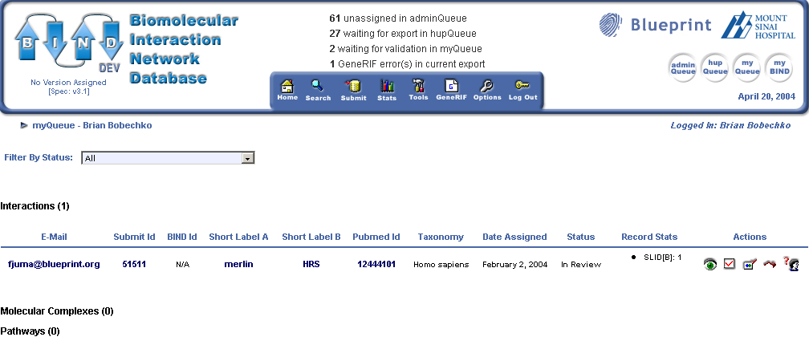
Supporting Distributed Curation
Records assigned to a curator are available in their personal ‘myQueue’

Slide 14
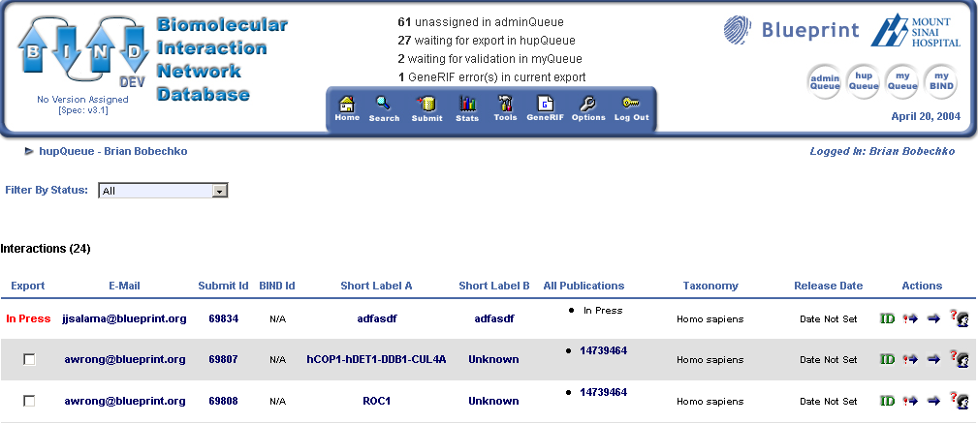
Supporting Distributed Curation
Records ready for public release enter into a separate queue

Slide 15
Distributed Submission & Curation Software
J2EE/XML/SQL architecture
BIND v3.0
Freely available under GPL

Slide 16
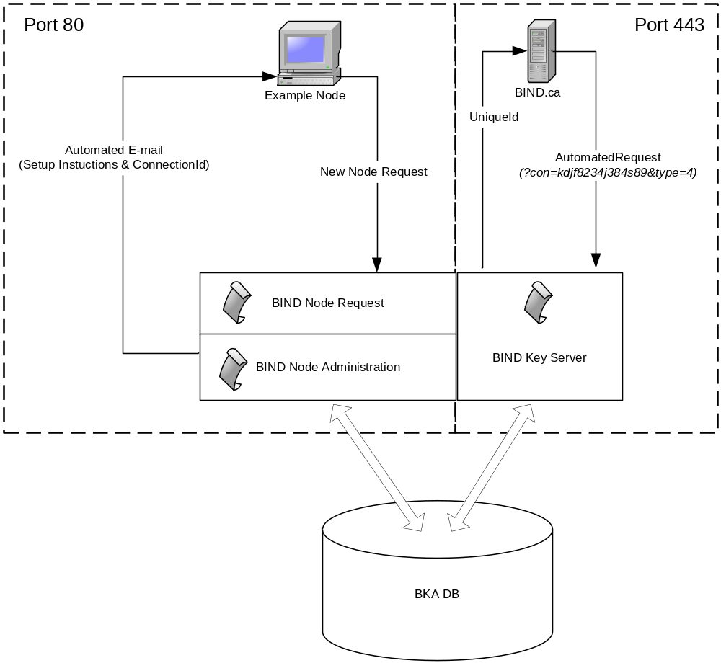
BIND Distributed Key Assignments – Universal Accession Space

Slide 17
Acknowledgments
Christopher W.V. Hogue
C. Eric Andrade
Employees at Blueprint North America and Blueprint Asia

