Slide 1
MIPS Protein Interaction Databases and the Integration of the PSI MI Standard
MIPS / IBI
V. Stümpflen
M. Oesterheld

Slide 2
MIPS / IBI:
Bioinformatics for genome analysis
Biology driven
  Infrastructure for the interpretation
  of experimental data (repository, FunCat, PEDANT, etc.)
  Annotation of genomes for functional
  comparative analysis (yeast, A. thaliana, N. crassa, cDNA, mouse)
Technology driven
  Datastructures and methods for
  the annotation of mammalian genomes (Stümpflen Group)
Methods
  Sequence characterisation
  Expression analysis
  Protein/protein interactions
  Structuring the sequence and functional spaces
  Projection of functional modules onto experimental
Notes:
Was MIPS so alles macht

Slide 3
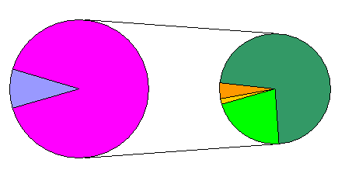
MIPS Interaction Databases
General Overview:
Binary Interactions
11.983
Yeast
16.661
Mammalian ~1.700
Complexes
783
285
3.630

Slide 4
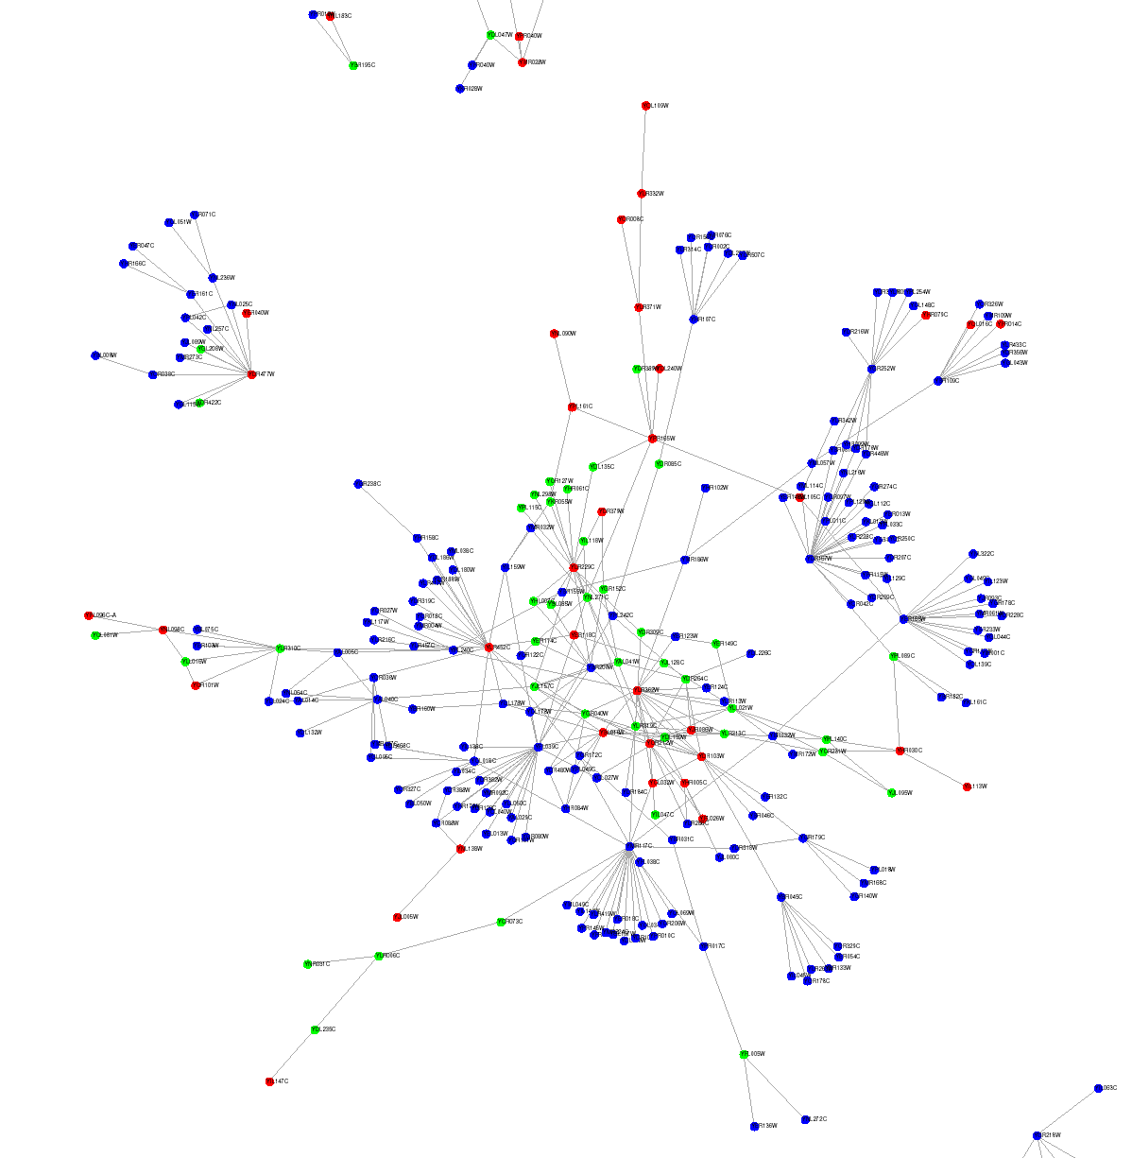
Context Specific Curation and Analysis: e.g. Signal Transduction

Slide 5
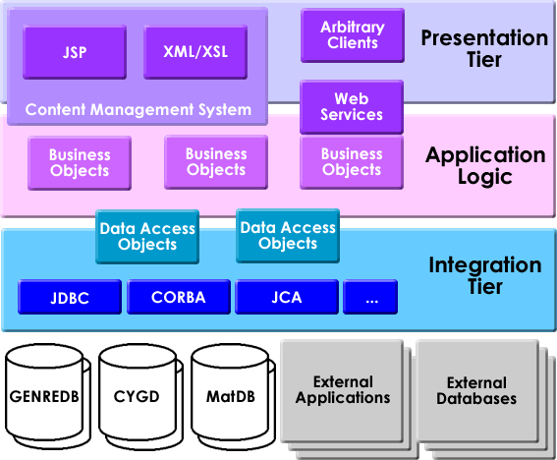
Integration in GenRE …
J2EE based component oriented architecture
Notes:
Hier darauf hinweisen, das wir bereits viel Erfahrung mit komponentenorientierten Architekturen haben und das Webservices logisch nur ein upscaling aufs Internet bedeuten.

Slide 6
… with EJBs and Hibernate
Presentation
Layer
…
PSI MI
Business
Logic
VOs
DAOs
DAOs
DAOs
Mammalian
PPI
Anno-
tation

Slide 7
Inter-database collaboration:
HOBIT
Open platform for bioinformatics
  Funding for interconnection NOT development of specific technologies
Participants:
Helmholtz DKFZ GBF MDC MIPS (Coordination V. Stümpflen) EMBL | Universities FU Berlin Uni Bielefeld Uni Göttingen Uni Köln LMU Uni Würzburg

Slide 8
Inter-database collaboration
Web Services
Layer Description | Implementations
Standard Messaging | ebXML
Service Composition | Business Process Execution Language for Web Services (BPEL4WS)
Service Registry | Universal Description, Discovery and Integration (UDDI), ebXML Registries
Service Description | Web Service Description Language (WSDL)
Service Transport | HTTP, SMTP, FTP

Slide 9
HOBIT Approach
WS standards combined with standards for data exchange
WSDL as standard definition for data and methods
  Taking standard schema (eg. PSI MI)
  Describing standardised methods for data access
  Publishing the WSDL / services
  Implementation belongs to consumer /service provider (in any language)

Slide 10
Conclusion
PSI MI: MIPS will coorporate
Internal:
  Restructuring according to PSI MI is done
WEB Appearance:
  Migration to GenRE presentation layer
Data Access:
  Download as PSI MI documents
  Web Service based access (HOBIT)

Slide 11
Acknowledgements
YEAST: U.Güldener, M. Münsterkötter
A. Ruepp and Annotation Group
Mammalian PPIs: P. Pagel

