Slide 1


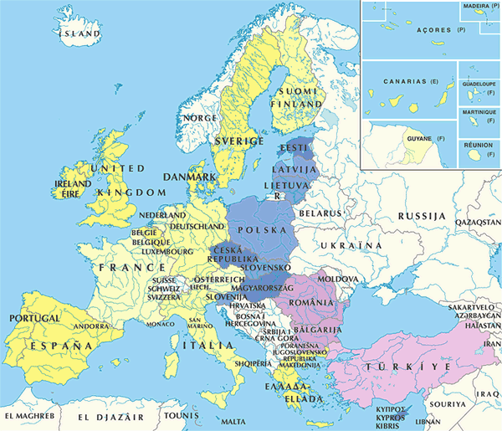
IntAct project
SDU
Start January 2002
Part of EU framework 5 Temblor grant
Coordinated by EBI
8 partners across Europe
EBI
GSK
MPI
UBX
SIB
CNB
MINT
HUJI

Slide 2
IntAct PSI export
PSI MI is IntAct’s native download format, all data freely available from ftp server in PSI MI format
All CVs available in GO DAG format

Slide 3
IntAct Annotation export
IntAct annotation structure is
“annotation topic” – “description”
Mapped to <attributeList> for experiments and interactions, potentially in the future also for proteins
<attributeList>
<attribute name="comment">Subcellular location is inferred rather than
proven.</attribute>
<attribute name="resulting ptm">CrkL is weakly phosphorylated by
MAP4K1</attribute>
</attributeList>

Slide 4
Implementation notes
PSI export: Two programmer months
  Problem: Giot experiment with 20.000 interactions
  Solution: Split into chunks of 2.500 interactions
  Kept split, also for benefit of end user
PSI import:
  Ready since two weeks in “internal” mode
  One programmer month

Slide 5
IntAct “Graph2MIF”
Dynamic download of local interaction graph in PSI MI XML format
Interactively from the graph display
By URL
By web service

Slide 6
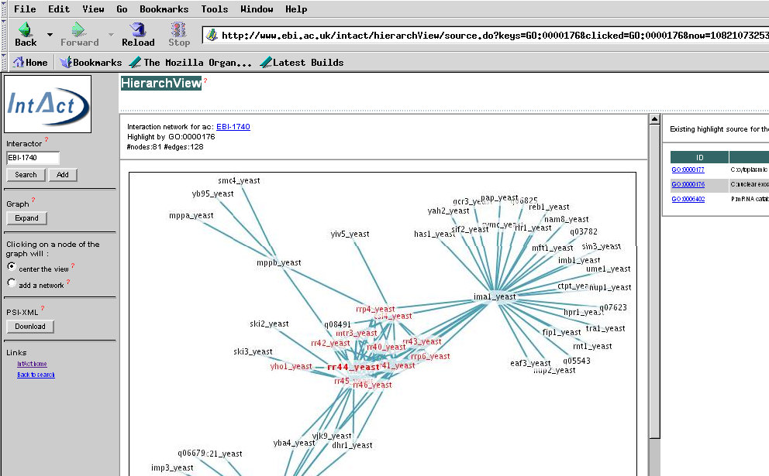

Slide 7


Future plans
PSI export for textual query results
Data exchange with other databases, curation coordination with Mint already working

Slide 8
Resources
Web:
  http://www.ebi.ac.uk/intact
Publications:
  H. Hermjakob, L. Montecchi-Palazzi, C. Lewington, S. Mudali, S. Kerrien, S. Orchard, M. Vingron, B. Roechert, P. Roepstorff, A. Valencia, H. Margalit, J. Armstrong, A. Bairoch, G. Cesareni, D. Sherman, R. Apweiler (2004).
  IntAct - an open source molecular interaction database.
  Nucl. Acids. Res. 32: D452-D455.

Slide 9
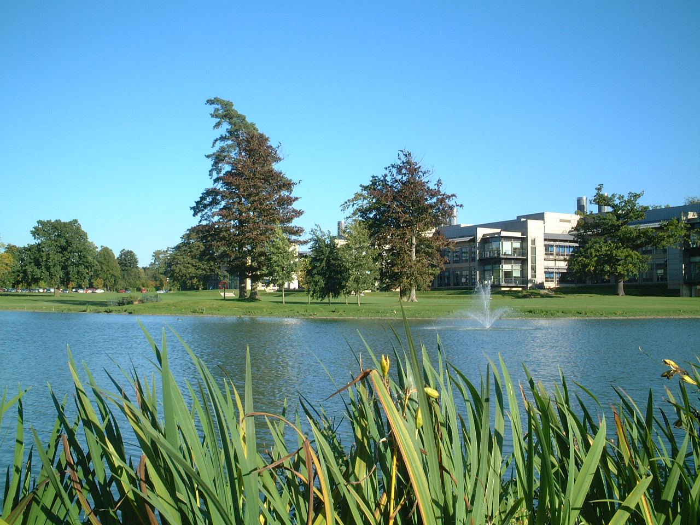
Thanks
IntAct team:
  Samuel Kerrien
  Chris Lewington
  Sugath Mudali
  Sandra Orchard
  Janet Harwood
  Jyoti Khadake
IntAct consortium:
  Luisa Montecchi
  David Sherman
  John Armstrong
  Ole Jensen
  Alfonso Valencia
  Bernd Roechert
  Hanah Margalit
  Martin Vingron
Rolf Apweiler, EBI
EU: grant number QLRI-CT-2001-00015 under the RTD programme "Quality of Life and Management of Living Resources“

