Slide 1

MINT and PSI
Proteomics Standards Initiative Spring Workshop
Nice, April 19-21
MINT: http://mint.bio.uniroma2.it
Luisa Montecchi-Palazzi, luisa@cbm.bio.uniroma2.it

Slide 2
MINT and PSI
Current PSI implementation in MINT :
  Structure conformity
  PSI controlled vocabularies fully used
  PSI ←→ MINT data flow
Suggestions to PSI consortium:
  PSI structure
  PSI controlled vocabularies
  PSI tools

Slide 3
Mint and PSI
Current PSI implementation in MINT

Slide 4
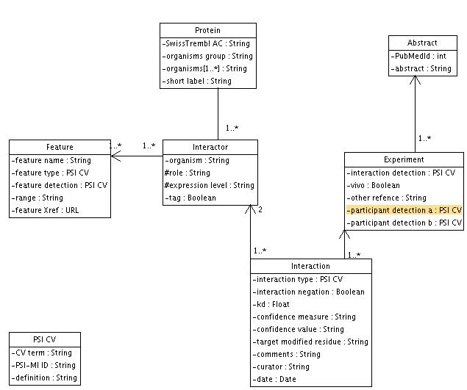
Structure

Slide 5
Usage of CV interaction identification in MINT experiments
experimental 0.069%
affinity chromatography technologies 0.003%
coimmunoprecipitation 0.272%
anti bait coimmunoprecipitation 0.008%
anti tag coimmunoprecipitation 0.003%
ha tag coimmunoprecipitation 0.001%
myc tag coimmunoprecipitation 0.002%
his tag coimmunoprecipitation 0.001%
flag tag coimmunoprecipitation 0.003%
tap tag coimmunoprecipitation 0.002%
pull down 0.176%
gst pull down 0.016%
his pull down 0.001%
copurification 0.016%
cosedimentation 0.001%
colocalization/visualisation technologies 0.045%
colocalization by fluorescent probes cloning 0.001%
colocalization by immunostaining 0.005%
cross-linking studies 0.022%
enzyme-linked immunosorbent assay 0.008%
far western blotting 0.001%
filter binding 0.027%
fluorescence technologies 0.001%
fluorescence polarization spectroscopy 0.001%
fluorescent resonance energy transfer 0.003%
phage display 0.005%
lambda phage display 0.001%
yeast display 0.001%
peptide array 0.001%
protein array 0.001%
mass spectrometry studies of complexes 0.001%
x-ray crystallography 0.089%
nuclear magnetic resonance 0.005%
surface plasmon resonance 0.001%
electron microscopy 0.001%
two hybrid 0.192%
two hybrid array 0.002%
two hybrid pooling approach 0.002%
ubiqitin reconstruction 0.002%
beta galactosidase complementation 0.001%
beta lactamase complementation 0.014%
Out of 76 experimental interaction detection methods on PSI CV
- 17 equivalent methods were present in MINT
- 59 new methods were added in December 2003
25 of this new methods are today mentioned.
Over all in 40 % of the experiment submitted in the last 6 months use new terms

Slide 6


PSI Maker/Flattener
XML Document
Curated data TO community
PSI Maker
PSI Flattener
Raw/curated data FROM community
Flat File
Postgres Dump
Mint Loader
http://cvs.sourceforge.net/viewcvs.py/psidev/psi/mi/tools/

Slide 7
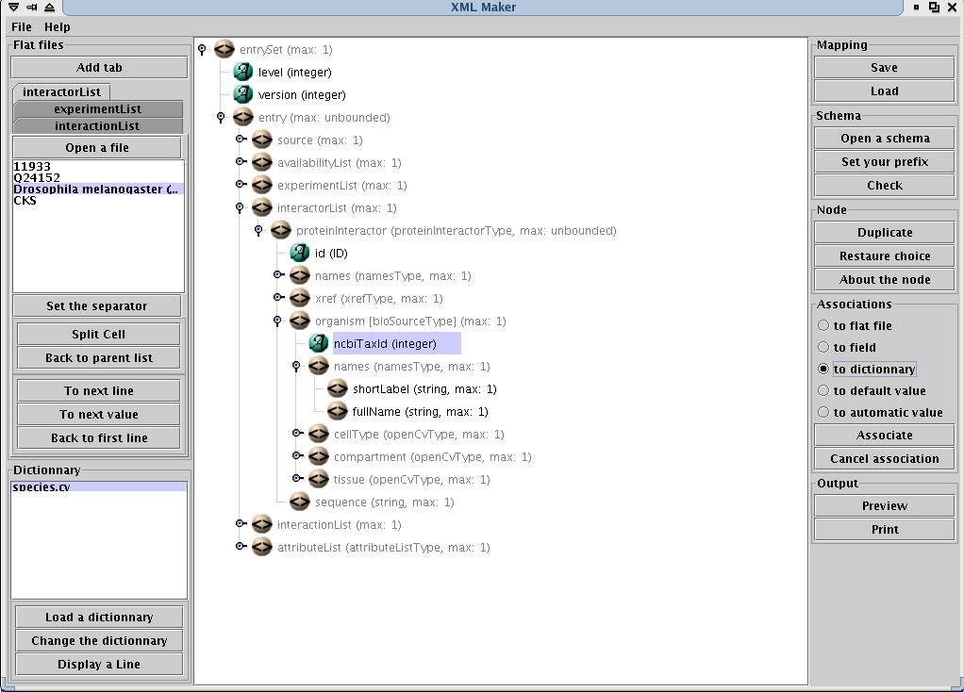
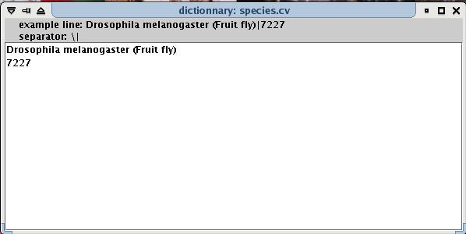

Slide 8
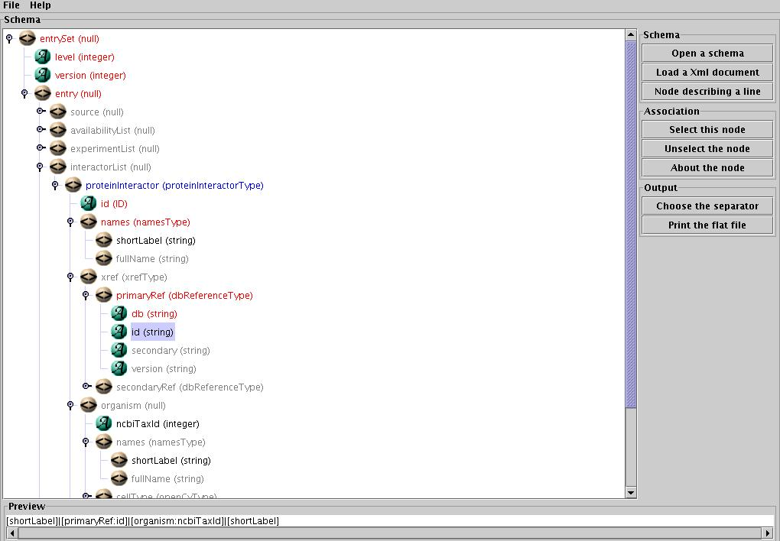
PSI Flattener
[shortLabel]|[primaryRef:id]|[organism:ncbiTaxId]|[shortLabel]
cRaf|P04049|9606|Homo sapiens (Human)
TIG-1|Q96RN5|9606|Homo sapiens (Human)
hSMAD4|Q13485|9606|Homo sapiens (Human)
HERC3|Q15034|9606|Homo sapiens (Human)
UBA52|P02248|8355|Xenopus laevis (African clawed frog)
P02788|P02788|9606|Homo sapiens (Human)
P06996|P06996|562|Escherichia coli
PLC-II|P10686|10116|Rattus norvegicus (Rat)
Q9JHW8|Q9JHW8|10116|Rattus norvegicus (Rat)
P46014|P46014|3702|Arabidopsis thaliana (Mouse-ear cress)
KIK1|O49974|4577|Zea mays (Maize)

Slide 9
MINT and PSI
Suggestions to PSI consortium

Slide 10
Suggestions about PSI structure and data type
Exchange Protein DNA interactions ? Other data types?
Is Go format adequate to PSI CV? What about DAM+OIL or OWL ?
Share MIAME/MGED biosample preparation?

Slide 11
Suggestions about PSI CV
URGENT for MINT (new terms on existing CVs) :
Add new terms in Cv interaction type
Add enzymatic assay to CV interaction detection
Other suggestions :
Create new CV to describe experiment biosource, role, xref databases…
Procedure to maintain dynamically CVs
Try to share common interaction annotation ? (free text quality, stimulus dependence, ect..)

Slide 12
Suggestions about PSI tools
1- Have a public hierarchical browser to display PSI CVs
2- Create a tool to translate protein database IDs in any direction otherwise most our exchange efforts are useless.
UNIPROT-ID
UNIPROT-ID
IPI-ID
IPI-ID
NCBI-GI
NCBI-GI

Slide 13
