Slide 1
HUPO-PSI
Mass Spectrometry
Working Group

Slide 2
Raw
Data
Archive
LIMS
Methods
& Meta data
Data
System
Purpose &
Sample Info
Exported
Raw Data
BioInfo
App
Sample
Instrument
Raw Data
Systems Biology
Shared
Data
Collection
Peak Data
Data
“Publisher”
Search
Engine
“Published”
Results
Search
Results

Slide 3
MS Working Group Scope
Search
engines
Vendor-Specific
Binary Format
Peaklist
formats
Outputs
formats
mzData
mzAnalysis
Upstream Data
Std. input format
Std. Output format
External Data
Repository
MIAPE
Retrieval system
& Visualisation
Data comparison
& Analysis
Data Mining

Slide 4
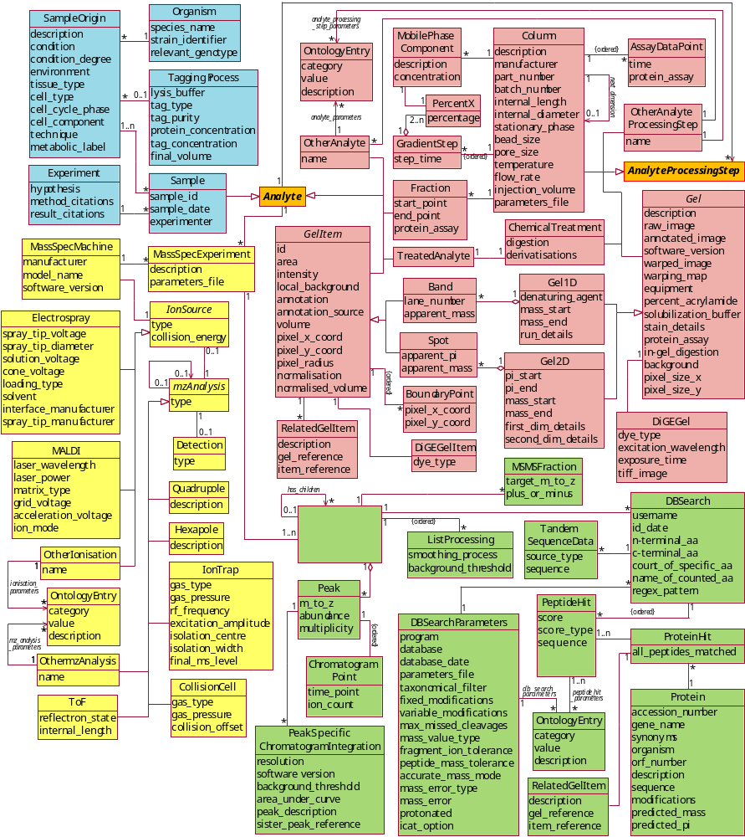

Slide 5
Application of mzData
Sample
Origin
Sep/Samp
Prep
mzData
MS
Pep/Prot
ID
sample.xml
MIAPE derived database

Slide 6
Status
Established goals for standard Jan ’03
Presented goals at ASMS May ‘03
Completed prototype July ’03
Presented working prototype HUPO Oct ’03
ASCII converters (.dta, mgf, etc.)
Prototype ‘raw’ converter (XCalibur API)

Slide 7
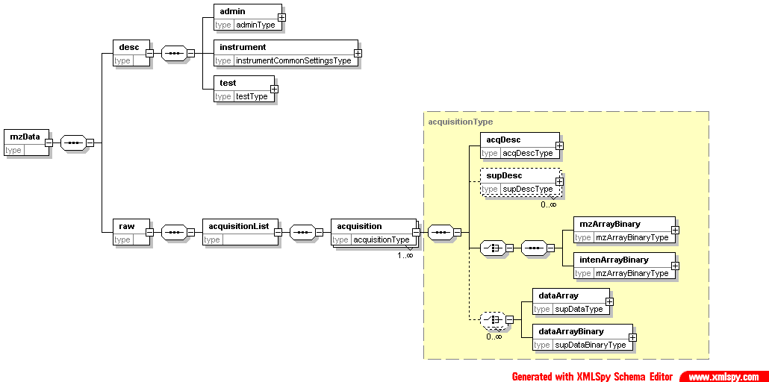

Slide 8
Examples
LC-MS (0.9 M ~ 200 scans)
  XML style (7 M)
  Base64 (1.2 M)
Triple-Play (47.8 M ~ 2500 scans)
  Base64 (72 M)
  MS/MS Only (821 scans)
    XML (10 MB)
    Base64 (2.2 MB)

Slide 9
Capturing Experiment-Specific Meta-Data

Slide 10
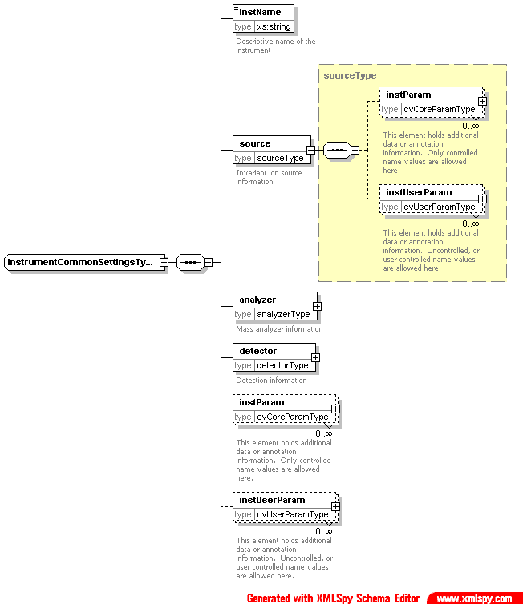

Slide 11
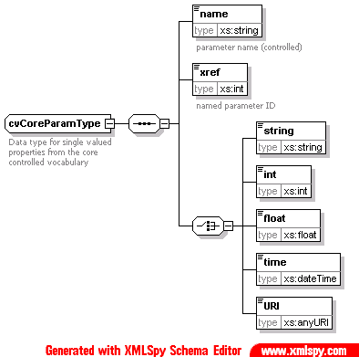
Controlled vocabulary
<instParam>
<name>scan segment</name>
<xref>10000001</xref>
<int>2</int>
</instParam>
<instUserParam>
<name>base intensity</name>
<float>302038.000000</float>
</instUserParam>
<instUserParam>
<name>base mass</name>
<float>292.525513</float>
</instUserParam>

Slide 12
Use ASTM Glossary as Start
FAB type
string
none
FAB matrix
string
none
source temperature
float
C
filament current
float
A
emission current
float
A
accelerating potential
float
V
detector type
string
none
detector potential
float
V
detector entrance potential
float
V

Slide 13
ASMS as Expert Group
ASMS
MS
Dictionary
mzData
AnIML
mzXML
HUPO
ASTM
Individual
Labs

Slide 14
High Level Conclusions
mzData valuable for data sharing and access
mzData data model ≡ MIAPE MS data model
Ontology approach allows diversity
Separate schema needed for analysis input
Separate schema needed for analysis output
Schema needed to describe separation

Slide 15
mzData Action Plan
Parameter list distributed to vendors
Propose ontology ownership to ASMS
Vendors to experiment with mzData to establish proof-of-concept for spectral and parameter storage

Slide 16
MS Working Group Scope
Search
engines
Vendor-Specific
Binary Format
Peaklist
formats
Outputs
formats
mzData
mzAnalysis
Upstream Data
Std. input format
Std. Output format
External Data
Repository
MIAPE
Retrieval system
& Visualisation
Data comparison
& Analysis
Data Mining

Slide 18
mzAnalysis
Common output format for MS Analysis
  Common syntax for peptide/protein ID
  Common syntax for modification description
Support Identification
  Database searching
  Denovo sequencing
Support Quantitation
  Chromatographic
  Spectrometric

Slide 19
Methods of Quantitation
1
I
2
1. Label States with mass tag
2. Pool samples
Q_{r}=I₁/I₂
m/z
RT:
500000000
78.32 - 81.88
80.04
A₁
NL:
5.17E8
m/z=
901.0-902.0 F: +
450000000
c ESI Full ms [
MS
300.00-1500.00]
400000000
RPC030527_2
350000000
Integrate sample 1
Integrate sample 2
Intensity
300000000
250000000
200000000
I
150000000
100000000
50000000
0
78.50
78.85
79.04
79.32
80.67
80.87
81.24
81.41
81.68
NL:
1.39E8
130000000
m/z=
900.0-901.0 F: +
120000000
c ESI Full ms [
MS
300.00-1500.00]
110000000
A₂
RPC030527_2
100000000
90000000
Q_{r}=A₁/A₂
80000000
Intensity
70000000
60000000
50000000
40000000
30000000
79.94
20000000
79.68
80.77
81.41
81.68
10000000
0
78.4
78.60
78.85
79.23
80.13
80.50
t
78.6
78.8
79.0
79.2
79.4
79.6
79.8
80.0
Time (min)
80.2
80.4
80.6
80.8
81.0
81.2
81.4
81.6
81.8

Slide 20
ID
Group
Spectrum
Protein
*
Peptide
Analysis
params
Quant
Quant

Slide 21
Long Term Direction
Peak lists too limiting for most reprocessing
Full raw data archive desirable
Use ASTM Standard for “full raw data” archiving when available (’05-’06)

Slide 22
Raw
Data
Archive
LIMS
Methods
& Meta data
Data
System
Purpose &
Sample Info
Exported
Raw Data
BioInfo
App
Sample
Instrument
Raw Data
Systems Biology
Shared
Data
Collection
Peak Data
Data
“Publisher”
Search
Engine
“Published”
Results
Search
Results

Slide 23
ASTM AnIML Structural Model
User
Enterprise
Vendor
Technique
Core

Slide 24
AnIML Core Schema
Examples of Content
  Sample Information
  Basic System Information
  Basic QA Information
  Basic Units
  Measurement Data
Responsibility
  Coalition of ASTM E-13.15 XML Work Group, IUPAC
animl.sf.net
Core

Slide 25
Technique-Specific Schema
Examples of Content
  System Information
  Measurement Metadata
  Method Information
  QA Information
  "Pre-result" Data
    i.e. TOF Time Data
  Links for Hyphenated Measurements
  More Units
Responsibility
  ASTM E-13.15 Subcommittees and Other Consensus Groups of Domain Experts
Technique
Core

Slide 26
Conclusions
mzData acceptable (with ‘polishing’) for representing mass spectrometry data
Spectral analysis output format design specifications started
Assume development of separation and sample prep descriptions
Goal: Preliminary repository by Oct HUPO meeting

