Slide 1

E
2
C
0
I
0
N
4
Henning Hermjakob, EBI

Slide 2



Human Proteome Organisation
Founded 2001
Congresses:
Paris, November 2002
Montreal, October 2003
Beijing, October 2004
Mission:
  Consolidate national and regional proteome organizations into a worldwide organisation (HUPO).
  Engage in scientific and educational activities
  Assist in the coordination of public proteome initiatives.

Slide 3
Work groups
Plasma Proteome Project:
  comparative plasma proteome from 35 labs
  Analysis Jambouree June 2004
Liver Proteome Project
Brain Proteome Project
Antibody initiative
Bioinformatics:
Proteomics Standards Initiative

Slide 4
Proteomics Standards Initiative
Develop data format standards
Data representation and annotation standards
  Standard controlled vocabularies and ontologies, e.g. GO
  Standard reference sets, e.g. for genes, proteins
Involve data produces, database providers, software producers, publishers

Slide 5
Three domains, three tracks
Mass spectrometry (mzData)
Proteomics experiment model (MIAPE)
Molecular Interactions (PSI-MI)

Slide 6
Publications
The HUPO PSI Molecular Interaction Format - A community standard for the representation of protein interaction data.
Henning Hermjakob, Luisa Montecchi-Palazzi, Gary Bader, Jérôme Wojcik, Lukasz Salwinski, Arnaud Ceol, Susan Moore, Sandra Orchard, Ugis Sarkans, Christian von Mering, Bernd Roechert, Sylvain Poux, Eva Jung, Henning Mersch, Paul Kersey, Michael Lappe, Yixue Lix, Rong Zeng, Debashis Rana, Macha Nikolski, Holger Husi, Christine Brun, K. Shanker, Seth G.N. Grant, Chris Sander, Peer Bork, Weimin Zhu, Akhilesh Pandey, Alvis Brazma, Bernard Jacq, Marc Vidal, David Sherman, Pierre Legrain, Gianni Cesareni, Ioannis Xenarios, David Eisenberg, Boris Steipe, Chris Hogue, Rolf Apweiler.
Nature Biotechnology 2004, 22, 176-183.
Further advances in the development of a data interchange standard for proteomics data.
Sandra Orchard, Weimin Zhu, Randall K. Julian Jnr, Henning Hermjakob and Rolf Apweiler.
Proteomics 2003, 3, 2965-2066.
The Proteomics Standards Initiative.
Sandra Orchard, Henning Hermjakob, Rolf Apweiler.
Proteomics 2003, 3, 1374-1376.
Progress in establishing common standards for exchanging proteomics data:
The second meeting of the HUPO Proteomics Standards Initiative.
Sandra Orchard, Paul Kersey, Weimin Zhu, Luisa Montecchi-Palazzi, Henning Hermjakob, Rolf Apweiler.
Comparative and Functional Genomics Volume 4, Issue 2, 2003. Pages: 203-206
The HUPO Proteomics Standards Initiative meeting: towards common standards for exchanging proteomics data
Sandra Orchard, Paul Kersey, Henning Hermjakob, Rolf Apweiler
Comparative and Functional Genomics Volume 4, Issue 1, 2003. Pages: 16-19

Slide 7
Sponsors and Meeting Structure

Slide 8
Molecular Interactions work group
Aims:
Develop community standard for exchange of molecular interaction data
Coordinate development of tools for the standard
Inter-database exchange
Status:
Jointly developed PSI MI XML format published in Nature Biotechnology in February 2004
Data and tools available from Mint, DIP, IntAct, MSKCC, Hybrigenics, University of Bordeaux, HRPD, …

Slide 9
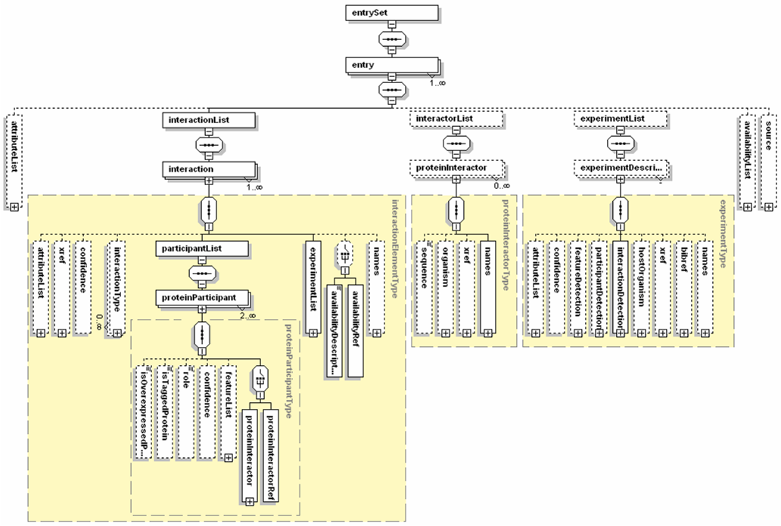

Slide 10
Summary of Pre-meeting
From PSI MI 1.0 to 1.1:
Updates to the schema to fix problems which have shown up during the use in production mode.
  Schema updates
  Controlled vocabulary updates and additions
  Unification of identifiers
Formal organisation for the maintenance of PSI MI vocabularies

Slide 11
Schema updates
Object identifiers (id):
  now all objects have (local) identifiers
  Standardisation of database naming:
  CvDatabase
  UniProt AC or NCBI GI required for proteins, if not available use sequence
Clearer ordering of schema elements
Allow aliases for object names
Allow non-continuous sequence features

Slide 12
Controlled vocabularies
CvDatabase
Extension of Interaction type to provide more detail, e.g. enzymatic interaction
Formalisation of CvRole
Extension of CVs for experimental methods
QuickGO server for CVs to be set up
CVs maintenance by editorial board of PSI participants

Slide 13
Status
Dealt with all requests from sourceforge
Pending:
  Schema: Representation of complex topology
  Documentation:
    Use cases
    Examples
    Standard procedures, e.g. for merging results of a DB query in a results PSI MI document.

Slide 14
Next steps
From PSI MI 1.1 to 1.9:
Larger updates which extend the capabilities of the PSI MI schema:
  New Interactor types
    RNA, DNA
    Small molecules
  Negative information
Formal organisation for the maintenance of PSI MI schema
PSI-based data exchange
Technical requirements
Curation coordination
Curation standardisation
Requirements for submissions etc BY EXAMPLE
Clear organisation of how to generate these
PSICQIC: PSI Common Query InterfaCe

