Slide 1
Suggestions for future PSI developments
Pathways and Reaction Polyhierarchies
In example TRANSPATH signal-transduction DB (no high-throuput, very detail-prone, primary literature)
nvo@biobase.de

Slide 2
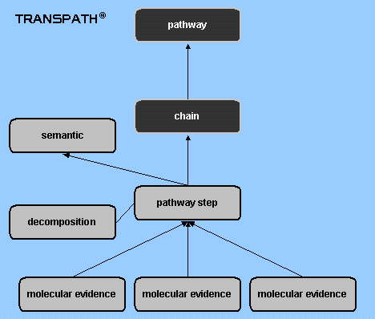
Annotation policy in TRANSPATH at the moment
We introduced new reaction relations in order to provide different levels of details and to deliver further filter options.
Semantic: Broad overview on pathways. This reaction level is often used in pathway cartoons in review literature.
Pathway Step: Constitutes pathways that depict the biochemical details of signal transduction cascades/pathways.
Molecular Evidence: Results of experiments published in primary literature. Information on material (tissue, cell line, constructs...) and methods used in the experiments. Has a quality value assignment.
Decomposition: Explains the mechanism and identifies acting molecules of reactions that occur in complexes. Is always linked to a highly complex pathway step reaction.
We introduced new pathway relations.
Since signaling molecules are highly connected, context discrimination is desired. Hence we designed a structure to group specific reactions to “chain“ and these to “pathway“. (pathway hierarchy)

Slide 3
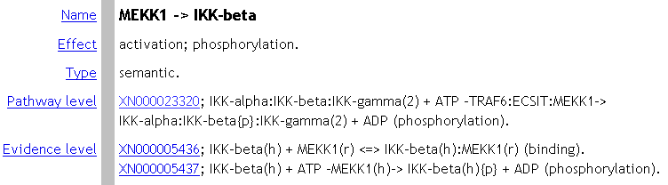
Reaction polyhierarchy – example
In this abstracted “semantic“ reaction entry “pathway level“ and “evidence level“ can all be seen at one glance.
Semantic level
Pathway level
Evidence level
“evidence level“ reactions are most specific: they indicate from which organism the proteins are derived and they show detailed information, if and sometimes where the proteins are phosphorylated or modulated. These reactions serve as hard facts for “pathway level“ reactions, which summarize the mechanisms of the process on a non-specific mammalian level. The “semantic level“ is a simplified version of this notation.

Slide 4

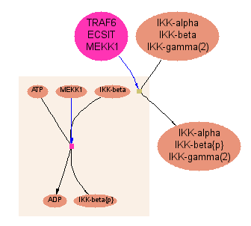
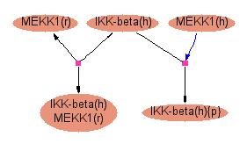
Reaction polyhierarchy example
Semantic level
Semantic: Broad overview on pathways. This reaction level is often used in pathway cartoons in review literature.
Pathway Step: Constitutes pathways that depict the biochemical details of signal transduction cascades/pathways.
Molecular Evidence: Results of experiments published in primary literature. Information on material (tissue, cell line, constructs...) and methods used in the experiments. Has a quality value assignment.
Decomposition: Explains the mechanism and identifies acting molecules of reactions that occur in complexes. Is always linked to a highly complex pathway step reaction.
pathway step level
decomposition
molecular evidence level

Slide 5
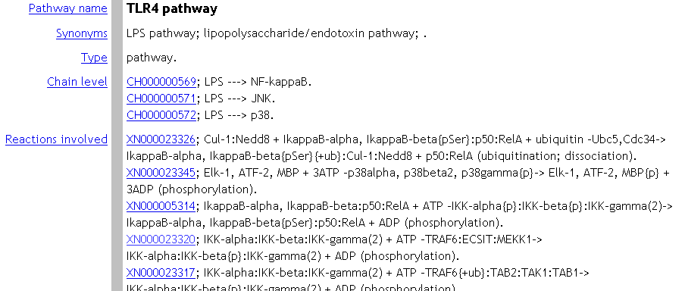
Pathway polyhierarchy – example
Pathway
Chain
Pathway step
reactions
Beside the “reaction hierarchy“ we also developed the “pathway hierarchy“. The reason for this is, that signaling molecules interact with a lot of other molecules. However, not all connected molecules might belong to one and only physiological context. One solution is to group several reactions to one “chain“ and several chains to one “pathway“.

Slide 6
Summary
Probably additional focus for PSI Format
Grouping abilities to distinguish contexts (e.g. pathways)
Different levels of interpretation, abstraction and nesting (e.g. reaction polyhierarchy)

