Slide 1
MIDDLEWARE DESIGN AND IMPLEMENTATION
Time & Synchronisation
Raúl Pardo

Slide 2
TODAY’S MENU
The need for time synchronisation
Clock synchronisation algorithms
  Cristian’s algorithm
  Berkley’s algorithm
  NTP
Logical Clocks

Slide 3

WHY DO WE NEED TIME SYNCHRONISATION?
Command make (in a single machine)
input.c
2144
input.o
2143
output.c
2144
output.o
2147
input.c needs to be recompiled
output.c does not need to be recompiled

Slide 4
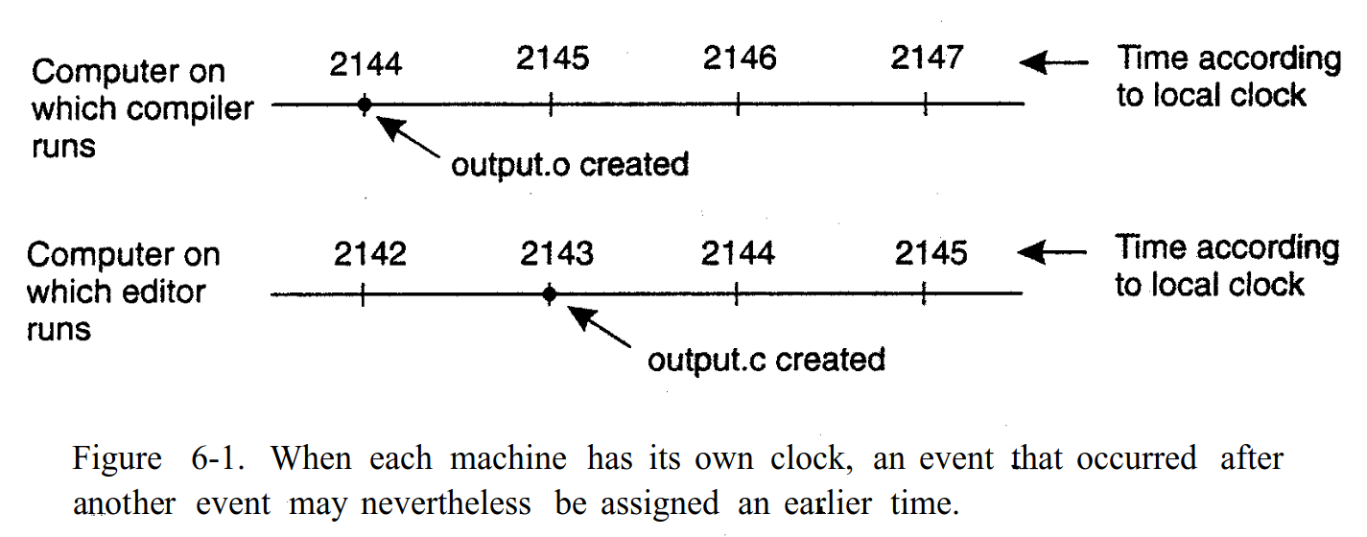
WHY DO WE NEED TIME SYNCHRONISATION?
Command make (in two different machines)
Source: Distributed Systems: Principles and Paradigms. Andrew S. Tanenbaum and Maarten Van Steen. 2007.

Slide 5
WHAT MAKES SYNCHRONISATION HARD?
Clocks accuracy is not perfect
  E.g., quartz oscillator in microprocessors is one part per million (one second of clock drift over 12 years)
  Clocks hardware is sensitive to temperature, age, vibration, radiation, …
Messages may be delayed

Slide 6
CLOCK SYNCHRONISATION

Slide 7
USING COORDINATED GLOBAL TIME
UTC is broadcast from radio stations on land and satellites (e.g., the Global Positioning System, GPS)
  Computers with receivers may synchronise their clocks with this signals
Signals from land-based stations are accurate to about 0.1 – 10 ms.
Signals from GPS are accurate to about 1 µs (0.001 ms).
  Why can’t we put GPS receivers on all our computers?

Slide 8
CLOCK SYNCHRONISATION
CRISTIAN’S ALGORITHM

Slide 9
SYNCHRONISATION VIA TIME SERVER
Assume there exists a server with an accurate clock
  We could use RPC (e.g., Java RMI) to request the time
current time?
Message delays may produce outdated server answers!
11:00

Slide 10
CRISTIAN’S ALGORITHM: OVERVIEW
Client sends a request package with its local clock T₁
Server timestamps its receipt of the request T₂ with its local clock
Server sends a response package with its local clock timestamps T₂ and T₃
Client locally timestamps its receipt of the server’s response T₄
T₁
request: T₁
T₂
T₃
T₄
response: T₂, T₃
How can the client use the timestamps to estimate the server clock (that is the offset between the two)

Slide 11
CRISTIAN’S ALGORITHM: OVERVIEW
Client’s goal
  Set clock ← T₃ + d_{req}
Client can compute the total travelling time (D)
  D = d_{req}+d_{res} = (T₂-T₁) + (T₄-T₃)
Note that the client only knows D and T_{n}
  The client does not know d_{req}
If we assume d_{req} ≈ d_{res}
  Client sets clock ← T₃ + D/2
T₁
d_{req}{
request: T₁
T₂
d_{res}{
T₃
response: T₂, T₃
T₄

Slide 12
CLOCK SYNCHRONISATION
BERKELEY ALGORITHM

Slide 13
BERKELEY ALGORITHM
Distributed algorithm for timekeeping
  No passive time server
  Master computer obtains average of participating computers and informs of the corrections in their clocks

Slide 14
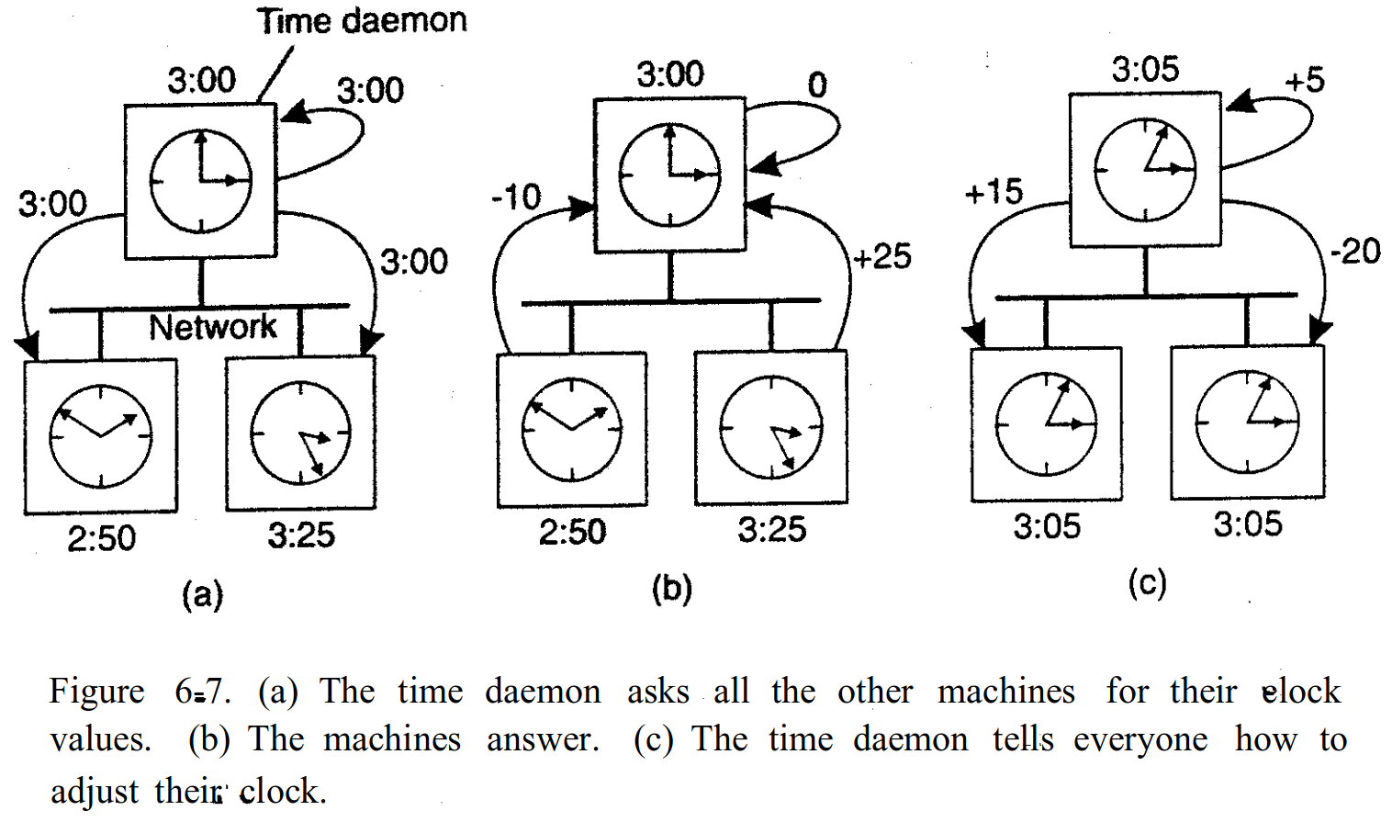
BERKELEY ALGORITHM
Source: Distributed Systems: Principles and Paradigms. Andrew S. Tanenbaum and Maarten Van Steen. 2007.

Slide 15
BERKELEY ALGORITHM
It is not necessary that the master is synchronised with the real time
It suffices for the participants to agree on the master’s time

Slide 16
CLOCK SYNCHRONISATION
NETWORK TIME PROTOCOL (NTP)

Slide 17
NTP
Enables clients to be accurately synchronized to UTC despite messages delays
Provides reliable service
  Survives lengthy losses of connectivity
  Communicates over redundant network paths

Slide 18
NTP STRUCTURE
Servers are organised in layers (strata)
  Stratum 0: High-accuracy time sources
    Atomic clocks, shortwave radio time receivers, etc
  Stratum 1: NTP servers directly connected to Stratum 0
  Stratum 2: NTP servers that synchronise with Stratum 1
    Stratum 2 servers are clients of Stratum 1 servers
  Stratum 3: NTP servers that synchronise with Stratum 2
    Stratum 3 servers are clients of Stratum 2 servers
Users’ computers synchronise with Stratum 3 servers

Slide 19
NTP SERVER SELECTION
Client and servers use Cristian’s algorithm to compute pairs (D_{i},d_{i}) where i server index
  d_{i}: Clock offset
  D_{i}: Round trip time
8 pairs (D_{i},d_{i}) are buffered, finally taking the minimal value found for d_{i} as the best estimation

Slide 20
UPDATING TIME
Can’t go back in time
Update clock rate
  Changes occur in a gradual fashion
  Prevents inconsistencies with local timestamps

Slide 21
PROBLEMS IN REAL TIME SYNCHRONISATION
Clocks in different machines will always behave differently
Clock are never exactly synchronised
Inadequate for distributed systems
  Most of the time it is necessary to reason about the order of events
  It may require excellent precision (ns)

Slide 22
LOGICAL TIME
LAMPORT CLOCKS

Slide 23
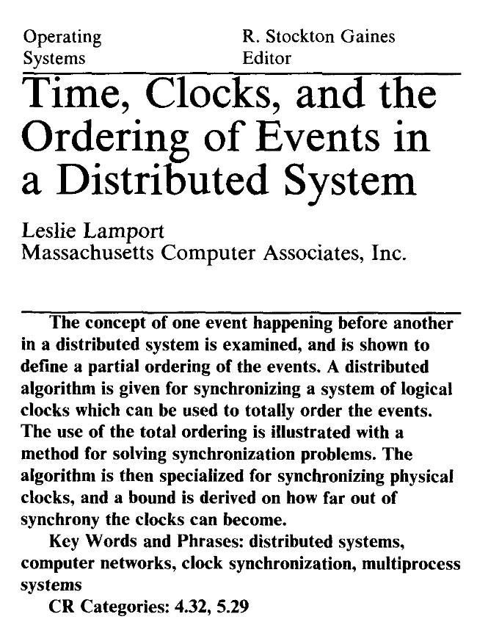

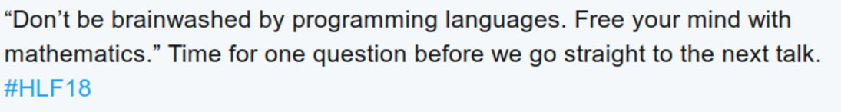
LAMPORTS LOGICAL CLOCKS
Insight
  Only the events themselves matter
The precise clock time is irrelevant
  Happens-before relation

Slide 24
LAMPORT LOGICAL CLOCKS
We say that an event “a” happens before an event “b” (denoted as a → b) iff
  a and b belong to the same process and a was executed before b
  a corresponds to an event of sending a message and b to receiving the message

Slide 25
LAMPORT LOGICAL CLOCKS
When it does not hold neither a → b nor b → a we say that the events are concurrent.
  It is denoted as a || b

Slide 26
LAMPORT LOGICAL CLOCKS
The relation → is a partial order among all the events
When it does not hold neither a → b nor b → a we say that the events are concurrent.
  It is denoted as a || b
→ is a transitive relation
  if a → b and b → c, then a → c

Slide 27
LAMPORT LOGICAL CLOCKS
Events are assigned a clock value C
The assignments respects the happens before ordering
  If a → b, then C(a) < C(b)

Slide 28
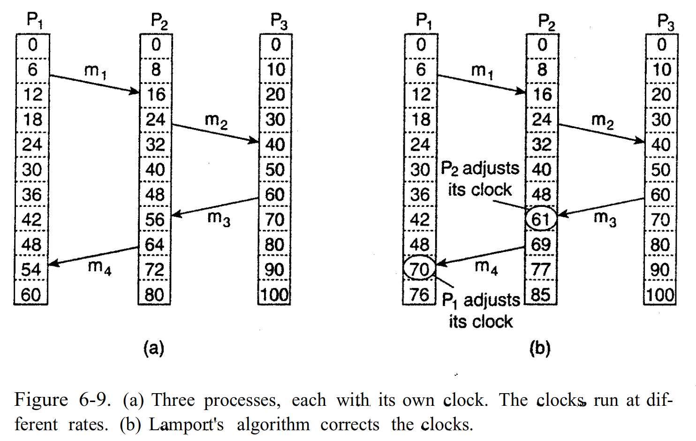
LAMPORT ALGORITHM (EXAMPLE)
Source: Distributed Systems: Principles and Paradigms. Andrew S. Tanenbaum and Maarten Van Steen. 2007.

Slide 29
LAMPORT ALGORITHM
Every process j has its own local clock C_{j}
Lamport algorithm
  Before executing an event C_{j} ← C_{j} + 1
  When j sends a message m, assigns its clock value
    ts(m) = C_{j}
  Upon process j receives message m updates its clock as follows
    C_{j} ← max{C_{j}, ts(m)} + 1

Slide 30
LAMPORT ALGORITHM TOTAL ORDER
Some applications require a total ordering among the events
  Break the ties by attaching the clock value with the process id
  Assuming that ids of processes in different machines are also different

Slide 31
CONSISTENCY OF CONCURRENT UPDATES
Two events:
  Deposit 100€
  Paid 1% interest
May lead to inconsistent state if they occur at the different locations
  E.g., deposit in P1 and interest in P2 then communicate the update
Solution using Lamport clock total order.
  The goal is to have the same totally ordered list of events in all replicas
€
%
P1
replicated databases
P2

Slide 32
TOTALLY ORDERED MULTICAST
Client sends update to one replica site j
  Replica assigns it Lamport timestamp C_{j}.j
Idea: Place events into a sorted local queue
  Sorted by Lamport timestamps
1.1
1.2
€
%

Slide 33
TOTALLY ORDERED MULTICAST
1.1
1.2
1.1
1.2
On receiving an update from client, broadcast to others (including yourself)
On receiving or processing an update:
  Add it to your local queue, if received update
  Broadcast an acknowledgement to every replica (including yourself) only from head of queue
On receiving an acknowledgement:
  Mark corresponding update acknowledge in your queue
A process can deliver a queued message to the application only when the message is ack’ed and at the had of the queue
€
%
€
%
ack
ack
P1
1.1
1.2
P2
€
%
€
ack
%
ack

Slide 34
ARE WE DONE?
Does totally-ordered multicast solve the problem of multi-site replication in general?
  No
Many assumptions
  No node failures
  No message loss
  No message corruption
All to all communication does not scale

Slide 35
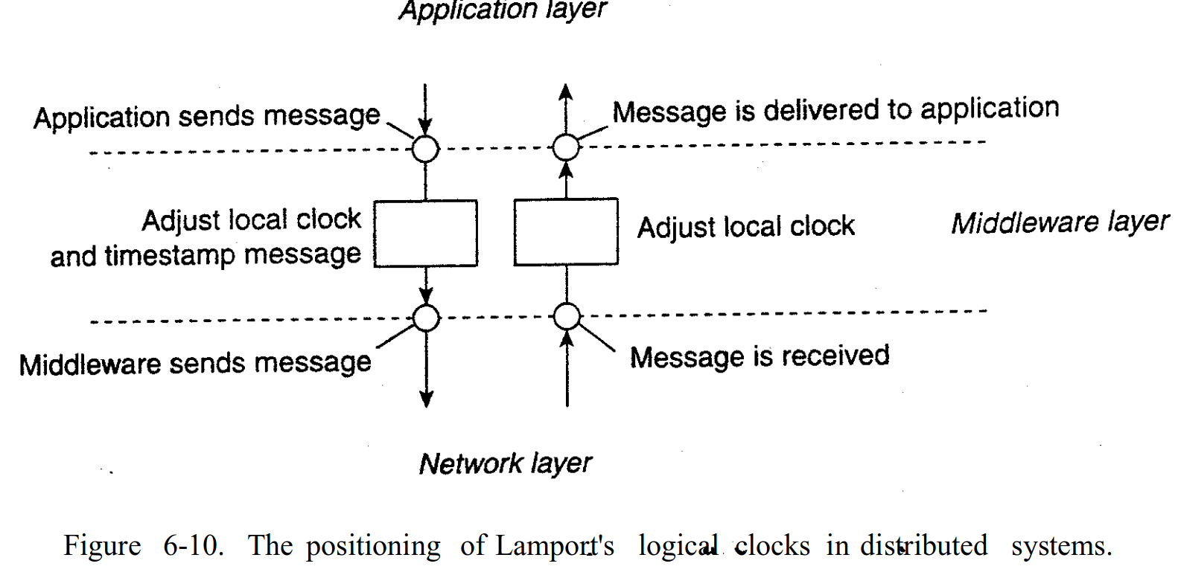
LAMPORT CLOCKS & MIDDLEWARE
Source: Distributed Systems: Principles and Paradigms. Andrew S. Tanenbaum and Maarten Van Steen. 2007.

Slide 36
LAMPORT CLOCKS
By definition we know
  a → b, then C(a) < C(b)
However, the converse is not necessarily true
  C(a) < C(b) does not imply a → b (possibly, a || b)
Can we use Lamport clock timestamps to infer casual relationships between events?

Slide 37
SUMMARY
The need for time synchronisation
Clock synchronisation algorithms
  Cristian’s algorithm
  Berkley’s algorithm
  NTP
Logical Clocks

