Slide 1
MIDDLEWARE DESIGN AND IMPLEMENTATION
Formal Verification of Distributed Systems:
A high-level introduction to using Promela/SPIN
Raúl Pardo

Slide 2
TODAY’S MENU
Promela/SPIN
  Models
  Properties
Counter Example
Distributed building firm (barrier synchronisation)
Proxy server

Slide 3
WHAT IS FORMAL VERIFICATION AND WHY IS IT USEFUL?

Slide 4

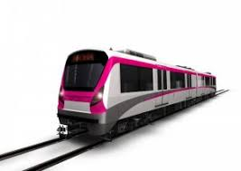
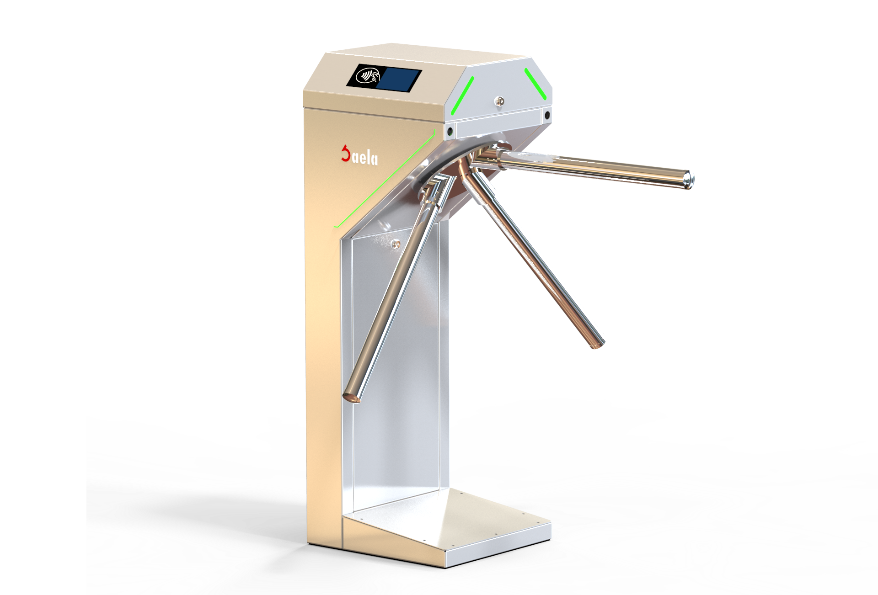
COUNTER EXAMPLE REVISITED
Turnstile counter
counter

Slide 5
COUNTER EXAMPLE REVISITED
Testing is not sufficient to verify the correct behaviour of the system
  Test cases may succeed or fail depending on the non-determinism in the scheduler
    If there are 20 people can we assert counter == 20?
An exhaustive search of all possible behaviours in the system is required to check correctness

Slide 6
MODEL CHECKING
Makes it is possible to explore all possible behaviours in the system
  Explicit state
    SPIN
  Symbolic state
    NuSMV

Slide 7


PROMELA/SPIN ARCHITECTURE
System model
System property
  p and q never enter the critical section at the same time
int x = 0;
active proctype p() {
...
}
active proctype q() {
...
}
Model Checker (SPIN)

Slide 8
PROMELA MODELS

Slide 9
PROMELA
Promela is a language for modelling concurrent systems
  Both shared memory and message passing (e.g., actors)
  C-like syntax
Promela models can be simulated (with SPIN)
Promela is not a full-fledge programming language
  Fewer control structures
  Data structures with fixed bounds
  No functions or methods
  No GUI or standard input (close models)
  No floating point numbers
  …
Nondeterminism

Slide 10
PROMELA BASICS EXAMPLES
Lets look at the following simple examples
  Hello world
  Arithmetic operations
    +, -, *, /, %, ...
  Datatypes and enumerations
    Enumerations, typedefs, arrays, booleans, …
  Control statements
    Sequence (;), conditional (if), repetition (do)

Slide 11
PROMELA PROCESSES EXAMPLES
Lets look at the following examples
  Define and start processes
  Message passing
    Channels with capacity
      Blocking send in full channels
      Always blocking receive (as expected)

Slide 12
SYSTEM PROPERTIES
(ASSERTIONS)

Slide 13
TRACES
A trace is a sequence of instructions in the model
Some of the traces of this program
byte c = 0;
active proctype p() {
p1: byte temp = c;
p2: c = temp + 1;
}
active proctype q() {
q1: byte temp = c;
q2: c = temp + 1;
}
Traces in SPIN are infinite
p1,p2,q1,q2 : c = 2 p1,q1,p2,q2 : c = 1 ...
q1,q2,p1,p2 : c = 2 p1,q1,q2,p2 : c = 1 ...

Slide 14
PROPERTIES IN SPIN
SPIN can automatically check whether a boolean predicates holds in all the traces of the model
  Assertions
  LTL formulae

Slide 15
ASSERTIONS
Is a function call that can be written anywhere in the model
The function takes a boolean predicate
SPIN checks whether the predicate holds for all the traces in the program

Slide 16

ASSERTIONS - COUNTER EXAMPLE

Slide 17
SYSTEM PROPERTIES
(LINEAR TEMPORAL LOGIC)

Slide 18
LINEAR TEMPORAL LOGIC
(IN PROMELA)
Let P = p,q,r,... be a set of propositions
  A proposition is a boolean predicate build using parts of a Promela model that are globally accessible
c > 112 a[23] == 52

Slide 19
LINEAR TEMPORAL LOGIC
(IN PROMELA)
Formulae are defined according to the grammar below
A ::= p | A && B | A || B | !A | A -> B | []A | <>A
Logical connectives
Temporal
operators

Slide 20
LINEAR TEMPORAL LOGIC
(IN PROMELA)
Logical connectives
  A && B (A and B)
  A || B (A or B)
  !A (not A)
  A -> B (A implies B)
Temporal operators
  []A (always A holds)
  <>A (eventually A holds)

Slide 21

SEMANTICS OF TEMPORAL OPERATORS
Always []
  Consider a formula A := c > 42
  Does []A hold in the following traces?
    (c=42),(c=42),(c=42),(c=42),(c=42),(c=42),...
    (c=42),(c=42),(c=0),(c=42),(c=42),(c=42),...
    (c=42),(c=42),(c=42),(c=42),(c=42),(c=41),...
Remember that
traces are infinite

Slide 22
SEMANTICS OF TEMPORAL OPERATORS
Eventually <>
  Consider a formula A := c > 42
  Does <>A hold in the following traces?
    (c=42),(c=42),(c=42),(c=42),(c=42),(c=42),...
    (c=42),(c=42),(c=0),(c=42),(c=42),(c=42),...
    (c=0),(c=0),(c=0),(c=0),(c=0),(c=42),...
    (c=0),(c=0),(c=0),(c=0),(c=0),(c=0),...

Slide 23
COMMON PROPERTIES
Deadlock freedom (in a system with two processes, p and q)
  []((p_tries && q_tries) -> <>(p_enter || q_enter))
  “Always eventually if p and q are trying to enter their critical section, then one of them eventually enters”
Starvation freedom (in a system with two processes, p and q)
  [](p_tries -> <>(p_enters)) && [](q_tries -> <>(q_enters))
  “Always if p tries to enter its critical section, then it can eventually enter” (and likewise for q)

Slide 24
LTL – DISTRIBUTED BUILDING FIRM

Slide 25
PROMELA PROXY SERVER

Slide 26



PROXY
R1
R2

Slide 27
PROXY
R2
R1

Slide 28
PROXY
R1
R2

Slide 29
PROXY
R1
R2

Slide 30
PROXY
R1
R2

Slide 31
PROXY
R1
R2

Slide 32
PROXY
R1
R2
Maximum two requests
at the same time
(2 sockets)

Slide 33
PROMELA PROXY SERVER

Slide 34
SUMMARY
Promela/SPIN
  Models
  Properties
Counter Example
Distributed building firm (barrier synchronisation)
Proxy server

Slide 35
FINAL REMARK
Here we have seen a high level overview of using a model-checker
Many technical details are hidden
  Promela/SPIN semantics, LTL semantics, …
To dig into these topics I recommend the following book
  Principles of Model Checking. Christel Baier and Joost-Pieter Katoen. MIT Press.

Slide 36
MERRY CHRISTMAS!
WESOŁYCH ŚWIĄT
BUON NATALE
FRÖHLICHE WEIHNACHTEN

