Slide 1
MIDDLEWARE DESIGN AND IMPLEMENTATION
INTRODUCTION
Raúl Pardo

Slide 2
BASIC INFO
Course responsible:
  Raúl Pardo (me)
Email
  raul.pardo-jimenez@inria.fr
Personal website:
  http://raulpardo.net
Course website
  http://mid-ist-fall-2018.github.io

Slide 3
COURSE STRUCTURE
Lectures
  Interactive process, please ask questions!
  Bring your laptop (Live coding)
Programming assignments
  Mandatory to pass the course
  Java
  Akka library
  Submission through Github Classroom
    Please, send me your email addresses

Slide 4
READING MATERIAL
Slides
Textbook (not official)
  Distributed Systems: Principles and Paradigms. Andrew Tanenbaum and Maarten van Steen,
  Prentice Hall.
Programming resources
  Java documentation
  Akka documentation

Slide 5
AKNOWLEDGEMENTS
Lectures & assignments are based on:
  Princestone;
  Distributed Systems (COS418)
  Chalmers University of Technology;
  Principles of Concurrent Programming (TDA382)
  Columbia University;
  Distributed Systems,(W4995-1)
  New York University;
  Distributed Systems, (G22.3033-001)

Slide 6
QUESTIONS?

Slide 7
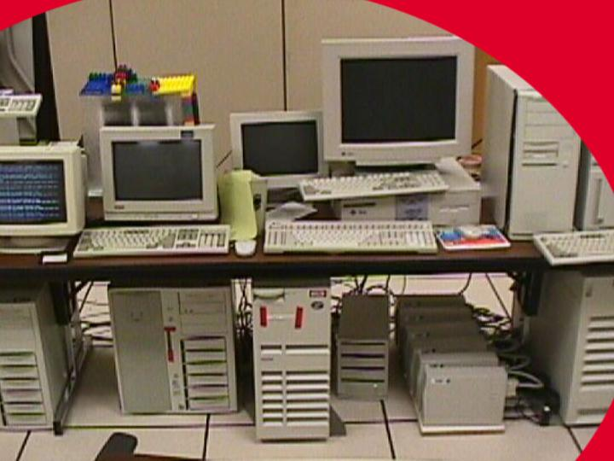
GOOGLE 1996

Slide 8
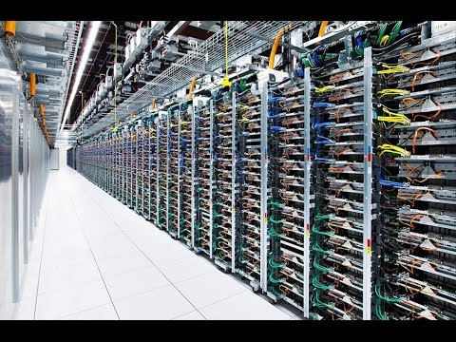
GOOGLE 2016 (30 years later...)

Slide 9
WHAT IS MIDDLEWARE?
Wikipedia
  “Middleware is computer software that provides services to software applications beyond those available from the operating system. It can be described as ‘software glue’.”

Slide 10
DISTRIBUTED SYSTEMS
Computer 1
Computer 2
Computer 3
Application A
Application B
Middleware (Distributed system layer)
Local OS 1
Local OS 2
Local OS 3
Network

Slide 11
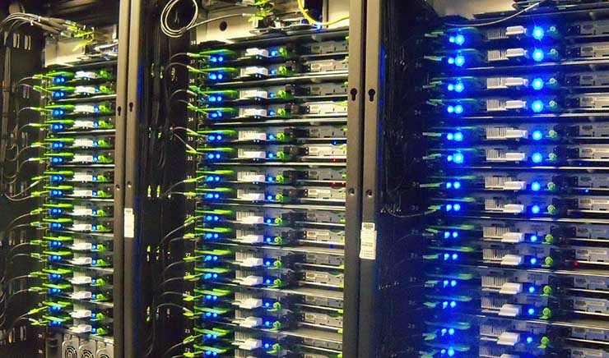
FACEBOOK
Facebook has nearly 1.4 million square meters
TAO (Facebook’s data storage system)
  Geographically distributed
  Can process a billion reads and millions of writes each second

Slide 12
DISTRIBUTED SYSTEMS GOALS

Slide 13
WHY DISTRIBUTED SYSTEMS?
Resource availability
Distribution transparency
Scalability
...
Many more!
In this course we will
focus on these three

Slide 14



Resource Availability
Easy for applications to access (remote) resources
  Storage
  Computers
  Printers
  …
As if resources
were not distributed

Slide 15
Distribution Transparency
Access transparency
Location transparency
Concurrency transparency
Migration transparency
Replication transparency
Relocation transparency
Failure transparency

Slide 16
Distribution Transparency
Access transparency
Location transparency
Concurrency transparency
Migration transparency
Replication transparency
Relocation transparency
Failure transparency

Slide 17
Distribution transparency
Access Transparency
Hides differences in data representation
Hides differences in how data resources might be access
UltraSPARC
Linux OS
Intel processor
Linux OS
AMD processor
Windows

Slide 18
Distribution transparency
Access Transparency
Hides differences in data representation
Hides differences in how data resources might be access
UltraSPARC
Linux OS
request(file)
Middleware
Intel processor
Linux OS
AMD processor
Windows

Slide 19
Distribution transparency
Location Transparency
Assigning logical names to resources
  http://mid-ist-fall-2018.github.io
UltraSPARC
Linux OS
Ireland
request(file)
Middleware
Intel processor
Linux OS
France
AMD processor
Windows
Japan

Slide 20
Distribution transparency
Location Transparency
Assigning logical names to resources (Naming)
  http://mid-ist-fall-2018.github.io
UltraSPARC
Linux OS
Ireland
request(file)
Switches, Routers, ...
Intel processor
Linux OS
France
AMD processor
Windows
Japan

Slide 21
Distribution transparency
Location Transparency
Assigning logical names to resources (Naming)
  http://mid-ist-fall-2018.github.io
  MAC, URL, file paths, registers, ...
Many issues to address
  Human readability?
  Fixed length?
  Hierarchies?
  Large name spaces
  Certification

Slide 22
Distribution transparency
Concurrency Transparency
Computer 1
Computer 2
Computer 3
Application A
Application B
Middleware (Distributed system layer)
Local OS 1
Local OS 2
Local OS 3

Slide 23
Distribution transparency
Concurrency Transparency
Computer 1
Operating systems use processes to run several tasks concurrently
Problems arise when many processes access the same resource.
  Data races
  Deadlocks
  Synchronisation
Application A
Middleware
Local OS 1

Slide 24




Distribution transparency
Replication Transparency
The middleware must keep track of outdated replicas
If a file is outdated must not be used
Consistency among replicas can be handled by middleware
Middleware
Middleware

Slide 25
Distribution transparency
Failure Transparency
Leslie Lamport (Turing award winner, 2013)
  “A distributed system is a system in which I can’t do my work because some computer that I’ve never even heard of has failed.”

Slide 26

Distribution transparency
Failure Transparency
Middleware
Middleware

Slide 27
Distribution transparency
Failure Transparency
Masking failures is one of the hardest problem in distributed systems
Failures may impact the correctness and efficiency of the code
Abstraction: programmers should (up to some degree) not handled failures in middleware layers
  Programmers must focus in failures at the layer they are working on

Slide 28
SCALABILITY
Aggregate resources
  CPU: MapReduce, Hadoop,
  Filesystem: NFS, Facebook’s TAO,
  Memory: Memcached
Tackles three main problems:
  Centralised services
  Centralised data
  Centralised algorithms
Example of achievable throughput
  Facebook’s TAO: a billion reads and millions of writes each second

Slide 29
SCALABILITY
Some solutions
  Asynchronous communication
  Distribute computation
  Caching
    Leads to inconsistency problems

Slide 30
ARCHITECTURAL STYLES

Slide 31
ARCHITECTURAL STYLES
Layering
Object based
Event-based
Data-centered

Slide 32
ARCHITECTURAL STYLES
Layering
Object-oriented
Event-based
Data-centered

Slide 33
LAYERING
Every layer L_{i} is only allowed to make requests to a layer L_{i-1}
Every layer defines an interface for communication
The implementation details are hidden to other layers

Slide 34
OBJECT-ORIENTED
Object can perform method calls in remote objects
Interfaces for each object are defined
The implementation details of the objects are hidden to callers
Object
Method calls
Object
Object

Slide 35
EVENT-BASED
Component
Component
Events may contain parameters
  For communication between components
Languages like JavaScriptript in web browsers
Event-based components a loosely coupled
  Events do not reference components
Event delivery
Event bus
Publish
Component

Slide 36
DATA-CENTERED
Shared data space
Non-blocking put
(Possible) blocking get
Decoupled components
  Also in time, no need to be active when data is published
Theoretical model
  Linda tuple space
Get data
Put data
Component
Component

Slide 37
SUMMARY
Administrative info for the course
High level definition of middleware
Some of the goals of distributed systems (and middleware)
  Availability
  Transparency
  Scalability
Different architectural styles
  Layered
  Object-based
  Event-based
  Data-centered

Slide 38
NEXT CLASS
Network communication
  Sockets
  Remote Procedure Calls (RPC)
  Java Remote Method Invocation (RMI)
Don’t forget your laptops!

