Slide 1
MIDDLEWARE DESIGN AND IMPLEMENTATION
Message Passing & Actors Model
Raúl Pardo

Slide 2
TODAY’S MENU
Akka Unit Testing (basic intro)
Parallelising computation
Workers
Timers
MapReduce

Slide 3
MATHEMATICS SERVER
SIMPLE UNIT TESTING

Slide 4

MATHS SERVER EXAMPLE

Slide 5
MATHS SERVER
AKKA UNIT TESTING
Akka contains libraries to test the “interfaces of actors”

Slide 6
MATHS SERVER SIMPLE TESTING
AKKA UNIT TESTING
SUM(1,2)
Mailbox
Mailbox
Synthetic
client
Maths
Server
Some functions:
expectMsgClass(ReponseServer.class)
  (Akka library)
assertsEquals(result,3)
  (JUnit)

Slide 7
MATHS SERVER SIMPLE TESTING
AKKA UNIT TESTING
Mailbox
Mailbox
Synthetic
client
Maths
Server
3
Some functions:
expectMsgClass(ReponseServer.class)
  (Akka library)
assertsEquals(result,3)
  (JUnit)

Slide 8
MATHEMATICS SERVER
PARALLELISING COMPUTATION

Slide 9
MATHS SERVER - DELEGATION
Use a different actor to perform the computation
  Commonly now as worker
Tasks may be done in parallel
Avoids delays if one task (among many to perform) is too slow
Increases robustness
  If there is an error during the execution of the operation the server is not directly affected and the remaining tasks can be performed

Slide 10
MATHS SERVER - DELEGATION
Mailbox
MUL(2,4)
Worker
SUB(0,23)
SUM(1,2)
Start worker
Mailbox
Client
Maths
Server
Mailbox
We can create a
worker actor for each
task that the server
must compute

Slide 11
MATHS SERVER - DELEGATION
Mailbox
MUL(2,4)
Worker
SUB(0,23)
PerformTask
  Perform task
SUM(1,2)
Mailbox
Client
Maths
Server
OperationDone
  Send to client
Mailbox

Slide 12
MATHS SERVER - DELEGATION
Mailbox
MUL(2,4)
Worker
SUB(0,23)
SUM(1,2)
Mailbox
Client
Maths
Server
Mailbox

Slide 13
MATHS SERVER - DELEGATION
Mailbox
MUL(2,4)
Worker
SUB(0,23)
Mailbox
Client
Maths
Server
Mailbox
SUM(1,2)

Slide 14
MATHS SERVER - DELEGATION
Mailbox
MUL(2,4)
Worker
SUB(0,23)
SUM(1,2)
Mailbox
Client
Maths
Server
Mailbox

Slide 15
MATHS SERVER - DELEGATION
Mailbox
MUL(2,4)
Worker
SUB(0,23)
Mailbox
Client
Maths
Server
3
Mailbox

Slide 16
MATHS SERVER - DELEGATION
Mailbox
MUL(2,4)
Worker
SUB(0,23)
Mailbox
Client
Maths
Server
Mailbox
3

Slide 17
MATHS SERVER - DELEGATION
Mailbox
MUL(2,4)
Worker
SUB(0,23)
Mailbox
Client
Maths
Server
3
Stop worker
Mailbox

Slide 18
MATHS SERVER - DELEGATION
Mailbox
MUL(2,4)
Worker
SUM(1,2)
Mailbox
Client
Maths
Server
Mailbox
If a task is received
before the worker is
done, we simply
create a new worker
SUB(0,23)

Slide 19
MATHS SERVER - DELEGATION
Mailbox
MUL(2,4)
Worker
SUM(1,2)
Mailbox
Client
Maths
Server
Mailbox
Worker
Mailbox
SUB(0,23)

Slide 20
MATHS DELEGATION SERVER EXAMPLE

Slide 21
MATHS SERVER - DELEGATION
Mailbox
MUL(2,4)
Worker
…
SUB(0,23)
SUM(1,2)
What happens if the server has a high amount of requests?
  Many actors may be created
  Too many resources may be taken
Mailbox
Client
Maths
Server
Mailbox

Slide 22
MATHS DELEGATION SERVER EXAMPLE

Slide 23
SAME UNIT TESTS
Mailbox
Synthetic
client
Maths
Server

Slide 24
MATHEMATICS SERVER
WORKERS

Slide 25
WORKERS
Replicated workers is a common design patter for parallelising computation in a controlled manner:
  There exists a fixed pool of workers
  There exists a set of pending tasks
When a task arrives:
  If there are free workers the tasks is immediately scheduled
  If there are no available workers, the task is added to the set of pending tasks

Slide 26
WORKERS
The main benefit of this pattern is that tasks can be executed in parallel while preserving hardware limitations such as memory, processors, etc.

Slide 27
MATHS SERVER - WORKERS
Mailbox
MUL(2,4)
Worker
SUM(1,2)
Mailbox
Client
Maths
Server
Mailbox
Worker
Mailbox
SUB(0,23)

Slide 28
MATHS SERVER - WORKERS
Pending
Tasks
Mailbox
MUL(2,4)
Worker
SUM(1,2)
Mailbox
Client
Maths
Server
Mailbox
Worker
Mailbox
SUB(0,23)

Slide 29
MATHS SERVER - WORKERS
Pending
Tasks
Mailbox
Worker
SUM(1,2)
Mailbox
Client
Maths
Server
Mailbox
Worker
Mailbox
SUB(0,23)
MUL(2,4)

Slide 30
MATHS SERVER - WORKERS
Pending
Tasks
Mailbox
Worker
MUL(2,4)
SUM(1,2)
Mailbox
Client
Maths
Server
Mailbox
Worker
Mailbox
SUB(0,23)

Slide 31
MATHS SERVER - WORKERS
Pending
Tasks
Mailbox
Worker
MUL(2,4)
Mailbox
Client
Maths
Server
Mailbox
Worker
Mailbox
SUB(0,23)
3

Slide 32
MATHS SERVER - WORKERS
Pending
Tasks
Mailbox
Worker
MUL(2,4)
Mailbox
Client
Maths
Server
Mailbox
Worker
Mailbox
SUB(0,23)
3

Slide 33
MATHS WOKERS SERVER EXAMPLE

Slide 34
MATHS SERVER - WORKERS
Some additional problems we haven’t addressed:
  Is it necessary to reply to the server?
    When can we do it?
  Reception order
    Imagine that packages must be received in order by the client. Would our solution work?

Slide 35
AKKA TIMERS

Slide 36
TIMERS
Useful to perform recurrent tasks
  Notify user once per day
  Collect user’s private data every 20 seconds...
  Restart re-connect after 10 seconds of inactivity
  Re-send ACK after 1 minute of inactivity

Slide 37
TIMERS IN ACTORS MODEL
MyActor
TimerMessage
Timer
Every 4 sec.

Slide 38
AKKA TIMERS
TimerMessage
Every 4 sec.
MyActor

Slide 39
AKKA TIMERS
public class Client extends AbstractActor {
}
public class Client extends AbstractActorWithTimers {
...
// Periodic timer
getTimers().startPeriodicTimer(”MyTimer”, new Message(), Duration.ofSeconds(1));
// One time timer
getTimers().startSingleTimer(”MyTimer”, new Message(), Duration.ofSeconds(1));
...
}

Slide 40
AKKA TIMEOUT
Timeouts are timers that are only trigger after a period of inactivity
  Only one timeout per actor can be defined
  The actor does not need to be defined as AbstractActorWithTimers
public class Client extends AbstractActor {
...
// Receive a timeout every 10 seconds of inactivity
getContext().setReceiveTimeout(Duration.ofSeconds(3));
...
}

Slide 41
AKKA TIMERS/TIMEOUTS EXAMPLE

Slide 42
MAPREDUCE

Slide 43
TECH GIANTS WORKLOAD
Google
  Processes 20 PB a day (2008)
  Crawls 20B pages a day (2012)
Amazon S3
  Contains 449B objects (2011)
  Processes up to 290k request/second (2011)

Slide 44
How do we process in parallel large amounts of data in a distributed system?

Slide 45
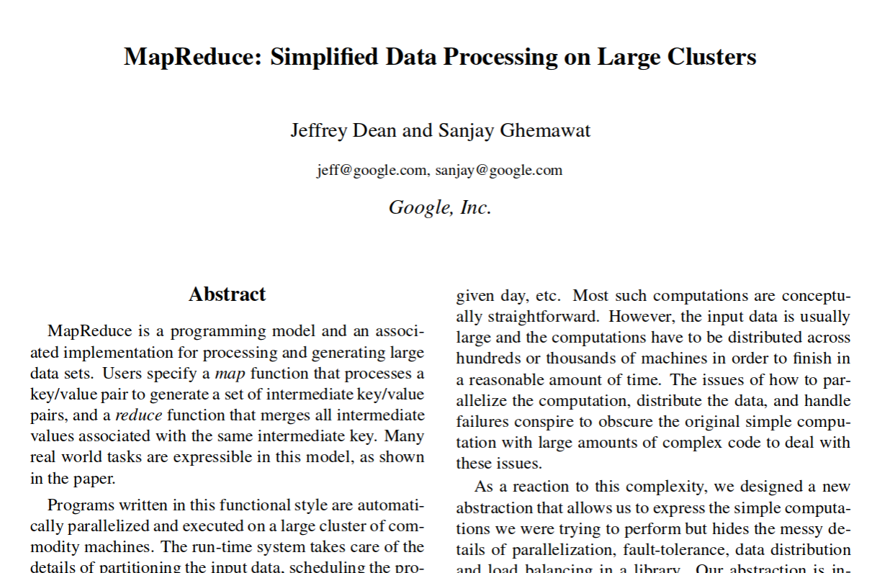

Slide 46
COMMON PROCESSING ROUTINE
Iterate over large number of records
Extract some information
Shuffle and sort the information
Aggregate intermediate results
Generate final output

Slide 47
COMMON PROCESSING ROUTINE
Iterate over large number of records
Extract some information [MAP]
Shuffle and sort the information
Aggregate intermediate results [REDUCE]
Generate final output

Slide 48
ASSUMPTIONS ON DATA
The dataset may be split in equal size independent blocks
  Each block can be processed by different processes/threads

Slide 49
CHALLENGES
How to distribute computation
  Master/slave architecture
  Workers
Machine failures

Slide 50
MAPREDUCE ABSTRACTION
MapReduces gives programmers an abstraction where they simply define the functions map and reduce
  Compute a large number of tasks in parallel
Programmers do not need to worry about
  Parallelisation
  Fault-tolerance
  Data distribution
  Load balancing

Slide 51
MAP/REDUCE FUNCTIONS
farewells.add("Goodbye");
farewells.add("Auf Wiedersehen");
farewells.add("Adiós");
farewells.add("Ciao");
farewells.add("Do widzenia");
farewells.stream().map(fa -> fa.length()) // [7,15,5,4,11]
.reduce(0,(x,y) -> x+y)); // 42

Slide 52
MAPREDUCE BY EXAMPLE
Consider a “huge” text document as the one below
Our task is to count the how many times each word appears
This is the best course
of the year.

Slide 53
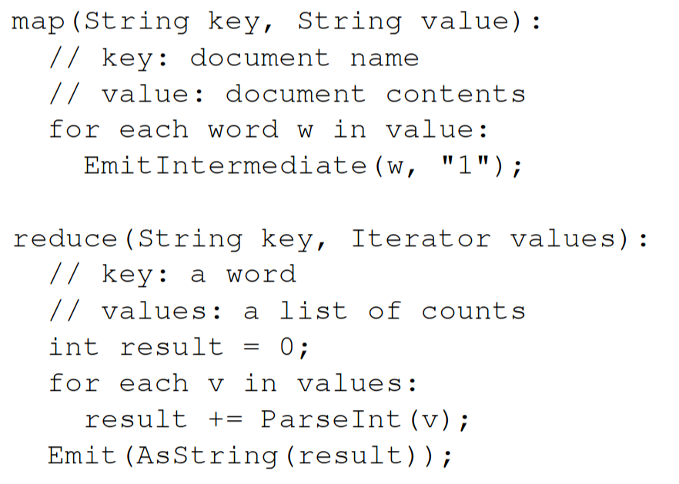
MAPREDUCE BY EXAMPLE
MapReduce, map and reduce functions
Source: Dean, Jeffrey, and Sanjay Ghemawat. "MapReduce: simplified data processing on large clusters." Communications of the ACM 51.1 (2008): 107-113.

Slide 54
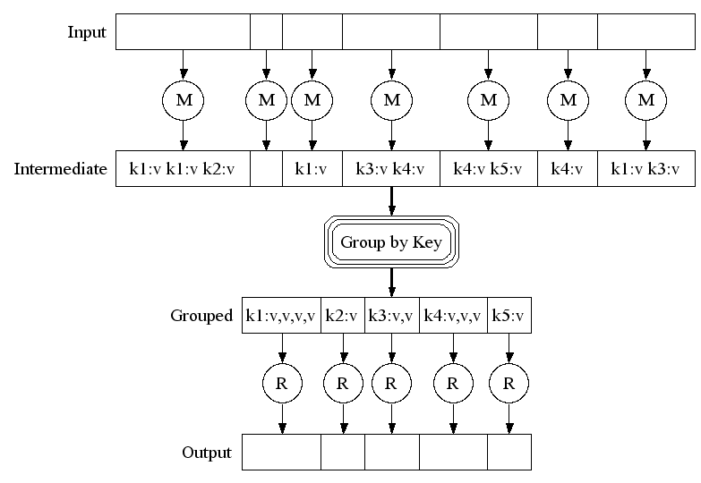
MAPREDUCE BY EXAMPLE
Source: https://research.google.com/archive/mapreduce-osdi04-slides/index-auto-0007.html

Slide 55
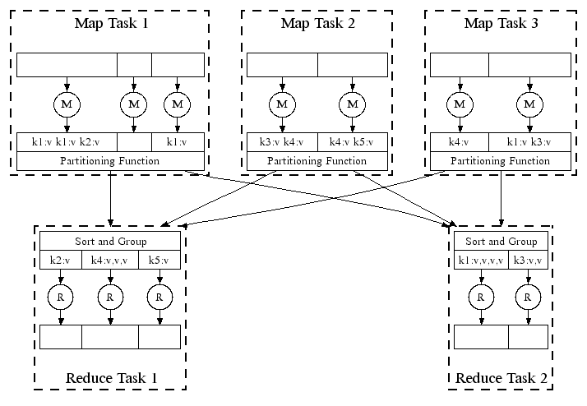
MAPREDUCE BY EXAMPLE
Source: https://research.google.com/archive/mapreduce-osdi04-slides/index-auto-0008.html

Slide 56
MAPREDUCE BY EXAMPLE
This is the best course
of the year.
Processing our document
This
is
the
best
course
of
the
year
(This, “1”)
(is, “1”)
(the, “1”)
(best, “1”)
(course, “1”)
(of, “1”)
(the, “1”)
(year, “1”)
(This, [“1”])
(is, [“1”])
(the, [“1”, “1”])
(best, [“1”])
(course, [“1”])
(of, [“1”])
(year, [“1”])
(This, 1)
(is, 1)
(the, 2)
(best, 1)
(course, 1)
(of, 1)
(year, 1)
group
reduce
map

Slide 57
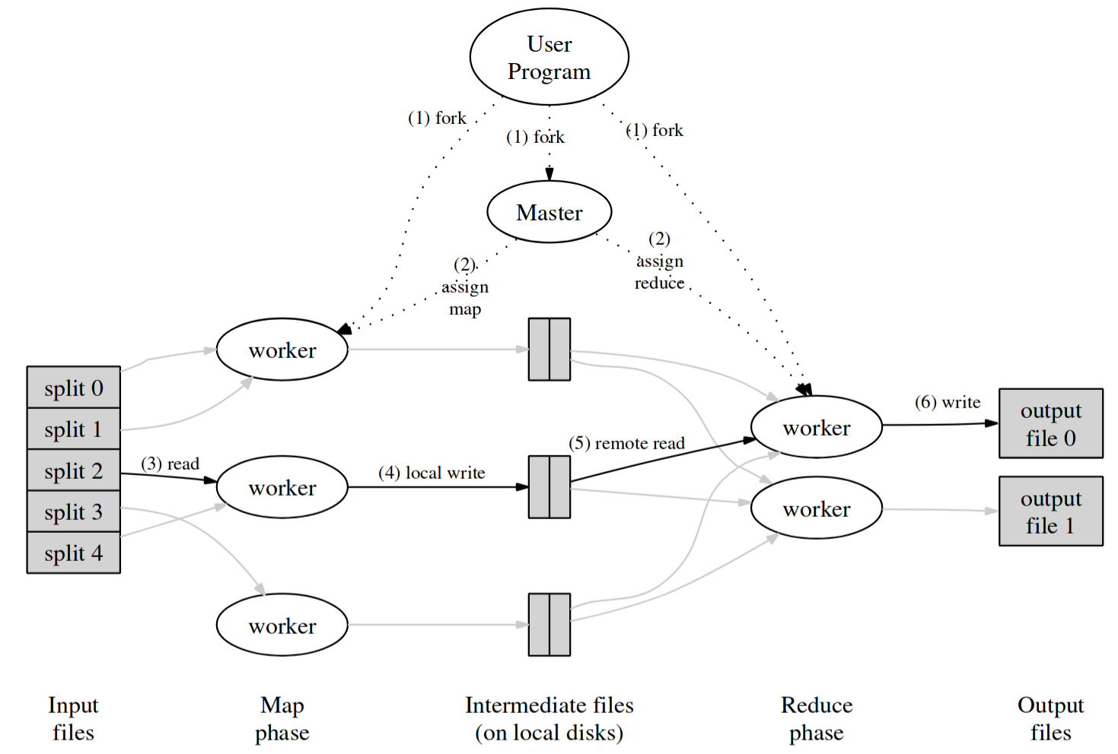
MAPREDUCE EXECUTION ENGINE

Slide 58
MAPREDUCE EXECUTION ENGINE
Initially the master process and n workers are created

Slide 59
MAPREDUCE EXECUTION ENGINE
The master assigns tasks to the map workers

Slide 60
MAPREDUCE EXECUTION ENGINE
The map workers write their outpus in intermediate files

Slide 61
MAPREDUCE EXECUTION ENGINE
The master assigns reduce workers to process intermediate results

Slide 62
MAPREDUCE EXECUTION ENGINE
The reduce workers produce the final outputs

Slide 63
(SOME) REFINEMENTS
Fault-tolerance
  Handled via re-execution
Redundant execution
Locality optimisation
…

Slide 64
SUMMARY
Akka Unit Testing (basic intro)
Parallelising computation
Workers
Timers
MapReduce

