Slide 1
MIDDLEWARE DESIGN AND IMPLEMENTATION
Shared Memory Concurrency
Raúl Pardo

Slide 2
TODAY’S MENU
Why shared memory concurrency?
Threads
  Java Threads Example

Slide 3
WHAT IS CONCURRENCY?

Slide 4
WHAT IS CONCURRENCY?
Threads (or processes, or agents)
  People (cooperating | competing | coordinating) to complete a task
Each thread works at its own speed
  Some may be faster than others
  Some may wait for different events
“Peer to peer synchronisation” – not based on clocks

Slide 5
WHAT IS CONCURRENCY?
Thread 1
Thread 2
Thread 3
time

Slide 6
CONCURRENCY PARALLELISM
Thread 1
Thread 2
Thread 3
time

Slide 7
CONCURRENCY PARALLELISM
Thread 1
Thread 2
Thread 3
time

Slide 8
WHY CONCURRENCY?

Slide 9
WHY CONCURRENCY?
Distribution transparency
  Shared memory concurrency provides transparency within computational units (e.g., threads or processes) that work on shared memory.
Scalability
  Dividing applications into computational independent tasks may increase the throughput of the application.

Slide 10
Distribution transparency
(Shared Memory) Concurrency Transparency
Computer 1
Operating systems use processes to run several tasks concurrently
App
A
App
B
Middleware
Local OS 1

Slide 11
Distribution transparency
(Shared Memory) Concurrency Transparency
Responsiveness
  Execute many tasks independently
  GUIs allow users to interact with all these tasks at the same time
Abstraction
  Divide complex tasks into independent tasks

Slide 12
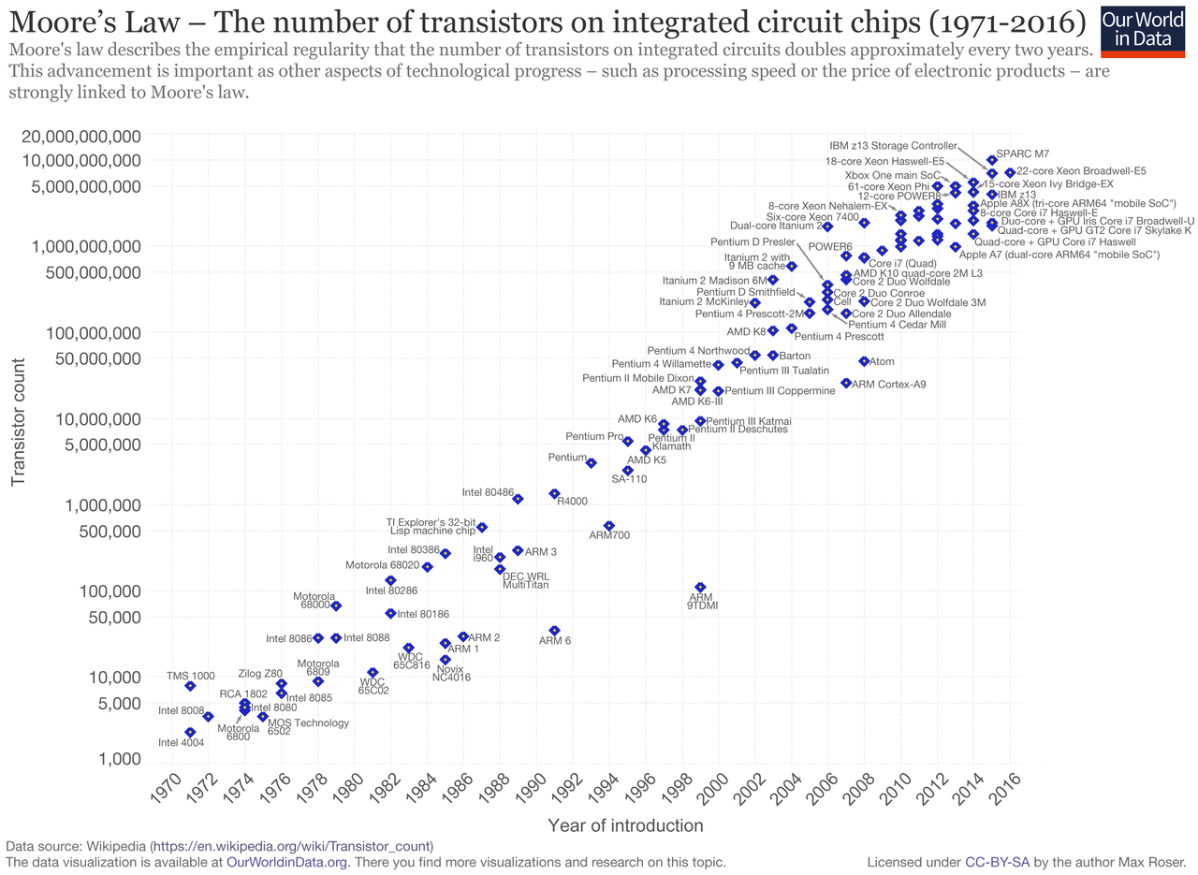
HOW DO PROGRAMS GET FASTER?

Slide 13

NOTHING LASTS FOREVER...

Slide 14
AMDAHL’S LAW
Limitations of parallelism
Given n processors that can run in parallel. How much speed up can we achieve?
Amdahl’s law shows that the impact of introducing parallelism is limited by the fraction p of a program that can be parallelised

Slide 15
AMDAHL’S LAW: EXAMPLES
n = 10 processors, how close do we get to a 10x speedup?
n = 100 processors, how close do we get to 100x speedup?
% SEQUENTIAL | % PARALLEL | MAX SPEEDUP
20% | 80% | 3.57
10% | 90% | 5.26
1% | 99% | 9.17
% SEQUENTIAL | % PARALLEL | MAX SPEEDUP
20% | 80% | 4.81
10% | 90% | 9.17
1% | 99% | 50.27

Slide 16


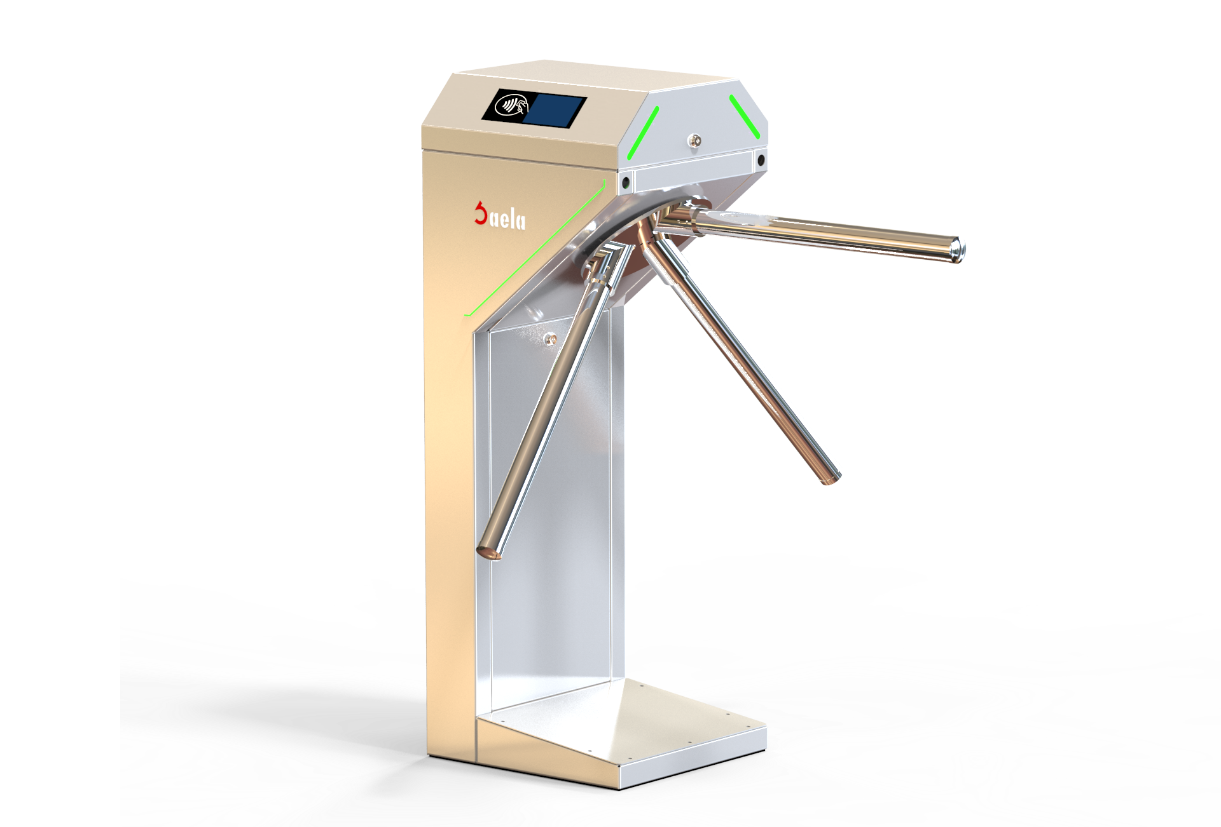
SHARED MEMORY CONCURRENCY EXAMPLE
Turnstile counter
counter

Slide 17

SHARED MEMORY CONCURRENCY EXAMPLE

Slide 18
THREADS

Slide 19
PROCESSES
Independent unit of computation
  Identifier
  Memory space
Processes may be in different states
  Ready
  Blocked
  Running
blocked
event
wait
new
resume
ready
running
suspend

Slide 20
SCHEDULER
Responsible for changing process states
Scheduler
Ready
There exists many scheduling policies that optimise different factors
  First Come First Served
  Round Robin
  ...
Running
p₁
p₂
p₃

Slide 21
THREADS
A thread is a lightweight process
  Identifier
  Memory
    Local memory, for each thread
    Shared memory
Shared memory
Thread 1
Thread n
Local Memory
Thread 1
Local Memory
Thread n

Slide 22
JAVA THREADS
There exist two ways to create a thread in java
  Extend from Thread
  Implement Runnable
class Counter implements Runnable {
…
public void run(){
// Code to be executed
}
}
class Counter extends Thread {
…
public void run(){
// Code to be executed
}
}

Slide 23
JAVA THREADS
Start a thread
  Counter t = new Counter();
  t.start();
Wait for termination
t.join();
Other functions
Thread.sleep(1000); // put a thread to sleep for 1 sec
t.wait(); // Wait for an event (from another thread)

Slide 24
JAVA THREADS – JVM SCHEDULER
blocked
event
wait
new
resume
ready
running
suspend

Slide 25
JAVA THREADS – SCHEDULE
Depends on
JVM scheduler
Depends on
other entities
blocked
event
t.wait();
…
t.start();
resume
ready
running
Thread.sleep(1000);
…

Slide 26
TO BE CONTINUED...

