Slide 1
MIDDLEWARE DESIGN AND IMPLEMENTATION
Shared Memory Concurrency
Raúl Pardo

Slide 2
TODAY’S MENU
Why (shared memory) concurrency?
Threads
Synchronisation
  Locks
  Semaphores
  Monitors

Slide 3
TODAY’S MENU
Why (shared memory) concurrency?
Threads
Synchronisation
  Locks
  Semaphores
  Monitors

Slide 4

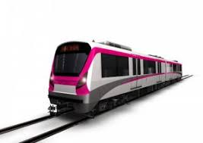
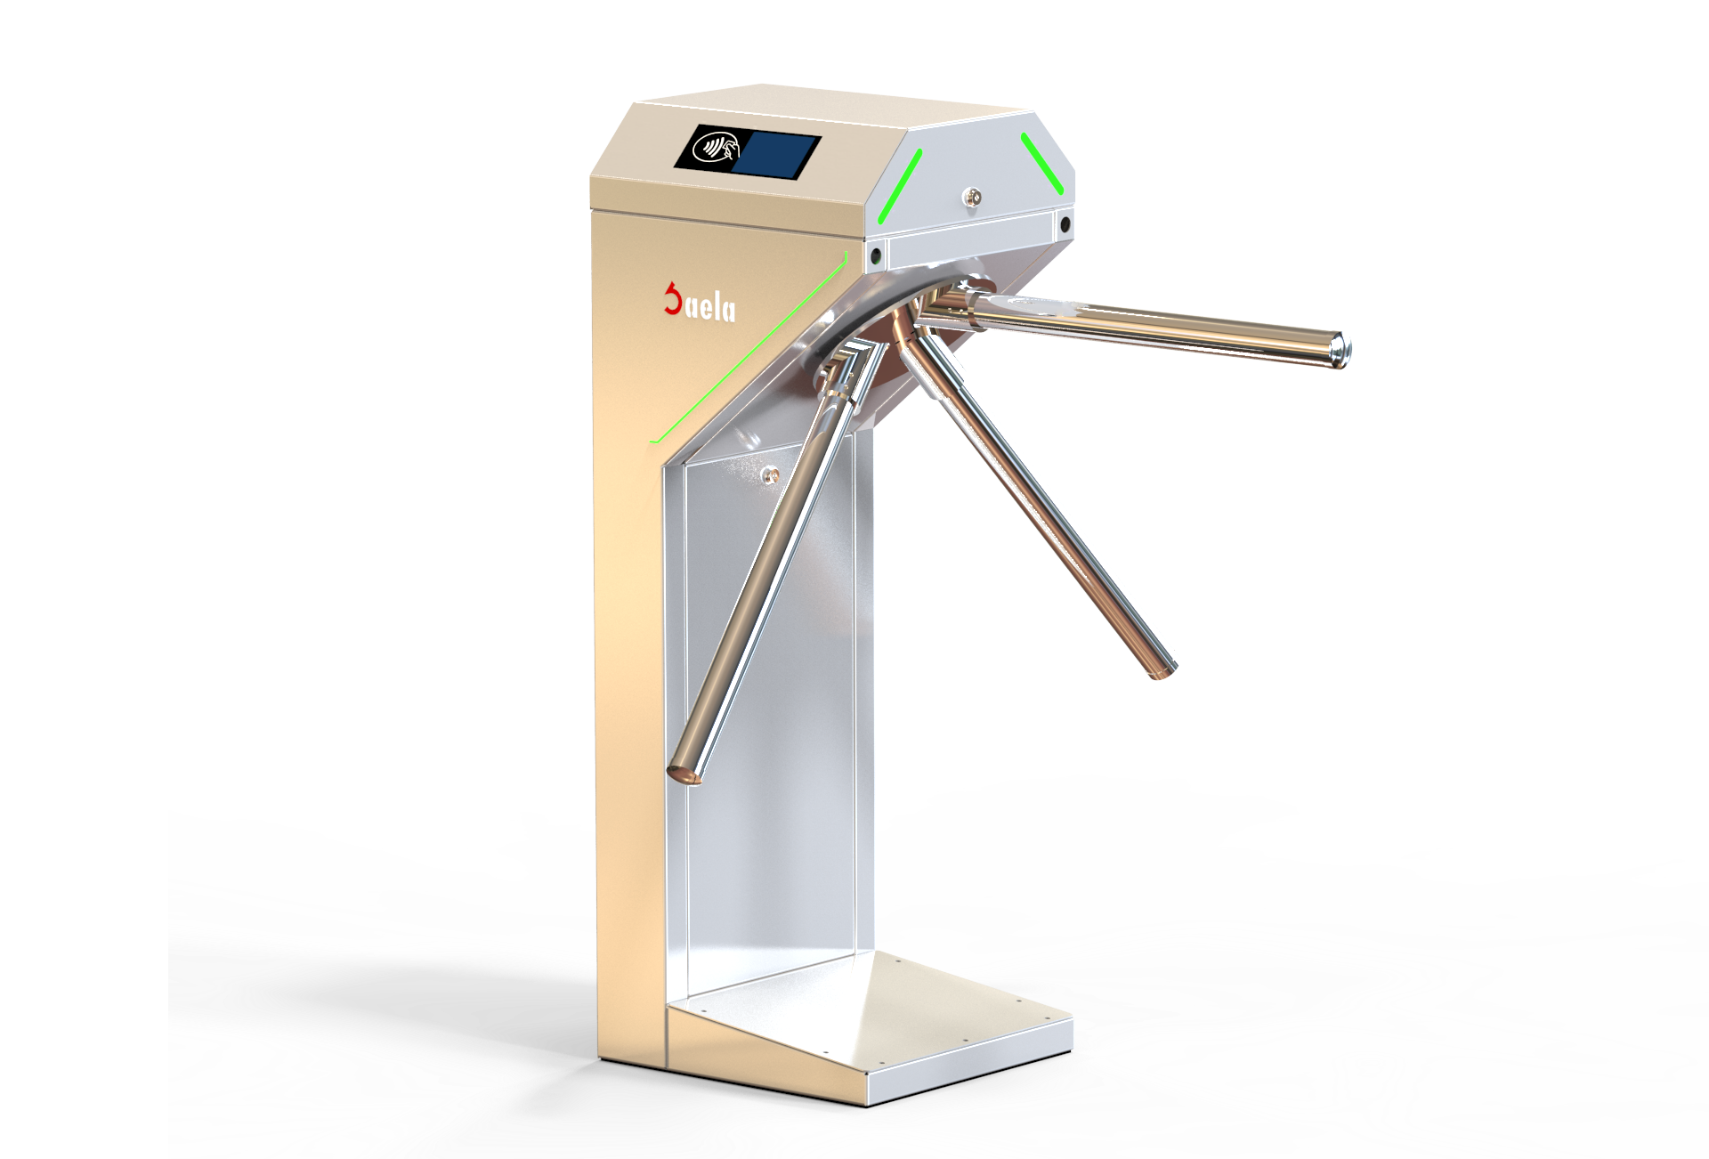
SHARED MEMORY CONCURRENCY EXAMPLE
Turnstile counter
counter

Slide 5
THREADS

Slide 6
PROCESSES
Independent unit of computation
  Identifier
  Memory space
Processes may be in different states
  Ready
  Blocked
  Running
blocked
event
wait
new
resume
ready
running
suspend

Slide 7
SCHEDULER
Responsible for changing process states
Scheduler
Ready
There exists many scheduling policies that optimise different factors
  First Come First Served
  Round Robin
  ...
Running
p₁
p₂
p₃

Slide 8
THREADS
A thread is a lightweight process
  Identifier
  Memory
    Local memory, for each thread
    Shared memory
Shared memory
Thread 1
Thread n
Local Memory
Thread 1
Local Memory
Thread n

Slide 9
JAVA THREADS
There exist two ways to create a thread in java
  Extend from Thread
  Implement Runnable
class Counter implements Runnable {
…
public void run(){
// Code to be executed
}
}
class Counter extends Thread {
…
public void run(){
// Code to be executed
}
}

Slide 10
JAVA THREADS
Start a thread
  Counter t = new Counter();
  t.start();
Wait for termination
t.join();
Other functions
Thread.sleep(1000); // put a thread to sleep for 1 sec
t.wait(); // Wait for an event (from another thread)

Slide 11
JAVA THREADS – JVM SCHEDULER
blocked
event
wait
new
resume
ready
running
suspend

Slide 12
JAVA THREADS – SCHEDULE
Depends on
JVM scheduler
Depends on
other entities
blocked
event
t.wait();
…
t.start();
resume
ready
running
Thread.sleep(1000);
…

Slide 13
CRITICAL SECTIONS

Slide 14
CRITICAL SECTION
A critical section is the part of a concurrent program where shared memory is updated
As we saw in the previous example, updating variables in the critical section can lead to erroneous results
public void run() {
for (int i = 0; i < PEOPLE; i++){
counter++; // Critical section
}
}

Slide 15
RACE CONDITIONS
A race condition occurs when the result of a program depends on the order of the execution
  Same inputs may lead to different outputs
  The order of execution is non-deterministic
    It is determined by the scheduler.

Slide 16
CONCURRENCY HUMOUR
Knock knock
Race condition
Who's there?

Slide 17
DATA RACES
The term data race is used for race conditions involving concurrent operations within shared memory
  At least one of the operations must be a write
  Counter example
Not all data races may produce incorrect results

Slide 18
THE ART OF CONCURRENT PROGRAMMING
Make your program as concurrent as possible while avoiding race conditions (i.e., preserving correctness)
  Careful synchronisation

Slide 19
MUTUAL EXCLUSION

Slide 20
MUTUAL EXCLUSION
Given a program running several threads, the mutual exclusion problem/requirement states that: a thread never enters its critical section at the same time than another thread is in its own critical section.
  Two threads cannot be in their critical sections at the same time

Slide 21
MUTUAL EXCLUSION
To study this problem we consider threads with the following parts
Thread 1
while(true) {
entry_protocol;
critical_section;
exit_protocol;
}
Sequence of operations to guarantee that there is no other thread in its critical section
Sequence of operations to notify that the thread is leaving its critical section

Slide 22
MUTUAL EXCLUSION
Counter example
int counter;
Thread 1
while(true) {
entry_protocol;
counter++;
exit_protocol;
}
Thread 2
while(true) {
entry_protocol;
counter++;
exit_protocol;
}

Slide 23
MUTUAL EXCLUSION PROPERTIES
A “good” solution to the mutual exclusion problem should satisfy the following properties:
  Mutual exclusion
    No more than one thread at the same time in the critical section
  Absence of deadlock
    At least one thread making can make progress
  Absence of starvation
    All threads can eventually access their critical sections

Slide 24
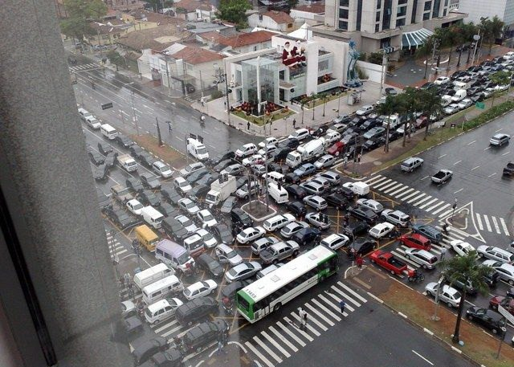
DEADLOCK
A deadlock occurs when all the threads in the program wait for a resource that is held by another thread (circular waiting)

Slide 25
DEADLOCK
Solving the mutual exclusion problem may lead to deadlocks
  Threads that attempt to enter their critical section must wait until no thread is in its critical section

Slide 26


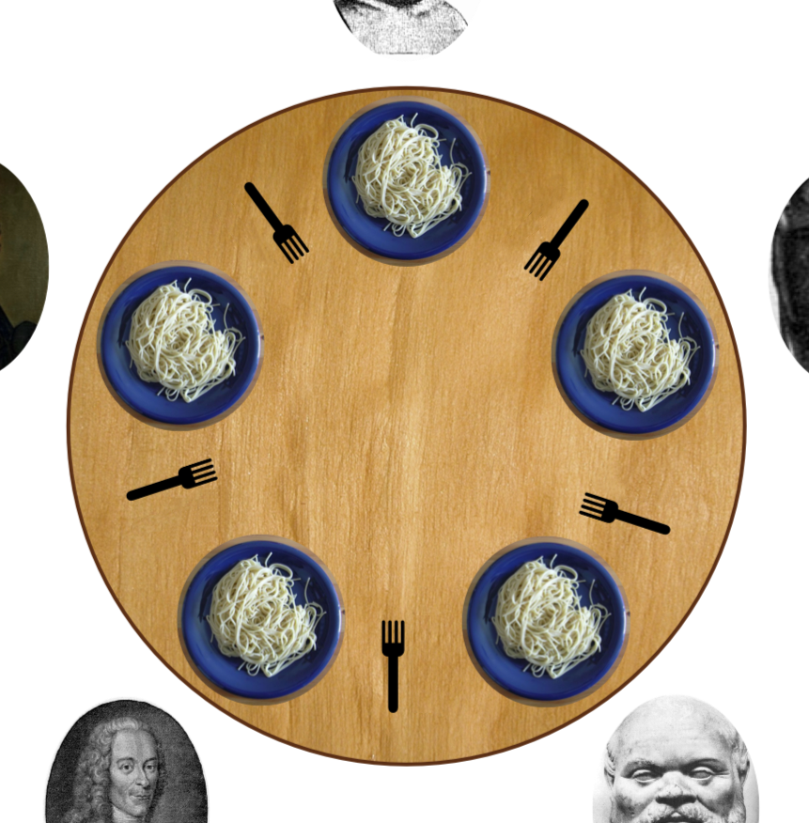



DINNING PHILOSOPHERS
Synchronisation problem introduced by Edsger Dijkstra
Rules
  Philosophers can only think or eat
  In order for the philosophers to eat they must their right and left fork

Slide 27
DINNING PHILOSOPHERS
Philospoher
while(true) {
think();
// entry_protocol;
left_fork.take();
right_fork.take();
// critical section
eat();
// exit_protocol;
left_fork.release();
right_fork.release();
}
DEADLOCK!

Slide 28
COFFMAN CONDITIONS
Necessary conditions for deadlocks
  Mutual exclusion
  Hold and wait
  No preemption
  Circular wait
Break one of the previous conditions and deadlocks are resolved

Slide 29
DINNING PHILOSOPHERS
Philospoher
while(true) {
think();
// entry_protocol;
both_forks.take();
// critical section
eat();
// exit_protocol;
both_fork.release();
}
STARVATION!
Atomic take and release
solves the deadlock
(resolves hold and wait)

Slide 30
STARVATION
Starvation occurs when an active thread never enters its critical section
  It is in the ready state but never goes to the running state
  Many reasons:
    Other threads are active at the same time
    When competing for shared resources the thread never takes them
Solving this problem requires assumptions on the scheduler

Slide 31

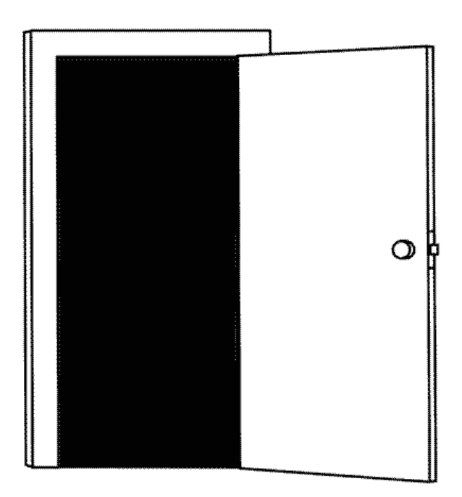
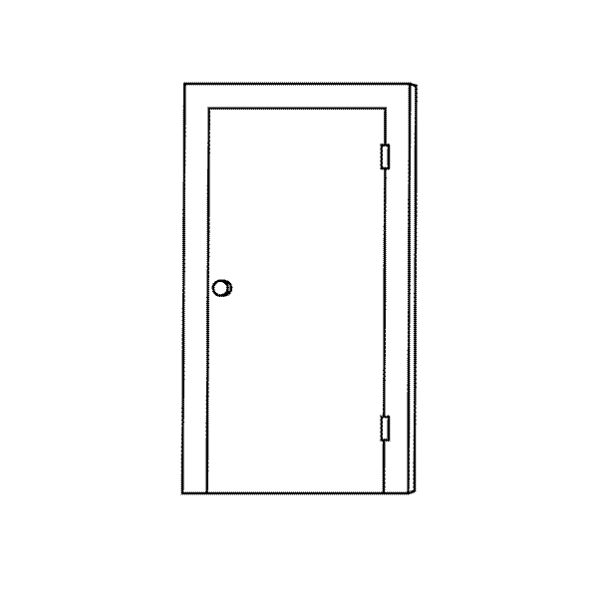
FAIRNESS
Solving starvation requires the scheduler to guarantee that all active threads make progress.
  Weak Fairness: A thread that is continuously active will eventually make progress
  Strong Fairness: A thread that is infinitely often active will eventually make progress

Slide 32

DINNING PHILOSOPHERS
Philospoher i
while(true) {
think();
// entry_protocol;
dish_{i}.take();
// critical section
eat();
// exit_protocol;
dish_{i}.release();
}
Waiter
while(true) {
for(i : 0..4) {
dish_{i}.release();
dish_{i}.take();
}
}

Slide 33
LOCKS

Slide 34
LOCKS
Locks are structures to provide support for thread synchronisation
  They can be taken or release by only one thread
A lock can be shared by many threads
Locks are composed by two atomic methods
  lock()
    This method checks whether the lock is free. If not, it puts the thread to wait, otherwise it changes the state of the lock as taken and lets the thread make progress.
    It is blocking
      May add the thread to an internal queue of blocked threads
    Only one thread at a time allow to hold the lock
  unlock()
    This method changes the state of the lock to free, if the thread executing the method holds the lock.
    If there were processes in the waiting queue it releases one (no fixed strategy to choose)
    It is non-blocking

Slide 35
LOCKS – COUNTER EXAMPLE
// Imports
import java.util.concurrent.locks.Lock;
// Shared variables
Lock lock = new Lock();
public void run() {
for (int i = 0; i < PEOPLE; i++){
entry_protocol;
counter++; // Critical section
exit_protocol;
}
}

Slide 36
LOCKS – COUNTER EXAMPLE
// Imports
import java.util.concurrent.locks.Lock;
// Shared variables
Lock lock = new Lock();
public void run() {
for (int i = 0; i < PEOPLE; i++){
lock.lock();
counter++; // Critical section
exit_protocol;
}
}

Slide 37
LOCKS – COUNTER EXAMPLE
// Imports
import java.util.concurrent.locks.Lock;
// Shared variables
Lock lock = new Lock();
public void run() {
for (int i = 0; i < PEOPLE; i++){
lock.lock();
counter++; // Critical section
lock.unlock();
}
}

Slide 38

LOCKS – COUNTER EXAMPLE

Slide 39
LOCKS – COUNTER EXAMPLE
// Imports
import java.util.concurrent.locks.Lock;
// Shared variables
Lock lock = new Lock();
More precisely, we will use
locks of type ReentrantLock
public void run() {
for (int i = 0; i < PEOPLE; i++){
lock.lock();
counter++; // Critical section
lock.unlock();
}
}

Slide 40
REENTRANT LOCKS
Only the thread holding the lock can enter the critical section
The thread can acquire the lock more than once (reentrancy)
Not fairness assumptions
  Nevertheless, new ReentrantLock(true); gives priority to the longest waiting thread

Slide 41
INTRINSIC LOCKS IN JAVA
All java objects include an intrinsic lock
  This lock can be used for synchronisation
    Keyword synchronized

Slide 42
USING INTRINSIC LOCKS IN JAVA
public synchronized T method() {
// Critical section
}
Object lock = new Object();
public T method() {
...
synchronized(lock) {
// Critical section
}
...
}
Intrinsic locks have the same semantics as ReentrantLock (i.e., they behave the equally)

Slide 43
INTRINSIC LOCKS –
COUNTER EXAMPLE

Slide 44
WHAT IF WE WOULD LIKE TO HAVE MORE THAN ONE THREAD IN THE CRITICAL SECTION?

Slide 45
SEMAPHORES

Slide 46
SEMAPHORES
Semaphores are structures to control the number of threads that enter a critical section (i.e., use shared resources)
  As locks, they can be taken or release by only one thread
A lock can be shared by many threads
Locks are composed by a variable and two atomic methods
  c
    Determines the number of threads that are allowed to enter the critical section
  acquire()
    This method checks whether c > 0. If not, it puts the thread to wait, otherwise it changes the state of the lock as taken and lets the thread make progress. In either case the call also reduces the variable, c--;
    It is blocking
      May add the thread to an internal queue of blocked threads
    Many threads (concretely c) at a time allow to hold the lock
  release()
    This method changes the state of the lock to free, if the thread executing the method holds the lock.
    If there were processes in the waiting queue and c > 0 it releases one (no fixed strategy to choose)
    It is non-blocking

Slide 47



SEMAPHORES
Semaphores can be used to limit the number of threads that access a set of shared resources
2 more people
can enter
1 more people
can enter
0 more people
can enter

Slide 48
SEMAPHORES – COUNTER EXAMPLE
// Imports
import java.util.concurrent.Semaphore;
// Shared variables
Semaphore sem= new Semaphore(1);
int counter = 0;
Number of threads
initially allowed in
the critical section
public void run() {
for (int i = 0; i < PEOPLE; i++){
sem.acquire();
counter++; // Critical section
sem.release();
}
}

Slide 49
SEMAPHORES –
COUNTER EXAMPLE REVISITED
Update
Model each person as
an independent thread
Update
If the train is full,
they go to have a coffee
and come back later
Turnstile counter
counter

Slide 50
WHAT IF WE WOULD LIKE TO HAVE THREADS WAITING IN DIFFERENT QUEUES?

Slide 51
MONITORS

Slide 52
MONITORS
A monitor is a structure with the following properties
  May contain conditions variables
    A condition variable is a queue where monitor can put threads to wait
  At most one thread is in the monitor at the same time
  It is composed by two main methods (this methods are atomic because of the previous item)
    await()
      If the condition to enter the critical section does not hold, puts the thread to wait in a condition variable, otherwise the thread can make progress
    signal()
      Notifies (or signals) a one of the threads waiting in a condition variable (if any)

Slide 53
WAITING QUEUES
Entry queue
  First-In First-Out (FIFO) queue of threads that determine which the order in which threads enter the monitor
Condition variables
  Explicit waiting structures (FIFO queues as well) used by the logic of the monitor

Slide 54
ENTRY QUEUE
p₁
p₂
p₂
p₃
// Shared variables
...
public void await() {...}
public void signal() {...}
public T m() {...}
...

Slide 55
CONDITION VARIABLE QUEUE
p₁
p₂
p₃
// Shared variables condition_variable:
...
public void await() {...}
public void signal() {...}
public T m() {...}
...

Slide 56
SIGNALING SEMANTICS
What happens after signaling a thread depends on the particular semantics of the monitor implementation
  The thread can go to the entry queue to compete for the lock again (Mesa semantics)
  Threads waiting in a condition variable may have preference over the thread waiting in the entry queue (Hoare semantics)
  ...

Slide 57
MONITORS IN JAVA

Slide 58
BARRIERS

Slide 59
BARRIER SYNCHRONISATION
The barrier synchronisation problem consists in synchronising a set of threads at a given point in the program.
t₁
At this point they can:
  Share results
  Proceed to do tasks that requires 3 threads
  ...
t₂
t₃

Slide 60
BARRIER WITH LOCKS
// Shared variables
Lock lock[] = {new Lock(); new Lock()}
Thread 1
// Before barrier
lock[0].unlock();
Lock[1].lock();
// After barrier
Thread 2
// Before barrier
lock[1].lock();
lock[0].unlock();
// After barrier

Slide 61
BARRIER WITH LOCKS
// Shared variables
Lock lock[] = {new Lock(); new Lock()}
Thread 1
// Before barrier
lock[0].unlock();
Lock[1].lock();
// After barrier
Thread 2
// Before barrier
lock[1].lock();
lock[0].unlock();
// After barrier

Slide 62
NEXT PROGRAMMING ASSIGNMENT
Solving the barrier problem with monitors
  You will implement the monitors as we described today, but they may be more complex

Slide 63
SUMMARY
Mutual exclusion problem
Synchronisation
  Locks
  Semaphores
  Monitors
Barriers

