Slide 1
Title of Presentation in Initial Capitals:
36 Points, Calibri Bold
Replace this box with key image to introduce talk’s scope, importance, or background
Name
Name
Name
Department
Institution
Date
Replace with
your Logo
Notes:
This file presents an assertion-evidence template for making effective slides for scientific presentations. Although much about the layout and typography contrasts sharply with the defaults of PowerPoint, these changes are done so to make the slides more effective at communicating technical information. The design advocated by this template arises from Chapter 4 of The Craft of Scientific Presentations, 2nd edition (Springer, 2013). The homepage for this template exists at the following website:
http://writing.engr.psu.edu/assertion_evidence.html
Right now you are viewing the notes pages. To work on the slides, click on “Slide” under “View.” Tip: When creating a new presentation, save this file as the name of your presentation. Warning: You are more than welcome to use this template for your presentation slides. You may not, though, distribute this template for profit or distribute this template without giving credit to the source: http://writing.engr.psu.edu/
This slide is for the title slide of a presentation. Consider inserting an image that helps orient the audience to the title. You should not leave this slide until the audience feel comfortable with the title. Forcing yourself to spend more time with this slide is good because a common mistake in presentations is to leave the title slide too soon. Because of this mistake, many in the audience do not have the chance to comprehend the key details of the title. See pages 172-184 in The Craft of Scientific Presentations, 2nd ed. (CSP).
This template shows one layout for the slide. You might want to rearrange the placement of the body’s wording to accommodate a different sized image. On the next slide is a sample title slide. You should delete the examples after you create your own slides.

Slide 2
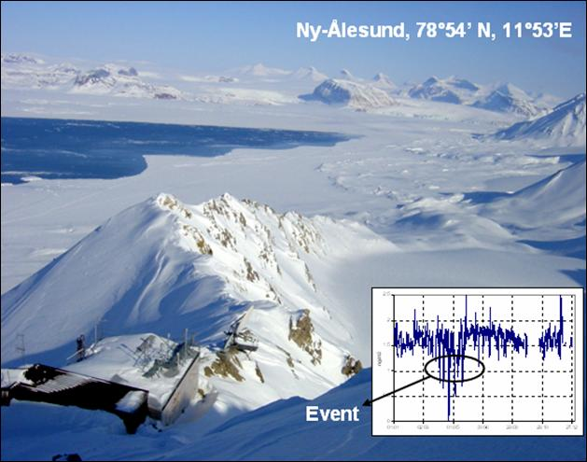


Atmospheric Mercury Depletion Events in Polar Regions during Arctic Spring
Katrine Aspmo
Torunn Berg
Norwegian Institute for Air Research
Grethe Wibetoe
University of Oslo, Dept. of Chemistry
16 June 2004
Notes:
Sample title slide.
Reference:
Katrina Aspmo, Torunn Berg, and Grethe Wibetoe, “Atmospheric Mercury Depletion Events (AMDEs) in Polar Regions During Arctic Spring,” presentation (Oslo, Norway: University of Oslo, 16 June 2004).

Slide 3
This presentation focuses on… (complete sentence, but go no more than two lines)
Image for
Topic 1
Topic 1
Image for
Topic 2
Topic 2
Image for
Topic 3
Topic 3
Notes:
Mapping slide for the presentation (note that a background slide or a slide justifying the importance might precede this slide). A common mistake with mapping slides is to give the audience simply an unmemorable bulleted list of topics (including the names “Introduction” and “Conclusion” and “Questions”). Such a list is quickly forgotten after the slide is removed.
On a mapping slide, take the opportunity to show a key image or perhaps a representative image for each major section of the presentation. In the second case, each image would be repeated on the first visual of the corresponding section and would remind the audience that they have arrived to a major section of the presentation’s middle.
In regards to the names “Introduction” and “Conclusion,” every talk has those sections, and the names are ignored by audiences. So why state them? Also, for the divisions that you do have, find a logical and parallel grouping. Note that groups of two’s, three’s, and four’s are much easier to remember and are not so nearly intimidating as groups of five’s, six’s, and seven’s. See the discussion of mapping slides in The Craft of Scientific Presentations, 2nd ed. (pages 177-181).

Slide 4
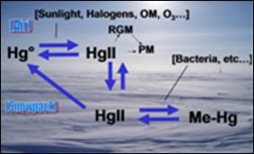
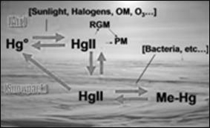
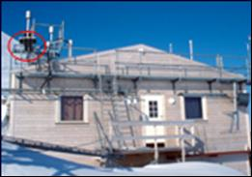
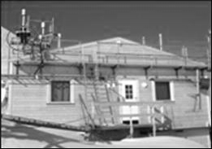
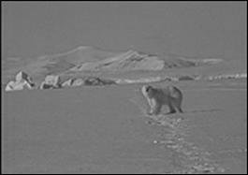
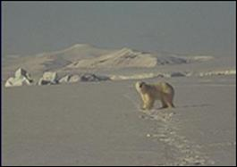
This talk traces what happens to mercury after it depletes from the atmosphere in arctic regions
Theory for mercury cycling
Measurements from Station
Environmental implications
Notes:
Sample mapping slide.
Reference:
Katrina Aspmo, Torunn Berg, and Grethe Wibetoe, “Atmospheric Mercury Depletion Events (AMDEs) in Polar Regions During Arctic Spring,” presentation (Oslo, Norway: University of Oslo, 16 June 2004).

Slide 5
Notes:
Blank slide for drafting mapping slide

Slide 6
This sentence headline makes an assertion on the first topic in no more than two lines
Image(s)
supporting above assertion
If necessary, identify key assumption or background for audience—keep to two lines (18–24 point type)
Notes:
Body slide from the first section of the presentation’s middle. Consider having the first-topic image from the mapping slide repeated here. Use the headline (no more than two lines) to make an assertion about this topic. In the body of the slide, support that headline with images and with words, if necessary. See Chapter 4 of The Craft of Scientific Presentations, 2nd ed.
This slide shows one orientation for the image and text in the body of the slide. Other orientations appear in this template. Choose the one that best supports your headline assertion.
Some institutions will insist that you place an institutional logo on each slide. Other institutions recommend a logo on the first slide and the last. If you do place a logo on each slide, make sure that logo is at the bottom of the slide rather than the top. Placing the logo at the top (the place on a slide that receives the most emphasis) shifts the emphasis away from the work.

Slide 7
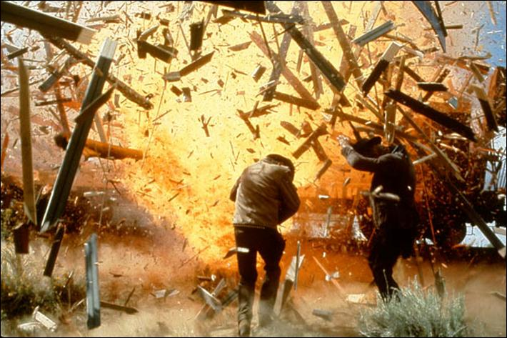

Fragments quickly outpace the blast wave and become the primary hazard to personnel
Notes:
Sample slide from second section of the presentation’s middle. The image was such that there was no need for subordinate descriptions.
Reference:
Jared Rochester, “Three Primary Products of an Explosive,” presentation (Aberdeen, MD: US Army Research Laboratory, 5 December 2005).

Slide 8
Notes:
Blank slide for drafting a body slide.

Slide 9
This sentence headline makes an assertion on the second topic in no more than two lines
Call-out, if necessary: keep to one or two lines
Call-out, if necessary: keep to one or two lines
Image or equations supporting the headline assertion
Call-out, if necessary: keep to one or two lines
Notes:
Body slide from the second section of the presentation’s middle. For the first body slide of this second section, consider repeating the corresponding image (or equation) from the mapping slide. Use the headline to make an assertion about this topic. In the body of the slide, support that headline assertion with images and needed callouts. See Chapter 4 of The Craft of Scientific Presentations, 2nd ed.
This slide shows one orientation for the image and text in the body of the slide. Other orientations appear in this template. Choose the orientation that best supports your headline assertion.

Slide 10
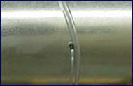
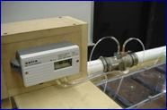
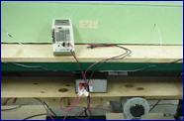
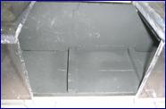
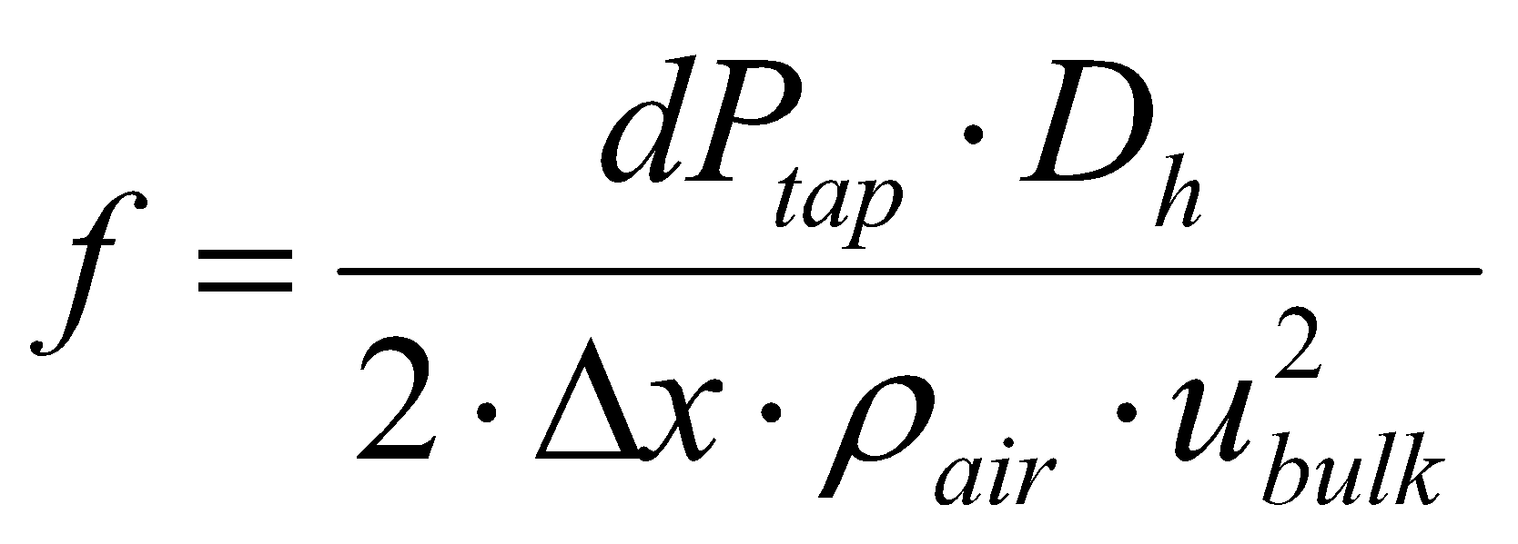
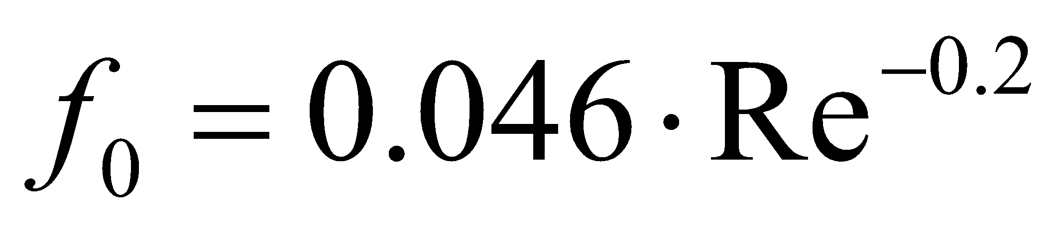

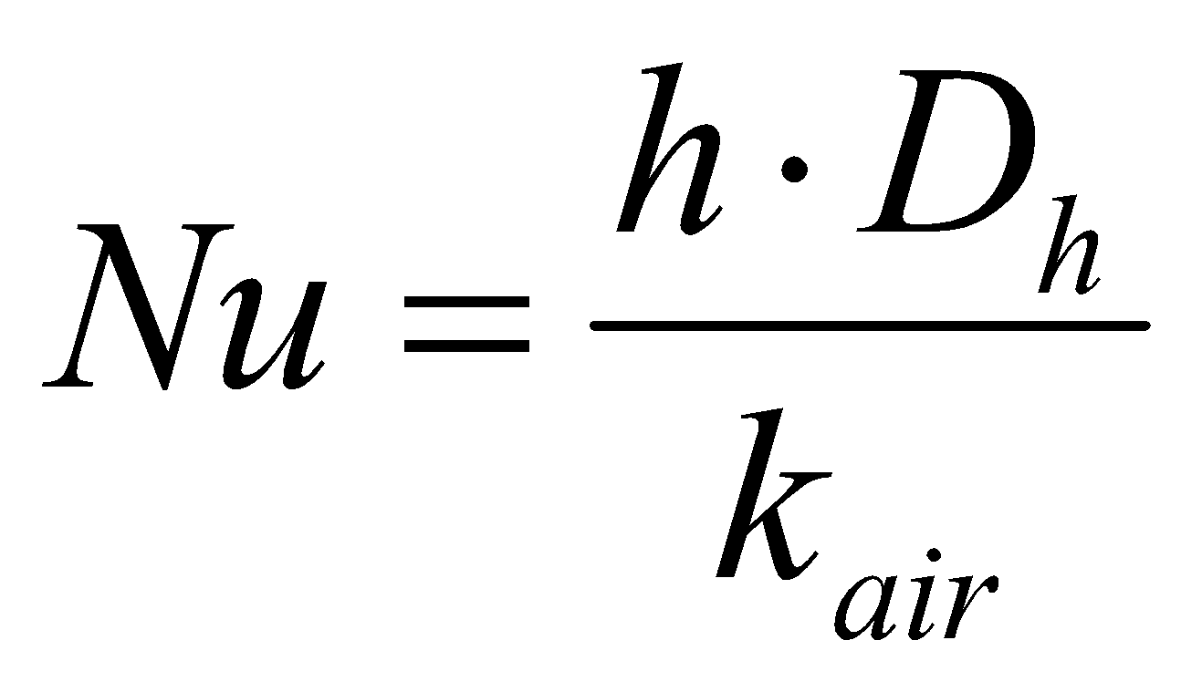

Normalized friction factors and Nusselt numbers correlated our data with the data of others
Pressure Taps
Venturi Meter
Voltmeter
Thermocouples
Pressure Drop
Reynolds Number
Heat Flux, q˝
T_{inlet}
T_{wall}
T_{bulk}
h
Friction Factor, f
Nu_{o}, f_{o}
Nu
Notes:
Sample slide from the middle of a presentation. Notice how animation works to allow the speaker to present fairly complex connections in a way that the audience can digest. Notice how the arrows show connections—something that bullets could not achieve.
Reference
This slide is a composite slide from a number of mechanical engineering seniors in ME 4006, a laboratory course at Virginia Tech. These presentations occurred during the Fall 2004 semester.

Slide 11
Notes:
Blank slide for drafting a body slide.

Slide 12
This sentence headline makes an assertion on the third topic in no more than two lines
Image supporting above assertion
Feature or call-out—no more than two lines
Feature or call-out—no more than two lines
Notes:
Body slide from the third section of the presentation’s middle. For the first body slide of this third section, consider repeating the corresponding image from the mapping slide. Use the headline to say state an assertion about this topic. In the body of the slide, support that headline with images and with needed callouts. See Chapter 4 of The Craft of Scientific Presentations, 2nd ed..
This slide shows one orientation for the image and text in the body of the slide. Other orientations appear in this template. Choose the orientation that best supports your headline assertion.

Slide 13
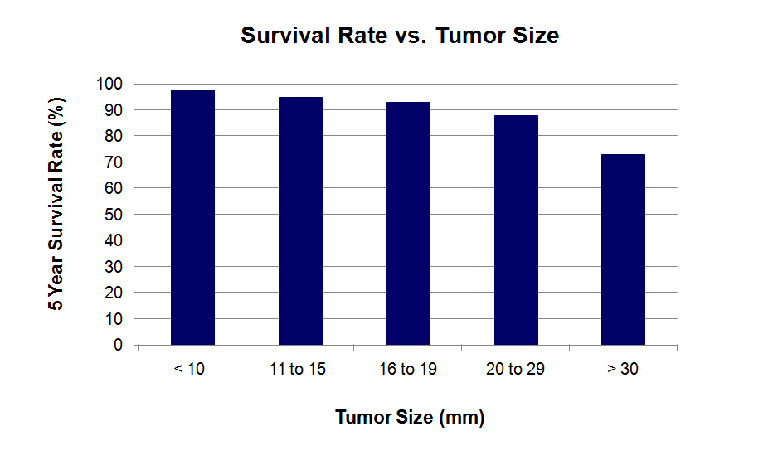

Early detection methods can identify small tumors and therefore improve survival rates of patients
[Lai et al., 2007]
Notes:
13
This slide was created by Lauren Sawarynski, who earned her B.S. in Bioengineering at Penn State in 2010 and is now in the Physician Assistant Program at Yale Medical School.
Reference for data:
J.K. Lai, M.A. Martin, R. Meyricke, T. O’neill, and S. Roberts (2007, February). Factors associated with short-term hospital readmission rates for breast cancer patients in Western Australia: an observational study. J Am Coll Surg. 204 (2):193-200.
13

Slide 14
Notes:
Blank slide for drafting a body slide.

Slide 15
In summary, this sentence headline states the most important assertion of the presentation
Image that supports conclusion
Supporting point (no more than two lines)
Another supporting point (parallel to the first)
Questions?
Logo
Notes:
Conclusion slide. Use the headline (no more than two lines) to state your most important conclusion. Begin the headline with In summary or In conclusion to ensure that the audience knows they have come to the presentation’s end. Support that headline with an image and parallel points.
This slide should be your last slide. Audiences lose patience when they believe that they have come to the end, but other slides follow.
Notice that the word Questions appears at the bottom of this slide. That strategy is much more effective than burning a slide with just the word Questions. This slide allows the audience to look at the most important slide of the presentation during the question period. See The Craft of Scientific Presentations, 2nd ed., pages 182-183.

Slide 16
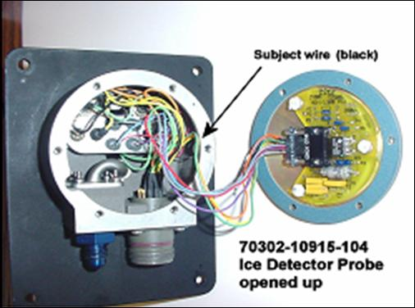

In summary, the detector failed because of a short-circuit created by the abrasion of wire insulation
Wires not harnessed to prevent contact with housing
Short circuit to ground created where wire contacted housing
Questions?
Notes:
Sample conclusion slide. Notice how the presenter showed the connection between words blocks on this slide—a strategy that is much more effective than a bullet list, which hides the connections between details.
Reference:
Manning Seltzer, “Failure Analysis of the Ice Detector in the Austria 13 Helicopter,” presentation (Hartford, CT: Sikorsky Helicopter, 30 April 2004).

Slide 17
Notes:
Black slide left for drafting conclusion

