Slide 1
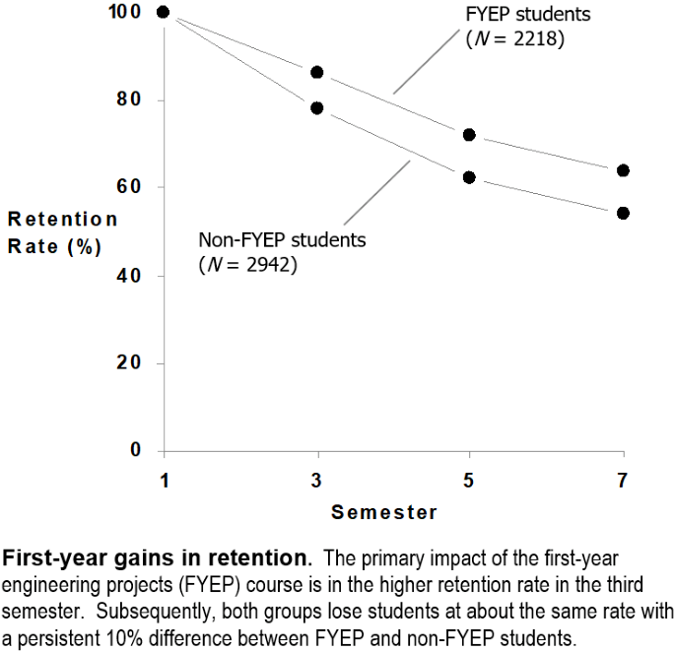

Designing effective displays
Richard Layton
Matthew Ohland
Workshop: Engaging with MIDFIELD Data
ASEE Annual Conference
2021-07-26

Slide 2
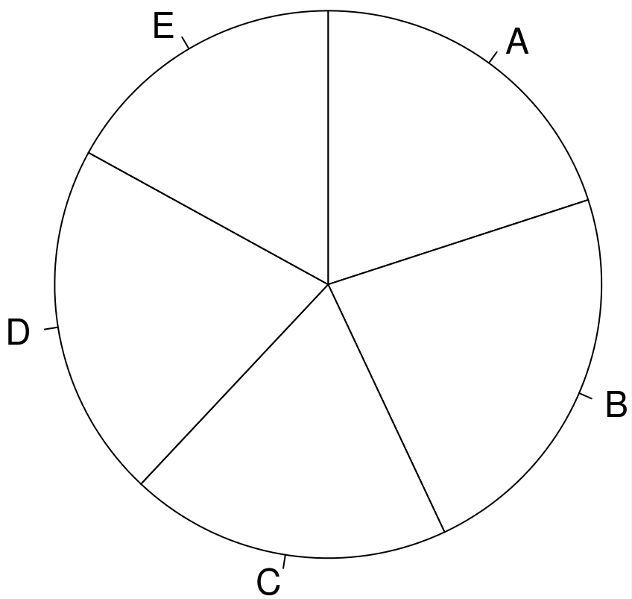
Pie charts support visual tasks of low-accuracy.
Poll: Which slice is largest?
Naomi Robbins (2013) Creating More Effective Graphs, Chart House, NJ, Ch. 1.

Slide 3
Pie charts support visual tasks of low-accuracy.
Poll: Which slice is largest?
Poll: Which slice is smallest?
Naomi Robbins (2013) Creating More Effective Graphs, Chart House, NJ, Ch. 1.

Slide 4
Pie charts support visual tasks of low-accuracy.
Poll: Which slice is largest?
Poll: Which slice is smallest?
Answer:
B (largest)
D
A
C
E (smallest)
Naomi Robbins (2013) Creating More Effective Graphs, Chart House, NJ, Ch. 1.

Slide 5
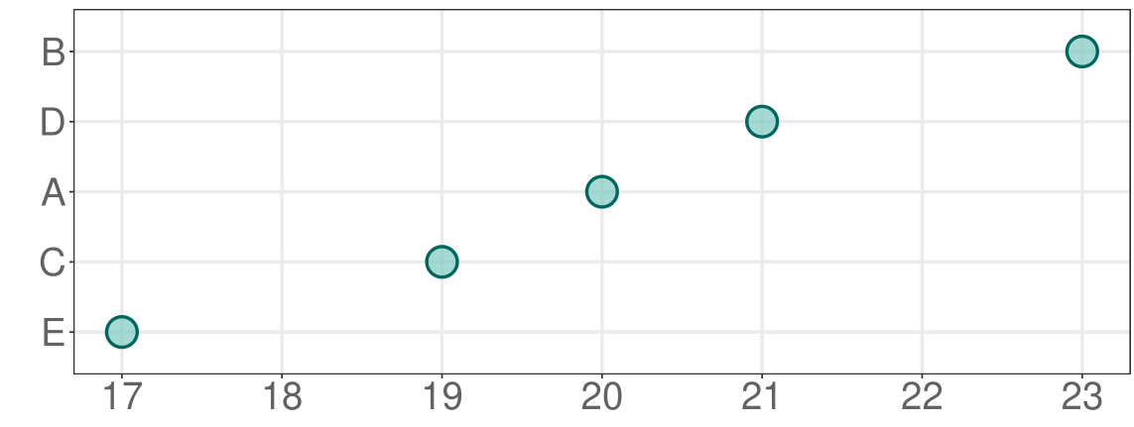
Judging position along a common horizontal scale is a visual task of high-accuracy.
The same data plotted along a common horizontal scale.

Slide 6
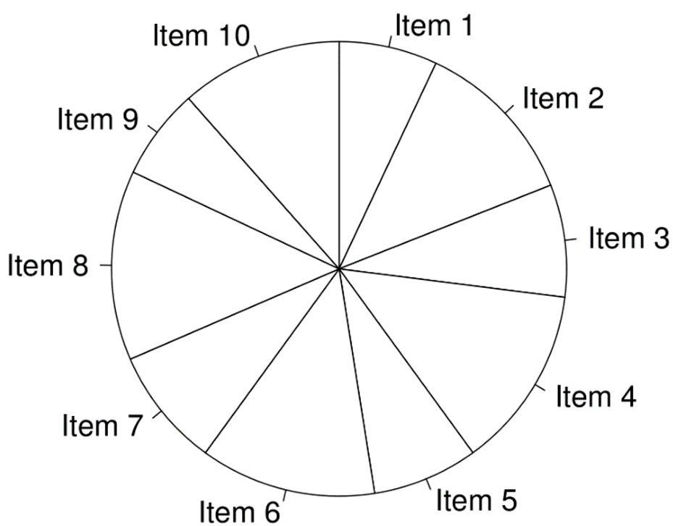
Pie charts support visual tasks of low-accuracy.
What patterns do you see?
Naomi Robbins (2013) Creating More Effective Graphs, Chart House, NJ, Ch. 2.

Slide 7
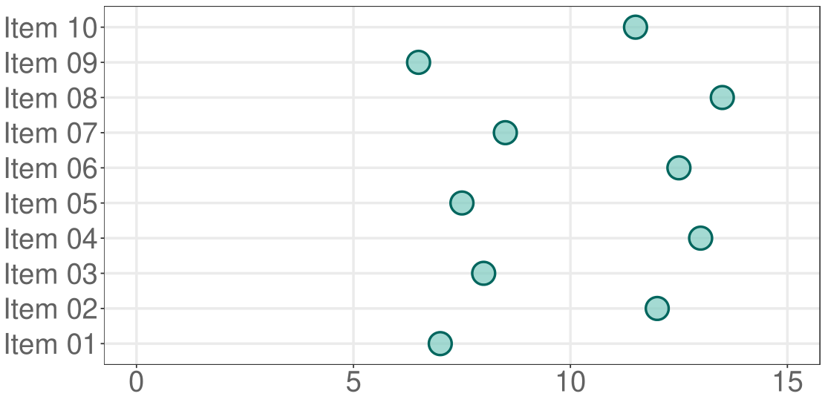
We position the data along a common horizontal scale.
Any new observations?

Slide 8
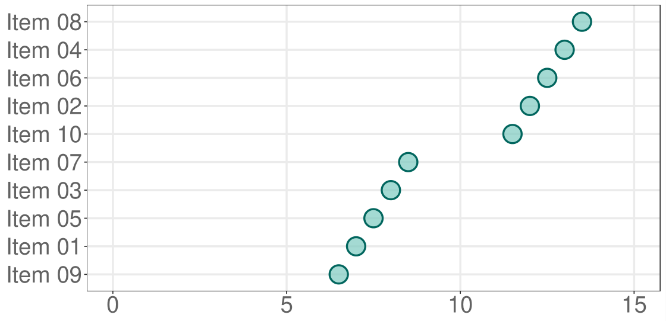
We reorder the rows by the data values.
Any new observations?

Slide 9
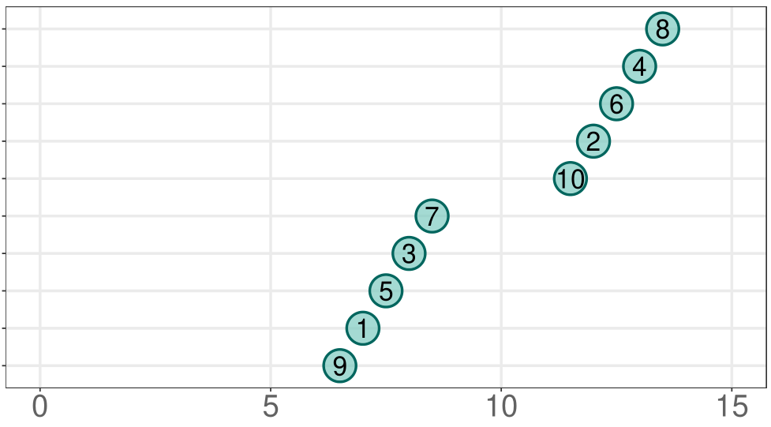
The item numbers are also data. Suppose we label the symbols.
Any new observations?

Slide 10
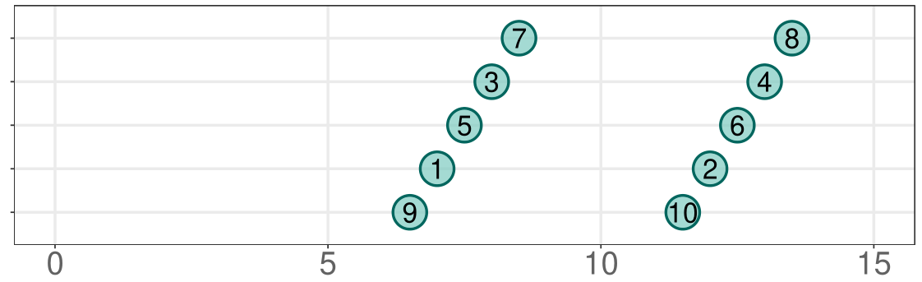
The evenly-spaced odd-even pairs are now obvious.
The greatest value of data visualization is when
it forces us to notice what we never expected to see.
— John Tukey (1915–2000)

Slide 11
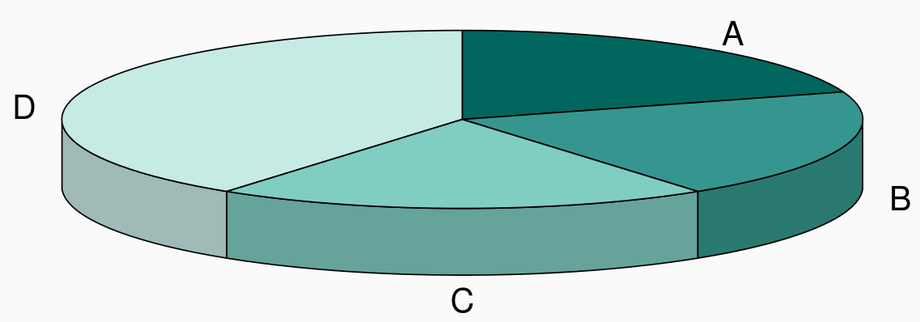
3D effects distort our judgement.
Poll: Slice D is what percentage of the whole?
Naomi Robbins (2013) Creating More Effective Graphs, Chart House, NJ, Ch. 2.

Slide 12
3D effects distort our judgement.
Poll: Slice D is what percentage of the whole?
Poll: Slice B is what percentage of the whole?
Naomi Robbins (2013) Creating More Effective Graphs, Chart House, NJ, Ch. 2.

Slide 13
3D effects distort our judgement.
Poll: Slice D is what percentage of the whole?
Poll: Slice B is what percentage of the whole?
Answer:
A 40%
B 20%
C 20%
D 20%
Naomi Robbins (2013) Creating More Effective Graphs, Chart House, NJ, Ch. 2.

Slide 14
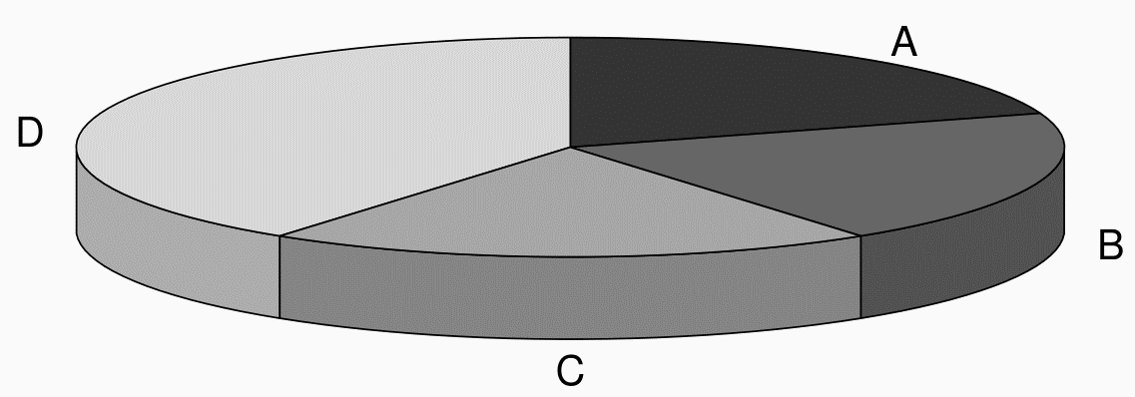
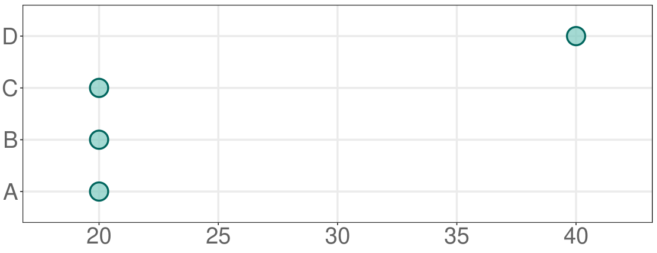
Judging position along a common horizontal scale is a visual task of high-accuracy.
The same data plotted along a common horizontal scale.

Slide 15
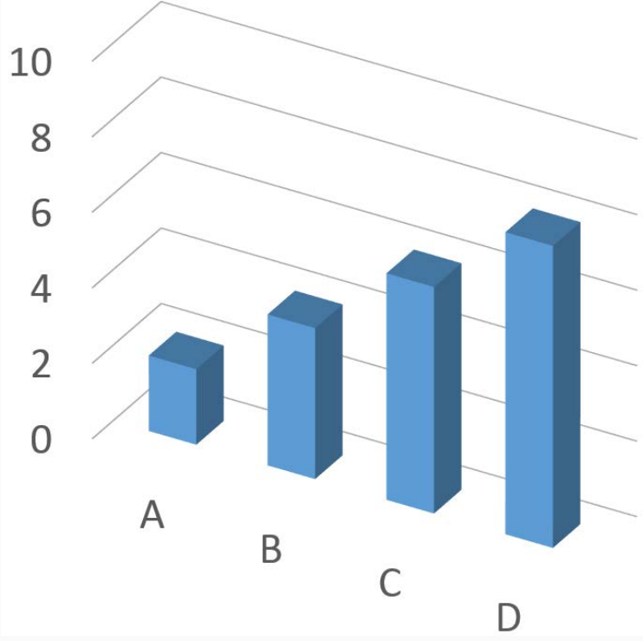
Write down the heights of the four bars.
This is a visual inspection only.
(No rulers.)
Naomi Robbins (2013) Creating More Effective Graphs, Chart House, NJ, Ch. 2.

Slide 16
Again, 3D effects distort our judgment.
This is a visual inspection only.
(No rulers.)
Answer:
A 2
B 4
C 6
D 8
Naomi Robbins (2013) Creating More Effective Graphs, Chart House, NJ, Ch. 2.

Slide 17
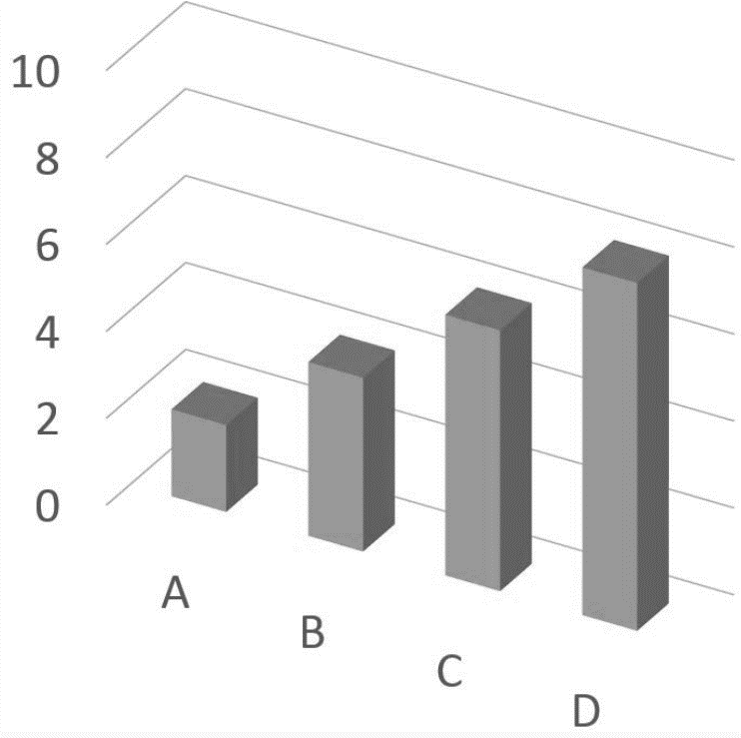
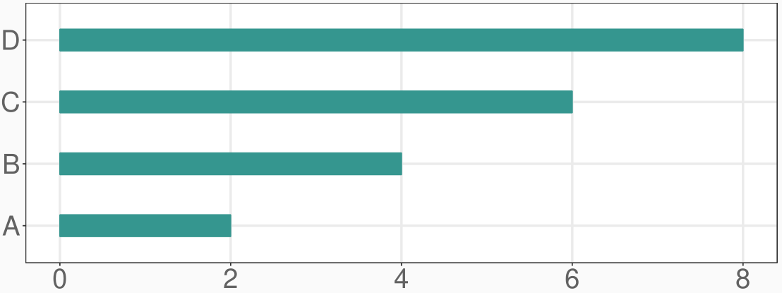
Bars align along a common horizontal scale, but the scales with bars must include zero.
Omitting the scale zero on a bar chart is
one of the most common graphical lies.

Slide 18
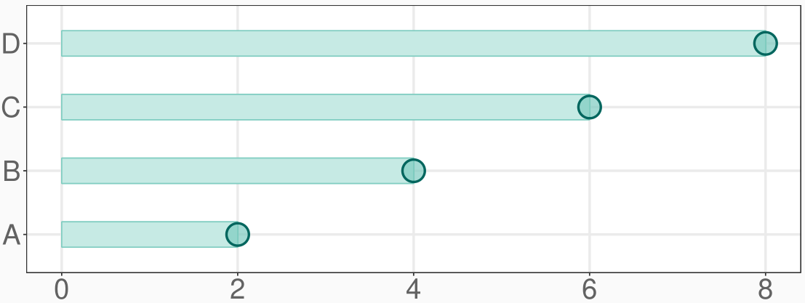
If you mark the endpoints, you can omit the bar.
The endpoints are the only data here.

Slide 19
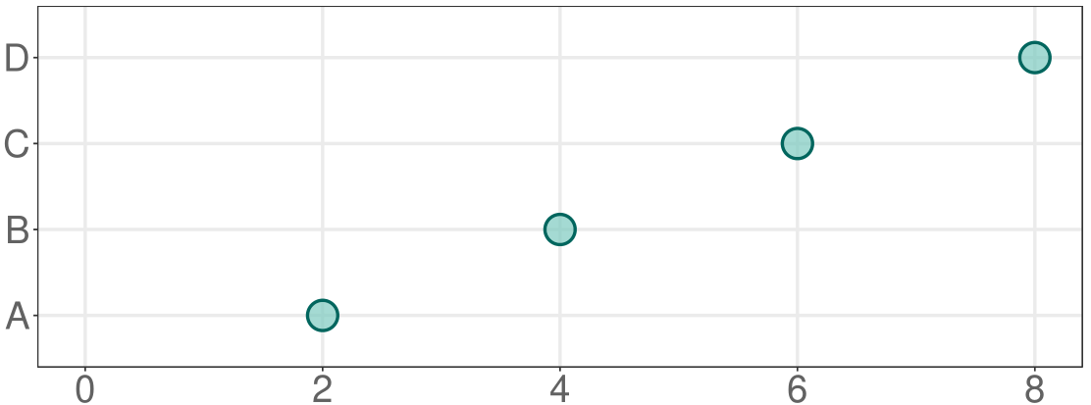
Producing a dot plot with rows ordered per the data
The scale zero can be omitted without distorting the visual comparisons.

Slide 20
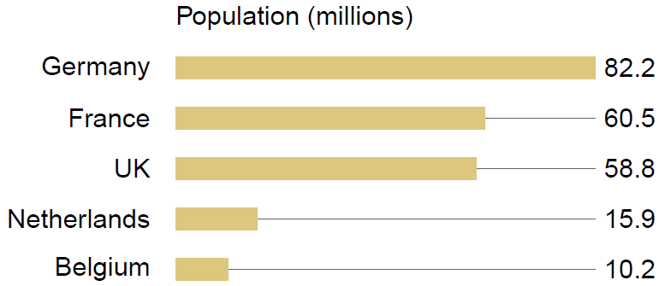
Not all bars are bad. This design employs both visual and textual information.
Jean‐luc Doumont (2009) Trees, maps, and theorems, Principiae, pp.135

Slide 21
Not all bars are bad. This design employs both visual and textual information.
The longest bar is 100%.
The baseline is 0%.
Jean‐luc Doumont (2009) Trees, maps, and theorems, Principiae, pp.135

Slide 22
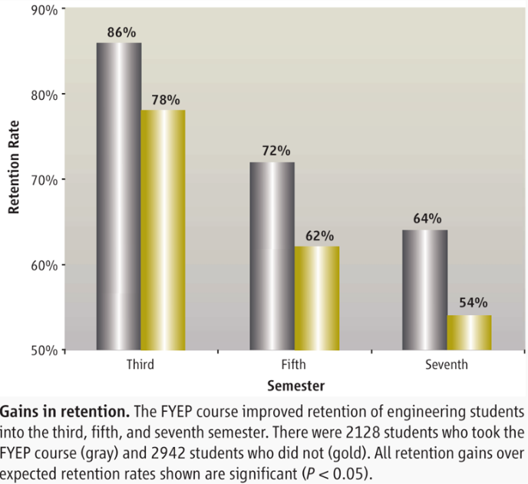
The trouble with bars. What’s wrong with this graph?
Norman L. Fortenberry, Jacquelyn F. Sullivan, Peter N. Jordan, and Daniel W. Knight (2007)
Engineering education research aids instruction, Science, 31:1175–1176.

Slide 23
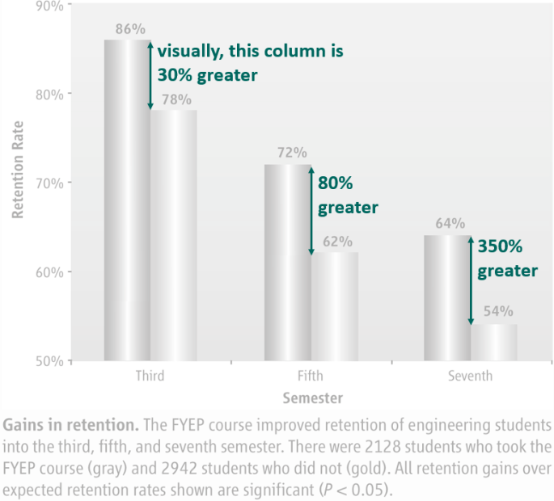
The visual story is the increasing significance of the gap over time.
Norman L. Fortenberry, Jacquelyn F. Sullivan, Peter N. Jordan, and Daniel W. Knight (2007)
Engineering education research aids instruction, Science, 31:1175–1176.

Slide 24
The visual story is the increasing significance of the gap over time.
A more subtle flaw:
Can you identify what information is missing?
Norman L. Fortenberry, Jacquelyn F. Sullivan, Peter N. Jordan, and Daniel W. Knight (2007)
Engineering education research aids instruction, Science, 31:1175–1176.

Slide 25
Redesigned, with full scales, a different story emerges.
Semester 1 was missing.

Slide 26
Redesigned, with full scales, a different story emerges.
FYEP impact is in the first year.

Slide 27
Redesigned, with full scales, a different story emerges.
FYEP impact is in the first year.
Attrition rate afterwards is about the same for both groups.

Slide 28
Redesigned, with full scales, a different story emerges.
FYEP impact is in the first year.
Attrition rate afterwards is about the same for both groups.

Slide 29
Implications for the designer
Visually explore the stories in the data.
Revise until the story is clear.
Explore context and causality; reveal complexity.
Consider what information might be missing.
Avoid 3D effects and other distortions.
Commingle visual and textual elements.

