Slide 1

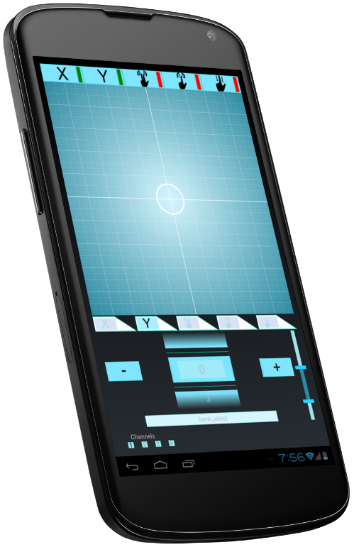
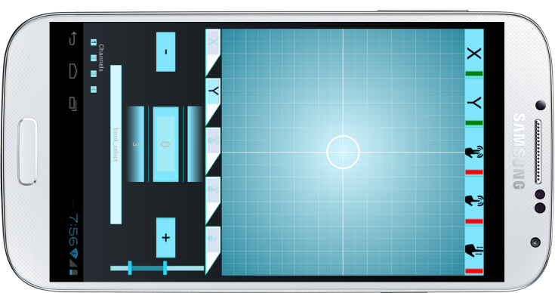
MIDIeval
XY Controller

Slide 2

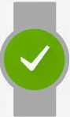
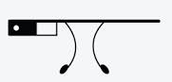


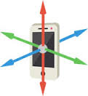




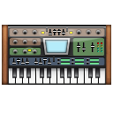

User Interface layer
Primary User Interface
Secondary User Interface
Control Interface layer
User Interface (UI) Controllers
Sensor Controllers
Recorded Automation Triggers
Low Frequency Oscillators (LFO)
Communication layer
MIDI-USB Driver
Android OS USB-host support API

Slide 3
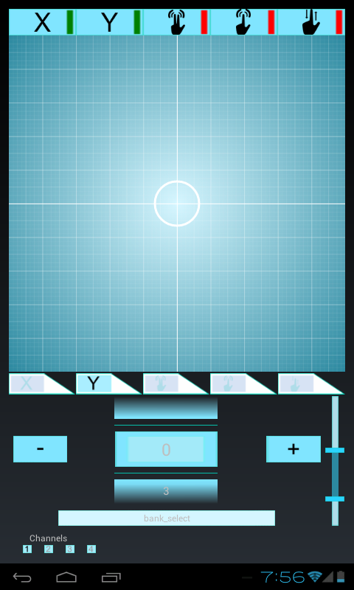
Toggle Switches to turn on Sub-Controller
XY grid for finger (Single Touch) UI Controller
Touch indicator
Touch navigation settings for Sub-Controller
Range setting for changing
XY-Resolution
MIDI parameter
MIDI channel
MIDI parameter number

