Slide 1
Intro to W251
Deep Learning in the Cloud and at the Edge
Dima Rekesh
Esteban Arias
Ryan DeJana
Brad DesAulniers
Prabs Attaluri

Slide 2
Grading
Graded homework assignments (3, 5, 9, 11): 100-point scale, 40% of total grade (evenly weighted). (Ask professors for their Github IDs)
Credit/No-Credit homework assignments (1, 2, 4, 6, 7, 8, 10, 12) 10% of total grade (evenly weighted).
Participation: 100-point scale, 10% of total grade
Final Project: 100-point scale, 40% of total grade. Students will organize into groups of four to five to perform an analysis on a large dataset and prepare a final presentation (slides) and a live demo or video (10 min).

Slide 3
AI News
Part of participation grade
Every student presents once
Present something current in the area of AI / Deep Learning and/or Cloud.
Can do a short write up or just talk to the the article
Example
AWS makes Arm processors available (https://www.zdnet.com/article/aws-makes-arm-processors-available-in-the-cloud-with-new-graviton-processor/).

Slide 4
Final Project
Large part of grade
Form teams of 3 -5 people
Across sections typically OK but do ask the instructor
Leverage Big Data, Cloud, DL, and the edge device
Should be more than you can do just on a workstation
Typically, modeled after an existing class of problems (e.g. NLP.. object detection…)
Check arxiv / conference workshops!
Collect your own dataset (alternatively find some new ones!)
Best to reuse an existing model architecture
Okay to invent your own but generally that’s out of scope
Use transfer learning
Train the model on your dataset in the cloud
Implement model runtime / inference on the jetson edge device
Shoot for an end to end architecture

Slide 5
Sample idea
Find a new a dataset of a missing persons
Select an existing object detector architecture
Download pre-trained weights
Finetune the model in the cloud on your dataset[s] to recognize the missing persons
Deploy the finetuned model to your edge device
Make sure it runs very well there (frame rate)
If a person is recognized, send the image and location back to the cloud for further actions
Make a Service? What does the runtime application look like?
Notes:
This is just a simple example

Slide 6
Final Project Details
A 5- to 10-page white paper which is due on the day of the last live session, discussing the following:
What does the project do? What problem does it solve?
What tools are used to accomplish this?
How was it built? Please provide complete directions so that it can be replicated.
Provide sample data or pointers to
Discuss the challenges and the alternative ways that this problem could be solved
Final presentation of roughly 15 minutes and 5 minutes follow up questions from the audience. The final presentation is during the last live session.
Start thinking about teams now!

Slide 7
Class at a glance..
Intro and setup of the Jetson device
Cloud: Infrastructure as a Service, Software as a Service
Containers, Docker and Kubernetes
Deep Learning 101
Deep Learning Frameworks
Running at the edge
Deep Learning 201
Datasets and Dataset processing
HPC and Multi-node Multi-GPU training
Generative Adversarial Networks
Deep Reinforcement Learning
Speech Recognition and Natural Language Processing
Examples of Deep Learning in Real Life

Slide 8
NGC: Nvidia GPU Cloud
Go to place to get assets (containers.. models..)
Please explore it
For the Jetson family, especially!
https://ngc.nvidia.com/catalog
Search for l4t
e.g. https://ngc.nvidia.com/catalog/containers/nvidia:l4t-ml
Note compatibility with your jetpack version
Also, for x86

Slide 9
Kaggle (by Google)
Competitions as a source of inspiration
Kernels / notebooks as a source of sample code
Datasets as a source of ground truth
Even models
Some GPU cycles, but GPUs are old
Cycles are limited
List of pre-installed packages sometime confusing
Docker file available

Slide 10
Colab (by Google Research)
Very easy to get started
GPUs are better than in KAggle but also limited
Limited packages installed
There’s a pro version that costs a little more
Less open; docker file not available

Slide 11
Cloud Computing
Cloud Computing has changed how IT resources are provisioned and consumed
At its core, Cloud Computing can be thought as an ATM for IT
Users provision via an API, CLI, or portal
No human interaction required
Typically available in minutes

Slide 12
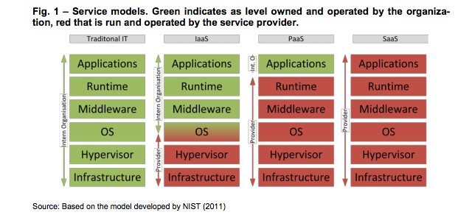
Responsibilities in the Cloud
Notes:
As a user moves to the right, the responsibilities decrease as dos time to market, however the flexibility decreases

Slide 13
Deep Learning: summary
Deep Learning (DL) is a brain-inspired branch of Machine Learning (ML) based on networks comprised of layers of “artificial neurons”
It gained popularity in 2012, when AlexNet won the ILSVC image classification challenge by a wide margin over traditional Computer Vision (CV) algorithms
Today, DL powers many (most) breakthrough AI systems and applications, outperforming humans on a growing range of tasks from image classification to automatic speech recognition
Leading DL models require hundreds of thousands / millions of artificial neurons and often take days and months to train on the latest hardware
Nvidia Graphics Processing Units (GPUs) are the leading DL HW accelerators, Google is developing their own TPU technology for Google Cloud, Intel and others are playing catchup
DL technologies are complex and exist at the unique intersection of Machine Learning, Big Data, Cloud, and High Performance Computing

Slide 14
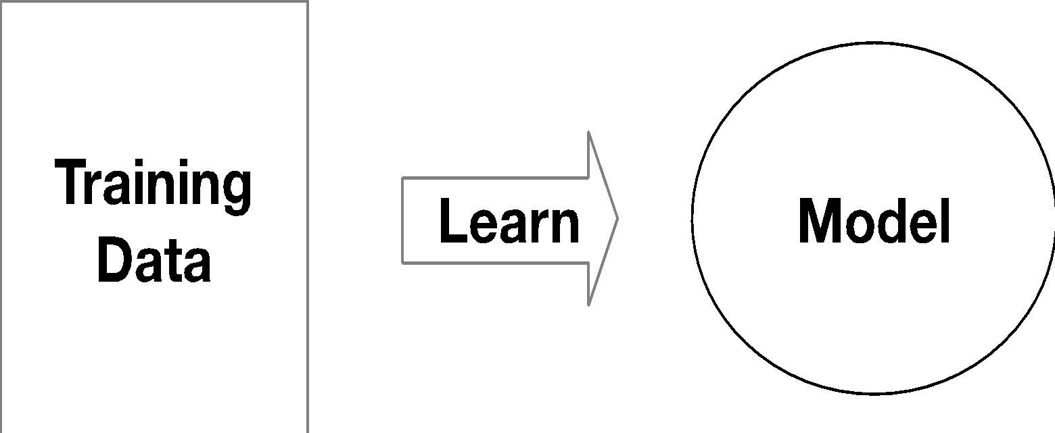
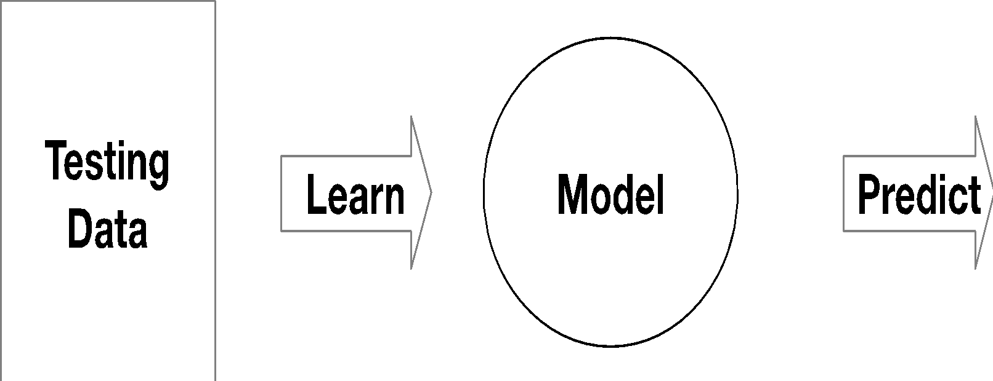
What is DL? What is ML? What is AI?
Deep Learning (DL) is a brain-inspired branch of Machine Learning (ML) based on networks comprised of layers of “artificial neurons”
“Machine learning is about predicting the future based on the past.”
-- Hal Daume III
past
future
Notes:
Machine learning is construction and study of systems that can learn from data
Do not explicitly program
Examples are used to train computers to perform tasks that would be difficult to program
Machine Learning relies on large quantities of data to train computers (OCR and detecting objects in images)
Computers can learn complex tasks that would require immense effort to program
Machine Learning is limited by the availability of examples and computational resources
With sufficient examples and computational power, computers can learn nearly any task
Models are the core component Machine Learning
A model is a method for using known examples to predict or produce inferences on new data.
Robots are exposed to noisy and dynamic environments, so programming a robot to handle all situations is infeasible
Therefore, engineers often use Machine Learning to teach robots to perform tasks, much like the way human children learn.
Deep Learning (DL) is a brain-inspired branch of Machine Learning (ML) based on networks comprised of layers of “artificial neurons”
It gained popularity in 2012, when AlexNet won the ILSVC image classification challenge by a wide margin over traditional Computer Vision (CV) algorithms
Today, DL powers many (most) breakthrough AI systems and applications, outperforming humans on a growing range of tasks from image classification to automatic speech recognition
Leading DL models require hundreds of thousands / millions of artificial neurons and often take days and months to train on the latest hardware
Nvidia Graphics Processing Units (GPUs) are the leading DL HW accelerators, Google is developing their own TPU technology for Google Cloud, Intel and others are playing catchup
DL technologies are complex and exist at the unique intersection of Machine Learning, Big Data, Cloud, and High Performance Computing

Slide 15
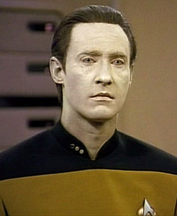
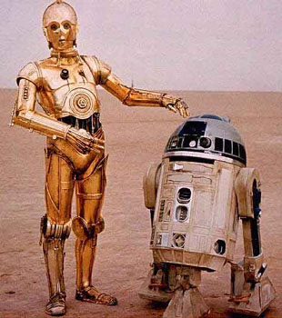
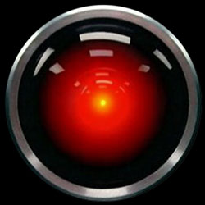
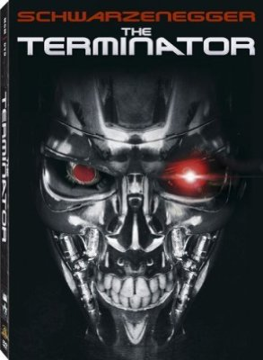
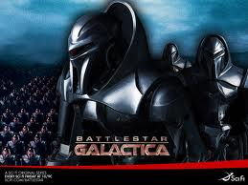
AI in Fiction
Notes:
Weak AI:
Machines can be made to act as if they were intelligent.
The philosophical position that machines can demonstrate intelligence, but do not necessarily have a mind
Strong AI:
Machines that act intelligently have real, conscious minds
An important topic for science fiction writers and futurists.

Slide 16
Types of DL
GAN – Generative adversarial network
CNN – Convolutional neural network
RNN – Recurrent neural network
DRL – Deep reinforcement Learning

Slide 17
GAN
Two neural networks contesting with each other
Can generate realistic images
Recent publicity for NVIDIA generating photographs of imaginary people

Slide 18
DL in Your Daily Life
Autonomous Vehicles
Speech Recognition
Chatbots
Google Translate using Video
Subtitles on YouTube
Apple Face ID

Slide 19
IoT: what is it?
Internet of “Things”
“Things” were originally meant to be low-power, dumb
Aka “Sensors”
Embedded OSes
Arcane protocols
“Things” mostly read-only
“Things” send to “gateways”

Slide 20
IoT: why do we care?
The data that “Things” / “Devices” generate is not just big, it’s HUGE
Much of it dies today before it can be processed
The value is is enormous

Slide 21
NVIDIA Jetson SDK
The Jetson Development Pack (JetPack) is an on-demand, all-in-one package that bundles and installs all software tools required to develop for the NVIDIA Jetson embedded platform.
JetPack includes tools for:
Deep Learning: TensorRT, cuDNN, NVIDIA DIGITS™ Workflow
Computer Vision: NVIDIA VisionWorks, OpenCV
GPU Compute: NVIDIA CUDA, CUDA Libraries
Multimedia: ISP Support, Camera imaging, Video CODEC
It also includes ROS compatibility, OpenGL, advanced developer tools, and much more.

Slide 22
NVIDIA Isaac
Create and deploy AI-powered robotics
A comprehensive set of frameworks, tools, APIs, and libraries to accelerate development of robotics algorithms and software.
Enables hardware-in-the-loop testing with NVIDIA Jetson AGX Xavier.

Slide 23
Next week…
Unit 2: Clouds, Infrastructure, and Machine Learning Cloud Services

