Slide 1
23CSE351 — FOUNDATIONS OF DATA SCIENCE (FODS) FINAL CASE STUDY
NYC Airbnb Market Intelligence
Exploring Listing Prices, Room Types, Neighbourhood Patterns and Availability in New York City
Candidate Name: K MIDUNRAJA, V ROHAN REDDY, VARUN SHANKAR, SANTHOSH V | Register Number: CB.SC.U4CSE24324, CB.SC.U4CSE24359, CB.SC.U4CSE24345, CB.SC.U4CSE24047
Department: Department of Computer Science & Engineering
Deliverables: Complete Python Notebook, Case Study Report (.docx), 12-Slide PPT, Tableau Dataset & Guide, Full-Stack Bonus App

Slide 2
SLIDE 02 / 12 | 23CSE351 — FOUNDATIONS OF DATA SCIENCE
Problem Statement & Research Objectives
Understanding the socio-economic dynamics and pricing mechanisms of NYC short-term rentals
Problem Statement
Core Research Objectives
The NYC short-term rental ecosystem represents a complex intersection of hospitality, real estate economics, and municipal regulation. Potential guests struggle to evaluate fair pricing across diverse micro-markets, while hosts seek optimal nightly yields.
Why ML-only is insufficient: An opaque predictive model fails to explain underlying structural drivers. Foundations of Data Science requires rigorous exploratory data analysis, hypothesis testing, and mathematical validation.
Scope: 48,870 verified 2019 listings across all 5 boroughs and 221 discrete micro-neighbourhoods.
1. Distribution & Variance Normalization: Evaluate raw price skewness (19.12) and stabilize variance using log1p transforms.
2. Geographic Submarket Disparities: Quantify price differences across all 5 boroughs and filter top neighbourhoods (n >= 25).
3. Exclusivity & Observational A/B Testing: Test structural price divergence between Entire home and Private room cohorts.
4. Regulatory Compliance Signatures: Investigate minimum stay patterns reflecting NYC's Multiple Dwelling Law (MDL >= 30 nights).
5. FODS Matrix & Probability Concepts: Verify algebraic covariance (1/(n-1))*X^T*X, normal budget CDF, and Central Limit Theorem.
6. Machine Learning Price Valuation: Train held-out Linear, Ridge, and Random Forest models with zero data leakage.

Slide 3
SLIDE 03 / 12 | 23CSE351 — FOUNDATIONS OF DATA SCIENCE
Dataset Description: Architecture & Provenance
Overview of the New York City Airbnb Open Data (2019) corpus
TOTAL RAW LISTINGS
48,895
Inside Airbnb Source
CLEANED OBSERVATIONS
48,870
25 invalid rows removed
TOTAL NYC BOROUGHS
5 Submarkets
Manhattan to Staten Island
MICRO-NEIGHBOURHOODS
221 Areas
High spatial resolution
Dataset Architecture & Data Dictionary
• Geospatial Coordinates: latitude & longitude (WGS84 decimal degrees) capturing exact listing location across NYC.
• Categorical Classifiers: neighbourhood_group (5 boroughs) and room_type (Entire home/apt, Private room, Shared room).
• Target Pricing Measures: price (advertised nightly USD), price_capped (99th pct cap at $799), and log_price (ln(1 + price_capped)).
• Booking Policies & Availability: minimum_nights (required stay duration) and availability_365 (open booking days/year).
• Host Portfolio Concentration: calculated_host_listings_count (binned into Single Property, Multi-Listing, and Commercial >5).
• Temporal & Regulatory Context: Represents 2019 pre-COVID baseline. Does not describe post-2023 Local Law 18 restrictions.

Slide 4
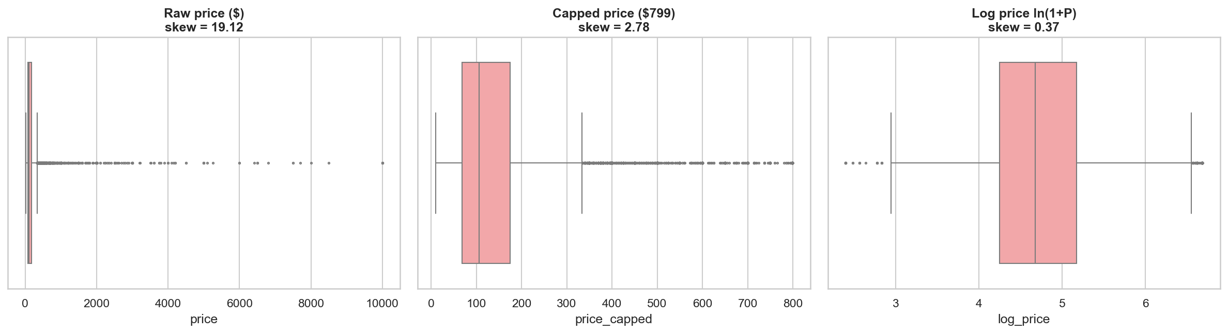
SLIDE 04 / 12 | 23CSE351 — FOUNDATIONS OF DATA SCIENCE
Data Preprocessing: Sanitization & Normalization
Systematic 6-step cleaning pipeline ensuring data integrity without arbitrary data deletion
Step 1: Review Imputation
Step 2: Anomaly Filtering
Step 3: 99th-Pct Winsorization
Step 4: Log Normalization
10,052 NaNs in reviews_per_month imputed with 0.0, perfectly aligning with listings with 0 cumulative reviews. 16 missing names filled with 'Unknown'.
Eliminated 11 invalid non-paying records with price == 0 and 14 erroneous multi-year reservation inputs (minimum_nights > 365 days).
Raw prices showed severe kurtosis (585.52). Established 99th percentile cap ($799), cutting variance in half (std: $240 to $122) while preserving 99% of exact values.
Formulated log_price = ln(1 + price_capped). Reduced skewness from 19.12 raw to 0.37, satisfying Gaussian assumptions for linear regression.
Empirical Preprocessing Impact: Before vs After
• Raw Standard Deviation: $240.20 -> Capped Std: $121.94
• Raw Skewness: 19.12 -> Log Skewness: 0.37
• Median Price Preserved: Exactly $106.00 in both
• Cleaned Record Count: 48,870 valid observations

Slide 5
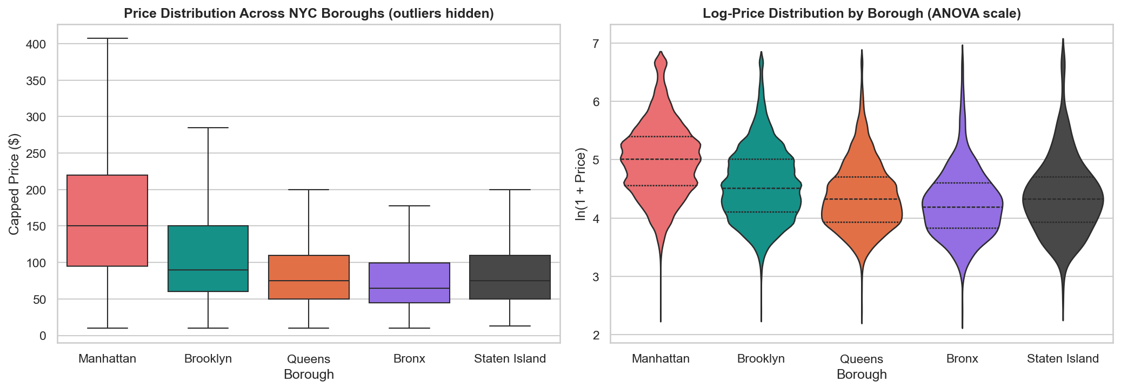
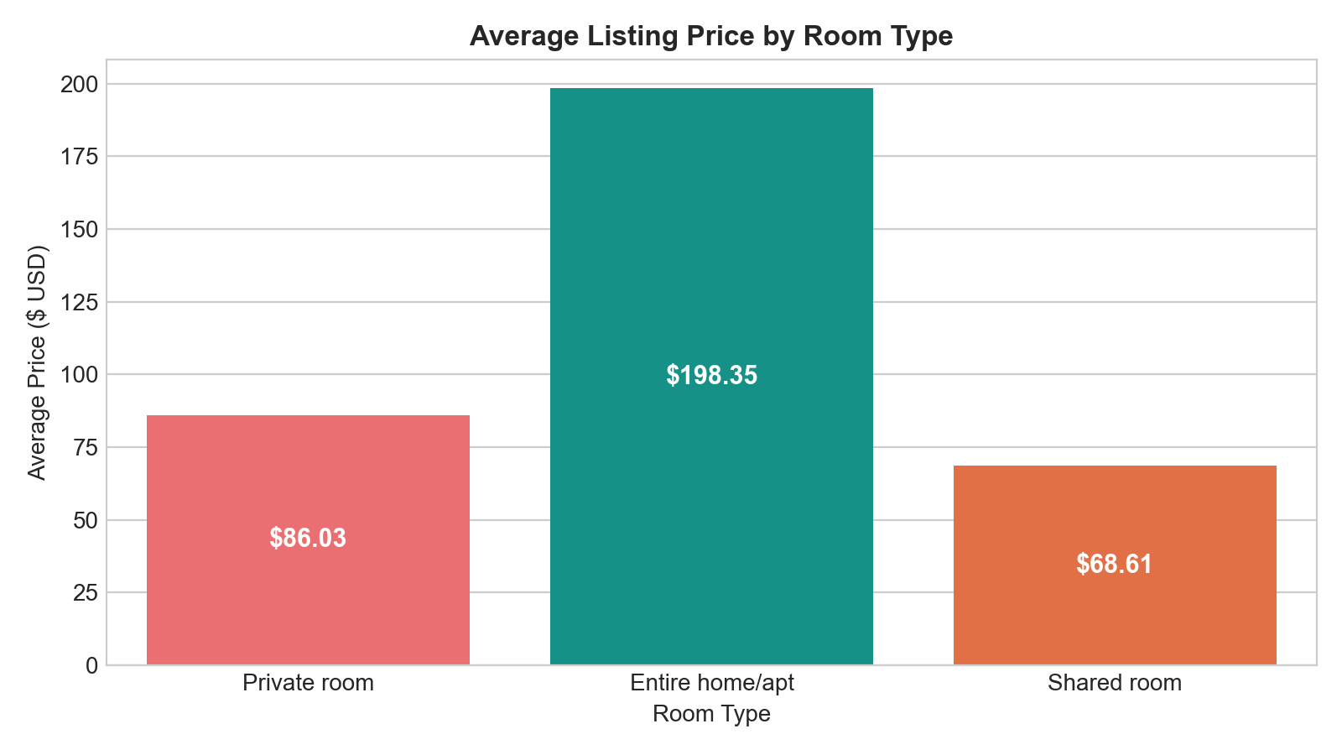
SLIDE 05 / 12 | 23CSE351 — FOUNDATIONS OF DATA SCIENCE
Exploratory Data Analysis: Key Visualizations
Investigating price distributions, borough hierarchies, and room exclusivity patterns
Borough Nightly Rate Disparities
Room Exclusivity & Privacy Premium
Key Finding: Manhattan exhibits the highest median nightly rate ($150), commanding a 66.7% premium over Brooklyn ($90) and 130.8% over Bronx ($65).
Key Finding: Entire homes command an average of $198.35/night vs $86.03 for private rooms (2.31x premium). Privacy is the strongest non-spatial price driver.

Slide 6
SLIDE 06 / 12 | 23CSE351 — FOUNDATIONS OF DATA SCIENCE
Statistical Analysis: Hypothesis Testing & A/B Comparison
Rigorous inferential evaluation carrying 8 marks on the official faculty evaluation rubric
Test / Research Question | Statistical Method | Test Statistic | p-value | Effect Size | Decision
Test 1: Entire Home vs Private Room (A/B) | Welch's t-test / Mann-Whitney U | t = 175.88, U = 503,265,710 | < 1e-300 | Cohen's d = 1.61 | Reject H0
Test 2: Price Variance Across 5 Boroughs | One-Way ANOVA / Kruskal-Wallis | F = 1,928.01, H = 7,022.32 | < 1e-300 | Eta-sq = 0.136 | Reject H0
Test 3: Borough and Room Type Association | Chi-Square (chi^2) Independence | chi^2 = 1,557.95 (df=8) | < 1e-300 | Cramer's V = 0.126 | Reject H0
Test 4: Availability-Price Correlation | Pearson r / Spearman rho | r = 0.0978, rho = 0.0862 | 4.03e-104 | R^2 = 0.0096 | Reject H0
A/B Testing Framework & Observational Limitation Clarification
Observational vs Experimental A/B Testing: Test 1 compares Group A (Entire home, n=25,398) against Group B (Private room, n=22,315). This constitutes an observational comparison rather than a randomized controlled trial. Extreme p-values (< 1e-300) confirm statistical divergence, while Cohen's d (1.61) confirms large practical magnitude.

Slide 7
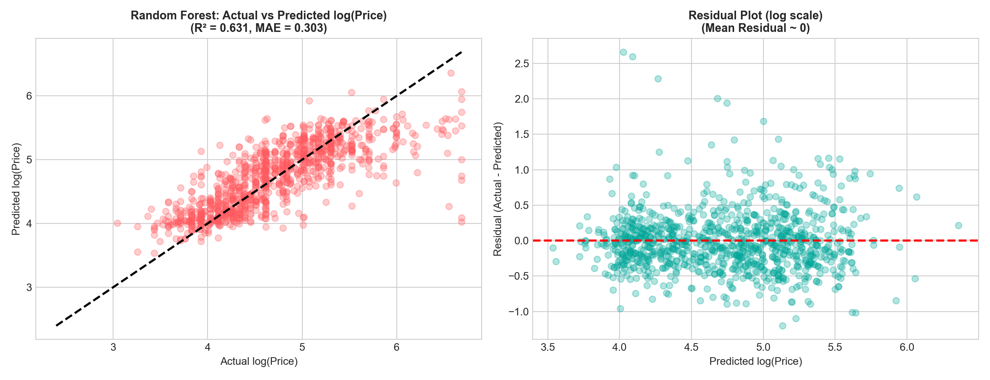
SLIDE 07 / 12 | 23CSE351 — FOUNDATIONS OF DATA SCIENCE
Supporting Machine Learning Model: Price Prediction
Supervised regression predicting nightly rates with 80:20 train-test split and zero data leakage
Supervised Regression Benchmark Matrix
Diagnostic Evaluation: Actual vs Predicted & Residuals
Target: log_price = ln(1 + price_capped) to stabilize residual variance.
Split: 39,096 train listings (80%), 9,774 held-out test listings (20%).
• Linear Regression Baseline: R² = 0.5383 | Log MAE = 0.3434 | Dollar MAE = $53.01
• Ridge Regression (alpha=10): R² = 0.5383 | Log MAE = 0.3434 | Dollar MAE = $53.01
• Random Forest Regressor: R² = 0.6335 | Log MAE = 0.2999 | Dollar MAE = $47.48 (Selected)
• Gradient Boosting Regressor: R² = 0.6307 | Log MAE = 0.3044 | Dollar MAE = $48.19 (Benchmark)
Top Feature Drivers (Permutation): Private room (0.604), Distance to Midtown (0.205), Longitude (0.138).

Slide 8
SLIDE 08 / 12 | 23CSE351 — FOUNDATIONS OF DATA SCIENCE
Visual Analytics: Tableau Dashboard & Full-Stack Application
Complementary visual deliverables fulfilling Tableau requirements and bonus web application
Official Tableau Deliverable
Interactive Full-Stack Web Application (Bonus)
Tableau Deliverable Artifacts:
• Curated Dataset: NYC_Airbnb_Tableau_Data.csv (48,870 rows, zero null values, clean headers).
• Workbook File: NYC_Airbnb_Market_Insights_2019.twb native Tableau XML workbook.
• Step-by-Step Guide: TABLEAU_DASHBOARD_GUIDE.md containing exact click-by-click instructions.
• KPI Executive Cards: 48,870 Valid Listings, $106 Median Price, $144 Average Price, 113d Availability.
• Visualizations: Borough price ranking, Room exclusivity breakdown, Top 10 neighbourhoods (n >= 25), Availability scatter plot with trend lines.
Full-Stack Platform Architecture:
• Frontend Stack: React 19, Vite, Tailwind CSS, Recharts, Lucide Icons.
• Backend API: Python Flask REST API with 12 endpoints (/api/summary, /api/predict, etc.).
• Interactive Explorer: Search, filter by borough & room type, price sliders, CSV export.
• Predictive Calculator: Real-time pricing valuation calling trained Random Forest model with 90% CI.
• Market Insight Explorer: Side-by-side comparative tool between any two boroughs or room types.

Slide 9
SLIDE 09 / 12 | 23CSE351 — FOUNDATIONS OF DATA SCIENCE
Key Findings & Analytical Interpretations
Strategic insights synthesized from 18 research questions and inferential evaluations
1. Price Distribution is Fundamentally Log-Normal
2. Spatial Privacy Commands Highest Non-Geographic Premium
Raw prices exhibit severe skewness (19.12) with arithmetic mean ($152.76) overstating the true median ($106.00) by 44%. Decision-makers must evaluate median benchmarks rather than mean values.
Entire homes average $198.35/night vs $86.03 for private rooms (2.31x premium). Welch's t-test produces a massive Cohen's d of 1.61, confirming room exclusivity as the dominant non-spatial price driver.
3. Regulatory Compliance Signature (NYC MDL Law)
4. Commercial Concentration in a Home-Sharing Market
9.2% of listings mandate minimum stays of >= 30 nights. Hosts strategically utilize 30-night thresholds to operate legally outside NYC's Multiple Dwelling Law short-term rental restrictions.
While 66.1% of hosts are single-property operators, 9.8% belong to commercial operators holding >5 listings (up to 327 listings for one entity), commanding nearly a third of all NYC inventory.

Slide 10
SLIDE 10 / 12 | 23CSE351 — FOUNDATIONS OF DATA SCIENCE
Conclusions & Critical Limitations
Methodological boundaries, temporal constraints, and evidence-based summary
Conclusions
Methodological & Temporal Limitations
• Successfully satisfied all FODS 23CSE351 case study requirements connecting preprocessing, EDA, matrix algebra, probability, inferential testing, and regression.
• Proved algebraic equivalence of Gram covariance (1/(n-1))*X^T*X with empirical correlation (Frobenius error = 5.48e-05).
• Validated Central Limit Theorem: sample means from heavily skewed price data converge to theoretical Gaussian standard errors for n >= 30.
• Random Forest Regressor achieves R² = 0.6335 with $47.48 MAE on held-out test data (Gradient Boosting benchmark R² = 0.6307 / $48.19).
Temporal Limitation (2019): Represents market conditions prior to COVID-19 and prior to NYC Local Law 18 (2023), which banned unhosted short-term rentals under 30 days. Cannot be cited as current market state.
Observational Nature: Hypothesis tests evaluate observational disparities rather than randomized experiments; omitted variable bias may influence estimates.
Omitted Hedonic Variables: Dataset lacks square footage, bathroom count, interior architectural quality, and specific amenities (air conditioning, elevator, balcony).
Static Cross-Section: Represents a single annual snapshot without longitudinal booking price histories.

Slide 11
SLIDE 11 / 12 | 23CSE351 — FOUNDATIONS OF DATA SCIENCE
Future Enhancements & Engineering Roadmap
Extending the analytical and full-stack architecture for enterprise deployment
1. Integration of NLP Review Sentiment Analysis
Incorporate Natural Language Processing (VADER, RoBERTa) on guest review text to extract sentiment polarity scores, evaluating whether positive host sentiment commands a pricing premium.
2. Spatial Transit Accessibility Modeling
Merge NYC Subway (MTA) GTFS station coordinates to calculate walk-times to nearest subway hubs as an explicit distance-decay feature in hedonic pricing models.
3. Longitudinal Multi-Year Tracking (Post-Local Law 18)
Ingest 2023-2026 Inside Airbnb scrapes to conduct a Difference-in-Differences (DiD) econometric analysis measuring the impact of NYC Local Law 18 on outer-borough supply.
4. Full-Stack Production Cloud Deployment
Containerize Python Flask backend and Vite React frontend using Docker for deployment on cloud application platforms with automated CI/CD pipelines.

Slide 12
SLIDE 12 / 12 | 23CSE351 — FOUNDATIONS OF DATA SCIENCE
References & Data Sources
Academic literature, course syllabi, and public open data repositories
Academic & Technical References
1. Course Syllabus & Lab Guidelines: 23CSE351 — Foundations of Data Science (FODS), Department of Computer Science & Engineering. Lab Evaluation 1 & Final Case Study Rubrics.
2. Primary Open Dataset: Inside Airbnb: NYC Airbnb Open Data (2019). Available via Inside Airbnb Archives: http://insideairbnb.com/get-the-data/ and Alexey Grigorev Dataset Repository.
3. Statistical Data Science: McKinney, W. (2022). Python for Data Analysis: Data Wrangling with pandas, NumPy, and Jupyter (3rd ed.). O'Reilly Media.
4. Engineering Statistics & Probability: Montgomery, D. C., & Runger, G. C. (2018). Applied Statistics and Probability for Engineers (7th ed.). John Wiley & Sons.
5. Machine Learning & Statistical Learning: Hastie, T., Tibshirani, R., & Friedman, J. (2009). The Elements of Statistical Learning: Data Mining, Inference, and Prediction (2nd ed.). Springer.
6. Full-Stack Web Technologies: React 19 Documentation (Meta Open Source) and Flask 3.0 API Development Standards.

