Slide 1
Gingerbreads

Slide 2
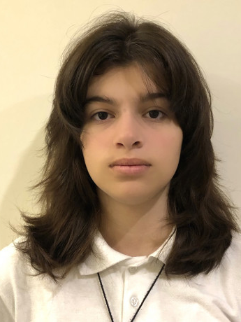
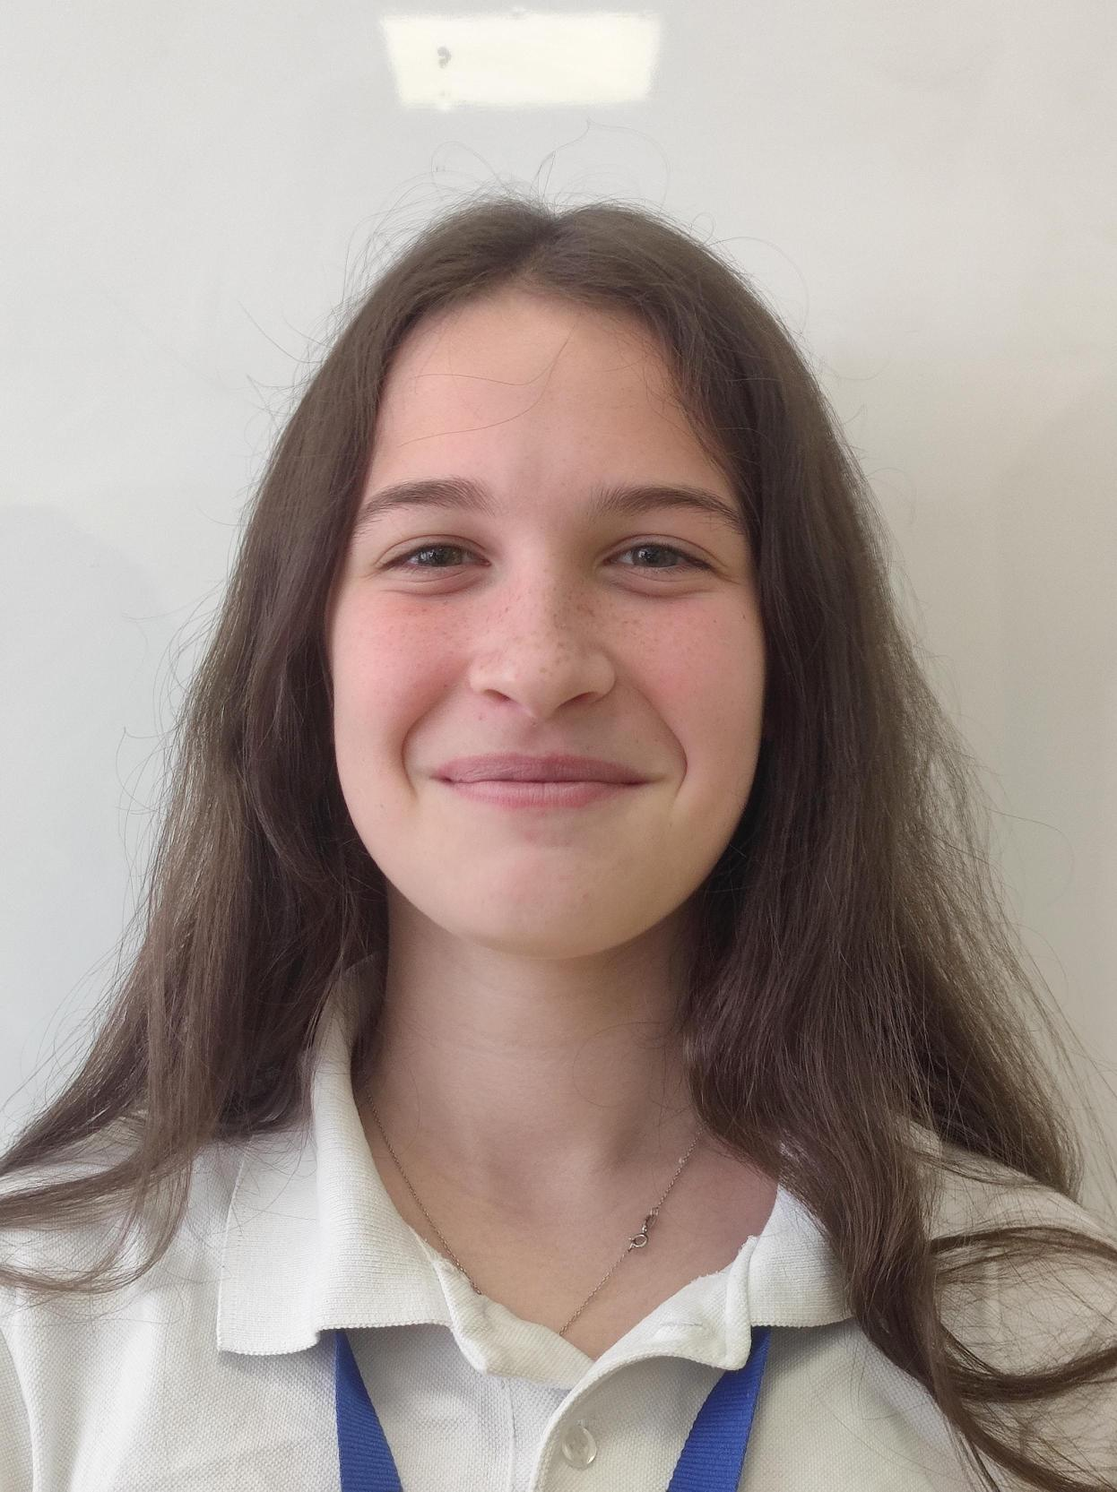
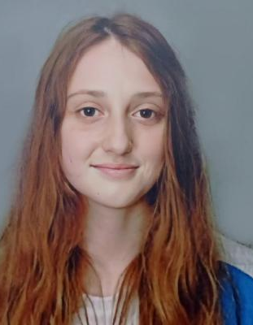
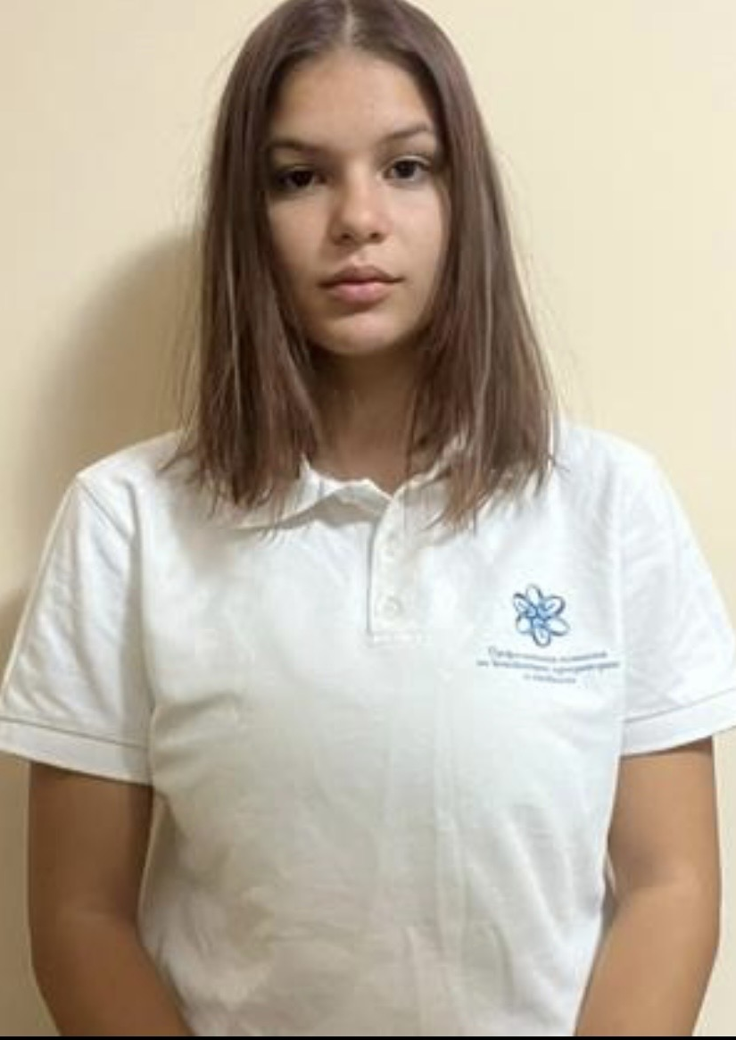
Our Team
Filipa Popova
Scrum Trainer
Mariela Dimova
QA Engineer
Mariq Koleva
Back-end developer
Nikoleta Ruseva
Front-end developer

Slide 3
Stages of creation
1
2
3
4
Choose an idea
Make a design
Make a game
Make documentation

Slide 4








Technologies

Slide 5
Let’s get to the game

