Slide 1
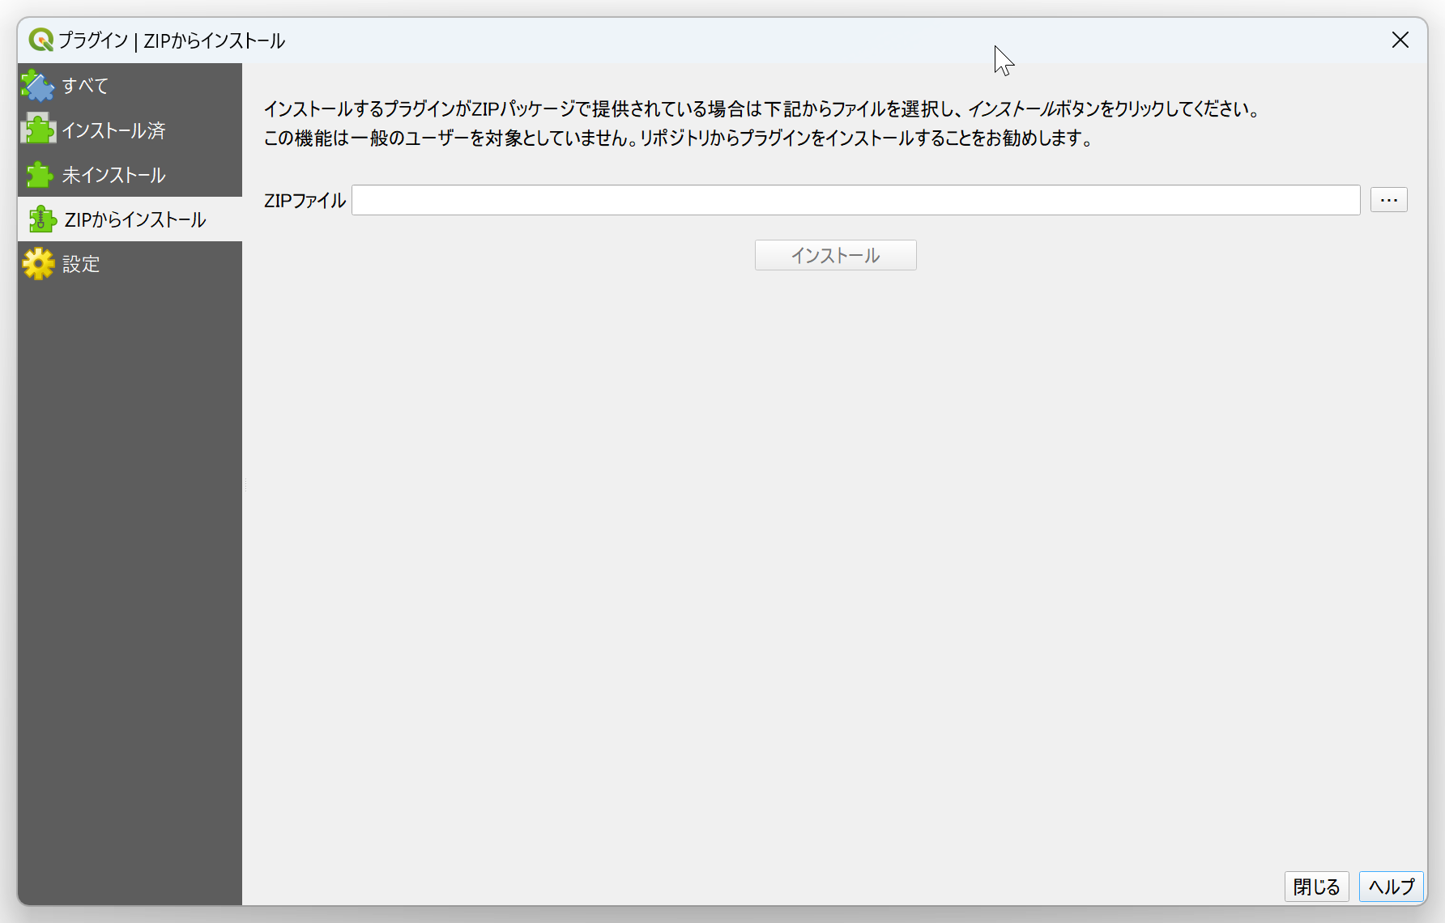
③
④
⑤

Slide 2
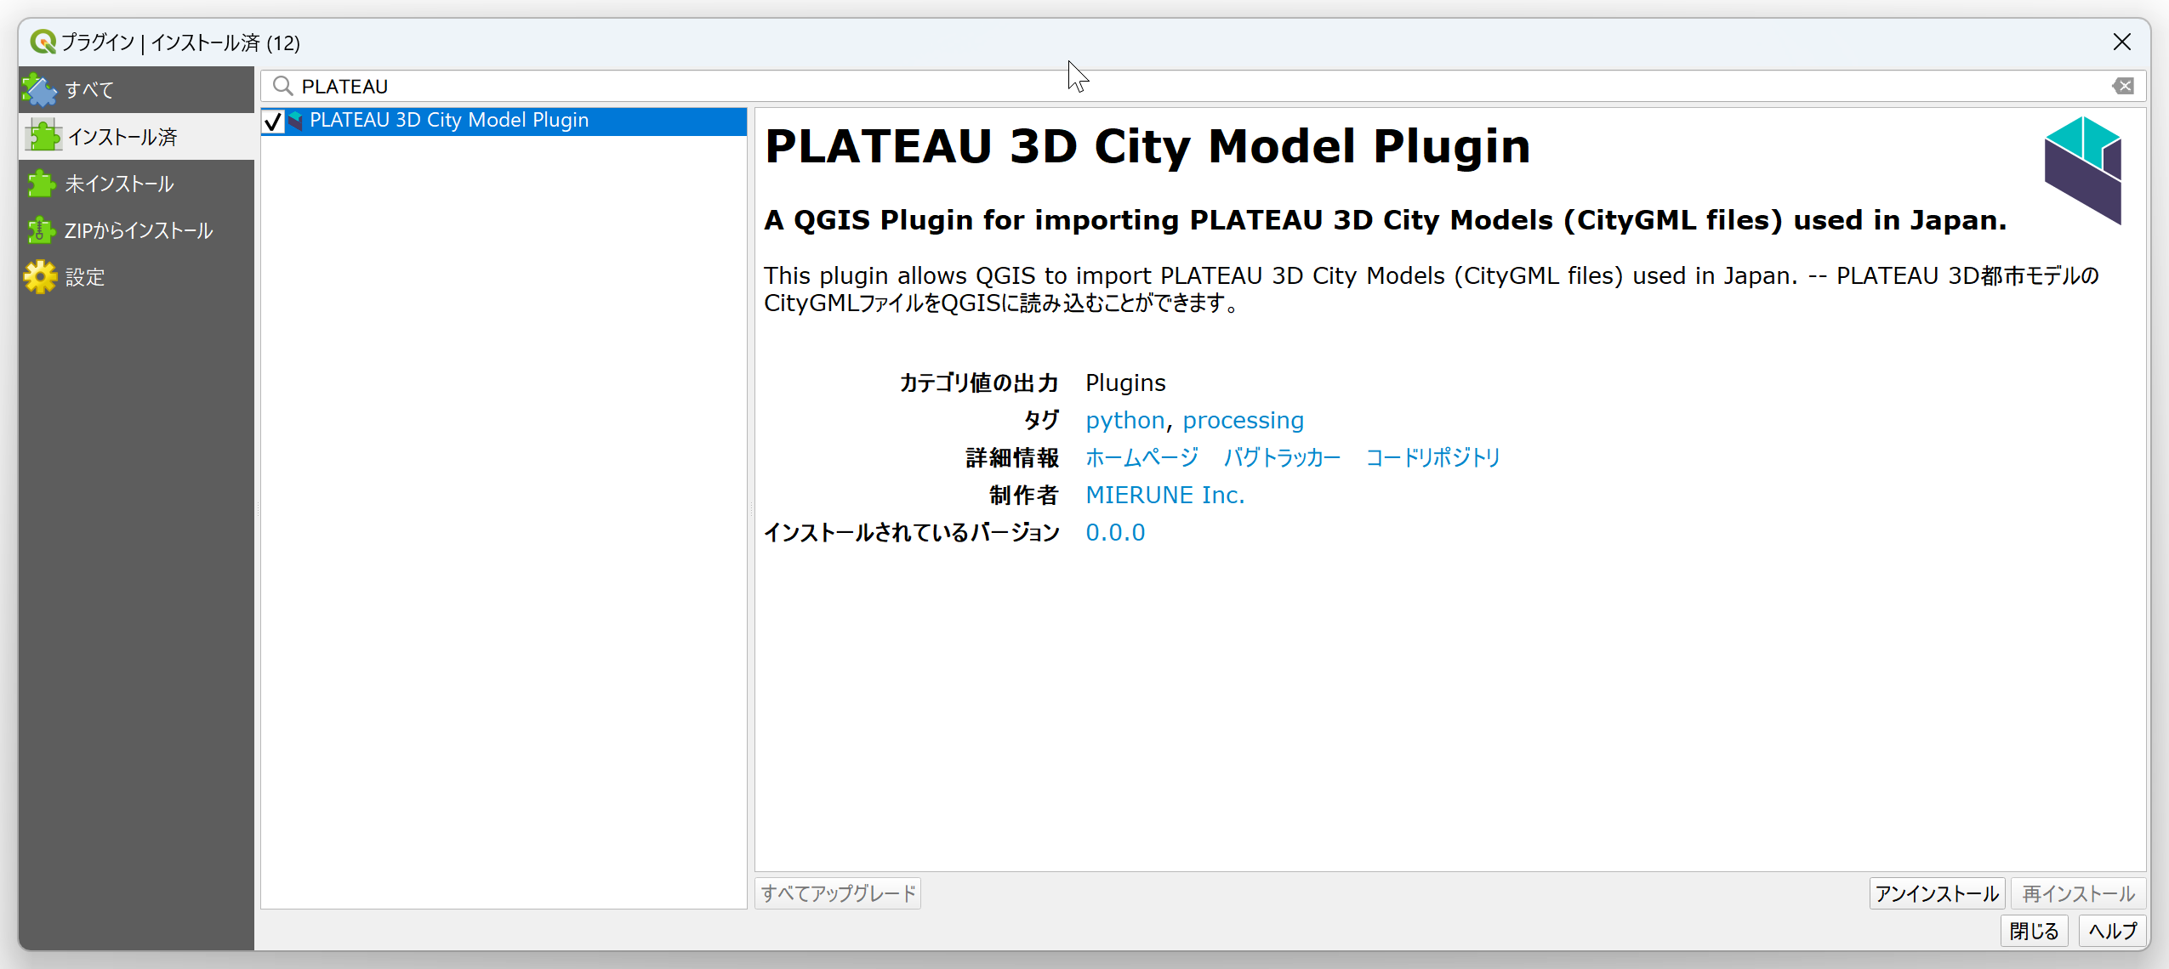
②
③

Slide 3
①
②

Slide 4
②
③

Slide 5
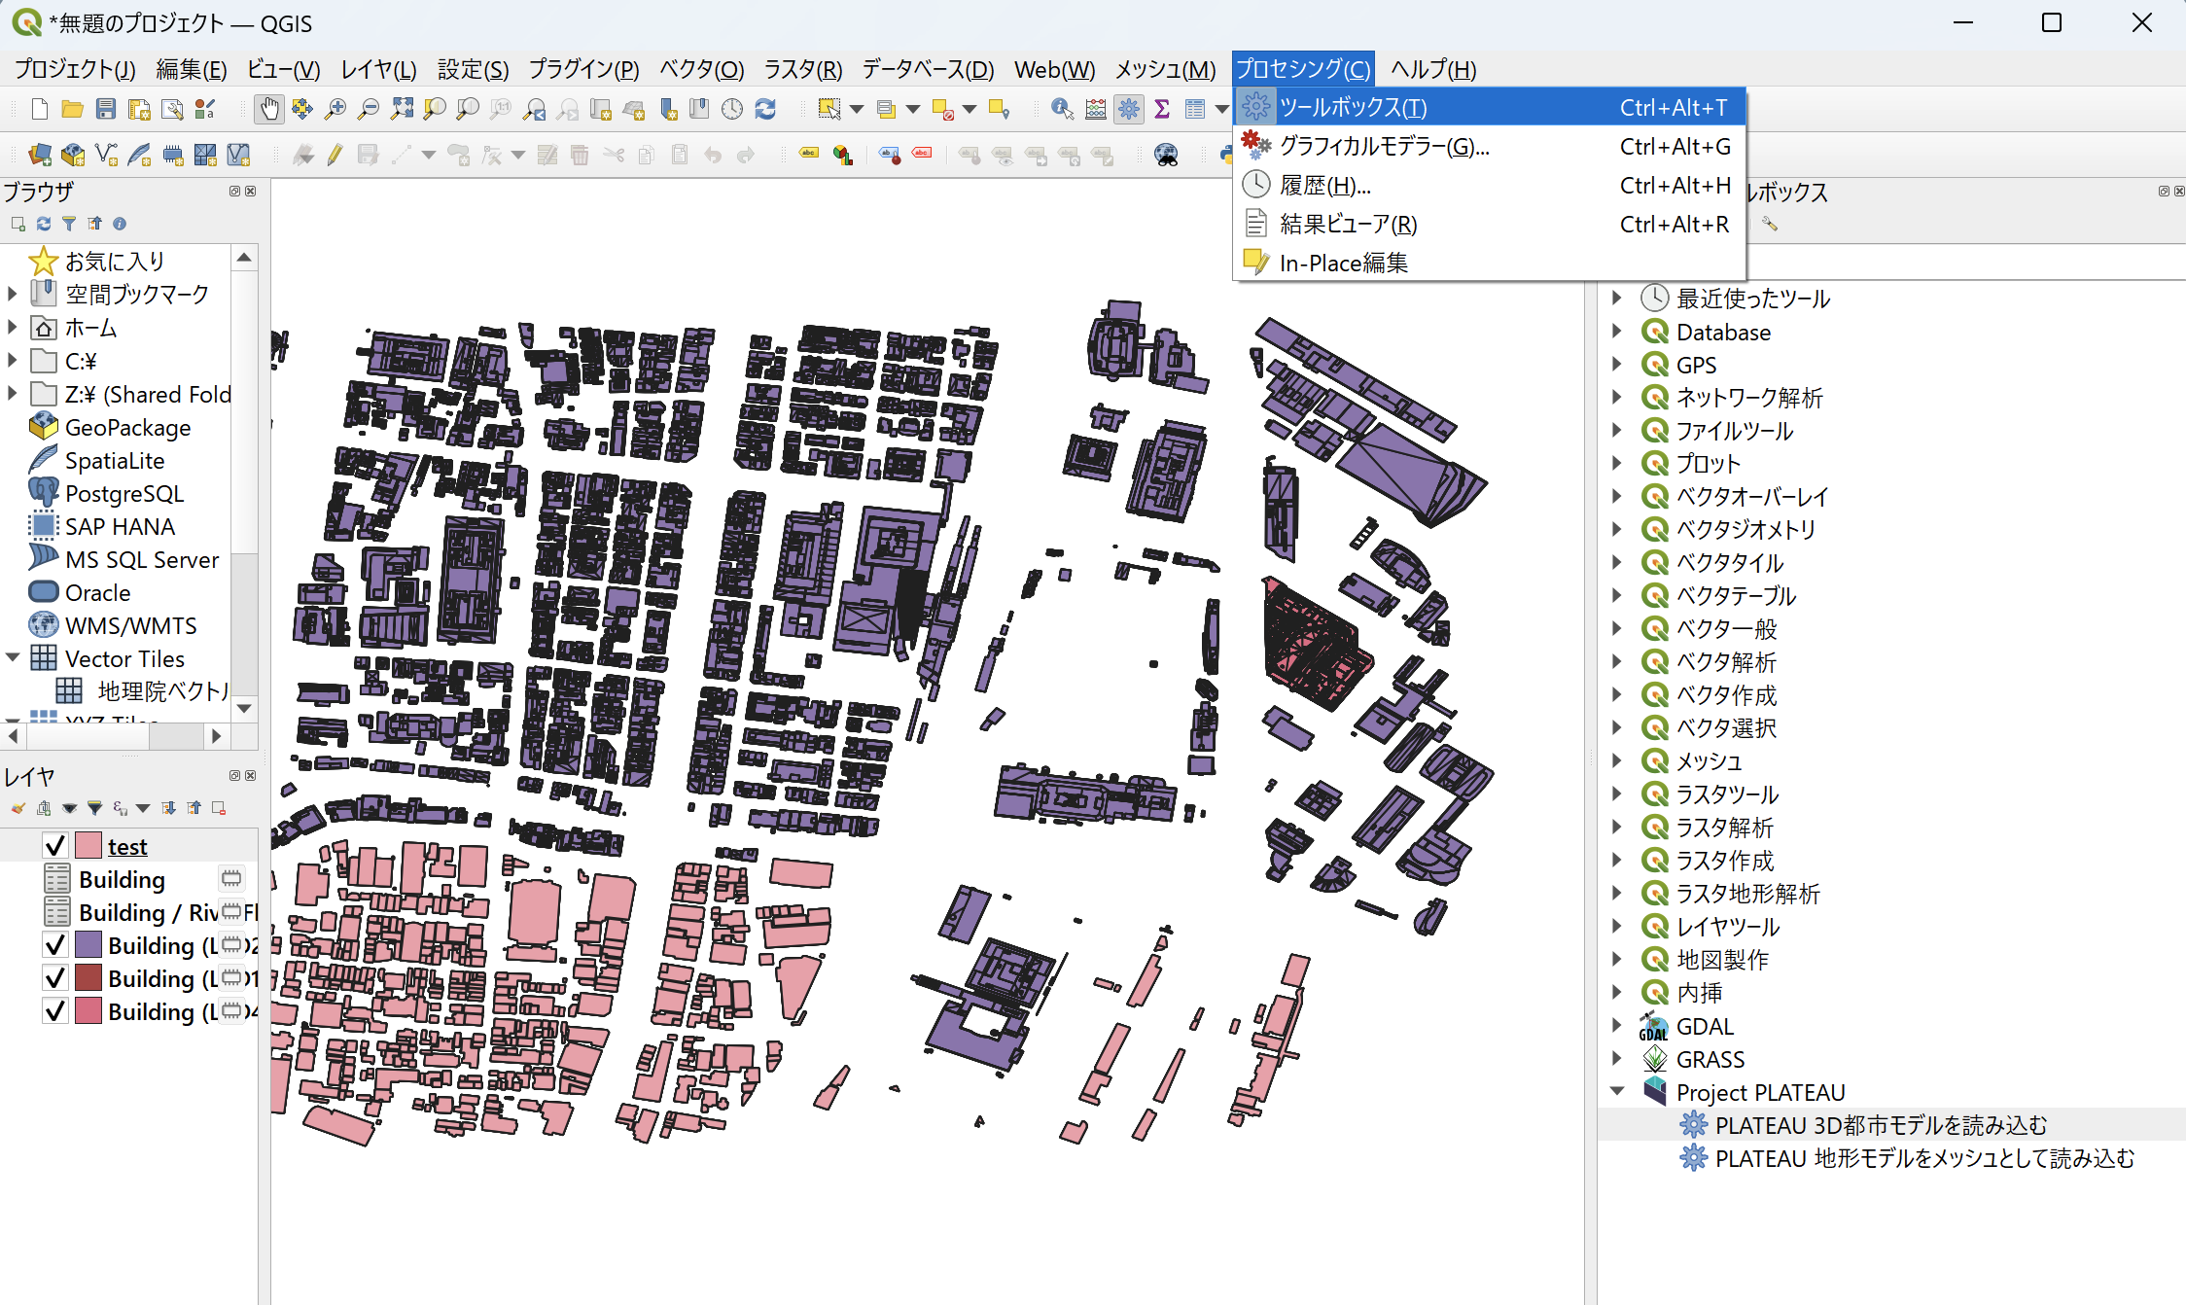

Slide 6
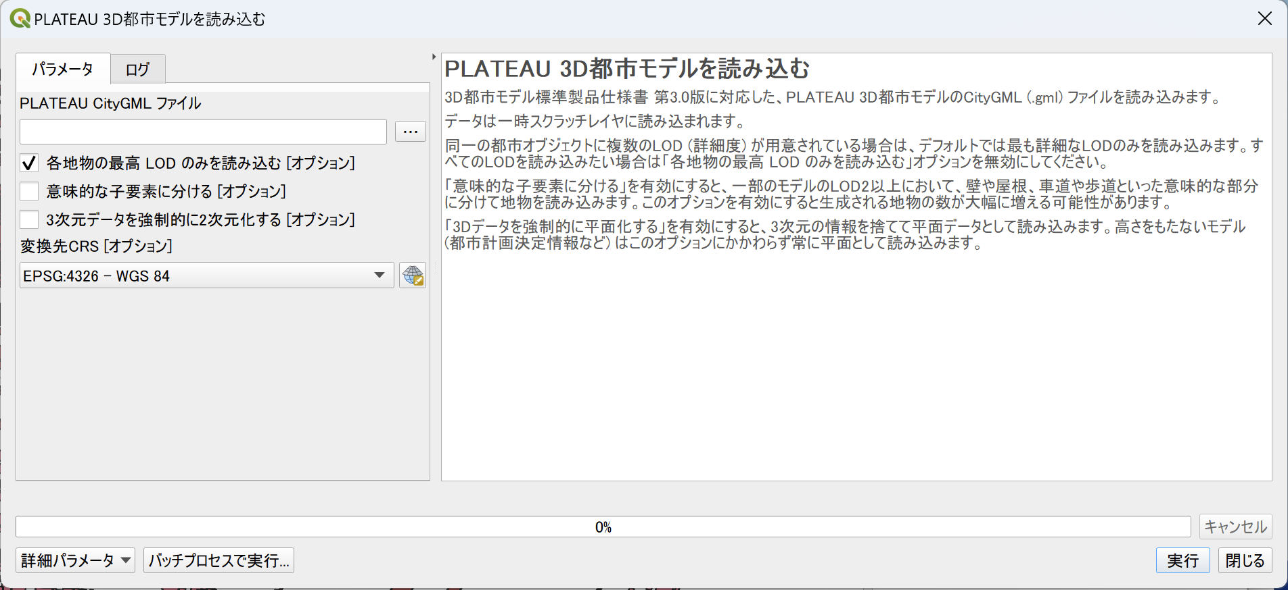
③
④
⑤
⑥
⑦
⑧

Slide 7
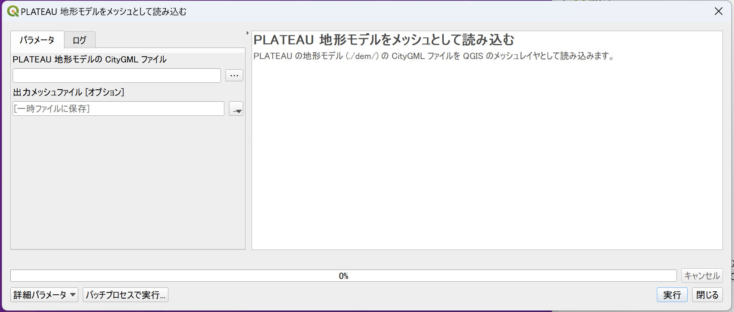
③
④
⑤

Slide 8
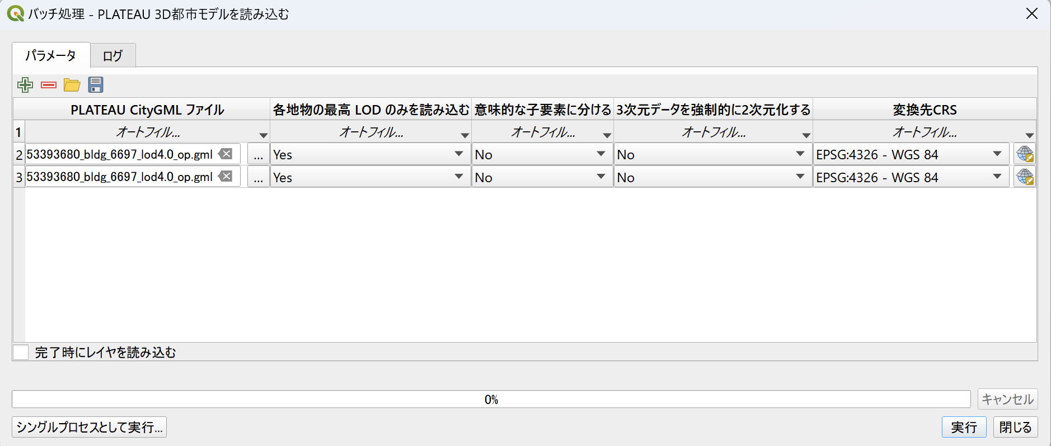

Slide 9
②

Slide 11
③
④
⑤

Slide 12
②

Slide 13
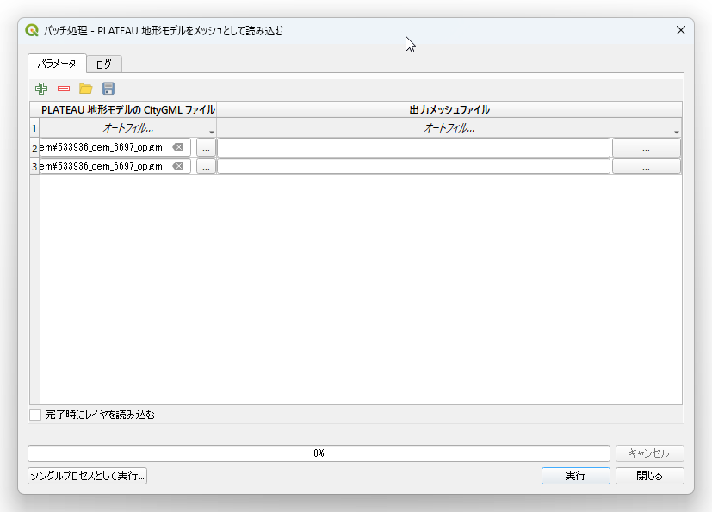
③
④
⑤

