Slide 1
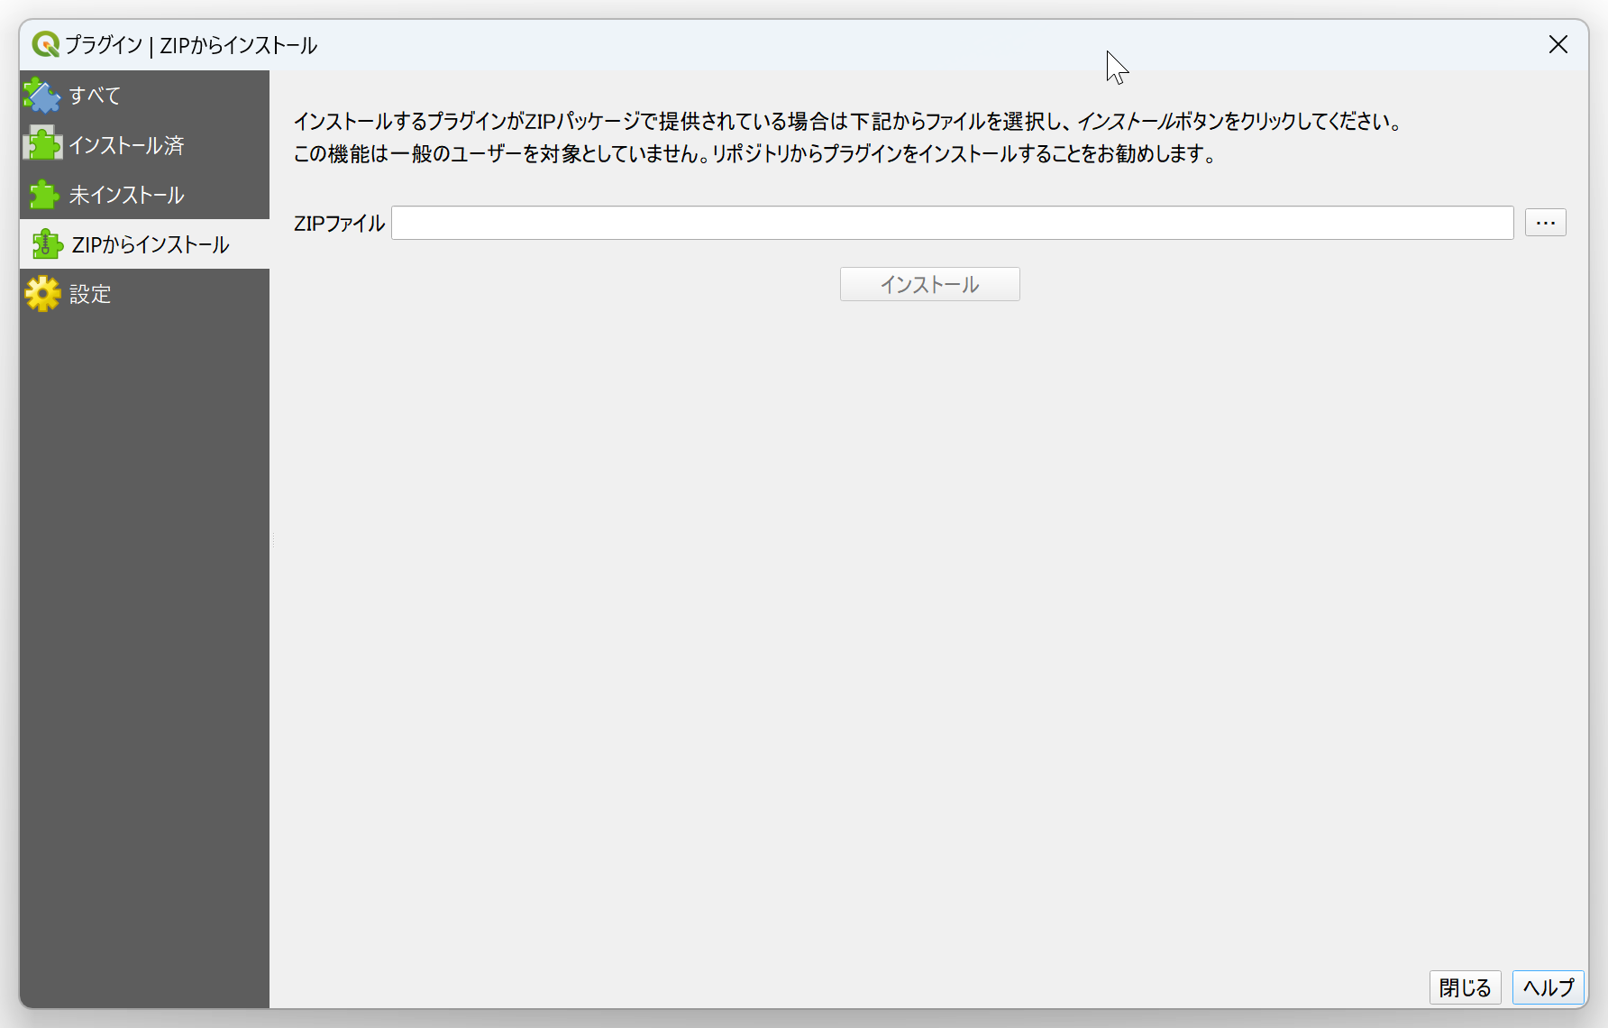
③
④
⑤

Slide 2
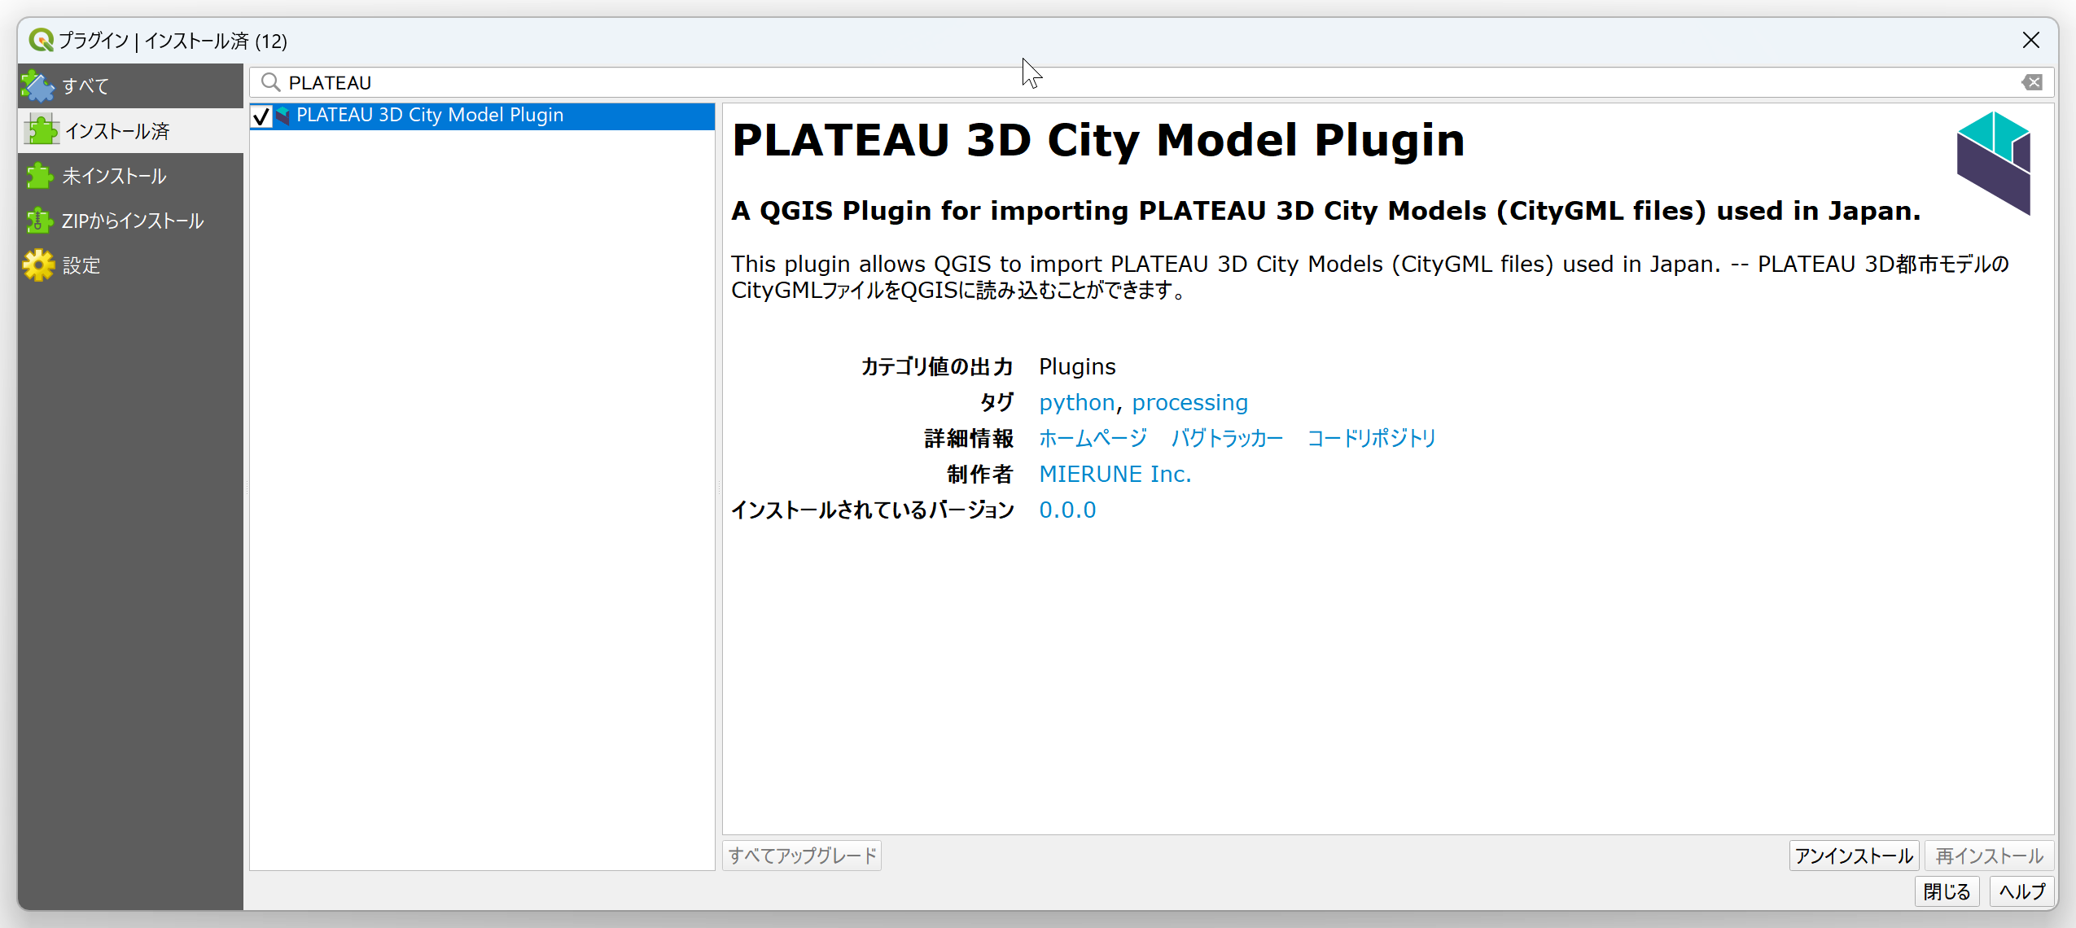
②
③

Slide 3
②
③

Slide 4
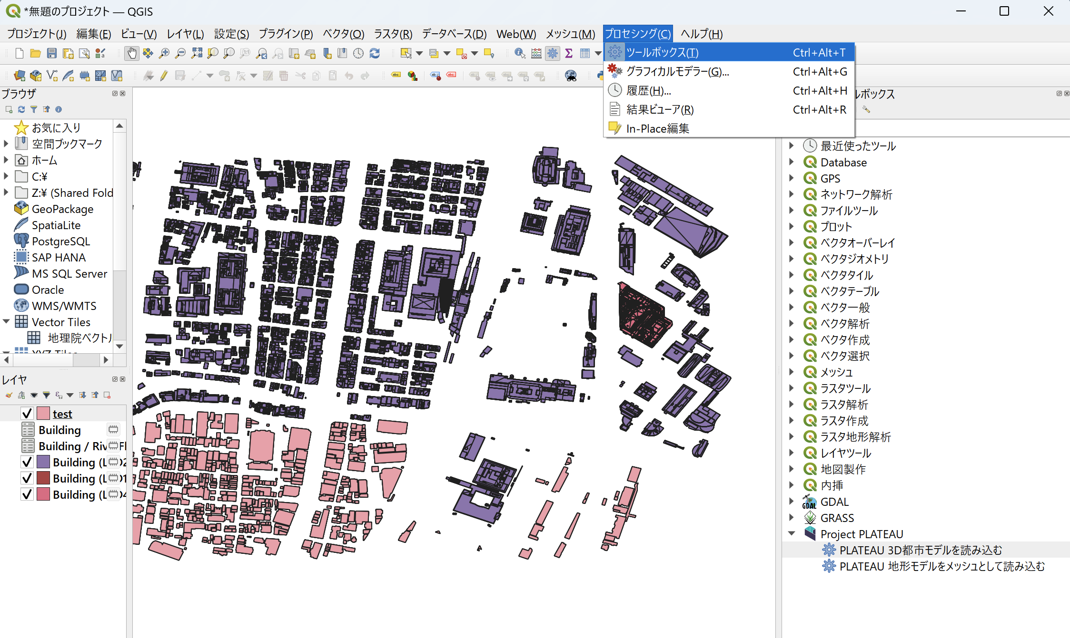

Slide 5
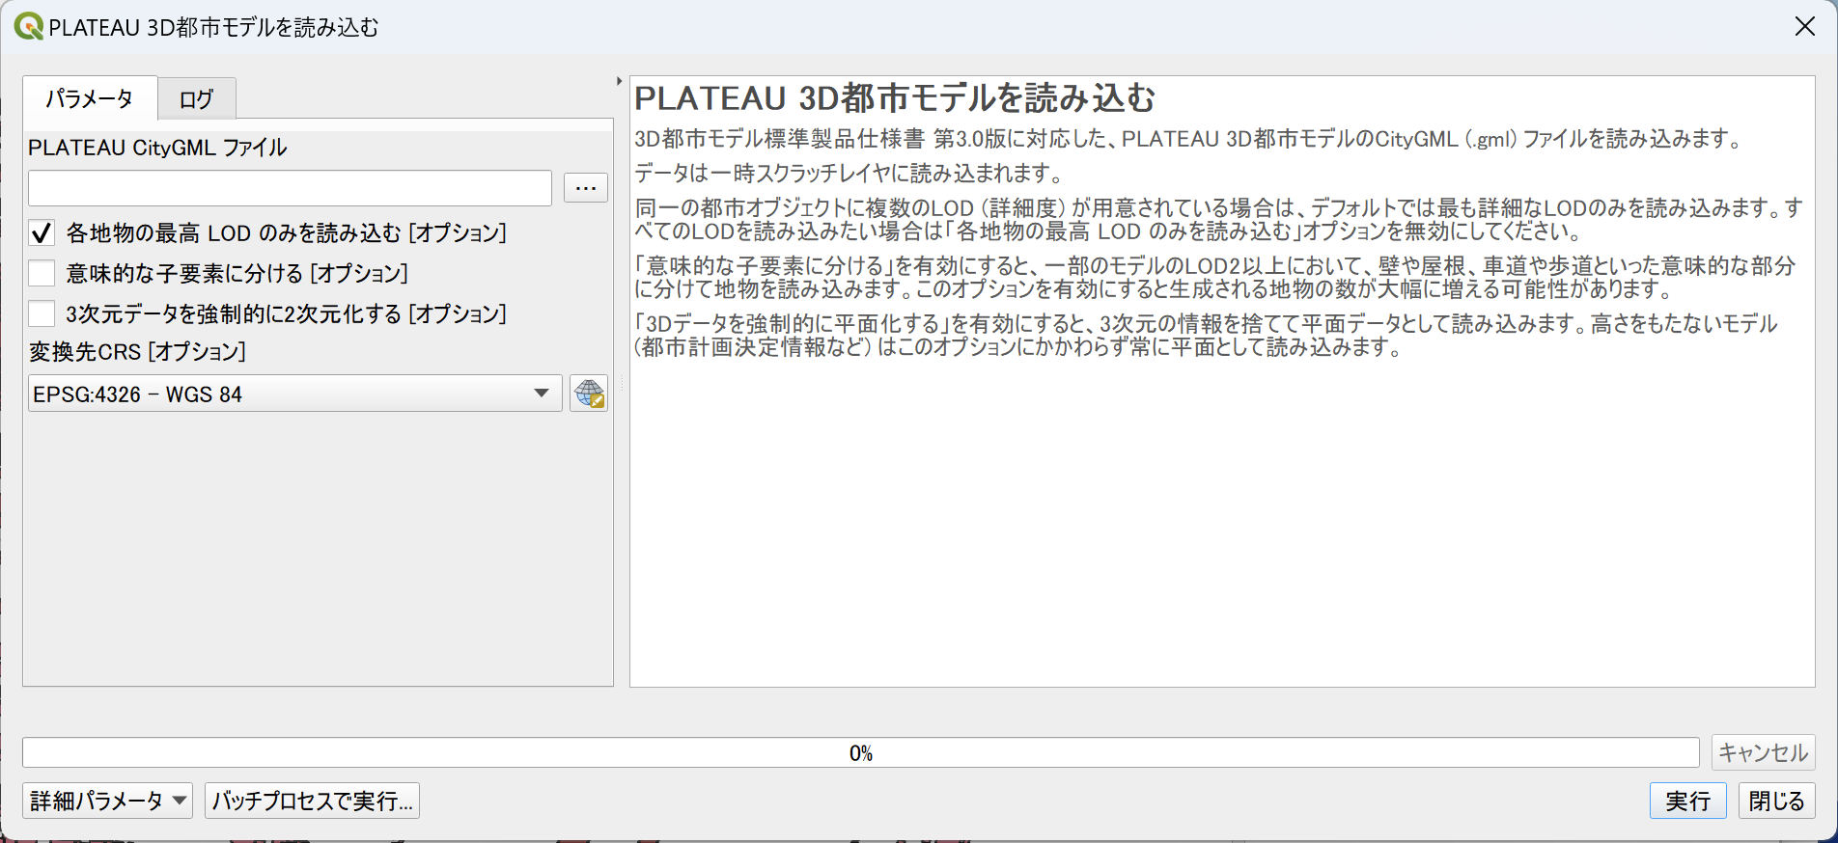
③
④
⑤
⑥
⑦
⑧

Slide 6
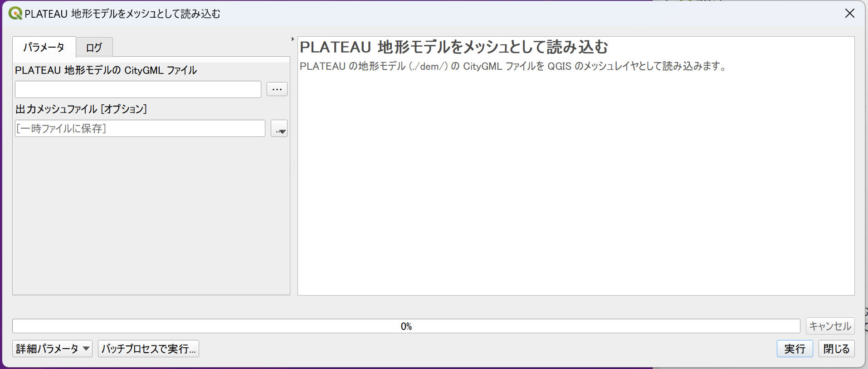
③
④
⑤

Slide 7
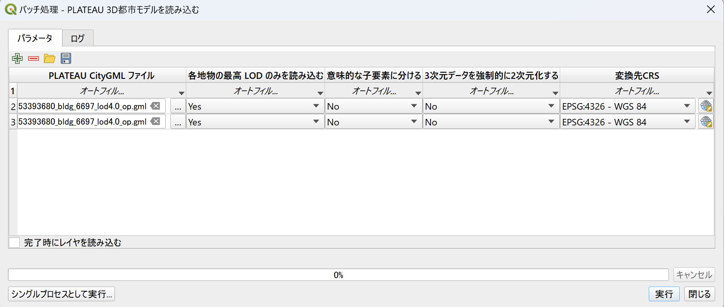

Slide 8
②

Slide 10
③
④
⑤

Slide 11
②

Slide 12
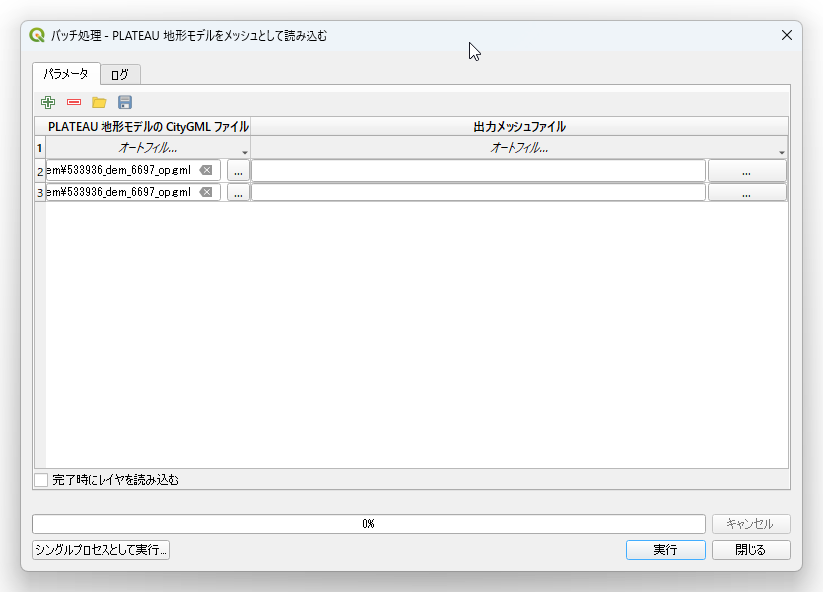
③
④
⑤

