Slide 1
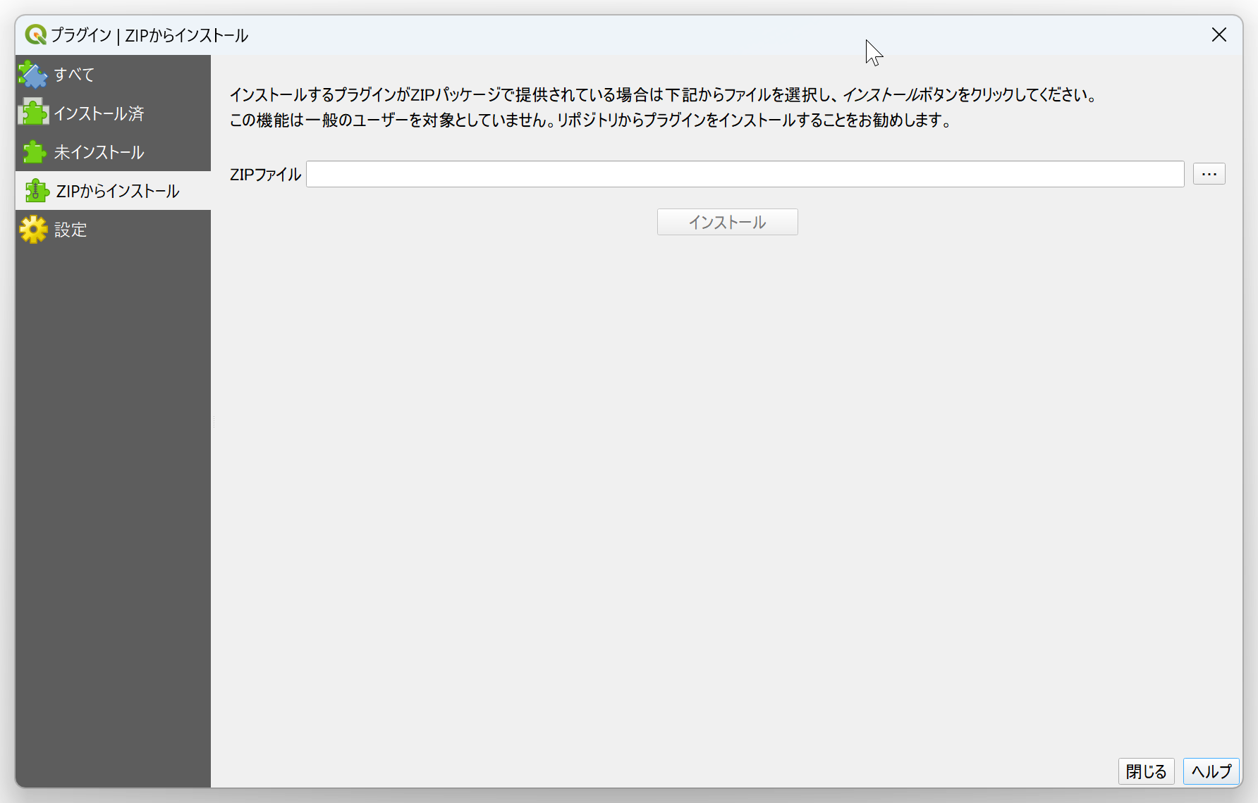
③
④
⑤

Slide 2
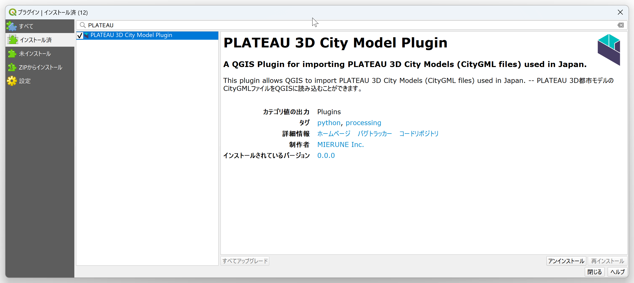
②
③

Slide 3
②
③

Slide 4
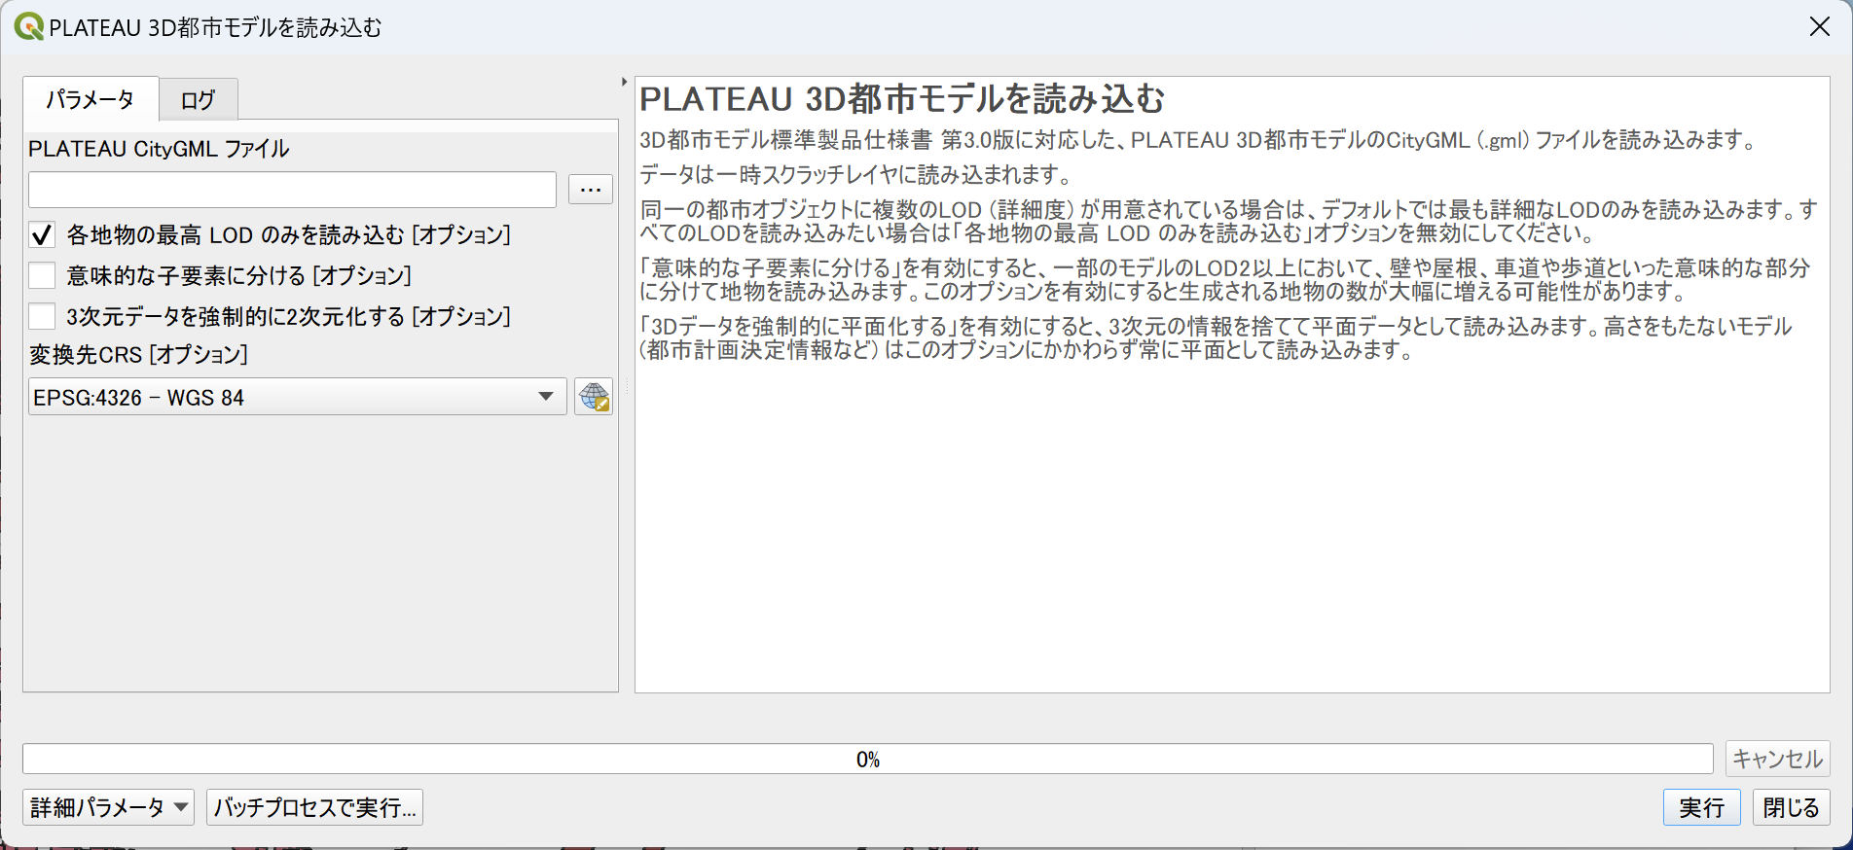
③
④
⑤
⑥
⑦
⑧

