Slide 1
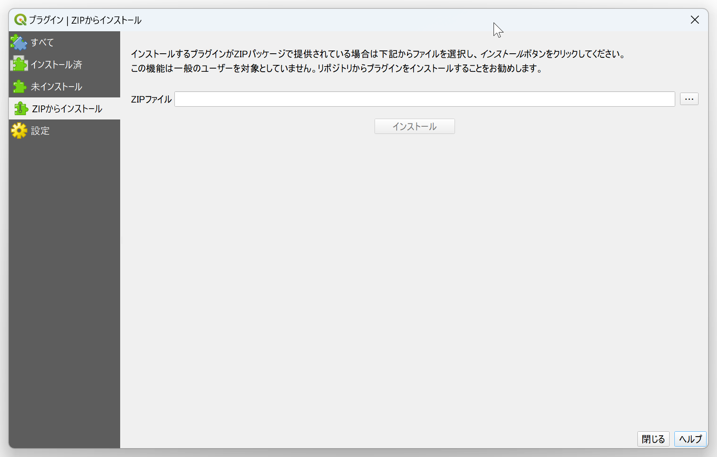
③
④
⑤

Slide 2
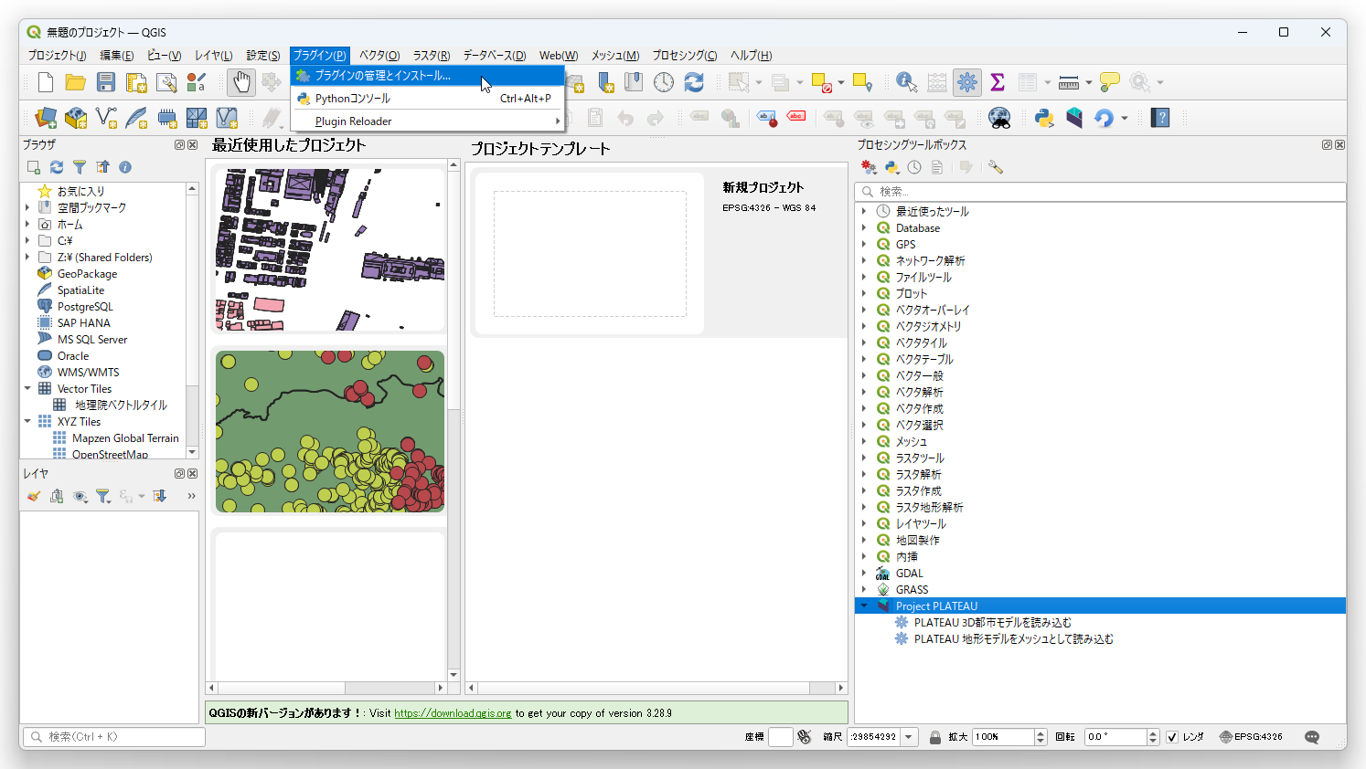
①

Slide 3
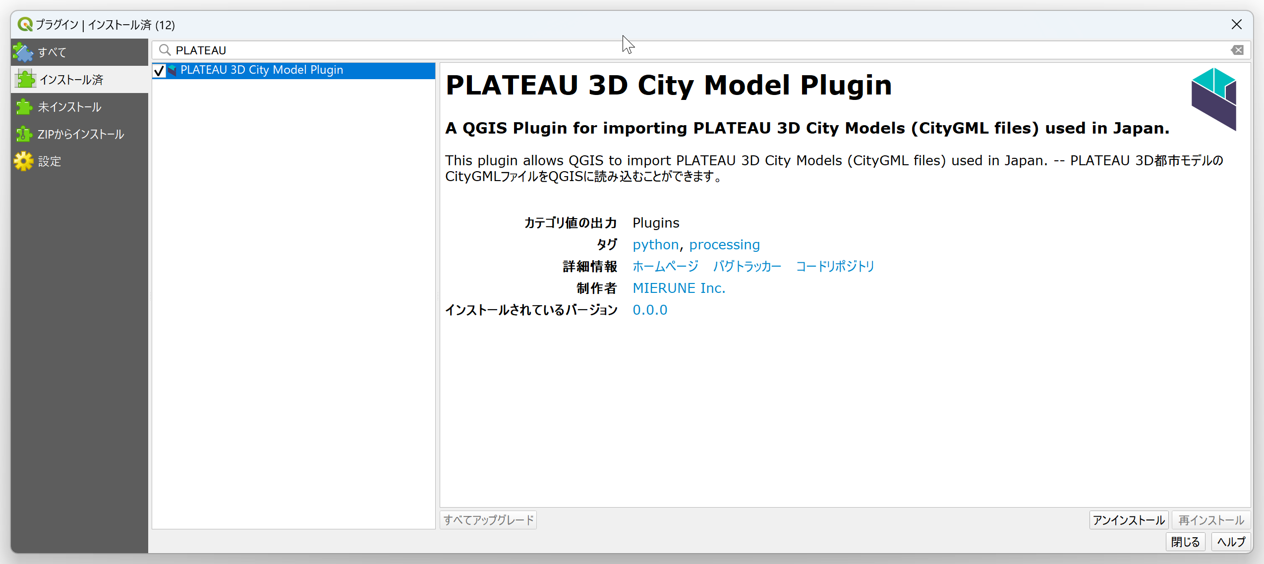
②
③

Slide 4
①
②

Slide 5
②
③

Slide 6
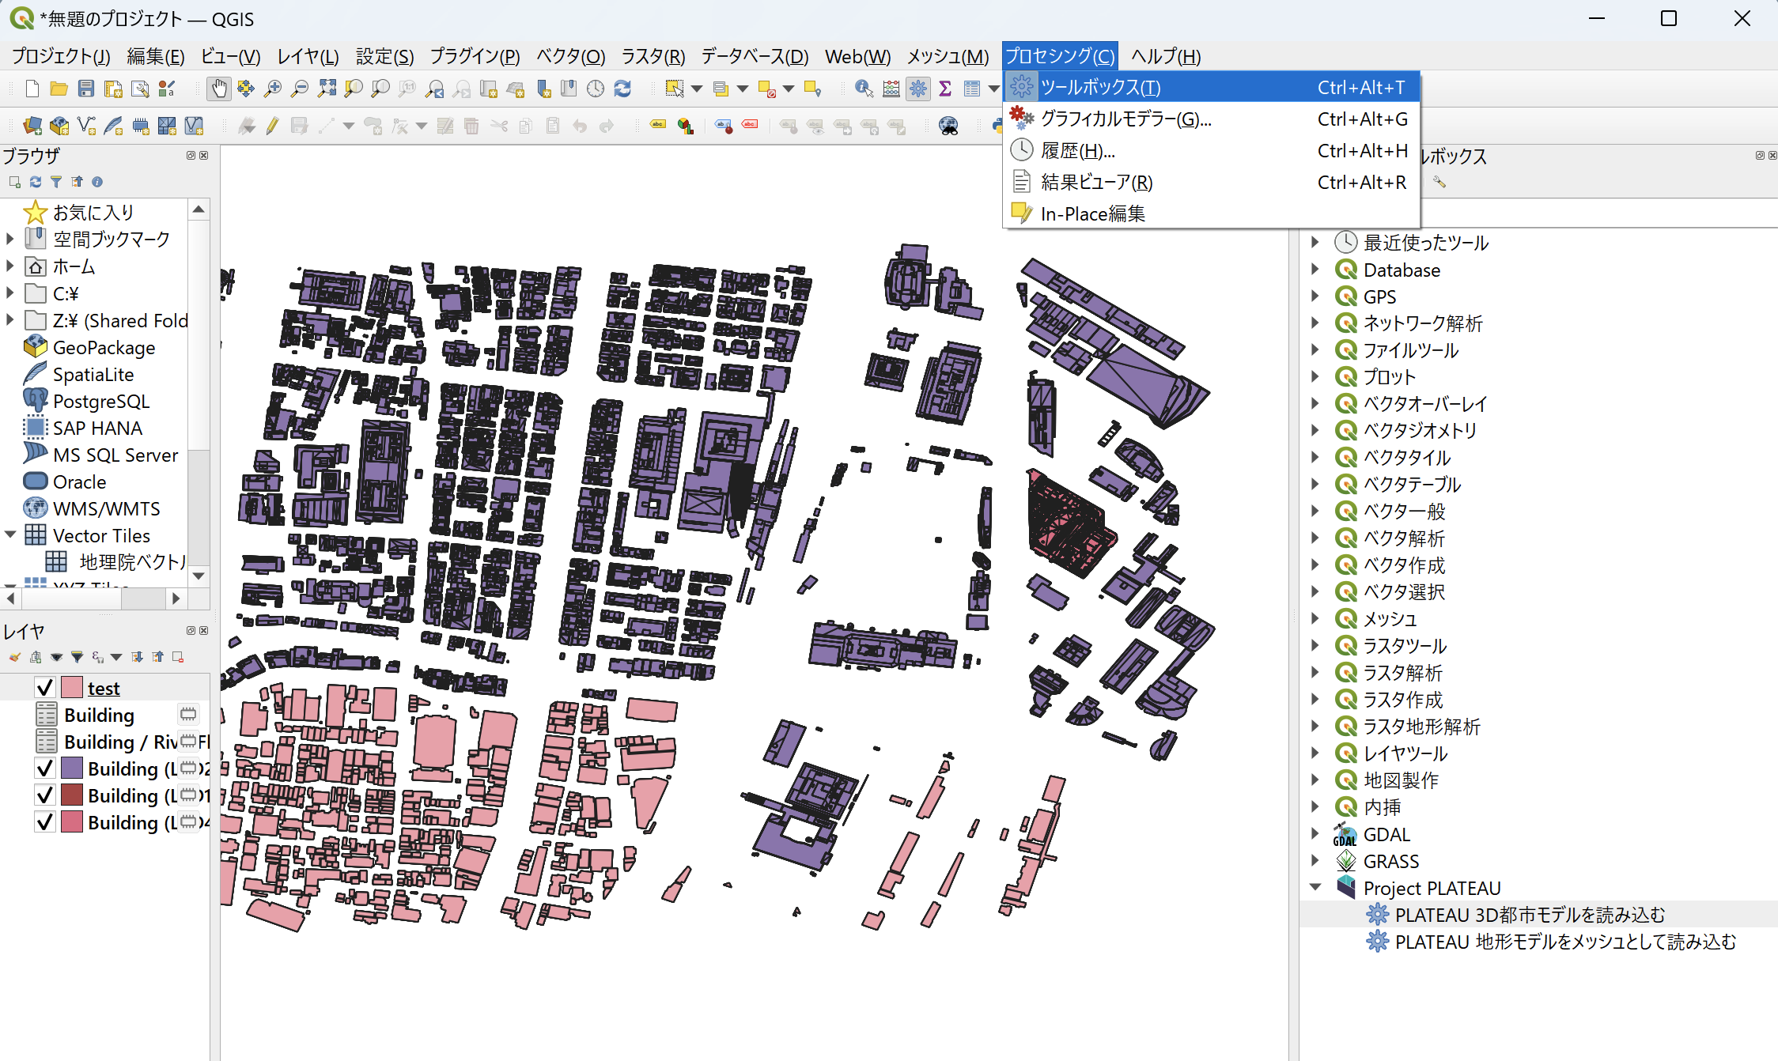

Slide 7
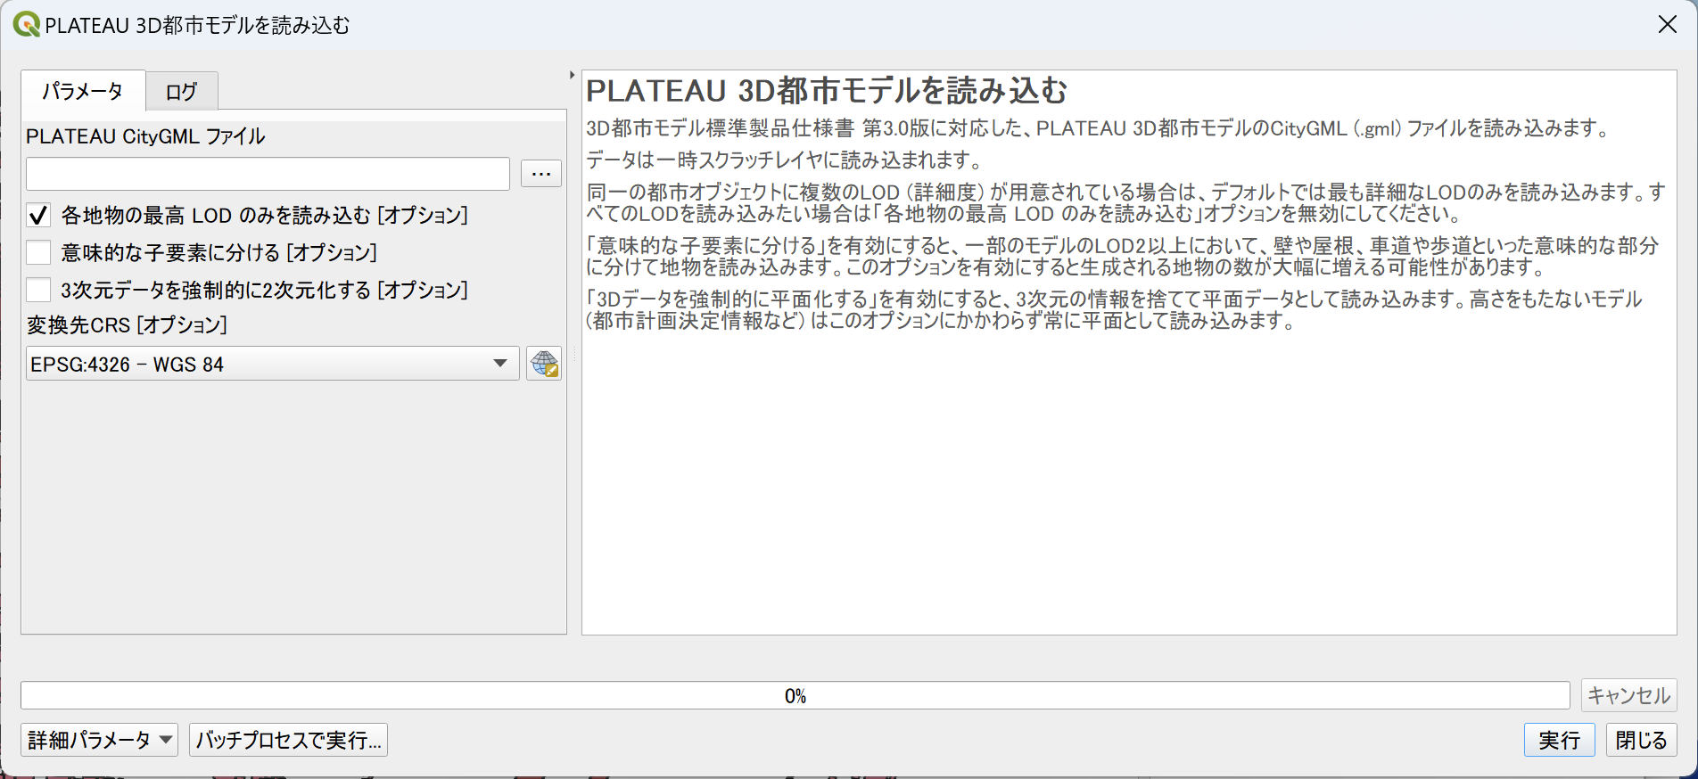
③
④
⑤
⑥
⑦
⑧

Slide 8
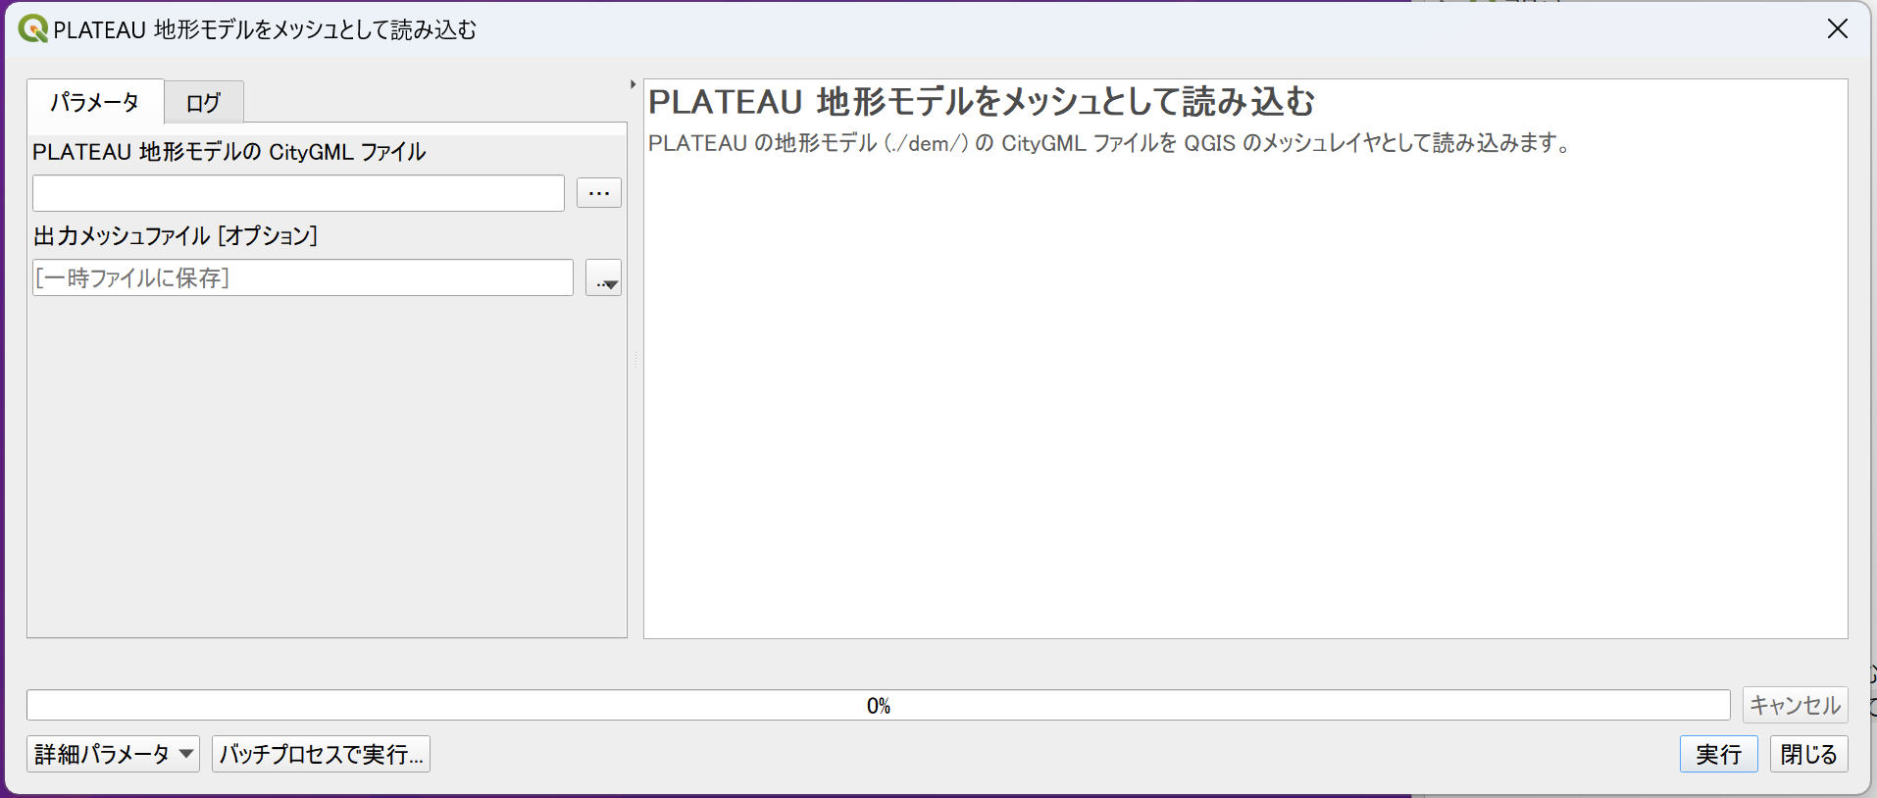
③
④
⑤

Slide 9
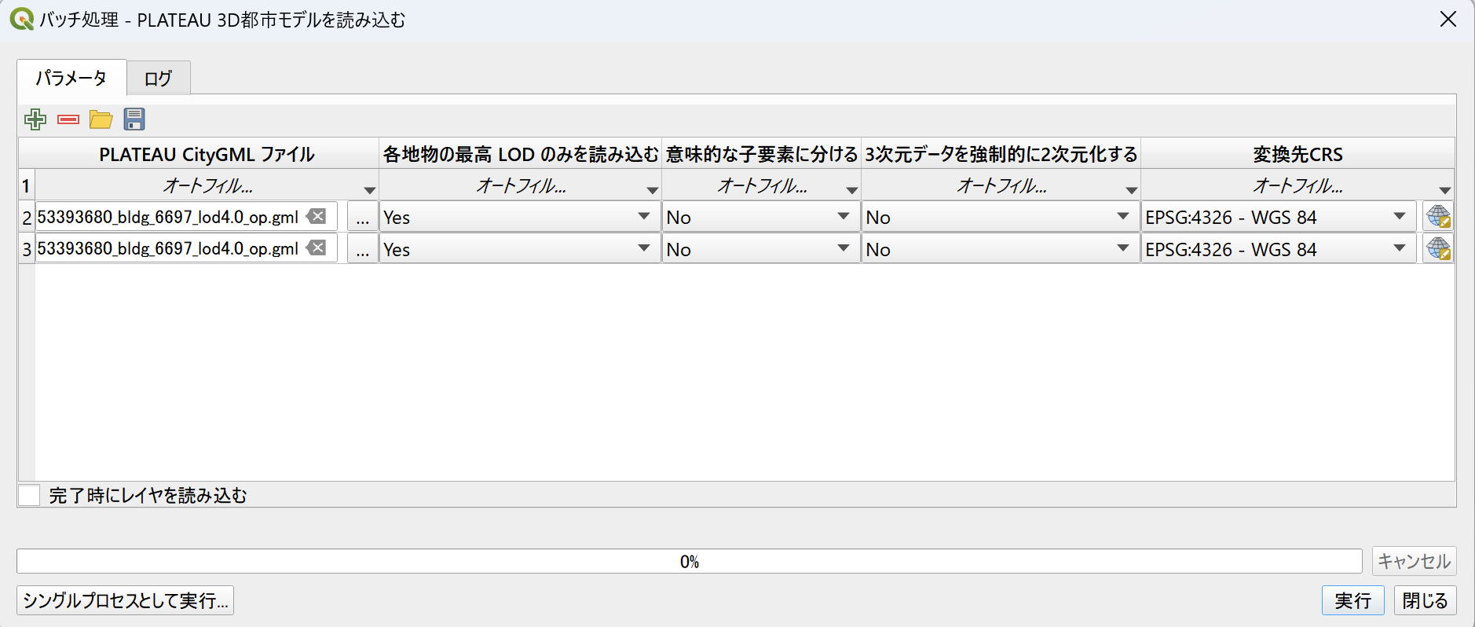

Slide 10
②

Slide 12
③
④
⑤

Slide 13
②

Slide 14
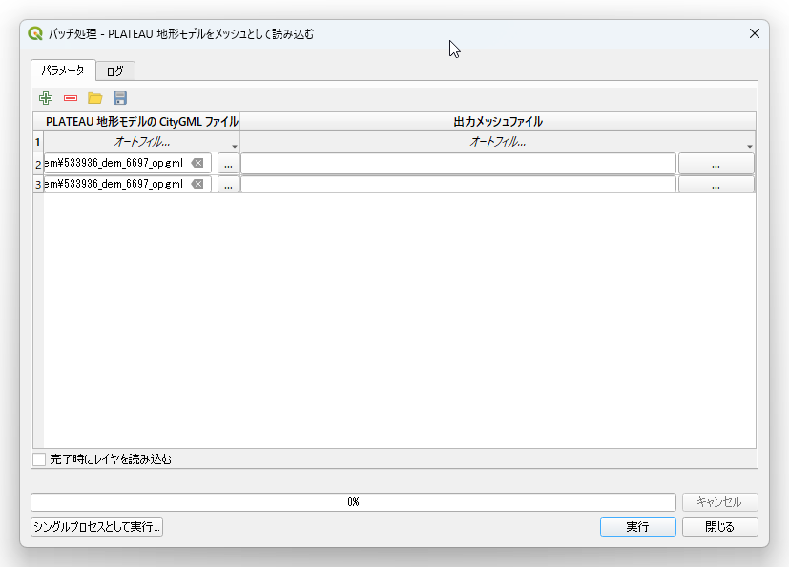
③
④
⑤

