Slide 1

Ukraine-Russia War Sentiment Analysis
Presenter
Suryansh Sharma(2020A1R119)
DEPARTMENT OF COMPUTER SCIENCE AND ENGINEERING
MIET(Autonomous), JAMMU

Slide 2
Contents
Problem Statement
Things Covered In Analysis
Tech Stack
Workflow
Demonstration

Slide 3
Problem Statement
When a user wishes to voice his view on a trending topic on social media, we apply sentiment analysis to try to determine the sentiment score of that given opinion.
Twitter is the most popular microblogging social media site, with over a billion users. Nearly 145 million people use the site on a daily basis.
In today's world, the user tweets utilizing Hashtags, emojis, and punctuation make it difficult to examine the data and Create sentiment scores of tweets. For this project, Tweets of ukraine-russia war are used for sentiment analysis.

Slide 4
Things Covered In Analysis
Tweets Preprocessing and Cleaning/Data Cleaning
Visualization from Tweets
Extracting Features from Cleaned Tweets from TfidfVectorizer
Model Building: Sentiment Analysis
Logistic Regression
Support Vector Machine
Random Forest
XGBoost

Slide 5
Tech Stack
Numpy
Pandas
Matplotlib
Vader Sentiment Analyzer
Machine Learning Models

Slide 6
WORKFLOW

Slide 7




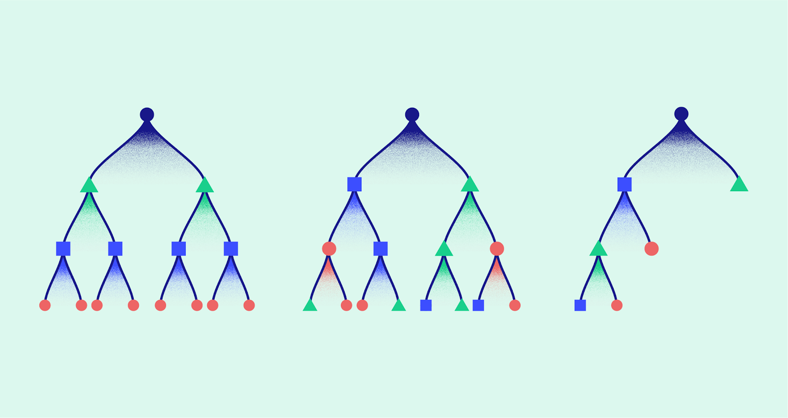


Tweet data
Preprocessing
Train and Test split
logistic regression model
svm
model
Random Forest
model
XGBoost
model

Slide 8
New Tweet data
Trained
logistic regression model
Trained
svm
model
Trained
Random Forest
model
Trained
XGBoost
model
Positive or Negative or Neutral Tweet Prediction

Slide 9
DEMONSTRATION

Slide 10


