Slide 1


ANALYZING NETWORK TRAFFIC FROM A LOCAL AREA NETWORK
COMPUTER NETWORKS
TEAM T-REX
FINAL PROJECT EVALUATION
Arjun Charak​
Aadhar Koul​
Shobit Kitchloo​
Anil Kumar​
Sidharth Bhawani
- 2020a1r058​
- 2020a1r040​
- 2020a1r055​
- 2020a1r052
- 2020a1r050
DEPARTMENT OF COMPUTER SCIENCE AND ENGINEERING​​
MIET(Autonomous), JAMMU​

Slide 2
AGENDA
WORKFLOW
PROBLEM STATEMENT
OUR MODEL
CONCLUSION
INTRODUCTION
FEATURES

Slide 3
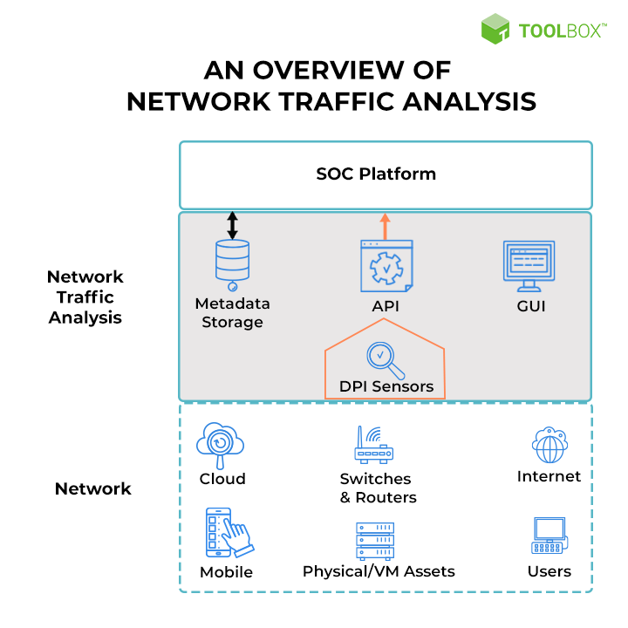
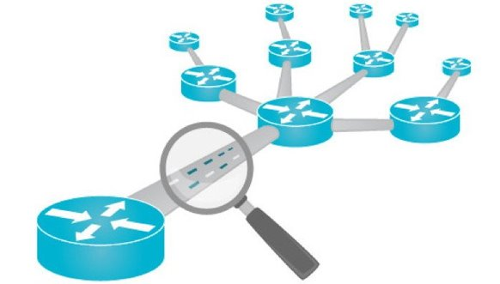
INTRODUCTION

Slide 4
PROBLEM STATEMENT
Organizations find it challenging to proactively identify serious security concerns.
Maintaining good network visibility has evolved into a challenging and burdensome task as a result of the growing adoption of cloud computing, DevOps practices, and the Internet of Things.
Networks observe everything and offer objective facts that other data sources frequently struggle to give.

Slide 5
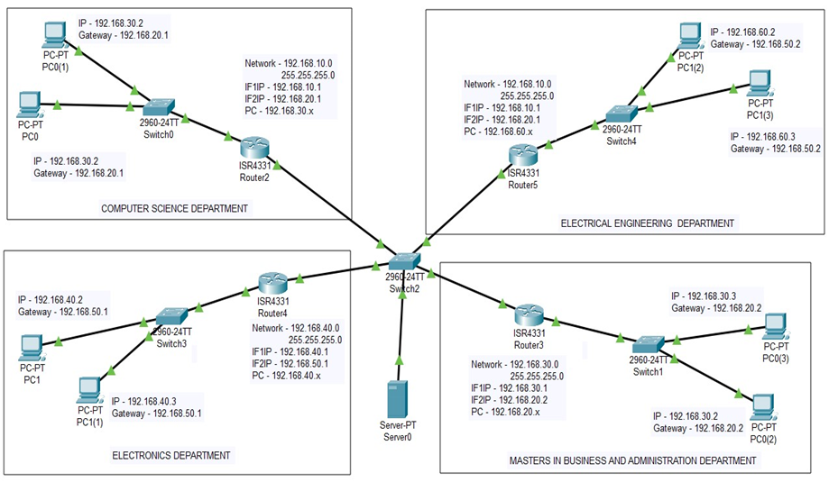
OUR MODEL

Slide 6
OUR MODEL
Broadcast | First Valid Host | Last Valid Host | Network Address
192.168.1.255 | 192.168.1 | 192.168.1.25 | 192.168.1
192.168.2.255 | 192.168.2 | 192.168.1.25 | 192.168.1
192.168.3.255 | 192.168.3 | 192.168.1.25 | 192.168.1
192.168.4.255 | 192.168.4 | 192.168.1.25 | 192.168.1
192.168.5.255 | 192.168.5 | 192.168.1.25 | 192.168.1
192.168.6.255 | 192.168.6 | 192.168.1.25 | 192.168.1
192.168.7.255 | 192.168.7 | 192.168.1.25 | 192.168.1
192.168.8.255 | 192.168.8 | 192.168.1.25 | 192.168.1
Table : IP Address Allocation

Slide 7
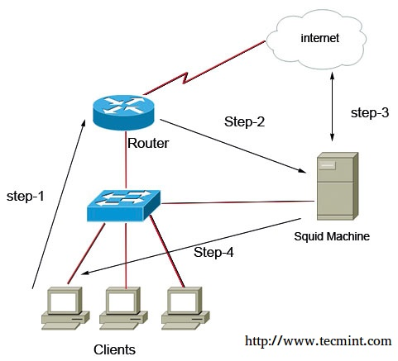
WORKFLOW
FLOW DIAGRAM

Slide 8
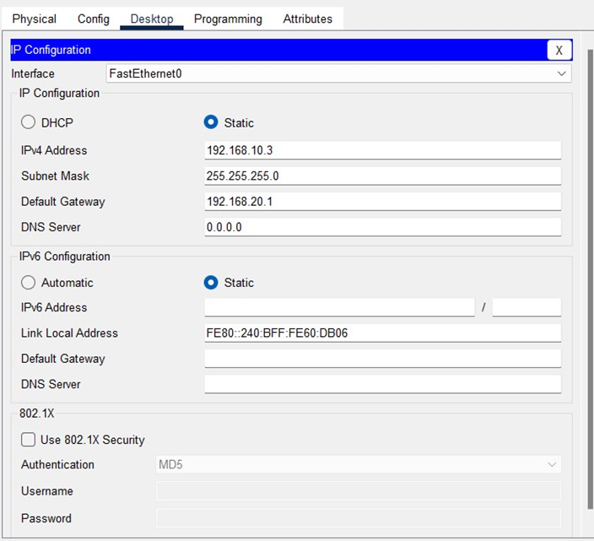
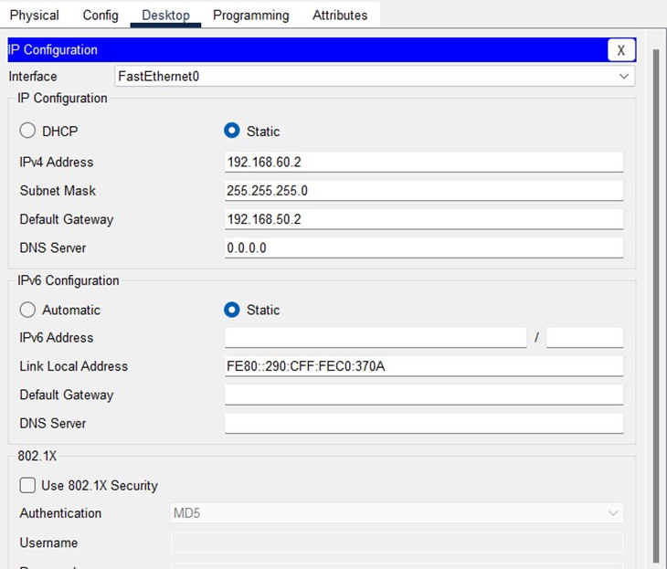
WORKFLOW
CONFIGURING COMPONENTS

Slide 9
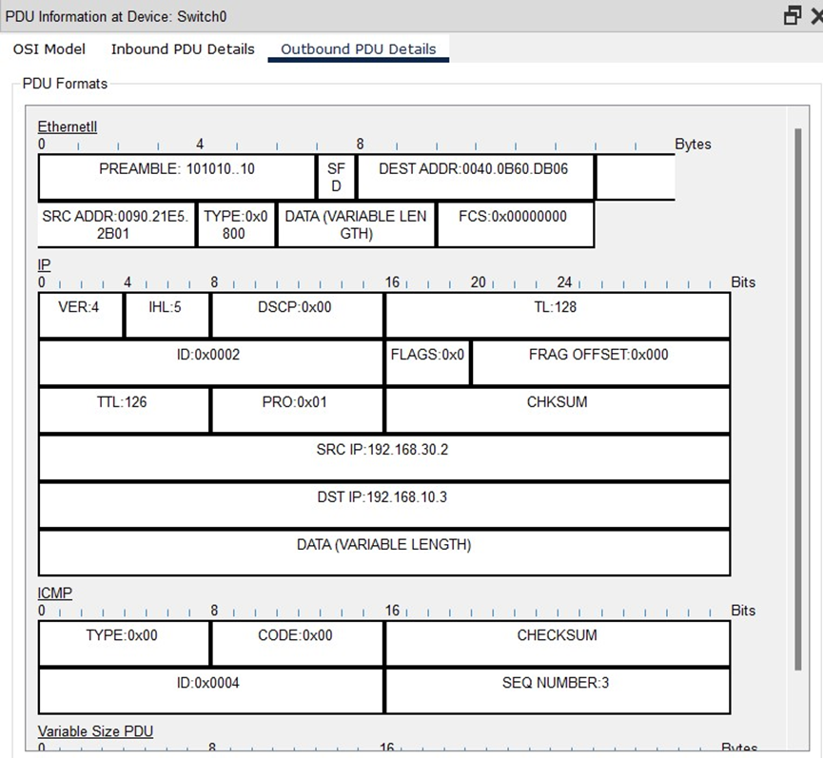
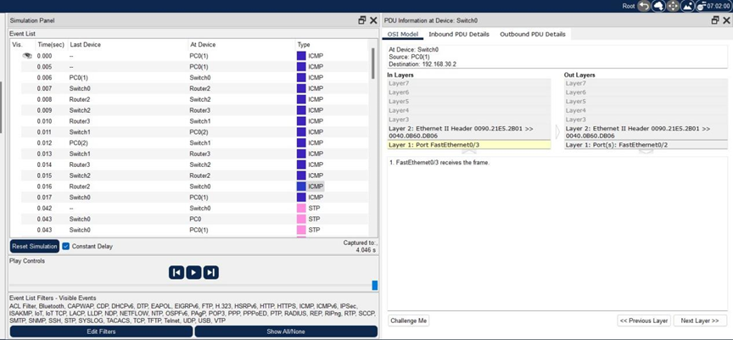
WORKFLOW
PDU INFORMATION AT DEVICES

Slide 10
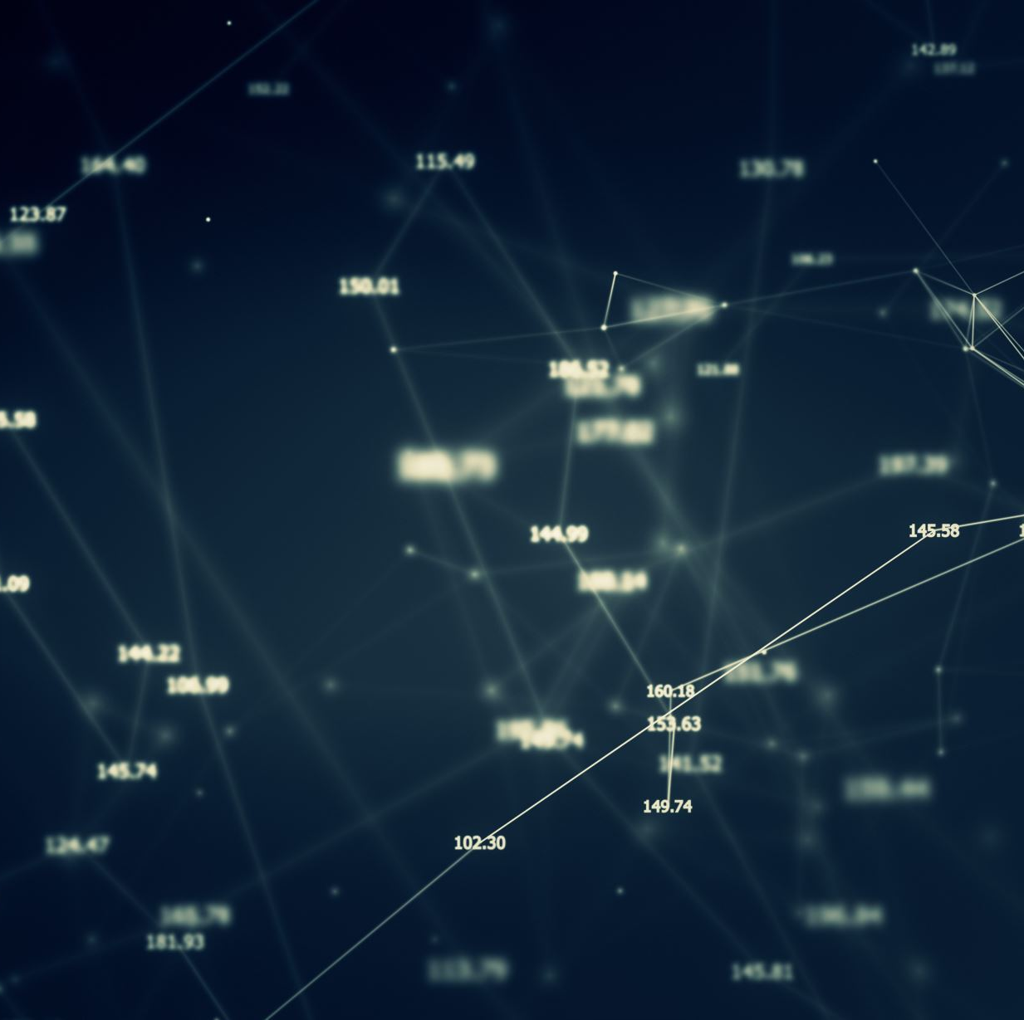
FEATURES
A Friendly User Interface.
Multiple LANs’ Analysis
Integration.
Coverage of Key Matrices.
Cloud Comprehension

Slide 11
CONCLUSION
Local Area Network that utilizes wired topology has been executed with some significant ideas like -
Dynamic Host Configuration Protocol
Domain Name System
Virtual LANs
Virtual Local Area Networks have been utilized to intelligently a mass customers on the system.
The design and particulars are for the underlying model and can further be created and extra usefulness can be added to expand backing and inclusion.

Slide 12
THANK YOU
TEAM T-TREX

