Slide 1

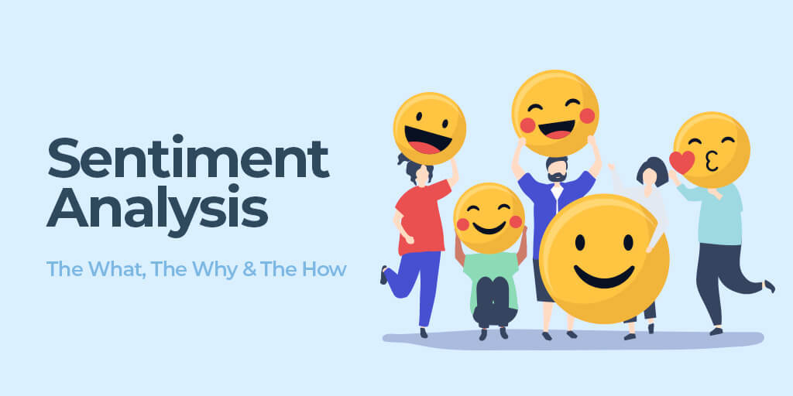
Model Institute of Engineering and Technology
Sentiment Analysis of incoming calls on helpdesk
Presented By:
Sukrit Upadhaya (2020a1r069)
Bhanu Partap Singh(2020a1r070)
Osheen Pandita(2020a1t081)
Ketan Arora (2020a1r090)

Slide 2
CONTENTS
Study Work
Problem Statement
Solution
Technology Stack
Workflow

Slide 3
Study Work
Aim: Understand caller emotions and feedback and Customer sentiments crucial for service enhancement , Initiative to improve service strategies and Goal is to Optimize support processes for better experiences
Emphasize how sentiment analysis aids in better decision-making processes.
Example: Data-driven insights enable proactive measures to address recurring
customer concerns.
Show how sentiment analysis provides deeper insights into customer emotions and feedback compared to the existing manual or limited systems

Slide 4
Problems In Existing Systems
Reduced Customer Satisfaction
Existing systems provide minimal visibility into the emotions and feedback expressed by customers during interactions with the helpdesk.
Inadequate insights into customer sentiments contribute to lower satisfaction levels and missed opportunities for service improvement.

Slide 5
Solution
Automated Call Transcription:
Implement automated call transcription systems to convert call recordings into text for easier analysis, enabling quicker sentiment assessment.
Continuous Monitoring and Optimization:
Implement continuous monitoring mechanisms to assess the effectiveness of sentiment analysis methodologies, allowing for ongoing refinement and optimization.

Slide 6
Technology Stack
Programming language used is Python
Speech-to-Text and Transcription:
- Google Cloud Speech-to-Text or IBM Watson: For converting
call recordings into text transcripts.
Sentiment Analysis Tools and Libraries:
- NLTK (Natural Language Toolkit): Python library for text
analysis and sentiment classification.

Slide 7
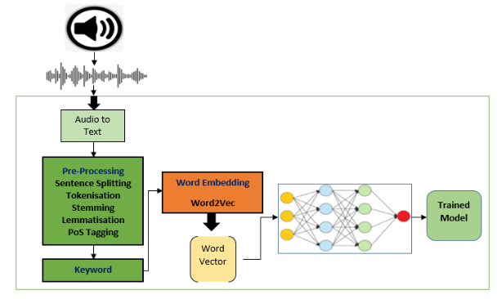
Workflow
DOI: https://doi.org/10.17762/ijritcc.v11i9.8113

Slide 8
Demonstaration

Slide 9
T
H
A
N
K
Y
O
U

