Slide 1
GestureAssist: Empowering Accessibility Through Hand Gestures
GestureAssist is a project that aims to empower individuals with limited mobility by providing an intuitive and accessible way to interact with computers using hand gestures. It addresses the challenge that traditional input methods like keyboards and mouse can pose for people with physical limitations.
GestureAssist holds the potential to revolutionize the way individuals with limited mobility interact with technology. By offering an intuitive and accessible solution, it empowers users to achieve greater independence and inclusivity in the digital world. We are excited to continue developing GestureAssist and making it a valuable tool for everyone.
Team Members:
Ujjwal Sharma – 2020a1r116
Nitish Baloria – 2020a1r125
Arjit Manhas – 2020a1r130
Bhanu Partap Singh Manhas – 2020a1r070

Slide 2
GestureAssist: Empowering Accessibility Through Hand Gestures
Project Features/Highlights:
Intuitive Gesture Recognition: Accurately recognizes and interprets hand movements for various actions.
Navigation and Control: Allows users to navigate the computer interface, open applications, and interact with software.
Accessibility Features: Compatible with various assistive technologies and screen readers.
Voice Assistant: A voice assistant in GestureAssist enhances interaction with gestures, voice commands, and responses.

Slide 3
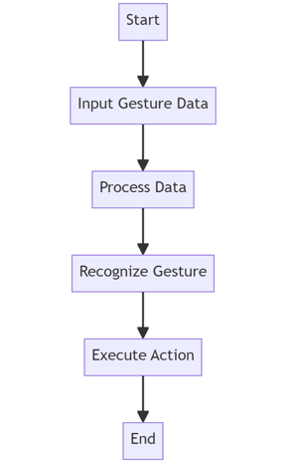
GestureAssist: Empowering Accessibility Through Hand Gestures
Workflow

Slide 4

GestureAssist: Empowering Accessibility Through Hand Gestures
Tech stack Used:
Computer Vision
Machine Learning
User Interface Design
Future Scope:
Expanding compatibility with different devices and platforms.
Integrating with smart home devices and virtual assistants.
Developing advanced features for more complex interactions.

Slide 5


