Slide 1

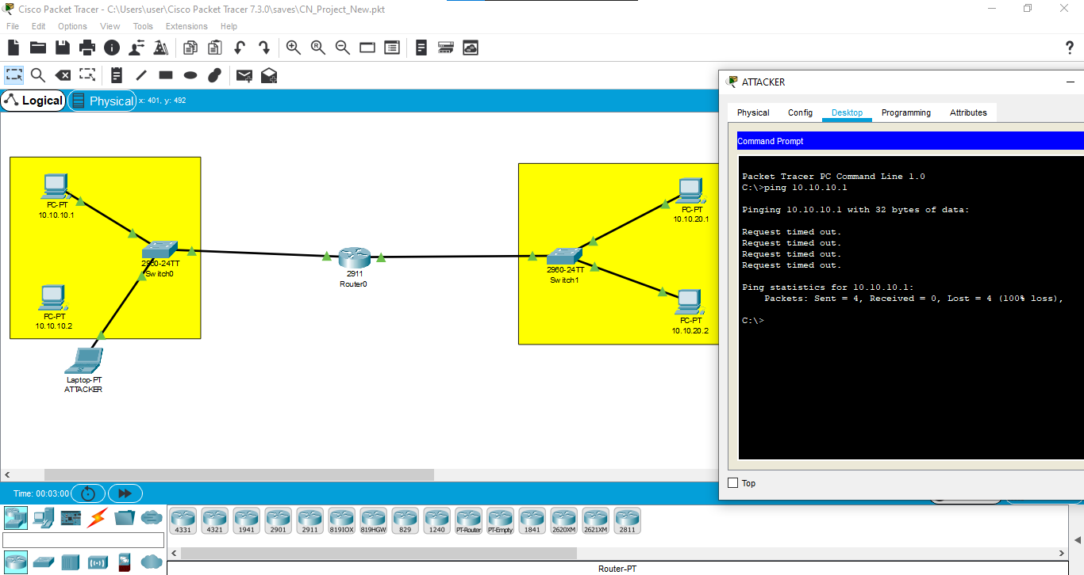
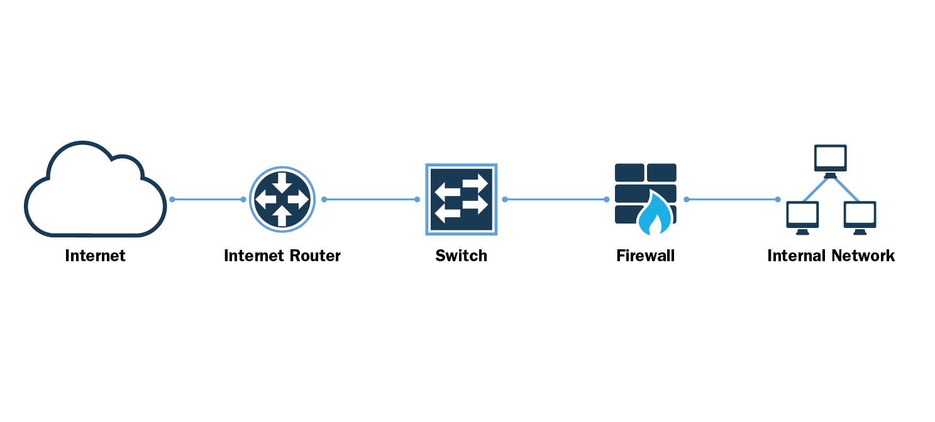

HOW TO SECURE YOUR NETWORK DEVICE
UJJWAL|NITISH |SANIDHYA|AYUSH RAINA
Abstract
Skills we will develop
In this project, we will be able to secure a network device using Cisco Packet Tracer. Throughout the project
We will be able to authenticate the switches and the routers in our network topology
Make PCs from different VLANs communicate with each other
Configure the DHCP protocol on the router
We will be able to protect our switch ports from the attackers.
Network Security
Testing Connectivity
Configuring
Building Network Topologies
Troubleshooting
Networking Device Used
1) ROUTER
2) SWITCH
Connecting Wire Used
Project Screenshots
1) COOPER STRAIGHT-THROUGH WIRE
End Devices Used
1) PCs
2) LAPTOP
Network Structure
Project Code: - CSE_12

