Slide 1

How to Secure your Network Device
Presenters
Ujjwal Sharma(2020A1R116)
Nitish Baloria(2020A1R125)
Sanidhya Sharma(2020A1R102)
Ayush Raina(2020A1T100)
DEPARTMENT OF COMPUTER SCIENCE AND ENGINEERING
MIET(Autonomous), JAMMU

Slide 2
Contents
Introduction
Networking Device Used
Connecting Wire Used
Network Structure
Skills we will develop
Screenshots
Demonstration

Slide 3
Introduction
In this project, we will be able to secure a network device using Cisco Packet Tracer. Throughout the project,
We will be able to authenticate the switches and the routers in our network topology
Make PCs from different VLANs communicate with each other.
Configure the DHCP protocol on the router.
We will be able to protect our switch ports from the attackers.

Slide 4
Networking Device Used
Router
Switch

Slide 5
Connecting Wire Used
Copper Straight-Through Cable

Slide 6
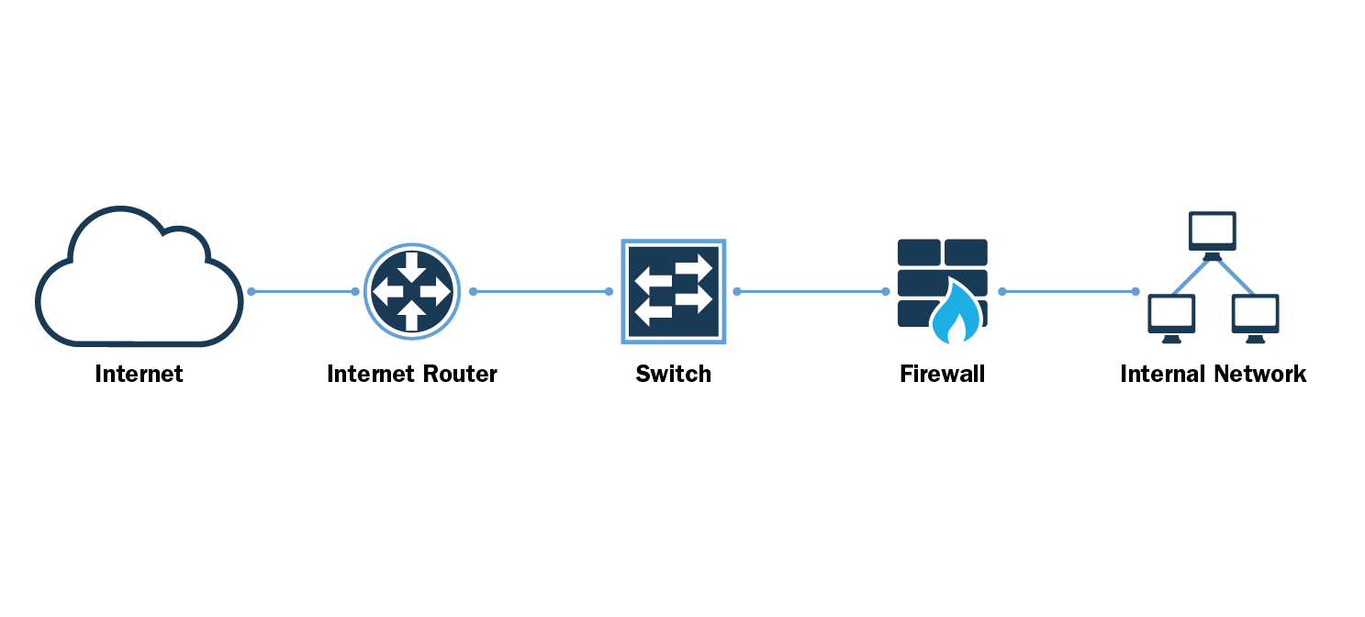
Network Structure

Slide 7
Skills we will develop
Network Security
Testing Connectivity
Configuring
Building Network Topologies
Troubleshooting

Slide 8
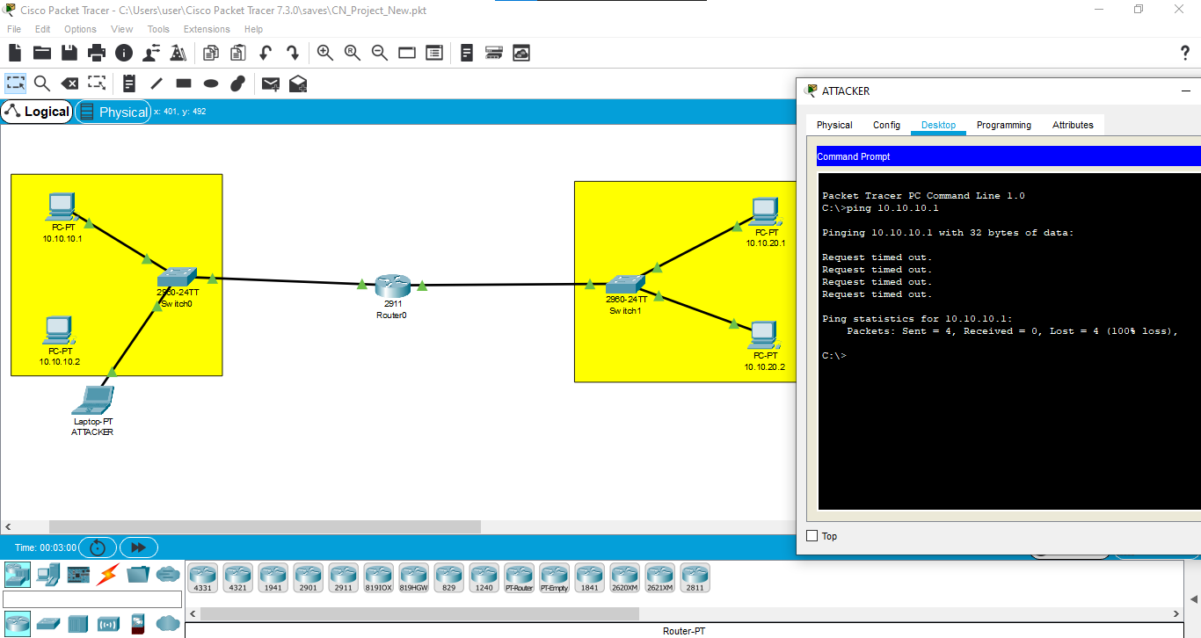
Screenshots

Slide 9
DEMONSTRATION

Slide 10


